Slide 1
Directions for this template
Use the Slide Master to make universal changes to the presentation, including inserting your organization’s logo.
  “View” tab > “Master” > “Slide Master”
Replace placeholders (indicated by brackets [ ]) with information specific to your Functional/Full-Scale Exercise.
Update default date (January, 2019) used in slide deck with date specific to your exercise.
Delete any slides that are not relevant for your exercise.
Delete slide 1 after customizing your slide deck.
Font size should not be smaller than 22 point.

Slide 2
2023 Statewide Medical and Health Exercise
Chemical Fire with Burn and Pediatric Surge Scenario
Tabletop Exercise [ Insert Exercise Date]
Notes:
There are a number of [insert here] notations throughout this slide presentation. Exercise Planners are responsible for filling in [insert] brackets with information pertaining to their local jurisdiction/agency/organization. These brackets appear both in the actual slides AND in the Notes sections, so please make sure that all brackets are filled in before the day of the exercise.

Slide 3
Welcome and Introductions
Notes:
Welcome Remarks
Introduction of Exercise Planners & Facilitators
Participant Introductions
Administrative Items
Schedule Overview

Slide 4
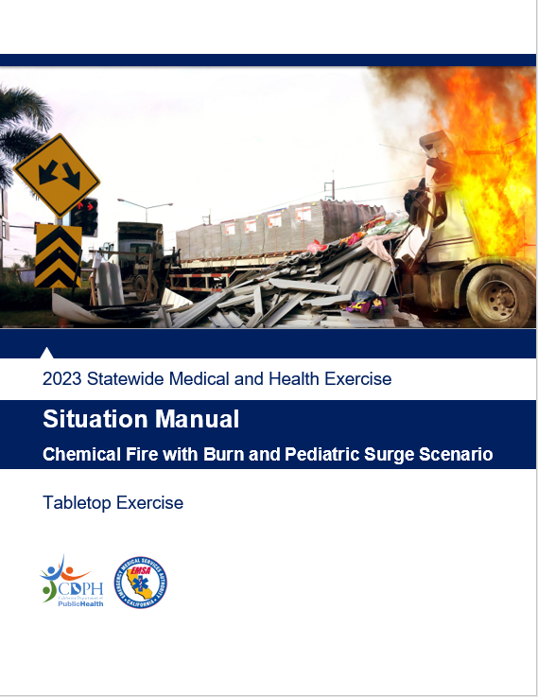
Welcome and Overview
Welcome
  Name
  Position
  Agency/Organization
  Optional: Icebreaker
Logistics
  Materials
    Situation Manual
      Follow along!
    Feedback Form
    Observer Handout
    Player Handout
Notes:
Introduce yourselves to the people at your table.
It is recommended that Exercise Planners facilitate group introductions by having an Icebreaker question or activity if time allows. One example icebreaker question could be: “Name one or two real world events that you have responded to, participated in, or experienced yourself.”

Slide 5
Administration
Exercise Materials
Breakout Discussion Groups
Parking Validations
Mobile Phones
Evacuation Procedure
  “This is Not A Drill”

Slide 6
Exercise Overview and General Information

Slide 7
Exercise Overview
Name
  Statewide Medical & Health Tabletop Exercise
Date
  [Insert date]
Scope
  4 phases in program
Mission Areas
  [Insert selected]
Capabilities
  [Insert selected Public Health Emergency Preparedness, Health Care Preparedness and Response, Medical Response and Surge Exercise, or Core Capabilities]
Notes:
This year’s capabilities and themes are listed in the Statewide Medical and Health Exercise Multi-Year Training and Exercise Plan (MYTEP).

Slide 8
Exercise Overview (continued)
Objectives
  [Insert selected]
Threat/Hazard
  [Insert selected]
Scenario
  [Insert selected]
Sponsor
  California Department of Public Health, Emergency Medical Services Authority, [insert your agency/organization]
Participating Organizations
  [Insert]

Slide 9
General Information
Participant Roles & Responsibilities
  Players: Respond to situation presented based on current plans, policies, and procedures
  Observers: Visit or view selected segments of the exercise , but do not participate in moderated discussion
  Facilitators: Provide situation updates and moderate discussions
  Evaluators: Observe and document player discussions
  Controllers (if applicable): Control delivery of injects to exercise players

Slide 10
General Information (continued) 1
Exercise Guidelines
  Open, low-stress, no-fault environment
  Varying viewpoints are expected
  Use current plans/capabilities
  Consider different and innovative approaches
  Issue identification is not as valuable as recommended actions and improvements

Slide 11
General Information (continued) 2
Assumptions
  The exercise is conducted in a no-fault learning environment wherein capabilities, plans, systems, and processes will be evaluated
  The exercise scenario is plausible, and events occur as they are presented
Artificialities
  Impacts across the response community
  Some time lapses may be artificially used to achieve the exercise objectives
  See page [insert] of your Situation Manual for more Assumptions & Artificialities

Slide 12
General Information (continued) 3
Exercise Evaluation
  Participant Feedback Forms
  Exercise Evaluation Guides
  Hot Wash Notes
Notes from today’s exercise may be used to design and implement the Functional/Full-Scale Exercise
Notes:
Are there any questions before the TTX scenario begins?

Slide 13
Scenario

Slide 14
Background Information
Responding Departments/ Agencies can include:
  Emergency Medical Services (EMS) / Ambulance
  Fire
  Police
  Search & Rescue
  Healthcare facilities
  Media
  Non-Profit Organizations
  Public Health
  Medical Examiner / Coroner

Slide 15
Background Information (continued)
Will there be enough:
  Staff?
  Space?
  Supplies & Equipment?
  System? (i.e., patient tracking)
Special considerations:
  Evacuations
  Staffing Impacts
  Responder Safety
  Public Messaging

Slide 16
Incident Information
[Day of Incident]
[Insert weather for the scenario]
[Available resources for the exercise]
[Other notional information for the exercise]

Slide 17

Discussion Format
Elect a group spokesperson
Use the Situation Manual and exercise materials to take notes
Focus on
  Strengths
  Areas for improvement
As it pertains to:
  Doctrine
  Organization
  Personnel
  Training
  Equipment
  Support

Slide 18
Discussion Questions (continued) 1
Does your organization have an emergency preparedness plan to address potential chemical burn and pediatric surge issues?
If so, does that plan address appropriate training and equipment, referral and transfer to tertiary centers, and ability to hold and stabilize patients when necessary?
What resources such as action planning procedures and forms are used to document and guide the response and recovery process?
What is your process for receiving and disseminating critical information (Situational Reports) internally and externally with government and non-government partners?

Slide 19
Discussion Questions (continued) 2
What is the process and format for submitting situation reports from the field or local level to the Medical and Health Operational Area Coordinator (MHOAC) Program?
How do you, at the field or local level, receive situation updates and other information from the Medical and Health Operational Area Coordinator (MHOAC)?
What redundant communication systems are in place for use in incidents like this (e.g. CAHAN, ReddiNet, WebEOC, etc.)? If these systems exist, how are they tested?
How will you communicate your situation status to your staff and with external agencies?

Slide 20
Discussion Questions (continued) 3
What information should be released to the public? How will that information be released? How will you communicate with and address the requirements of persons with disabilities and others with access and functional needs (e.g., non-English speaking, seniors, homeless, and homebound)? How do you utilize local media, social media and other resources?
How are you utilizing local emergency medical services, ambulance providers, law enforcement and other emergency management resources to aid your efforts?
How do you plan for, and respond to, possible chemical contamination in your facility?

Slide 21
Discussion Questions (continued) 4
How do you plan for and respond to staffing needs when staff are unable to access your facility?
Do you have MOU’s or other agreements with other agencies to share resources in a disaster?

Slide 22
Discussion Questions (continued) 5
  [Additional questions to consider, customize accordingly]
How do you track your staff who may be evacuated from their homes or sheltering-in-place?
How do you notify the family of patients your facility is evacuating or sheltering in place?
Do healthcare providers have a policy or plan for requesting an 1135 waiver?
How does your facility shelter in place for a hazardous materials incident?
Do you have continuity plans in place with key vendors to provide services/deliveries when access to the facility is limited?

Slide 23
Conclusion of the discussion-based Tabletop

Slide 24
Debrief Questions
Debrief questions
  Identify three strengths
  Identify three areas for improvement
  What processes should be addressed in future efforts?
Functional/Full-Scale Exercise planning
  Duration
  Stakeholders
  Roles and responsibilities
Closing comments
Notes:
*Ask participants to identify three strengths from the exercise*
*Ask participants to identify any areas for improvement (with a strengths-based perspective if possible)*
Run through the activities listed above to plan for the Functional Exercise

Slide 25
Conclusion
Please complete your Participant Feedback Form or evaluation notes / Exercise Evaluation Guide and return them to an Exercise Facilitator at Registration
Please clean up your area and take all your materials with you
Additional materials can be found at the Statewide Medical and Health Exercise Program website: https://www.cdph.ca.gov/Programs/EPO/Pages/swmhe.aspx

