Slide 1
Directions for this template
Use the Slide Master to make universal changes to the presentation, including inserting your organization’s logo.
“View” tab > “Master” > “Slide Master”
Replace placeholders (indicated by brackets [ ]) with information specific to your exercise.
Update default date (exercise date) used in slide deck with date specific to your exercise.
Delete any slides that are not relevant.
Delete slide 1 after customizing your slide deck.
Font size should not be smaller than 22 point.
Last Revised 11/29/22

Slide 2
2023 Statewide Medical and Health Exercise
Player Debrief
[Exercise Location]

Slide 3
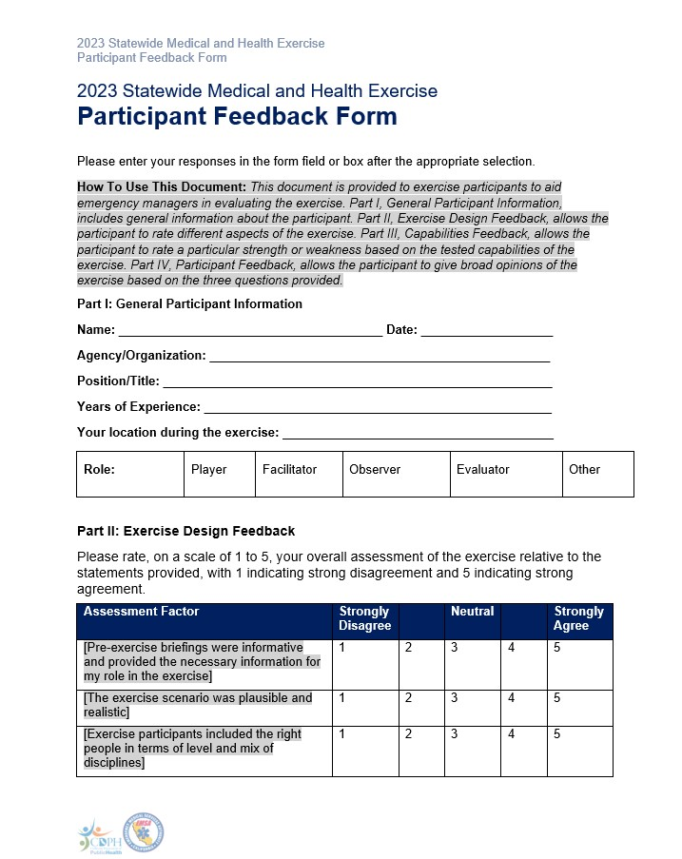
Administration
Sign-In
Introductions
Name and role in exercise
Materials
Participant Feedback Form

Slide 4
SWMHE Exercise Debrief Overview
Purpose of Todays Exercise
Objectives
Expectations
Outcome: Strengths
Outcome : Areas of Improvement
Conclusion

Slide 5
Purpose of Today’s Exercise
2023 SWMHE Exercise Debrief

Slide 6
Purpose of Today’s Exercise (continued)
The purpose of this exercise was to evaluate role-player actions/decisions within current response plans and capabilities in the context of a potential chemical fire with burn and pediatric surge response.

Slide 7
Objectives
2023 SWMHE Exercise Debrief

Slide 8
Objectives and Core Capabilities
[Insert Objective 1]
- [Linked Public Health Emergency Preparedness (PHEP) / Health Care Preparedness and Response / Federal Emergency Management Agency (FEMA) Core Capabilities]
[Insert Objective 2]
- [Linked PHEP / Health Care Preparedness and Response / FEMA Core Capabilities]
[Insert Objective 3]
- [Linked PHEP / Health Care Preparedness and Response / FEMA Core Capabilities]

Slide 9
Expectations
2023 SWMHE Exercise Debrief

Slide 10
Outcome: Strengths
2023 SWMHE Exercise Debrief

Slide 11
Outcome: Areas for Improvement
2023 SWMHE Exercise Debrief

Slide 12
Conclusion
2023 SWMHE Exercise Debrief

Slide 13
Conclusion (continued)
Thank you for your
participation and feedback!
Please turn in any forms, including:
Completed Participant Feedback Forms
Player Logs and Notes
Please return any equipment you received/borrowed
Please return your badges and vests
[Insert any additional concluding information]

Slide 14
2023 Statewide Medical and Health Exercise (final slide)
SWMHE Exercise Debrief
2023, [Exercise Location]

