Slide 1
Directions for this template
Use the Slide Master to make universal changes to the presentation, including inserting your organization’s logo.
  “View” tab > “Master” > “Slide Master”
Replace placeholders (indicated by brackets [ ]) with information specific to your exercise.
Update default date used in slide deck with date specific to your exercise.
Delete any slides that are not relevant.
Delete slide 1 after customizing your slide deck.
Font size should not be smaller than 22 point
Last Revised 11/29/22

Slide 2
2023 Statewide Medical and Health Exercise
  Player Briefing
Chemical Fire with Burn and Pediatric Surge
Notes:
This briefing is designed to provide you with the information you need to serve as a player for the Statewide Medical and Health Exercise for your jurisdiction/agency/facility.

Slide 3
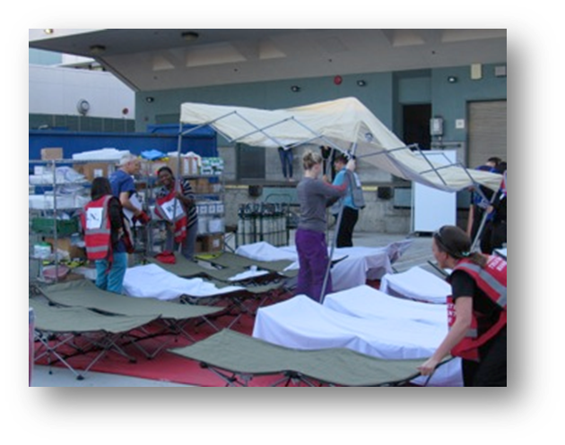
Welcome
Introductions
  Players
  Controllers/Evaluators
Documents
  Player Handout
  Waiver Form
  Feedback Form
  Exercise Plan

Slide 4
Briefing Objectives
Player-specific information
  [Identify roles and responsibilities during the exercise]
  [Review day-of exercise details, such as locations and schedule]
  [Review the activities that will take place after the exercise]
Exercise safety
  [Identify rules and safety precautions]

Slide 5
Exercise Purpose
The purpose of this exercise is to test pre-selected capabilities and evaluate agency/organizational/facility response in alignment with current response plans.

Slide 6
Exercise Overview
Threat/hazard
  Chemical fire surge incident
  Scenario
  Chemical Fire with Burn and Pediatric Surge incident
  Sponsor
  California Department of Public Health (CDPH), Emergency Medical Services Authority (EMSA), [Insert your agency/organization/facility]
  Participating organizations
  [Insert participating organizations]

Slide 7
Exercise Scope
[Mission area(s)]
[Exercise parameters]
[Exercise duration]
[Exercise location]

Slide 8
Objectives and Core Capabilities
[Exercise objective]
  [Linked core capabilities]
[Exercise objective]
  [Linked core capabilities]
[Exercise objective]
  [Linked core capabilities]
[Exercise objective]
  [Linked core capabilities]

Slide 9
Exercise Participants
Players [Insert color] badges
Observers [Insert color] badges
Controllers [Insert color] badges
Evaluators [Insert color] badges
Support staff [Insert color] badges
Media [Insert color] badges
Actors [Insert color] badges

Slide 10
Exercise Assumptions
The exercise will be conducted in a no-fault learning environment wherein systems and processes, not individuals, will be evaluated.
The scenario is plausible, and results occur as they are presented.
Simulation will be realistic, plausible, and will contain sufficient detail from which players can respond.
Participating agencies may need to balance play with real-world emergencies. Real-world emergencies take priority.
[Insert other assumptions as needed]

Slide 11
Exercise Artificialities
Communication and coordination is limited to participating exercise organizations, venues, and the Simulation Cell (SimCell).
Only communication methods listed in the Communications Directory are available for players to use.
[Insert other artificialities as needed]

Slide 12
Schedule
[Insert controller/evaluator briefing time] – Controller/Evaluator Briefing
[Insert player briefing time] – Player Briefing
[Insert start of exercise time] – Start of Exercise
[Insert end of exercise time] – End of Exercise
[Insert player hot wash time] – Player Hot Wash
[Insert other scheduled activities as needed]

Slide 13
Exercise Safety
Safety concerns override execution.
  Call 9-1-1 if necessary.
  Alert the nearest controller if you have safety concerns or need to report any injuries.
Actual emergencies will be identified by saying [“This Is Not a Drill.”]
Be aware that operating in an operations-based environment is inherently dangerous.
Badges identify authorized persons.
  Unauthorized persons are to be escorted out of the play area.

Slide 14
Player Communications
Follow these steps when communicating with exercise staff:
  Step 1: Start all exercise related communication with [“This is an exercise.”]
  Step 2: Identify the organization or agency you wish to speak with when contacting the Simulation Cell.
  [Insert other steps as needed]

Slide 15
Player Instructions
Before the Exercise:
  Review Player Handout [and any other exercise materials.]
  Players should arrive at the site [30 minutes] in advance.
  Players should complete and turn in their Waiver Forms.
  [Insert other instructions as needed

Slide 16
Player Instructions (continued)1
During the Exercise:
  Respond as though this is a real event.
  Obtain information through emergency channels.
  [Insert other instructions as needed]

Slide 17
Player Instructions (continued)2
After the Exercise:
  Participate in the Hot Wash.
  Complete Feedback Form and turn it in.
  Return any materials provided during the exercise (vests, etc.).
  [Insert other instructions as needed]

Slide 18
Questions?

Slide 19
2023 Statewide Medical and Health Exercise
  Player Briefing
Chemical Fire with Burn and Pediatric Surge
Notes:
This briefing is designed to provide you with the information you need to serve as a player for the Statewide Medical and Health Exercise for your facility.

