Slide 1
Directions for this template
Use the Slide Master to make universal changes to the presentation, including inserting your organization’s logo.
  “View” tab > “Master” > “Slide Master”
Replace placeholders (indicated by brackets [ ]) with information specific to your Functional Exercise (FE).
Update default date (November 16, 2017) used in slide deck with date specific to your FE.
Delete any slides that are not relevant for your FE.
Delete slide 1 after customizing your slide deck.
Font size should not be smaller than 22 point.
Last revised: 11/28/22

Slide 2
2023 Statewide Medical and Health Exercise
Controller and Evaluator Briefing
2023, [Insert Exercise Location]
Notes:
This briefing is designed to provide you with the information and resources you need to coordinate exercise control and conduct exercise evaluation for the Statewide Medical and Health Exercise for your facility.

Slide 3
Administration
Agenda
  Administration
  Exercise Overview
  General Information
  Exercise Logistics
  Controller Information and Guidance
  Evaluator Evaluation and Guidance
  Additional Information (Appendices)

Slide 4
Administration 1
Welcome and Logistics

Slide 5
Administration 2
Welcome
  Name
  Position
  Agency/Organization
Logistics
  Meeting materials
    Sign-in Sheet
    Controller/Evaluator (C/E) Handbook
      Follow along in your handbook!
    Exercise Evaluation Guides (EEGs)
    Master Scenario Events List (MSEL)

Slide 6
Exercise Overview
High Level Summary

Slide 7

Exercise Overview 1
Name
  2023 Statewide Medical and Health Exercise
Date
  [insert date]
Scope
Mission Areas
  [insert selected]
Capabilities
  [insert selected]

Slide 8
Exercise Overview (continued)
Objectives
  [insert selected]
Threat/hazard
  Chemical fire
  Scenario
  Chemical fire surge
  Sponsor
  California Department of Public Health (CDPH), Emergency Medical Services Authority (EMSA), [insert your agency/organization]
  Participating organizations
  [insert]

Slide 9
General Information
Key Material

Slide 10
General Information 1
Introduction
Objectives and Capabilities
  Hospital Preparedness Program (HPP) Core Capabilities
    [insert agency/organization and core capability details]
  Public Health Emergency Preparedness (PHEP) Core Capabilities and Objectives
    [insert agency/organization objectives and PHEP capability details]
  Health Care Preparedness and Response
    [insert agency/organization objectives and Health Care Preparedness and Response capability details]

Slide 11
General Information (continued)
Scenario
  Chemical fire surge
    Pediatric Surge
    Burn Surge

Slide 12

General Information (continued) 1
Participant Roles and Responsibilities
  Players
  Exercise Director
  Safety Controller
  Controllers
    Senior Controller
  Simulators
  Evaluators
  Actors
  Observers
  Media Personnel
  VIPs
  Support Staff

Slide 13
General Information (continued) 2
Assumptions and artificialities
  Impacts across response community
  Timelines are condensed
  See handbook for others
Tools
  C/E resources reviewed today
  Multiple resources provided via
Homeland Security Exercise and Evaluation Program (HSEEP)
  Aligned with HSEEP

Slide 14
Exercise Logistics
Security, Observer Coordination, and More

Slide 15

Exercise Logistics (continued)
Safety
  Chemical fire surge policy
Site access
  Security
  Media/observer coordination
  Exercise identification

Slide 16
Exercise Logistics (continued) 1
Parking and transportation
  Designated areas
Registration/check-in
Lunch
  [insert time and location]
Cleanup and restoration
  Supply packaging
  Trash supplies
  Recycling areas

Slide 17
Post-Exercise & Evaluation Activities
Debriefings, Evaluation and Improvement Planning

Slide 18
Post-Exercise and Evaluation
Debriefings
  Hot Wash
    Strengths and areas for improvement discussed with the players
    Up to 30 minutes
  Controller/Evaluator debriefing
    Key observations discussed with Controller Evaluators
  Participant Feedback Forms
    Collect written feedback
    Return completed forms to the After Action Report (AAR) lead

Slide 19
Post-Exercise and Evaluation (continued)
Evaluation
  Exercise Evaluation Guides (EEG)
    Completed by Evaluators
  After Action Report (AAR)
    Strengths, areas for improvement, and recommendations
Improvement planning
  After Action Meeting (AAM)
    Reviews draft AAR
  Improvement Plan (IP)
    Provides due dates and assignments for action items

Slide 20
Participant Information and Guidance
Exercise Rules, Player Instructions and Simulation

Slide 21
Participant Information
Exercise Rules
  Real-world emergencies take priority
  Start all exercise related communication with “This is an exercise”
  Identify the organization or agency you wish to speak with when contacting the Simulation Cell (SimCell)
  Keep the exercise objectives in mind throughout the exercise
  [insert others as needed]

Slide 22
Participant Information (continued)
Player Instructions
  Before the exercise
    Review Player Handout and other exercise materials
    Players should arrive at the exercise site 30 minutes in advance
    [insert others as needed]
  During the exercise
    Respond as though real
    Obtain information through emergency channels
    [insert others as needed]

Slide 23
Participant Information (continued) 1
Player Instructions
  After the exercise
    Participate in Hot Wash
    Complete Feedback Form
    [insert others as needed]
Simulation Guidelines
  Based on Master Scenario Events List (MSEL)

Slide 24
Controller Information And Guidance
Overview, Instructions and More

Slide 25
Controller Information
Exercise control documentation
  Controller package
  Incident simulation
  Scenario tools
    Master Scenario
    Events List (MSEL)

Slide 26
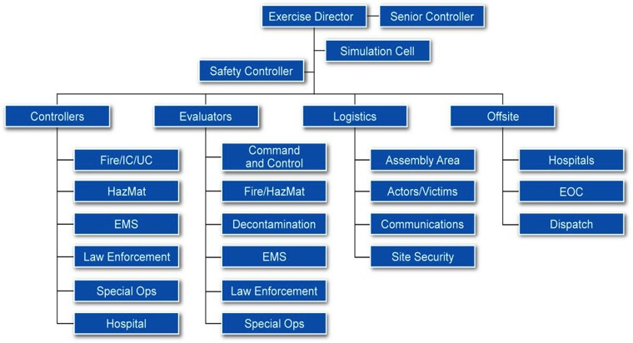
Controller Information (continued)
Exercise Control Structure

Slide 27
Controller Information (continued) 1
Controller instructions
  Before the exercise
    Review materials
    Attend briefings
    [inserts others as needed]

Slide 28
Controller Information (continued) 2
During the exercise
  Wear identification
  Avoid personal conversations
  Deliver injects at the time indicated on the MSEL or as directed by Exercise Director
  Avoid prompting or providing extra or advance information to players
  Note all key actions and the time they occur
  Receive and record information from players that would be directed to non-participating groups
  Ensure observers and/or media stay out of exercise play area
  [insert others as needed]

Slide 29
Controller Information (continued) 3
Exercise controller maintains exercise scope, pace, and integrity during exercise conduct.
Controller instructions
  After the exercise
    Distribute Participant Feedback Forms
    Conduct Hot Wash
    [inserts others as needed]
  Chemical fire surge tools
    MSEL

Slide 30
Controller Information (continued) 4
Controller responsibilities
  After the Exercise
    Controller/Evaluator Debriefing
    Placement and monitoring
    Post-exercise activities
Exercise report
  AAR feedback
  After Action Meeting

Slide 31
Evaluator Information and Guidance
Overview, Instructions and More

Slide 32
Evaluator Information
General information
  Assess the organization’s ability to accomplish a mission, function, or objective
Exercise evaluation
  HSEEP AAR/IP
EEGs
  Tool for identifying and analyzing key events

Slide 33
Evaluator Information (continued)
Exercise evaluation validates strengths and identifies areas for improvement.
Evaluator instructions
  Before the exercise
    Review materials
    Be familiar with the plans, policies, and procedures
    Attend briefings
    [inserts others as needed]

Slide 34
Evaluator Information (continued) 1
During the exercise
  Wear identification
  Stay near decision makers
  Use EEGs to document performance relative to exercise objectives, capabilities, and tasks
  Document performance
  Avoid providing extra information or interfering in player actions
  [insert others as needed]

Slide 35
Evaluator Information (continued) 2
Evaluator instructions
  After the exercise
    Participate in Hot Wash
    Turn in EEGs to Lead Evaluator
    Report exercise outcomes in the AAR
    [inserts others as needed]

Slide 36
Evaluator Information (continued) 3
Using the Exercise Evaluation Guides
  [P - Performed without Challenges]
  [S - Performed with Some Challenges]
  [M - Performed with Major Challenges]
  [U - Unable to be Performed]
Tips and focus areas
  Activities and key decisions that relate to goals and objectives
  Expected actions associated with injects
  Critical events or initiating chemical fire surge events
  Deviation from plans or procedures
  Judge the plans, capabilities, and actions, NOT the players

Slide 37
Evaluator Information (continued) 4
Assessment, review, and analysis of exercise
  Evaluator package
  Controller/Evaluator debriefing
  Placement and monitoring
  Post-exercise activities
    Hot Wash
    C/E debrief
    Evaluations
    Participant Feedback Forms
After Action Report

Slide 38
Action Items
Questions and More

Slide 39
Action Items 1
Review all materials
Ask questions
Report to exercise check-in

