Slide 1
DIRECTIONS FOR THIS TEMPLATE
Use the Slide Master to make universal changes to the presentation, including inserting your organization’s logo.
“View” tab > “Master” > “Slide Master”
Replace placeholders (indicated by brackets [ ]) with information specific to your Functional Exercise (FE).
Update default date (January, 2019) used in slide deck with date specific to your FE.
Delete any slides that are not relevant for your FE.
Delete slide 1 after customizing your slide deck.
Font size should not be smaller than 22 point.
Revised 1/2019

Slide 2
[INSERT YEAR] STATEWIDE MEDICAL AND HEALTH EXERCISE
TABLETOP EXERCISE
[Exercise Name / Exercise Date]
Notes:
There are a number of [insert here] notations throughout this slide presentation. Exercise Planners are responsible for filling in [insert] brackets with information pertaining to their local jurisdiction/agency/organization. These brackets appear both in the actual slides AND in the Notes sections, so please make sure that all brackets are filled in before the day of the exercise.

Slide 3
WELCOME & INTRODUCTIONS
Notes:
Welcome Remarks
Introduction of Exercise Planners & Facilitators
Participant Introductions
Administrative Items
Schedule Overview

Slide 4

WELCOME & OVERVIEW
Welcome
Name
Position
Agency/Organization
Optional: Icebreaker
Logistics
Materials
Situation Manual
Follow along!
Feedback Form
Observer Handout
Player Handout
Notes:
Introduce yourselves to the people at your table.
It is recommended that Exercise Planners facilitate group introductions by having an Icebreaker question or activity if time allows. One example icebreaker question could be: “Name one or two real world events that you have responded to, participated in, or experienced yourself.”

Slide 5
ADMINISTRATION
Exercise Materials
Breakout Discussion Groups
Parking Validations
Mobile Phones
Evacuation Procedure
“THIS IS NOT A DRILL”

Slide 6
EXERCISE OVERVIEW & GENERAL INFORMATION

Slide 7
EXERCISE OVERVIEW
Name
Statewide Medical & Health Tabletop Exercise
Date
[insert date]
Scope
4 phases in program
Mission Areas
[insert selected]
Capabilities
[insert selected Public Health Emergency Preparedness , Health Care Preparedness and Response, or Core Capabilities]
Notes:
This year’s capabilities and themes are listed in the Statewide Medical and Health Exercise Multi-Year Training and Exercise Plan (MYTEP).

Slide 8
EXERCISE OVERVIEW
Objectives
[Insert selected]
Threat/Hazard
[Insert selected]
Scenario
[Insert selected]
Sponsor
California Department of Public Health, Emergency Medical Services Authority, [insert your agency/organization]
Participating Organizations
[Insert]

Slide 9
GENERAL INFORMATION
Participant Roles & Responsibilities
Players: Respond to situation presented based on current plans, policies, and procedures
Observers: Visit or view selected segments of the exercise , but do not participate in moderated discussion
Facilitators: Provide situation updates and moderate discussions
Evaluators: Observe and document player discussions
Controllers (if applicable): Control delivery of injects to exercise players

Slide 10
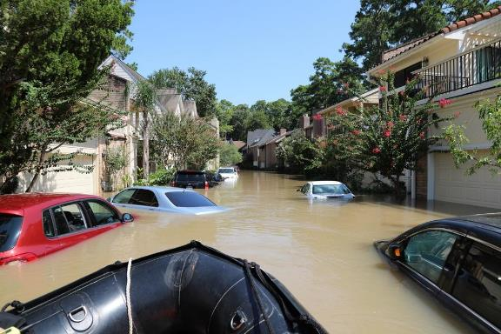
GENERAL INFORMATION
Exercise Guidelines
Open, low-stress, no-fault environment
Varying viewpoints are expected
Use current plans/capabilities
Consider different and innovative approaches
Issue identification is not as valuable as recommended actions and improvements

Slide 11
GENERAL INFORMATION
Assumptions
The exercise is conducted in a no-fault learning environment wherein capabilities, plans, systems, and processes will be evaluated
The exercise scenario is plausible, and events occur as they are presented
Artificialities
Impacts across the response community
Some time lapses may be artificially used to achieve the exercise objectives
See page [insert] of your Situation Manual for more Assumptions & Artificialities

Slide 12
GENERAL INFORMATION
Exercise Evaluation
Participant Feedback Forms
Exercise Evaluation Guides
Hot Wash Notes
Notes from today’s exercise may be used to design and implement the Functional Exercise (FE)
Notes:
Are there any questions before the TTX scenario begins?

Slide 13
SCENARIO

Slide 14
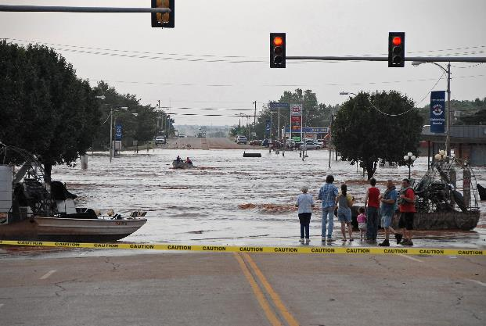
BACKGROUND INFORMATION
Responding Departments/ Agencies can include:
Emergency Medical Services (EMS) / Ambulance
Fire
Police
Search & Rescue
Healthcare facilities
Media
Non Profit Organizations
Public Health
Medical Examiner / Coroner

Slide 15
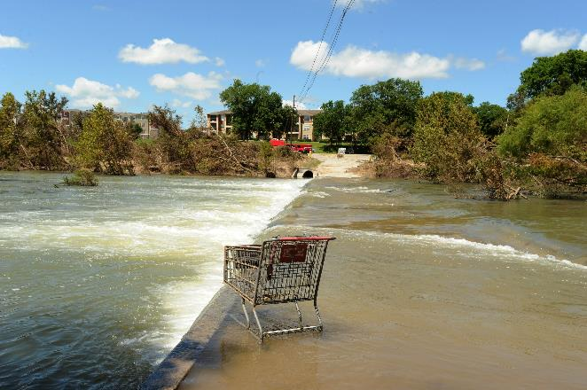
BACKGROUND INFORMATION
Will there be enough:
Staff?
Space?
Supplies & Equipment?
System? (i.e., patient tracking)
Special considerations:
Evacuations
Staffing Impacts
Responder Safety
Public Messaging

Slide 16
PRE-INCIDENT INFORMATION
[One Month Pre Exercise]
Your region has had an unusually wet season, with a record amount of rainfall. Extended rainfall has saturated the soil and caused runoff directly into streams and rivers, causing small area floods. Wet weather is expected to continue, and a slow-moving low-pressure storm system continues to produce heavy rainfall. Local street flooding has been continuous throughout the past month.
The persistent rainfall has caused a [levee, dam, aqueduct, river, etc.] in your area to exceed the normal water elevation, and has been compromised. Officials have concerns that a failure could occur during future storms and this could result in a flash-flood scenario.
Consider information regarding sand bag quantities, use, filling locations, delivery of sand bags, muscle walls, plastic sheeting, etc.

Slide 17
PRE-INCIDENT INFORMATION
[One Week Before Exercise]
During an intense and sudden rainstorm, flash flooding occurred on a [Main Local Highway]. Two vehicles were caught in the storm waters. One vehicle, a truck, was pushed off the road and the driver was rescued by local authorities. The other vehicle was pushed off the road and unfortunately was struck with debris and the driver was unable to exit the car and drowned.
The [Local Health Department] and news stations are reminding the public with “Turn Around, Don’t Drown” messages.
Flooding of a local recreation area has caused the mass relocation of a homeless camp. [Your jurisdiction] has had to establish a shelter for this newly displaced population.
Local media is reporting widely on the storms headed to your area, and there are concerns that there may be additional flooding in the area.

Slide 18
INCIDENT INFORMATION
[Week of Exercise]
The National Weather Service issues a [Flood Watch] for [Your jurisdiction]. The forecast calls for additional heavy rainfall, perhaps as much as 2-6 inches during the next 72 hours.
The primary road used to access your facility is flooded and impassable.
[Your facility, organization] has been contacted by the media to discuss the impact the road closure is having on your ability to provide services.

Slide 19
INCIDENT INFORMATION
[Day Before Exercise]
As the storm continues, the National Weather Service issues a [Flash Flood Warning] for [Your jurisdiction]. It is estimated that flash flooding may occur within 12 hours.
Areas around the facility are experiencing minor flooding, including the parking lot and garage.
The [local authority] has issued a voluntary evacuation for [insert County, City, Agency, Facility] and as a result, [Your facility, organization] is beginning to experience staffing problems. Road closures have affected the ability of some staff to report to work. Other staff are asking to return home.
Many local schools and child care facilities are closing early today. Your [Agency, Facility] is experiencing staffing problems.
Delivery drivers are unable to access your facility and you are not receiving critical shipments.

Slide 20
INCIDENT INFORMATION
[Day of Exercise]
The [local authority] has issued a [mandatory evacuation] for [insert County, City, Agency, Facility].
Floodwaters reach your facility and cause significant damage on the first floor and supply storage areas.
Large parts of [insert County, City] are without power, and some areas are without water.
In some areas, residents have to be rescued from flooded homes and vehicles.
Roadways remain flooded and impassable.
Police officers have established a perimeter around heavily damaged areas, including your organization, and are not allowing anyone to enter for safety reasons.

Slide 21

DISCUSSION FORMAT
Elect a group spokesperson
Use the Situation Manual and exercise materials to take notes
Focus on
Strengths
Areas for improvement
As it pertains to:
Doctrine
Organization
Personnel
Training
Equipment
Support

Slide 22
DISCUSSION FORMAT
Does your organization have an emergency preparedness plan to address potential flooding or weather related issues?
If so, does that plan address potential utility failures, rapid evacuation, supply shortages, equipment failure (e.g., equipment stored in the basement)?
What resources such as action planning procedures and forms are used to document and guide the response and recovery process?
What is your process for receiving and disseminating critical information (Situational Reports) internally and externally with government and non-government partners?
What is the process and format for submitting situation reports from the field or local level to the Medical and Health Operational Area Coordinator (MHOAC) Program?

Slide 23
DISCUSSION FORMAT
How do you, at the field or local level, receive situation updates and other information from the Medical and Health Operational Area Coordinator (MHOAC)?
What redundant communication systems are in place for use in incidents like this (e.g., CAHAN, ReddiNet, Web EOC, etc.)? If these systems exist, how are they tested?
How will you communicate your situation status to your staff and with external agencies?
What information should be released to the public? How will that information be released? How will you communicate with and address the requirements of persons with disabilities and others with access and functional needs (e.g., non-english speaking, seniors, homeless, and homebound)? How do you utilize local media, social media and other resources?

Slide 24
DISCUSSION QUESTIONS
How are you utilizing local emergency medical services, ambulance providers, law enforcement and other emergency management resources to aid your efforts?
How do you plan for, and respond to, flooding in your facility basement or lower levels?
How do you plan for and respond to staffing needs when staff is unable to access your facility?
Do you have MOU’s or other agreements with other agencies to share resources in a disaster?

Slide 25
DISCUSSION QUESTIONS
[Additional questions to consider, customize accordingly]
How do you track your staff who may be evacuated from their homes?
How do you track your staff when they accompany evacuated patients to other facilities?
How do you notify the family of patients you are relocating?
Do healthcare providers have a policy or plan for requesting an 1135 waiver?
How does your facility deal with “boil water” orders?
Does your facility have a plan for potential flooding of generator locations?
When would the facility activate Business Continuity Plans to continue operations and recover post flooding?
What are your plans to house staff onsite in the event they are unable to go home?
Do you have continuity plans in place with key vendors to provide services/deliveries when access to the facility is limited?

Slide 26
CONCLUSION OF THE DISCUSSION-BASED TABLETOP

Slide 27
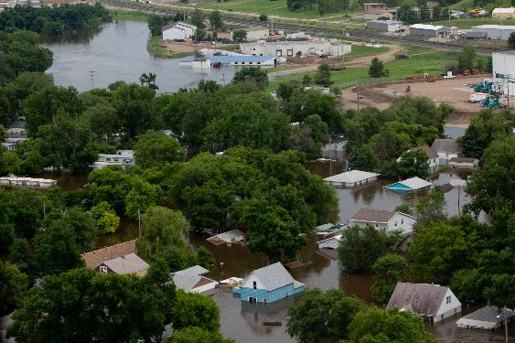
DEBRIEF QUESTIONS
Debrief questions
Identify three strengths
Identify three areas for improvement
What processes should be addressed in future efforts?
Functional Exercise (FE) planning
Duration
Stakeholders
Roles and responsibilities
Closing comments
Notes:
*Ask participants to identify three strengths from the exercise*
*Ask participants to identify any areas for improvement (with a strengths-based perspective if possible)*
Run through the activities listed above to plan for the Functional Exercise

Slide 28
CONCLUSION
Please complete your Participant Feedback Form or evaluation notes / Exercise Evaluation Guide and return them to an Exercise Facilitator at Registration
Please clean up your area and take all your materials with you
Additional materials can be found at the Statewide Medical and Health Exercise Program website: www.swmhe.com

