Slide 1
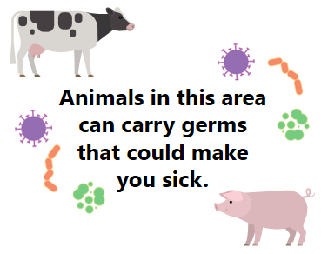
Options for Using These Fair Signs
Sample signs on the following slides are fully editable and may be customized with agency and/or fair logos.
  White space is provided for the addition of logos, but existing contents can be rearranged as needed.
  Permission from CDPH is not necessary to edit or customize.
Some slides include alternate graphics that may be interchanged as desired.
Signs may be used individually or in series with other signs in this or other sets.
Logo
Logo

Slide 2


Please no drinking, eating, smoking, chewing gum, or using pacifiers in this area.
Wait to put anything in your mouth until after you’ve washed your hands.

Slide 3



Germs from animal poop are all over this area.
Do not let children sit or play on the ground.

Slide 4

Do not let children sit or play on the ground in animal areas.

Slide 5


While in this area
Children who can’t walk should be carried.
Germs from animal poop are all over this area.

Slide 6
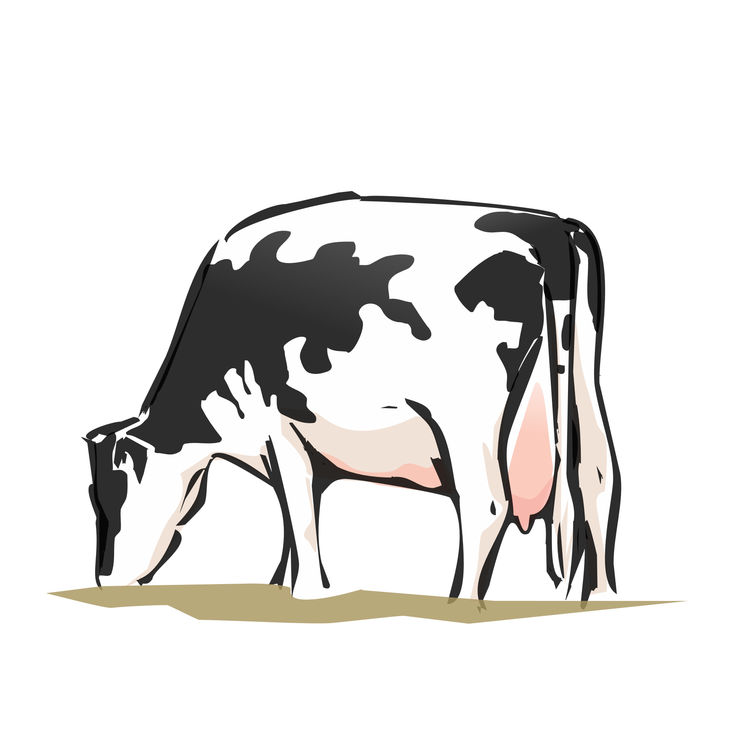



Please do not touch or grab railings, fences, hay or bedding, or other objects in or near the animal stalls.
These surfaces and objects can be covered with germs from animal poop.

Slide 7


Please do not kiss or cuddle animals.
We know they’re cute, but animals can carry germs that can make you sick.

