Slide 1
2023 California STI Surveillance
Prepared by CDPH STD Control Branch

Slide 2
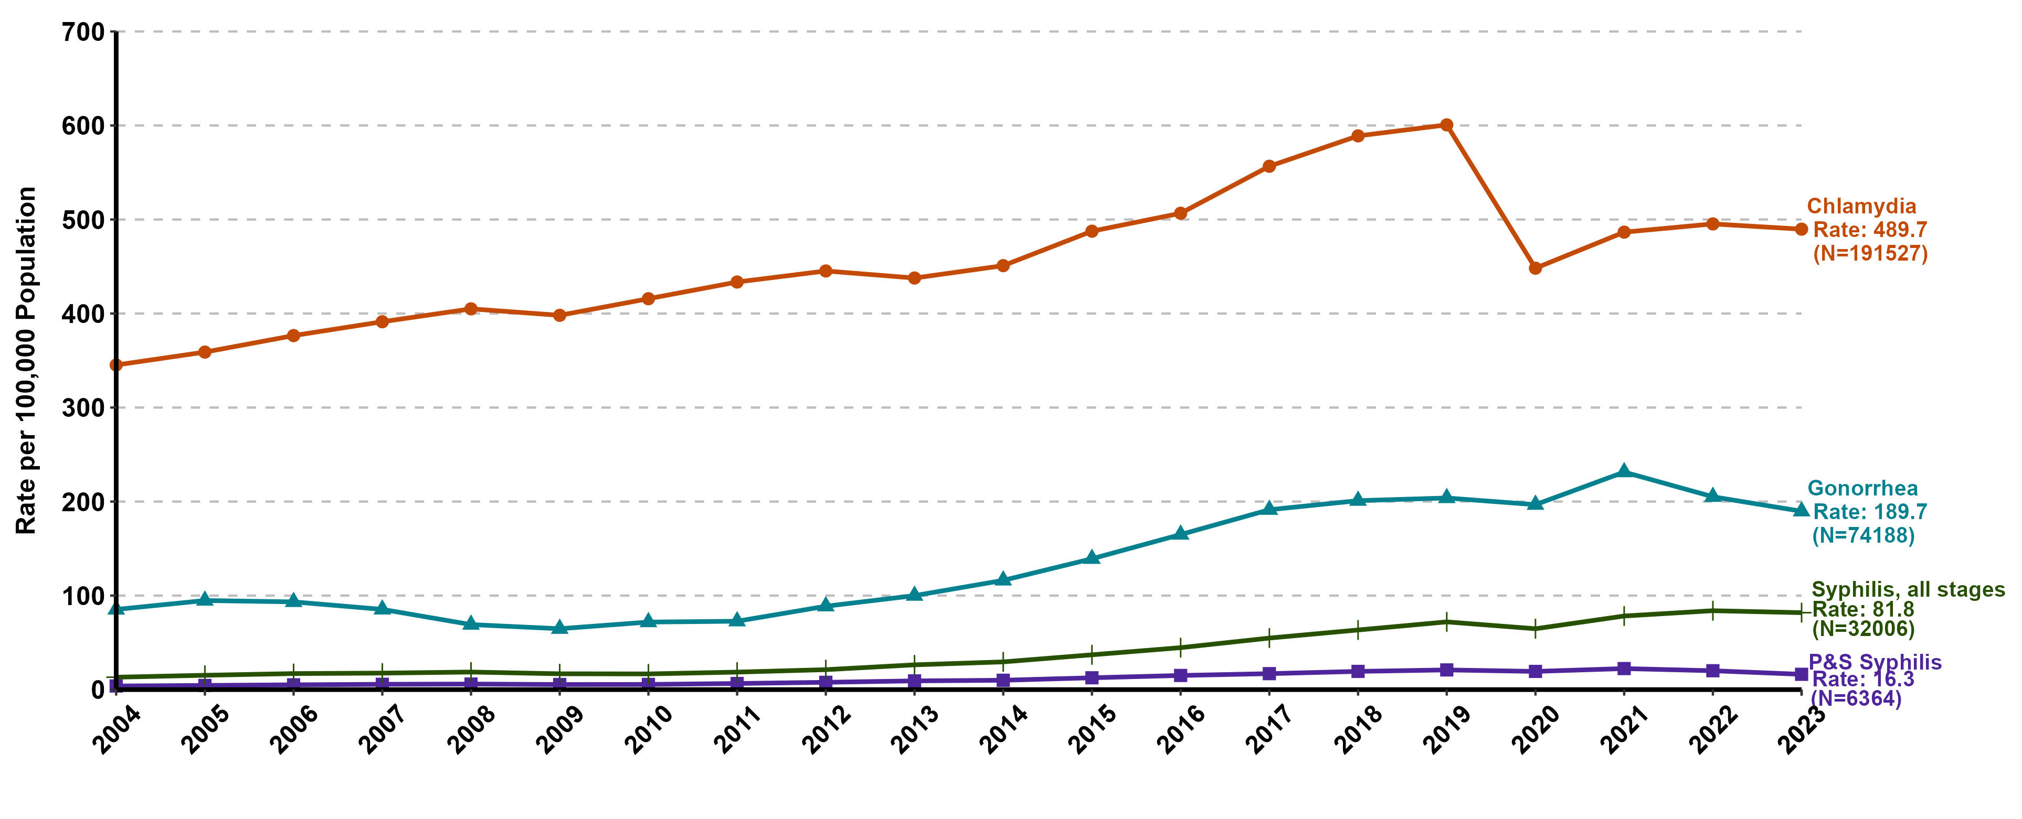
Chlamydia, Gonorrhea, Primary & Secondary Syphilis, and Syphilis (all stages) Incidence in California, 2004–2023
P&S syphilis includes primary and secondary syphilis. Syphilis (all stages) includes primary, secondary, early non-primary non-secondary, and unknown duration or late syphilis.

Slide 3
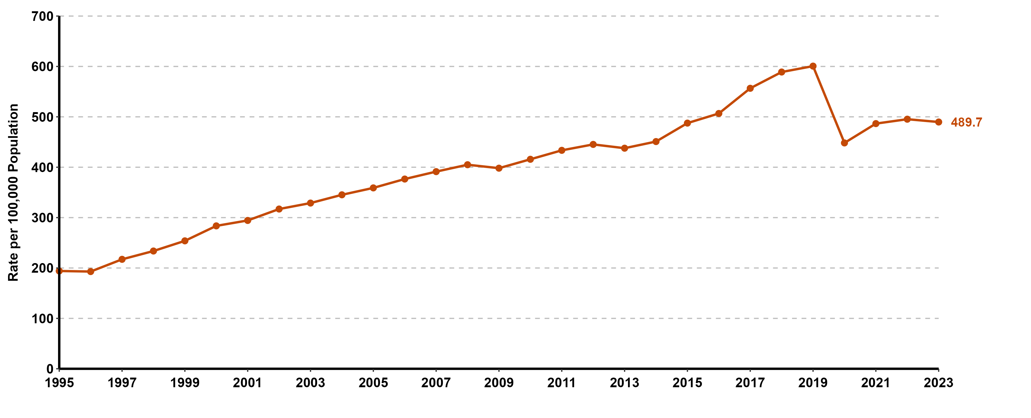
Chlamydia Incidence in California, 1995–2023

Slide 4
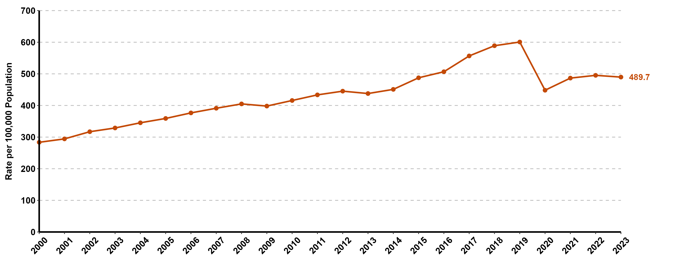
Chlamydia Incidence in California, 2000–2023

Slide 5
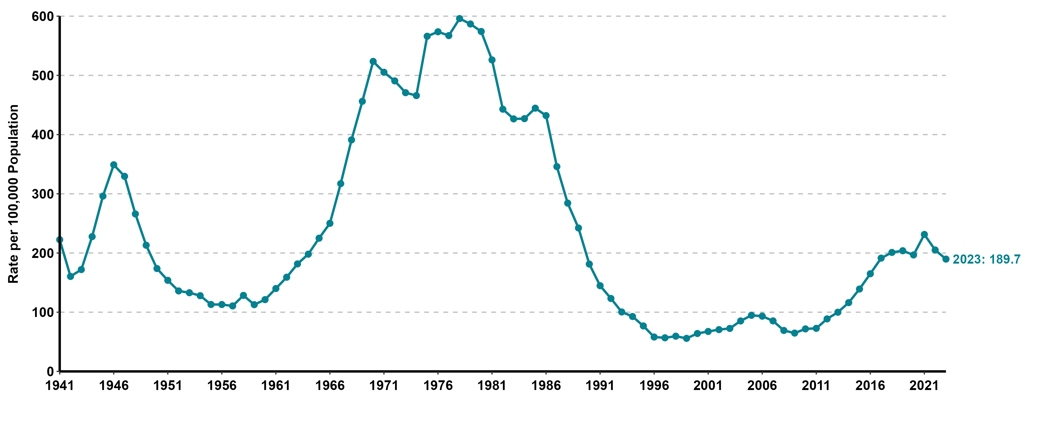
Gonorrhea Incidence in California, 1941–2023

Slide 6
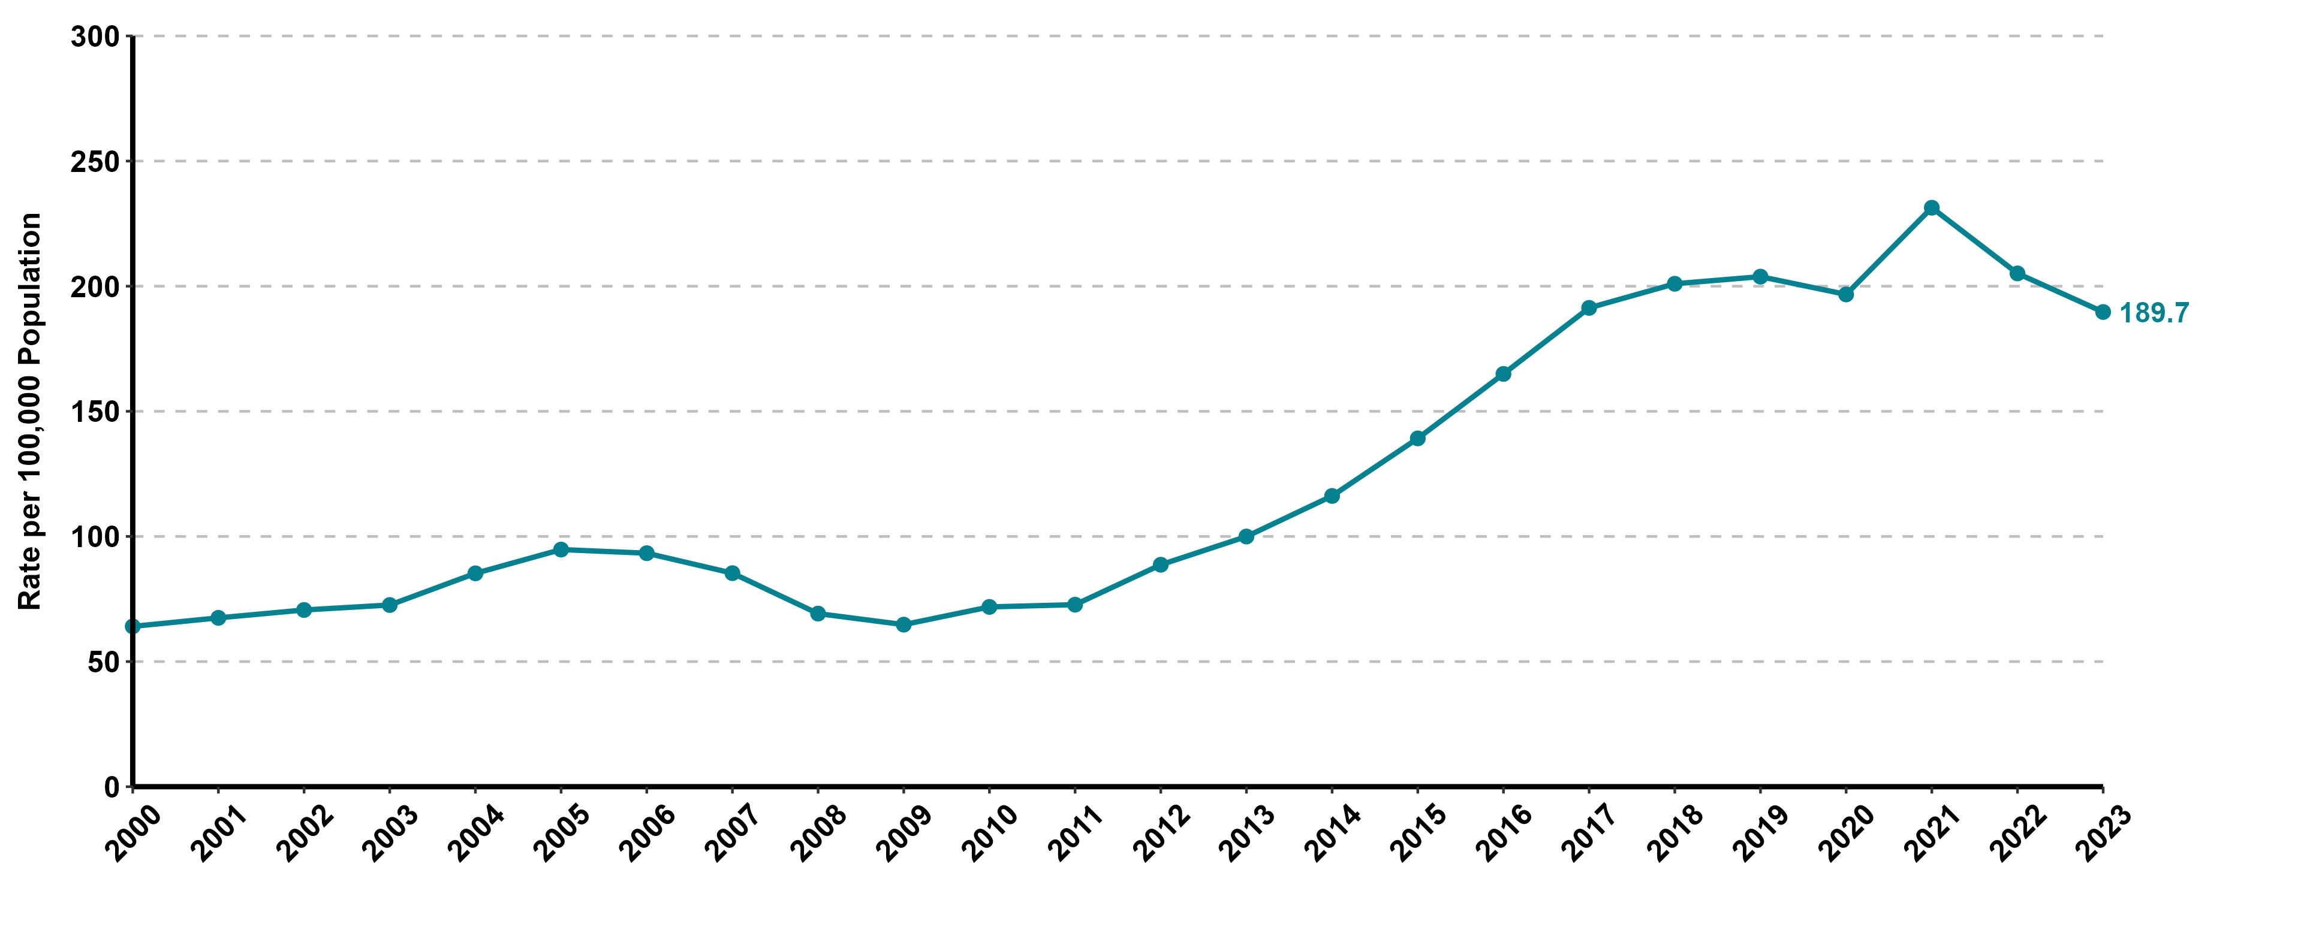
Gonorrhea Incidence in California, 2000–2023

Slide 7
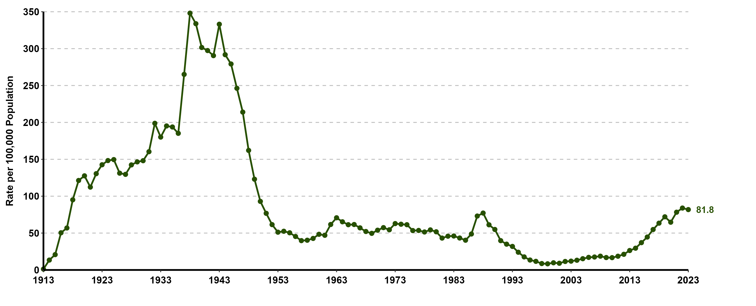
Syphilis (all stages) Incidence in California, 1913–2023
Syphilis (all stages) includes primary, secondary, early non-primary non-secondary, and unknown duration or late syphilis.

Slide 8
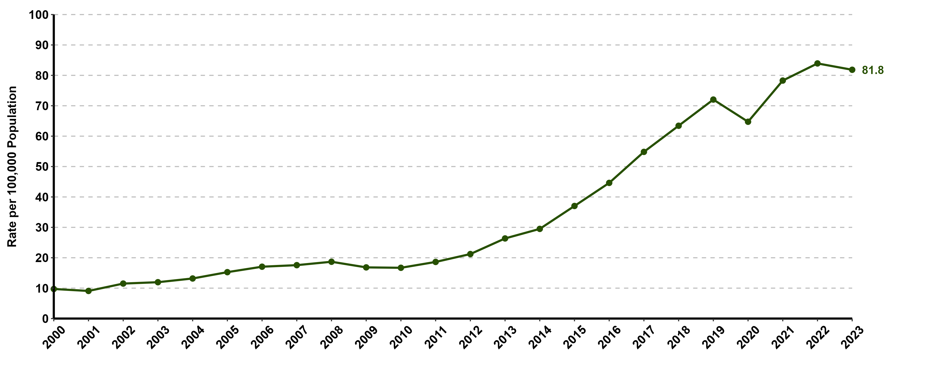
Syphilis (all stages) Incidence in California, 2000–2023
Syphilis (all stages) includes primary, secondary, early non-primary non-secondary, and unknown duration or late syphilis.

Slide 9
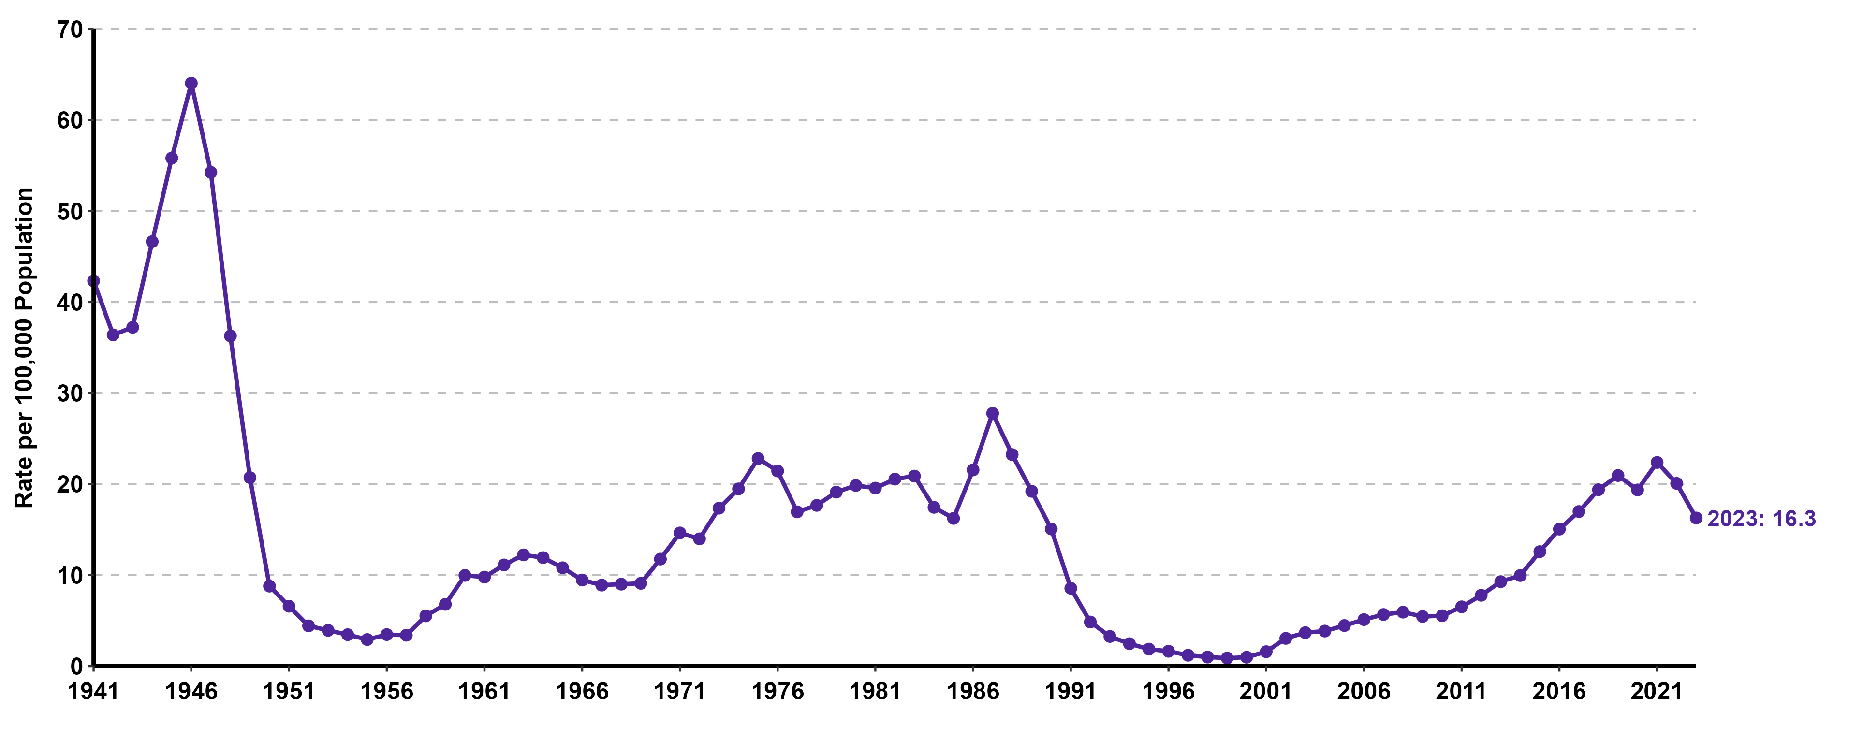
Primary & Secondary Syphilis Incidence in California, 1941–2023

Slide 10
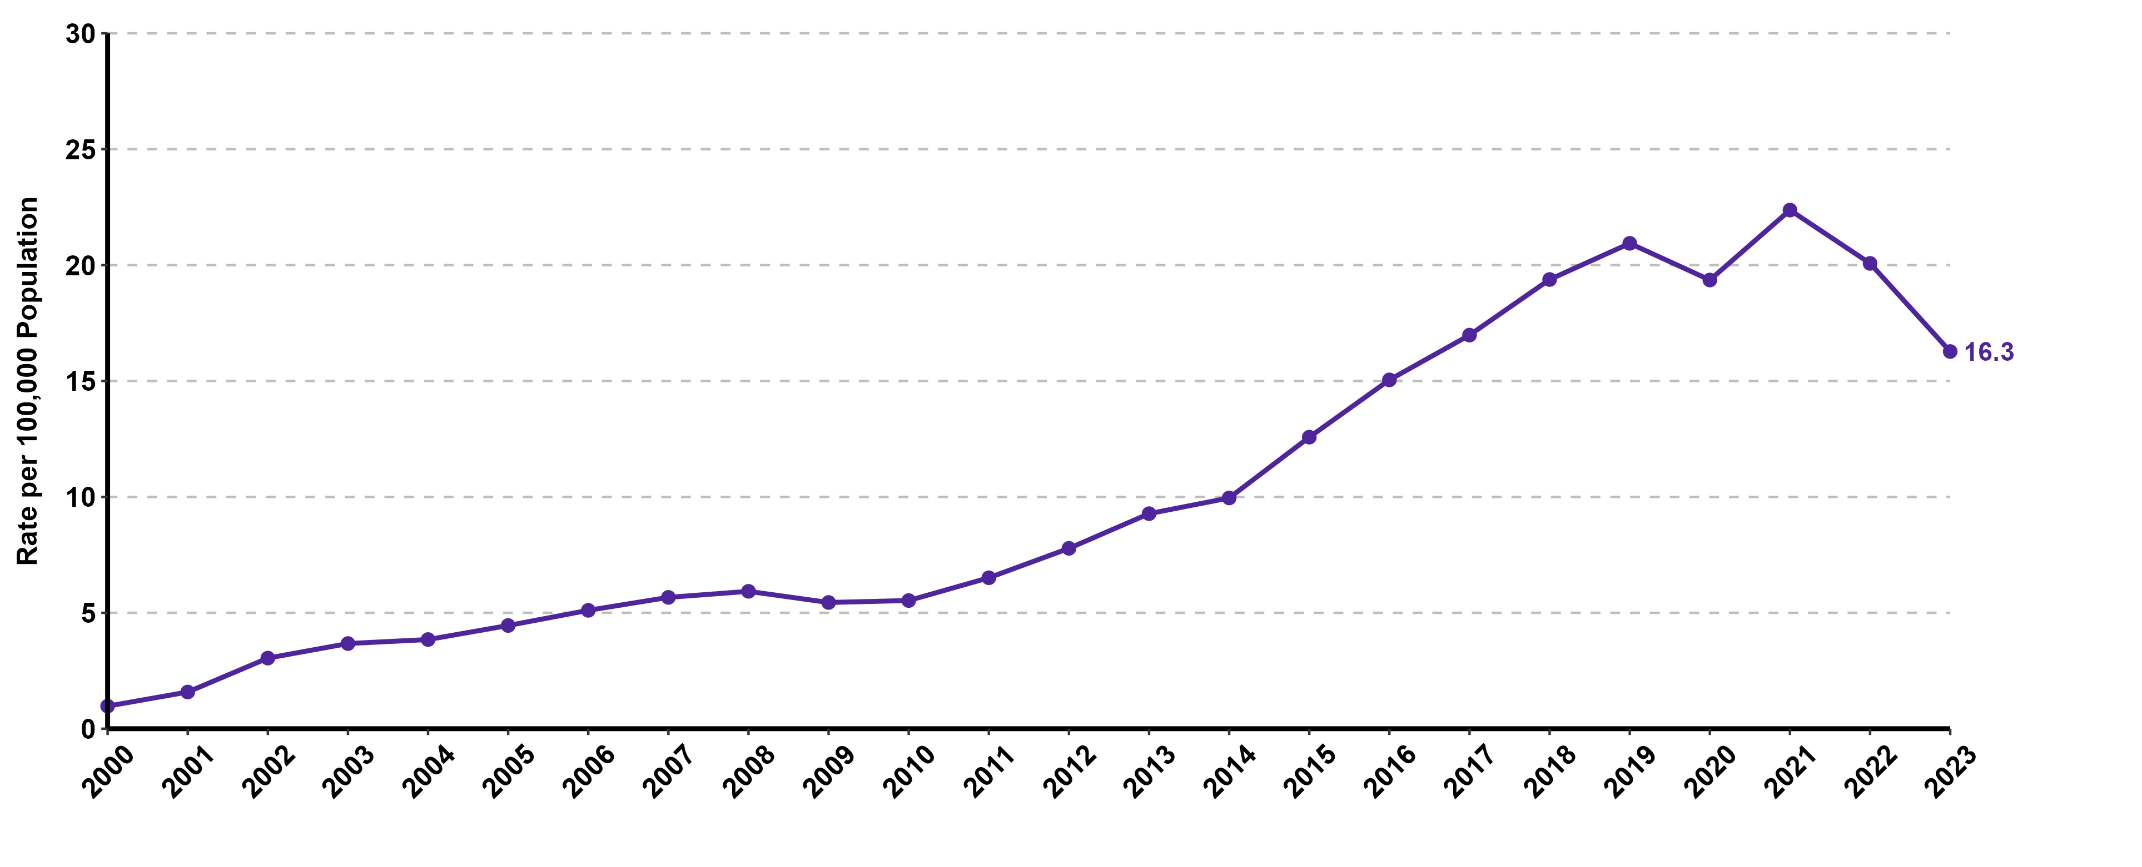
Primary & Secondary Syphilis Incidence in California, 2000–2023

Slide 11
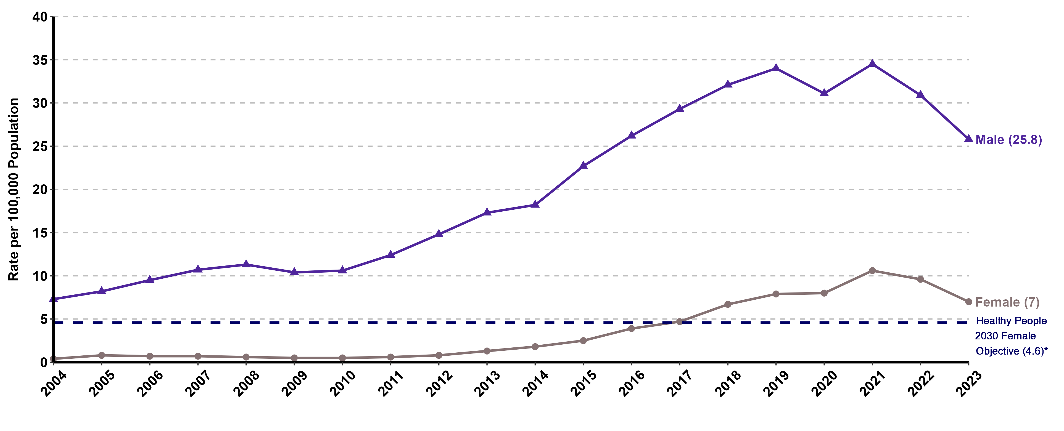
Primary & Secondary Syphilis Incidence by Gender in California, 2004–2023
*Healthy People 2030 does not have a primary & secondary syphilis target for men.

Slide 12
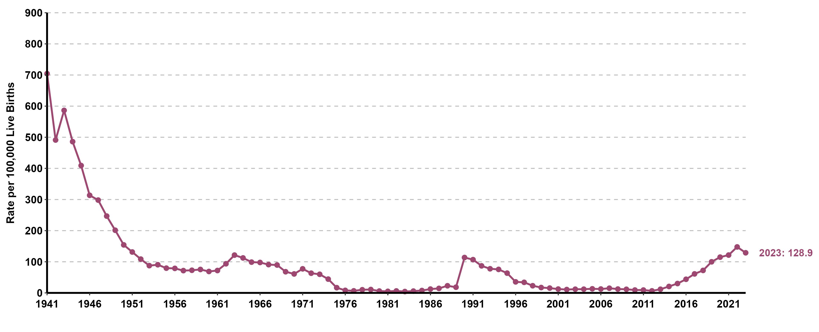
Congenital Syphilis Incidence in California, 1941–2023

Slide 13
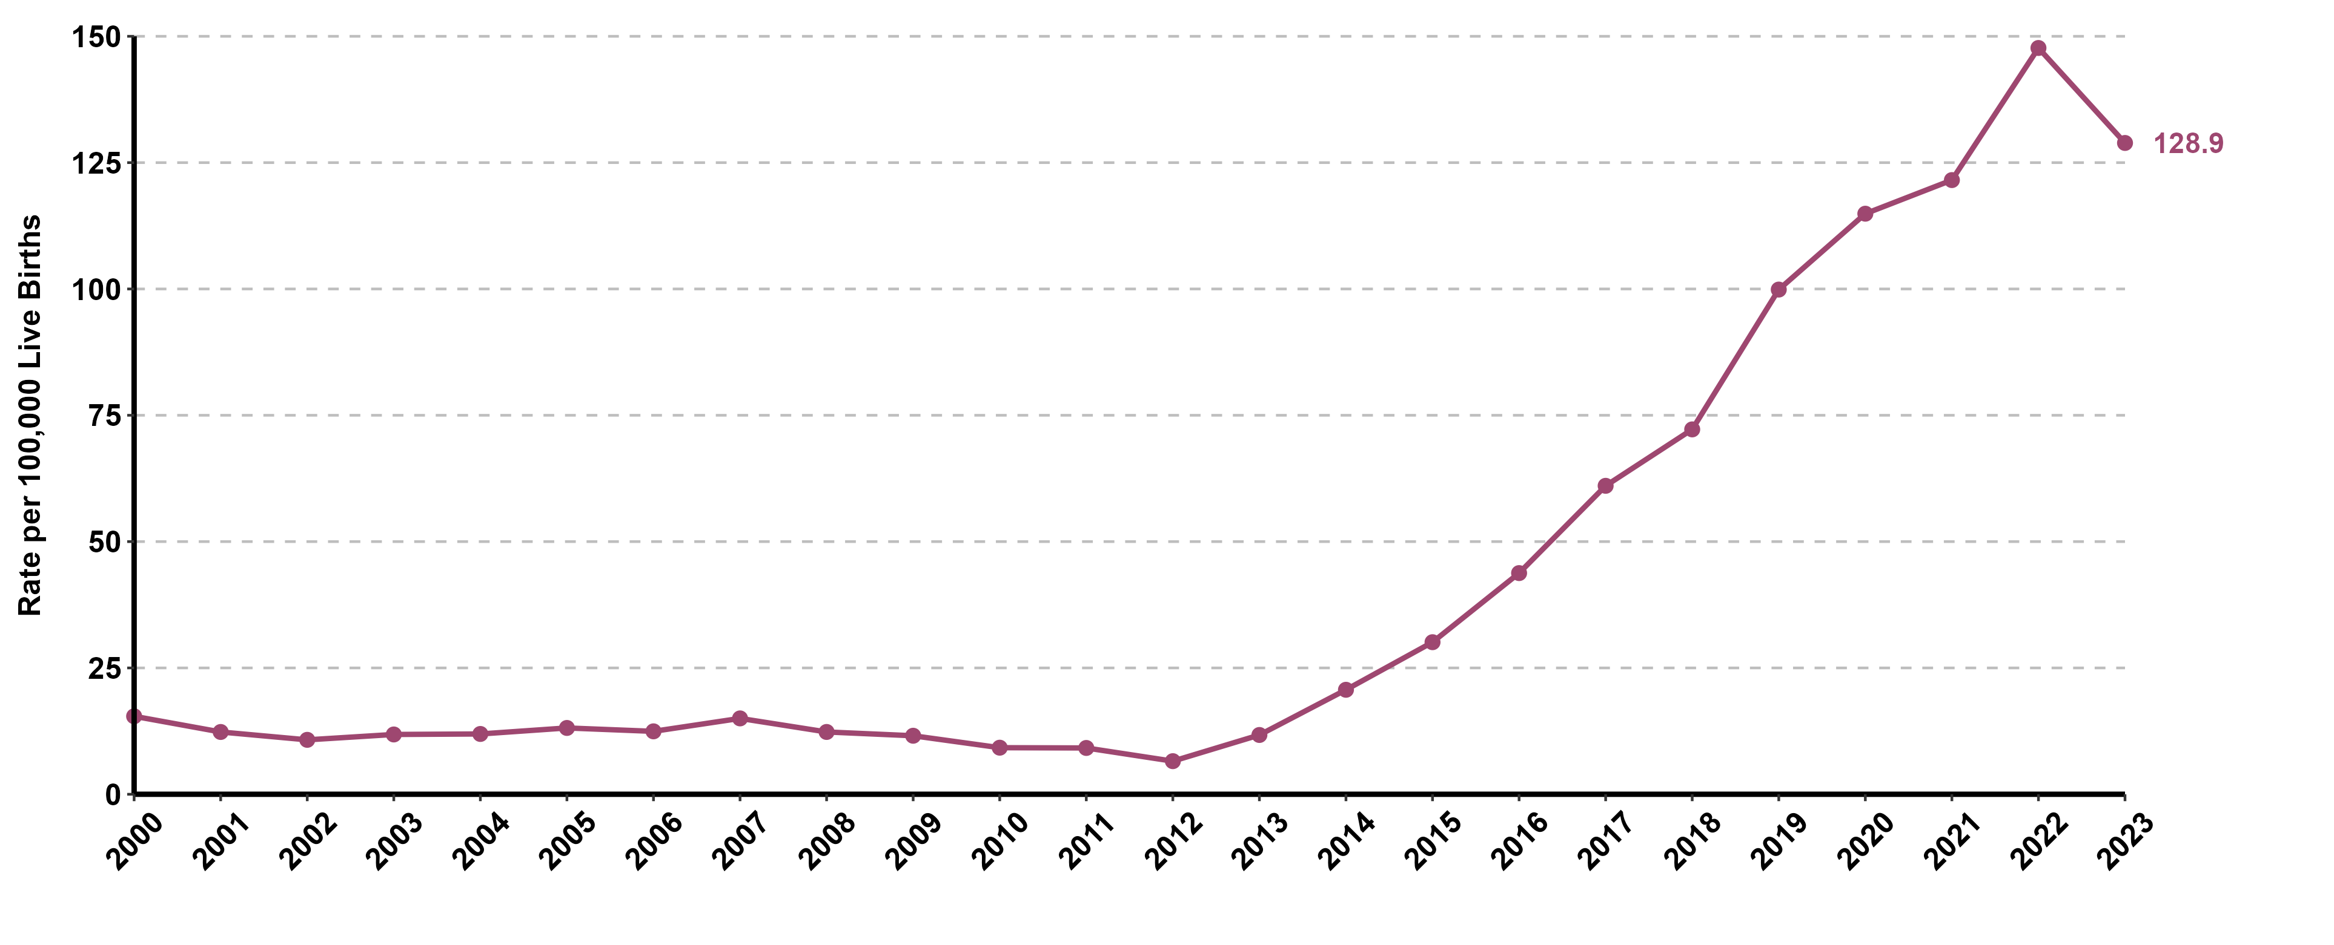
Congenital Syphilis Incidence in California, 2000–2023

Slide 14
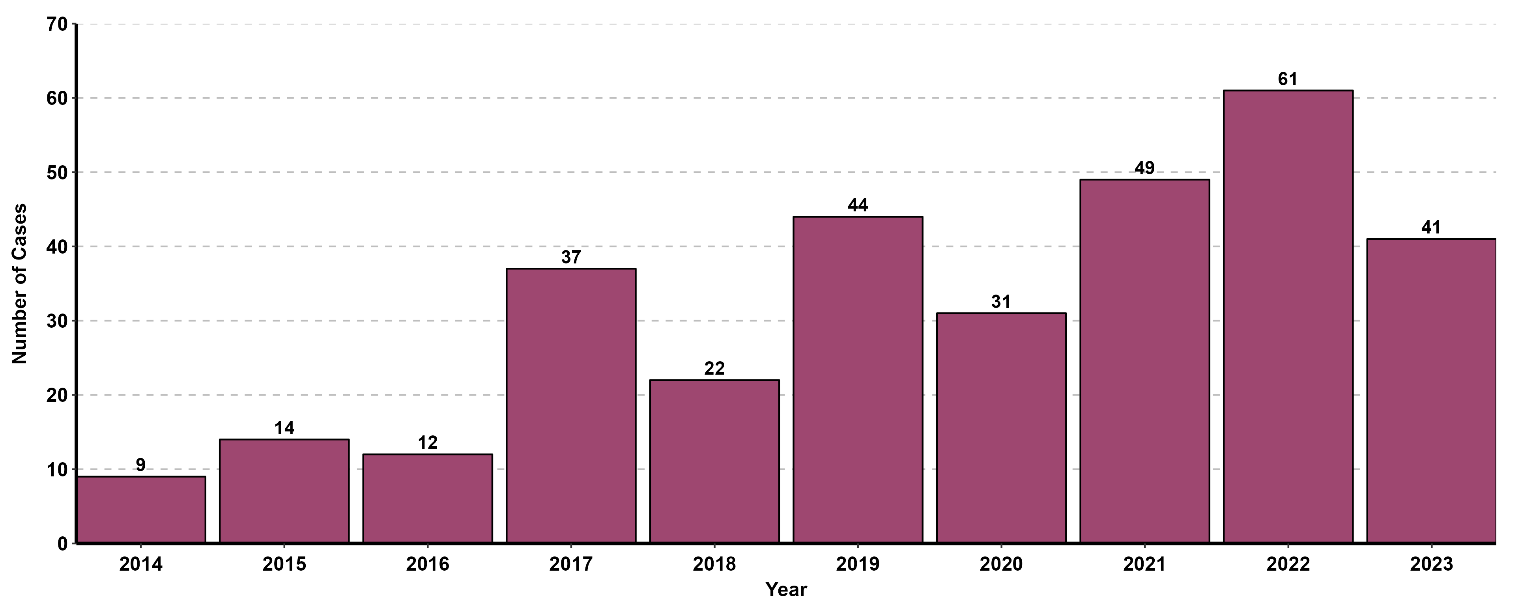
Congenital Syphilis Stillbirths or Neonatal Deaths, 2014–2023

