Slide 1
California STI Surveillance
2021 Data Graph Set
(Revised 02/2023)

Slide 2
Data Sources
The STI surveillance systems operated by state and local STD control programs are the sources of California data in these slides. Case reports are submitted to local health jurisdictions in the form of laboratory reports and Confidential Morbidity Reports (CMRs). The local health jurisdictions then submit the data to the California Department of Public Health (CDPH), with the majority using the California Reportable Disease Information Exchange (CalREDIE) system. A small number of health jurisdictions report case data from county-generated databases.
Rates by county and selected city health jurisdictions were calculated using State of California, Department of Finance, E-6. Population Estimates and Components of Change by County, July 1, 2010-2021. Sacramento, California, December 2021.
Rates by age, race/ethnicity, and gender were calculated using State of California, Department of Finance, Report P-3: State and County Population Projections by Race/Ethnicity, Detailed Age, and Gender, 2010-2060, Baseline 2019. Sacramento, California, July 2021.
The race and ethnicity information listed and the corresponding census categories are:
  American Indian/Alaska Native (American Indian/Alaska Native, non-Hispanic)
  Asian American (Asian American, non-Hispanic)
  Black/African American (Black or African-American, non-Hispanic)
  Hispanic/Latino (Hispanic ethnicity, regardless of race designation)
  Native Hawaiian/Other Pacific Islander, (Native Hawaiian/Other Pacific Islander, non-Hispanic)
  White (White, non-Hispanic)
  Other (Other, non-Hispanic)
  Multi (two or more races, non-Hispanic)
  Not Specified (no race or ethnicity information was available)

Slide 3
Data Limitations/Notes
Missing race/ethnicity data hampers the interpretation of disease burden by race/ethnicity from surveillance data. The observed racial/ethnic disparities may reflect true differences in the infection rates, or reporting practices of different types of providers that serve different populations, among other factors that influence completeness of these data.
The “year” for California data presented in these slides is based on a hierarchy of dates (i.e., the earliest of the following dates: clinic visit, specimen collection, diagnosis, treatment, and lab report/CMR received by the health jurisdiction).
In slides on race/ethnicity, where space is limited, the following abbreviations are used:
  AI/AN = American Indian/Alaska Native
  NHPI = Native Hawaiian/Other Pacific Islander
Chlamydia trends are difficult to interpret due to the often-asymptomatic presentation of the disease, provider reporting patterns, access to screening programs in different health care settings, and recent increased availability of more sensitive diagnostic tests.
For prevalence monitoring slides, percent positive in males is generally higher than females, not necessarily because the true prevalence is higher, but most likely because men seen in these venues are typically tested for symptomatic reasons whereas several screening programs specifically target women.
CDPH continues to explore the factors that led to changes in STI morbidity in California during the COVID-19 pandemic.

Slide 4
Social Determinants of Health & Racial Equity
Social Determinants of Health (SDOH)
Racial Equity and the Impact of Racism
SDOH are the conditions in which people are born, grow, live, learn, work, play, and age. They include a broad range of socioeconomic and environmental factors.
SDOH are caused by social and institutional inequities.
SDOH influence how we think about health behaviors.
SDOH influence health outcomes.
Racial and Health Equity will be achieved when race can no longer be used to predict health outcomes and SDOH among all populations are evenly distributed.
Racism is a root cause of health inequities and disparities – historical and current experiences of racism impact the health and wellbeing of Californians.
In this report, we include data broken down by race/ethnicity to describe differences in disease burden. The differences in disease burden between these populations are driven by the political, social, and cultural factors that lead to the inequitable distribution of resources and opportunities.

Slide 5
State Summary
(Revised 02/2023)

Slide 6
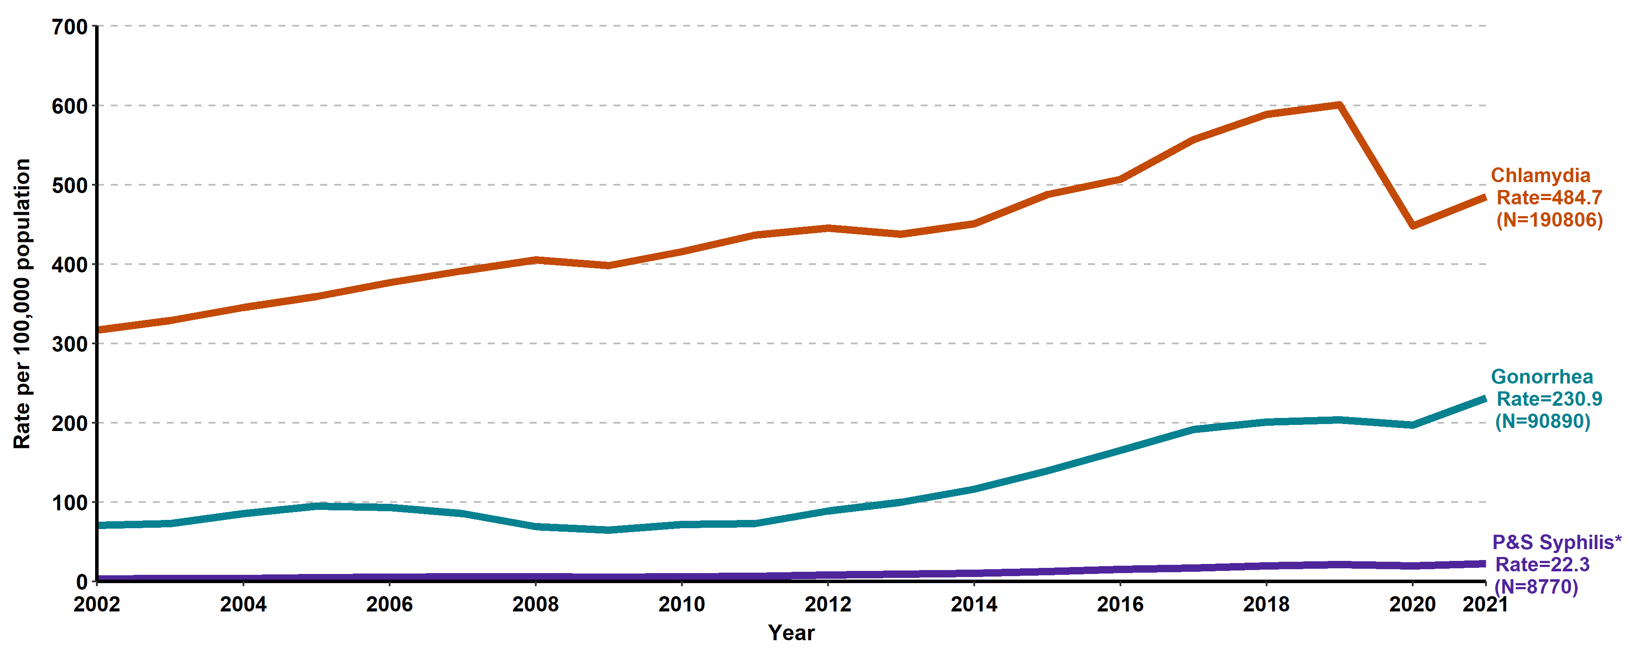
Chlamydia, Gonorrhea, and Primary & Secondary Syphilis California Incidence Rates, 2002–2021
* P&S syphilis includes primary and secondary syphilis.

Slide 7
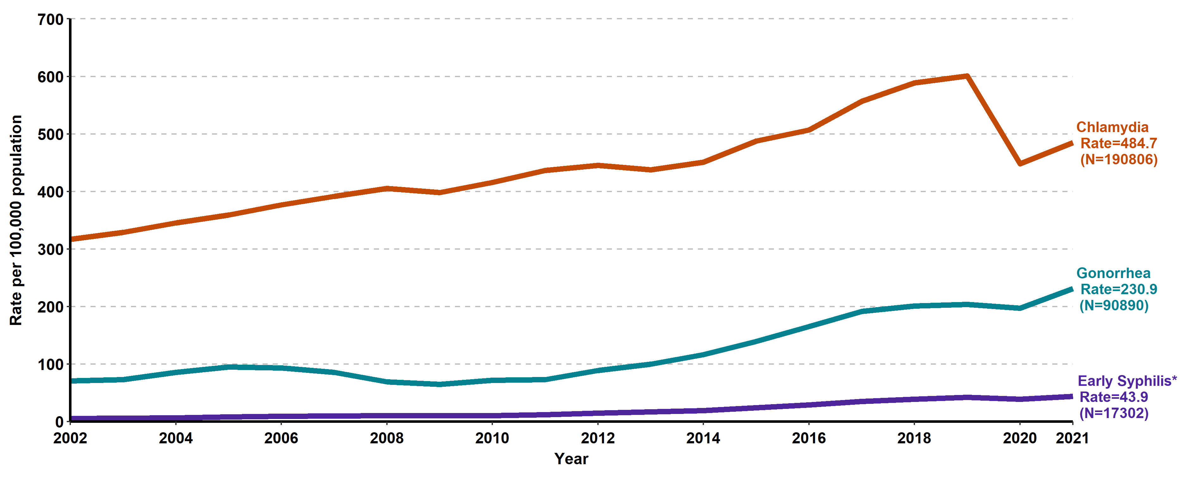
Chlamydia, Gonorrhea, and Early Syphilis* California Incidence Rates, 2002–2021
* Early syphilis includes primary, secondary, and early non-primary non-secondary syphilis.

Slide 8
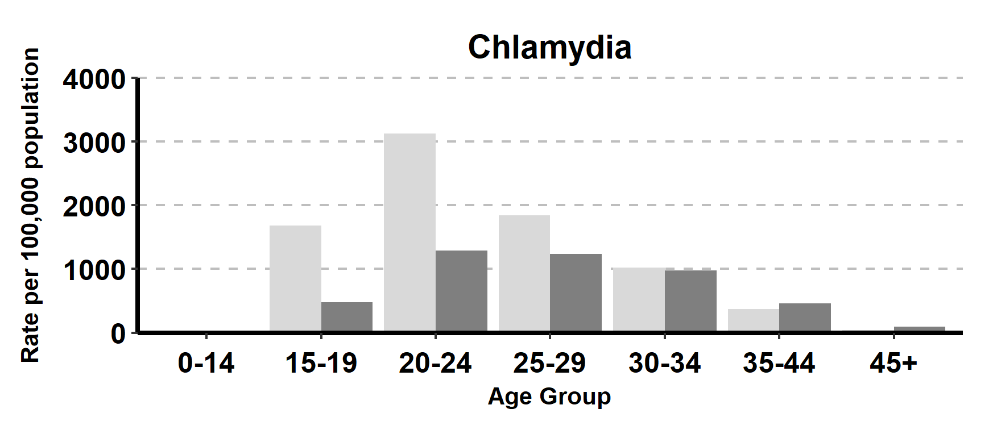
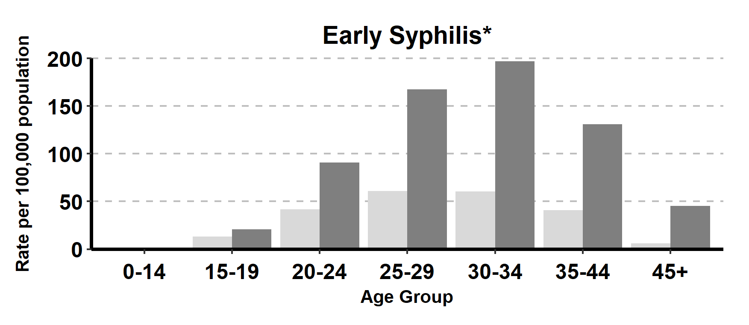
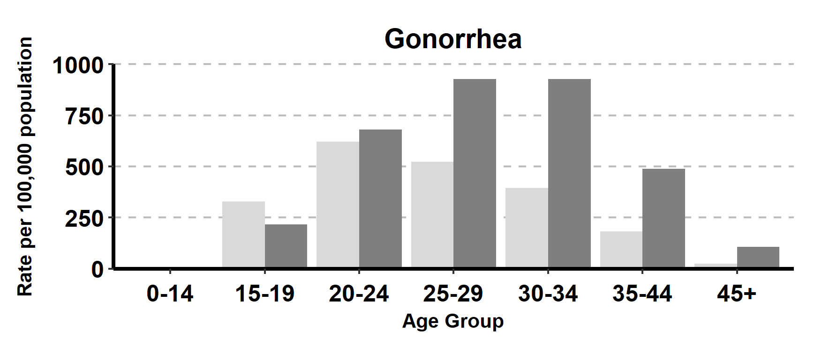
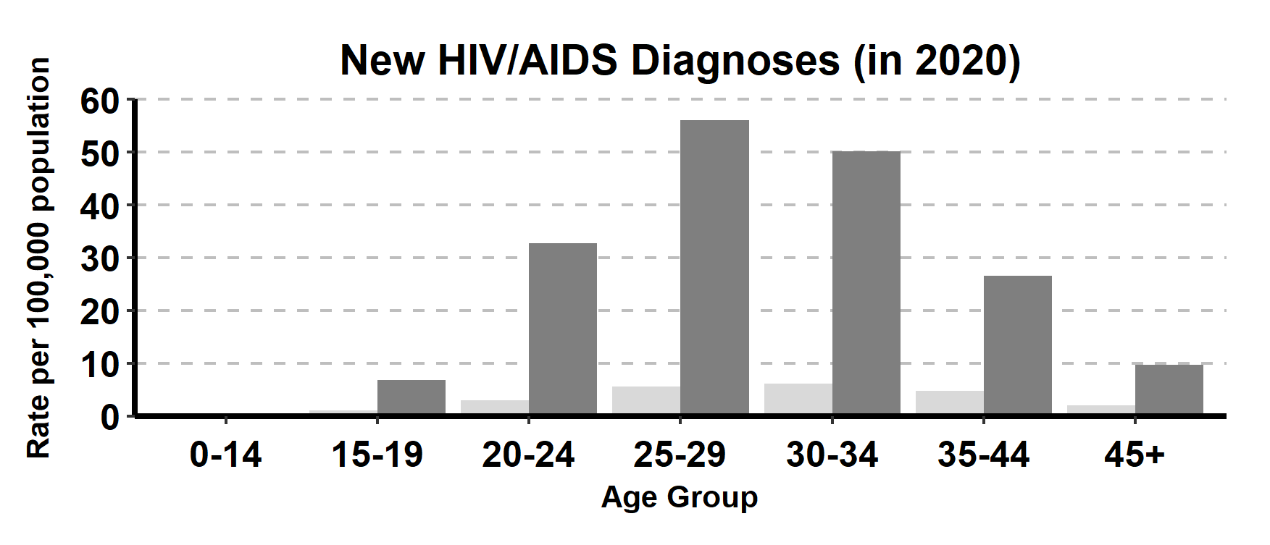
Incidence Rates of Chlamydia, Gonorrhea, Early Syphilis*, and HIV/AIDS by Age Group (in years) and Gender, California, 2021
* Early syphilis includes primary, secondary, and early non-primary non-secondary syphilis.

Slide 9
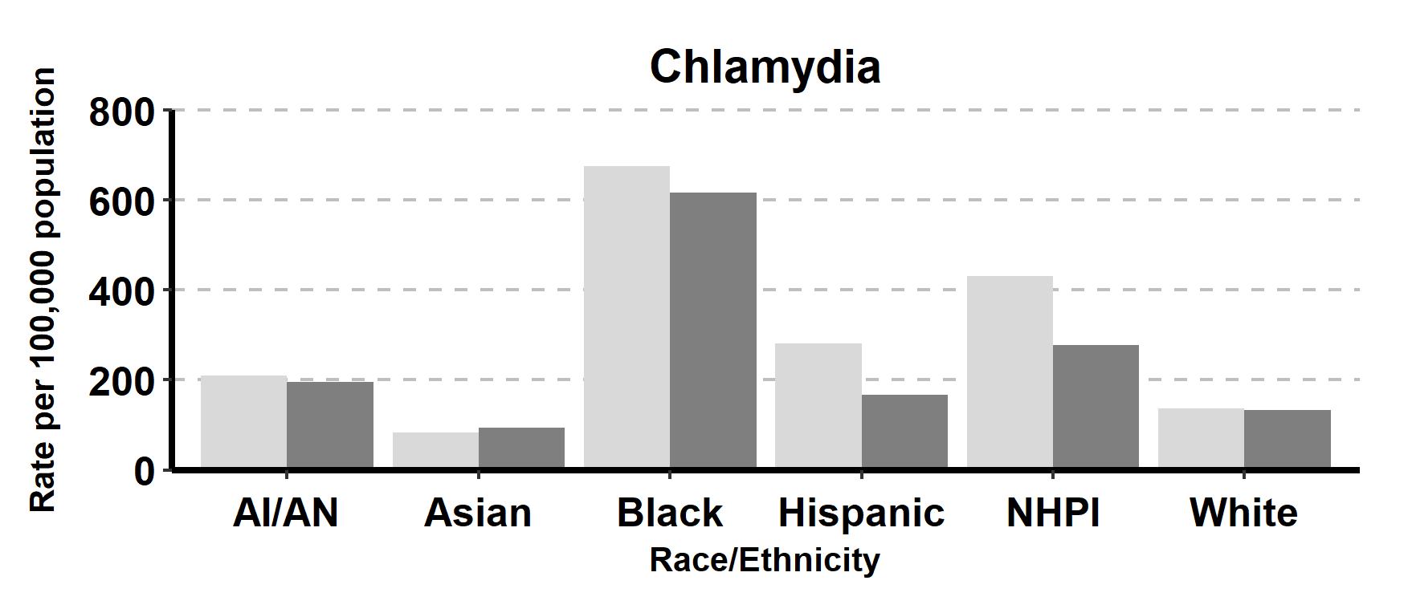
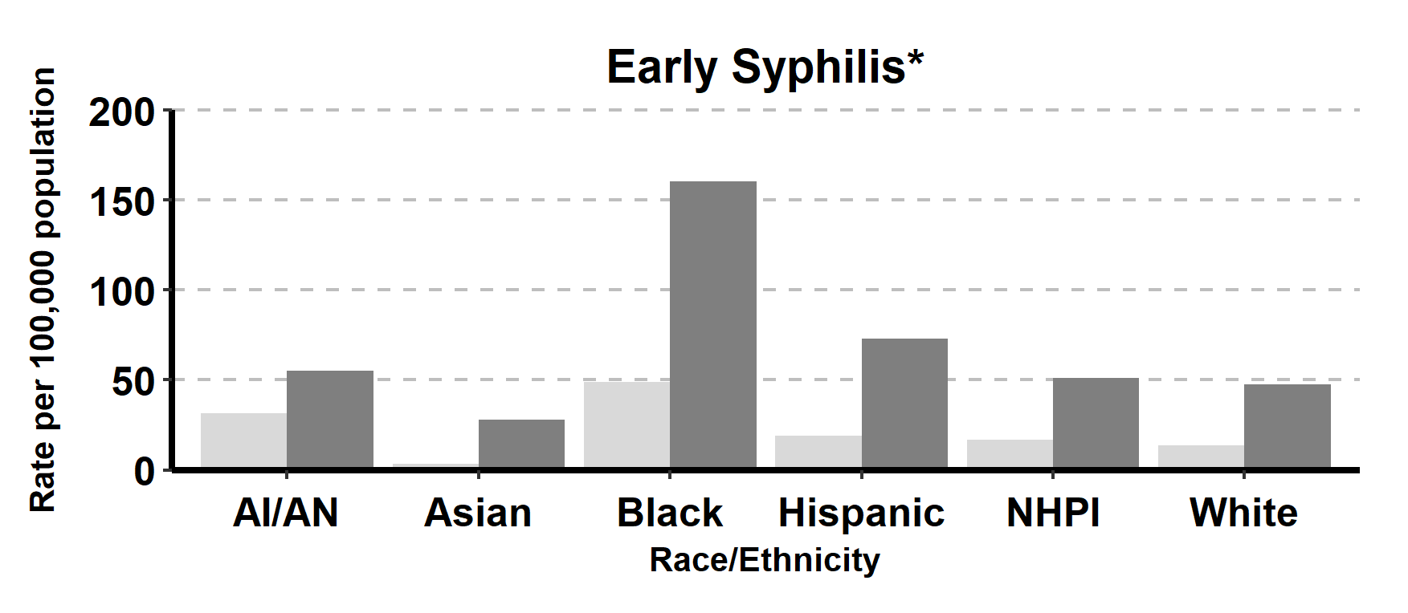
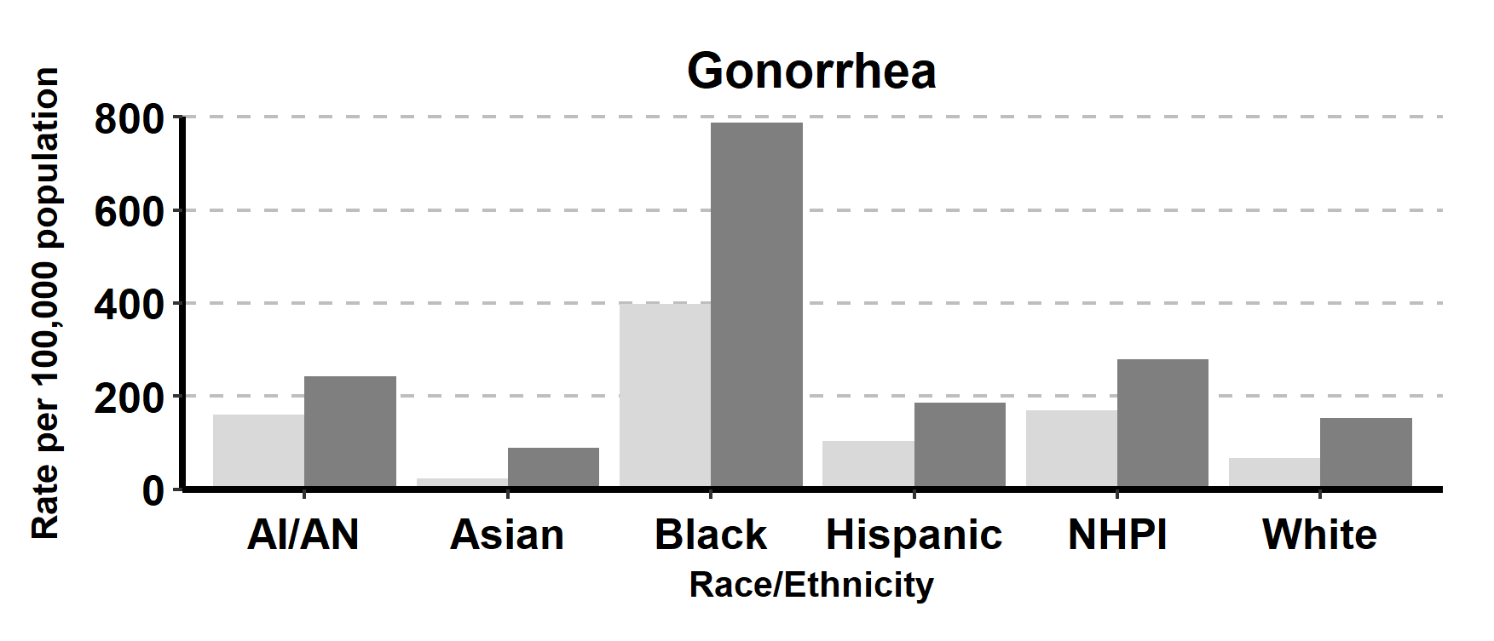
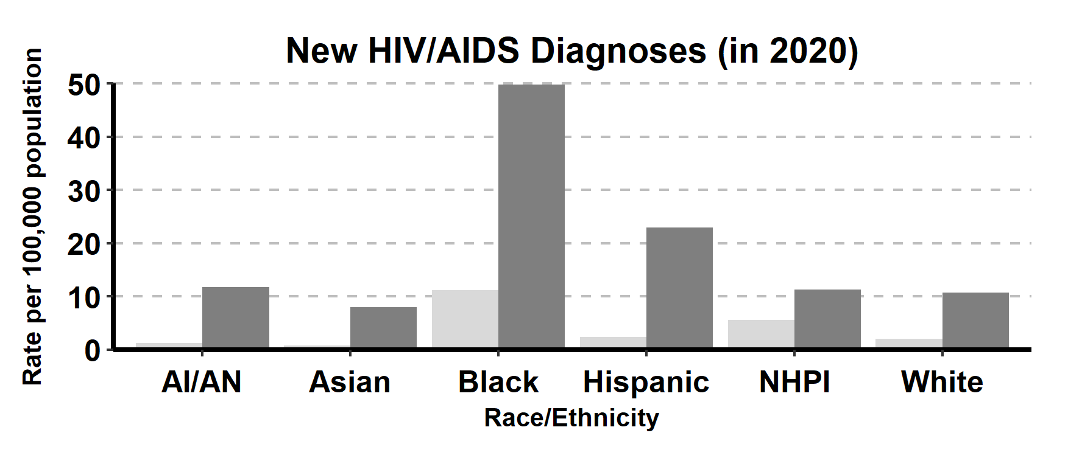
Incidence Rates of Chlamydia, Gonorrhea, Early Syphilis*,and HIV/AIDS by Race/Ethnicity and Gender, California, 2021
AI/AN = American Indian/Alaska Native, NHPI = Native Hawaiian/Other Pacific Islander.
* Early syphilis includes primary, secondary, and early non-primary non-secondary syphilis.

Slide 10
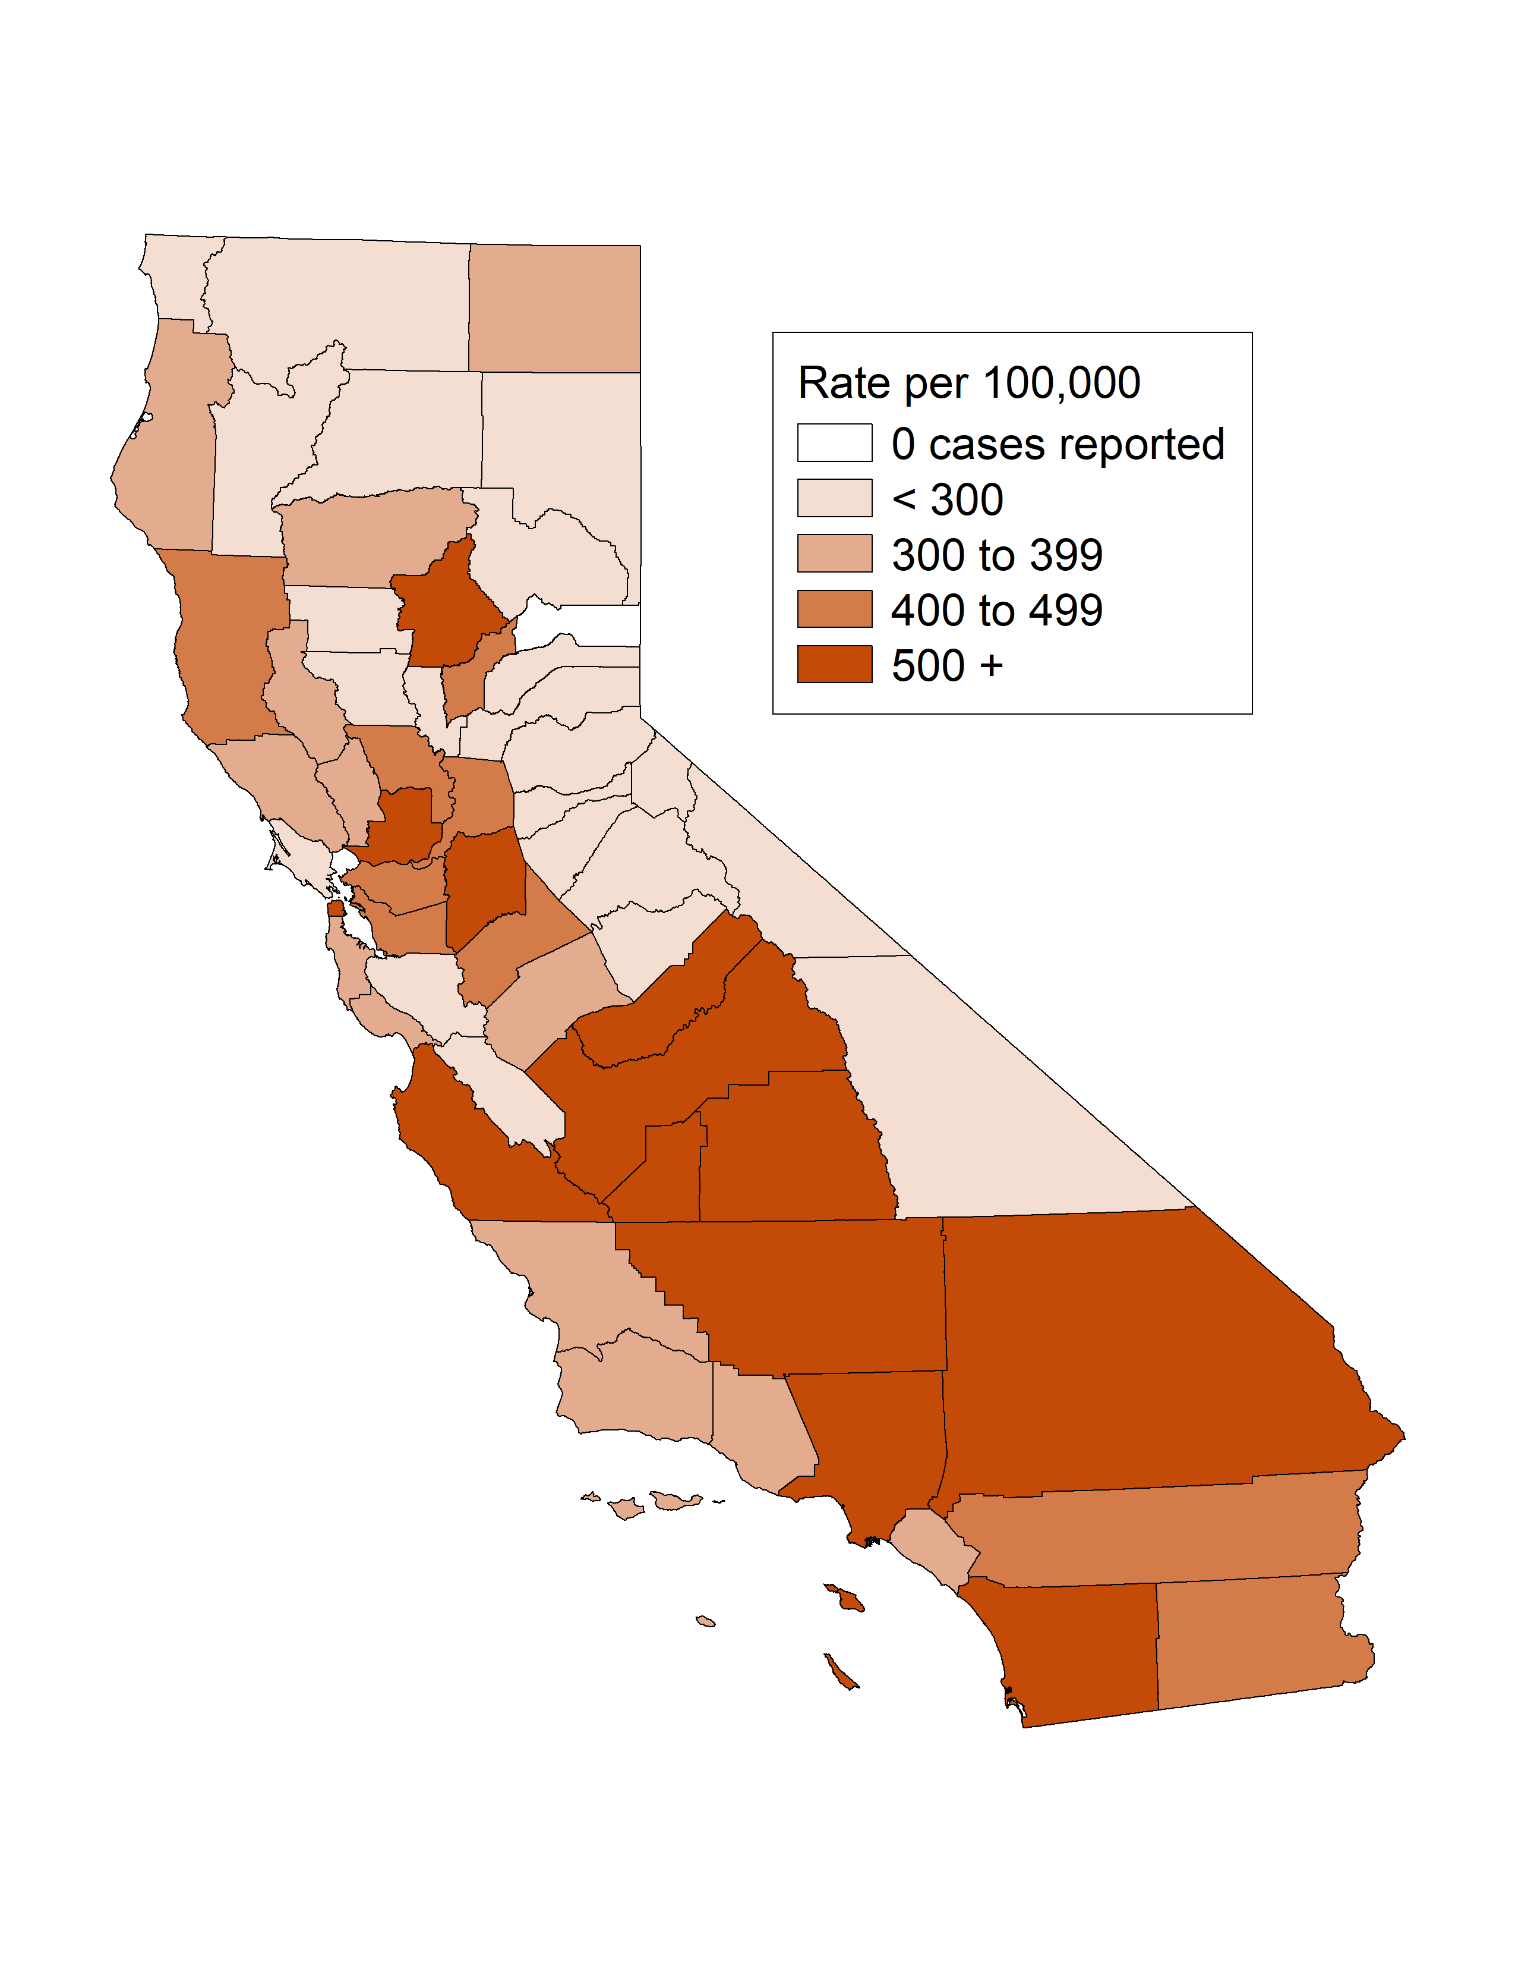
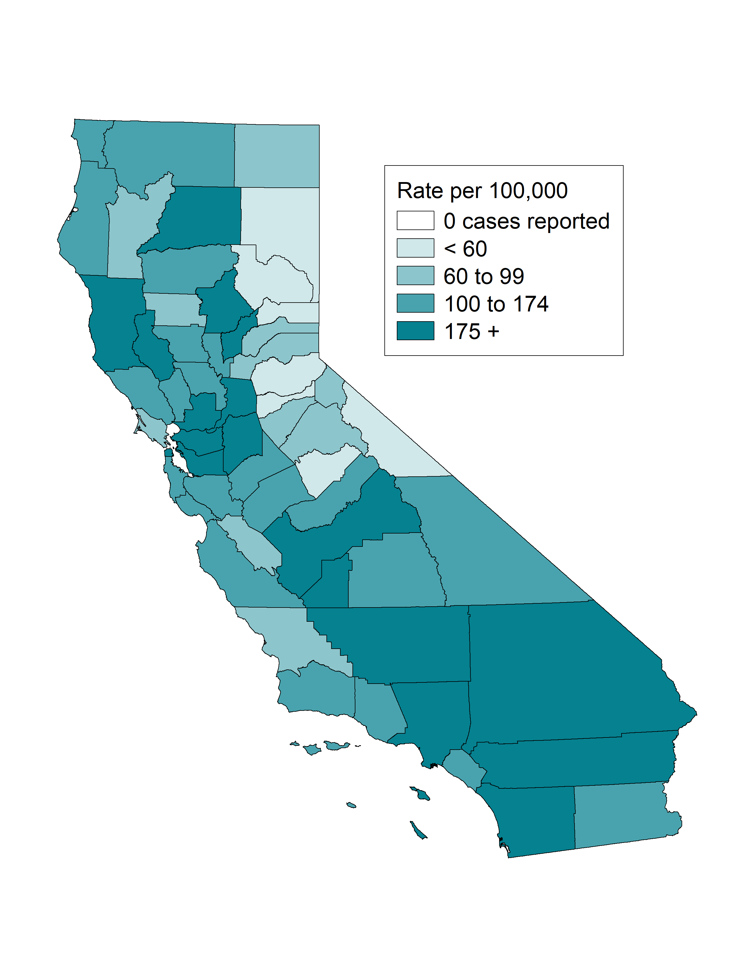
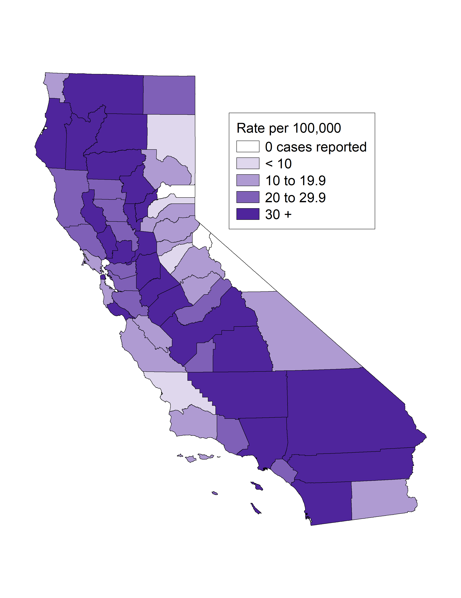
Chlamydia, Gonorrhea, and Early Syphilis* Incidence Rates by County, California, 2021
Chlamydia
Gonorrhea
Early Syphilis*
* Early syphilis includes primary, secondary, and early non-primary non-secondary syphilis.

Slide 11
Chlamydia
(Revised 02/2023)

Slide 12
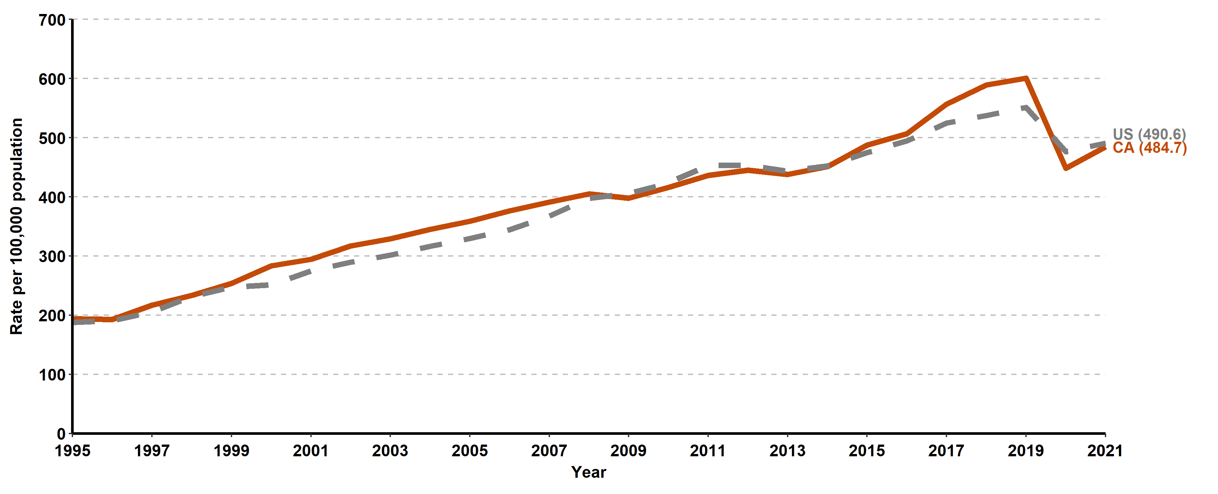
Chlamydia, California versus United States Incidence Rates, 1995–2021

Slide 13
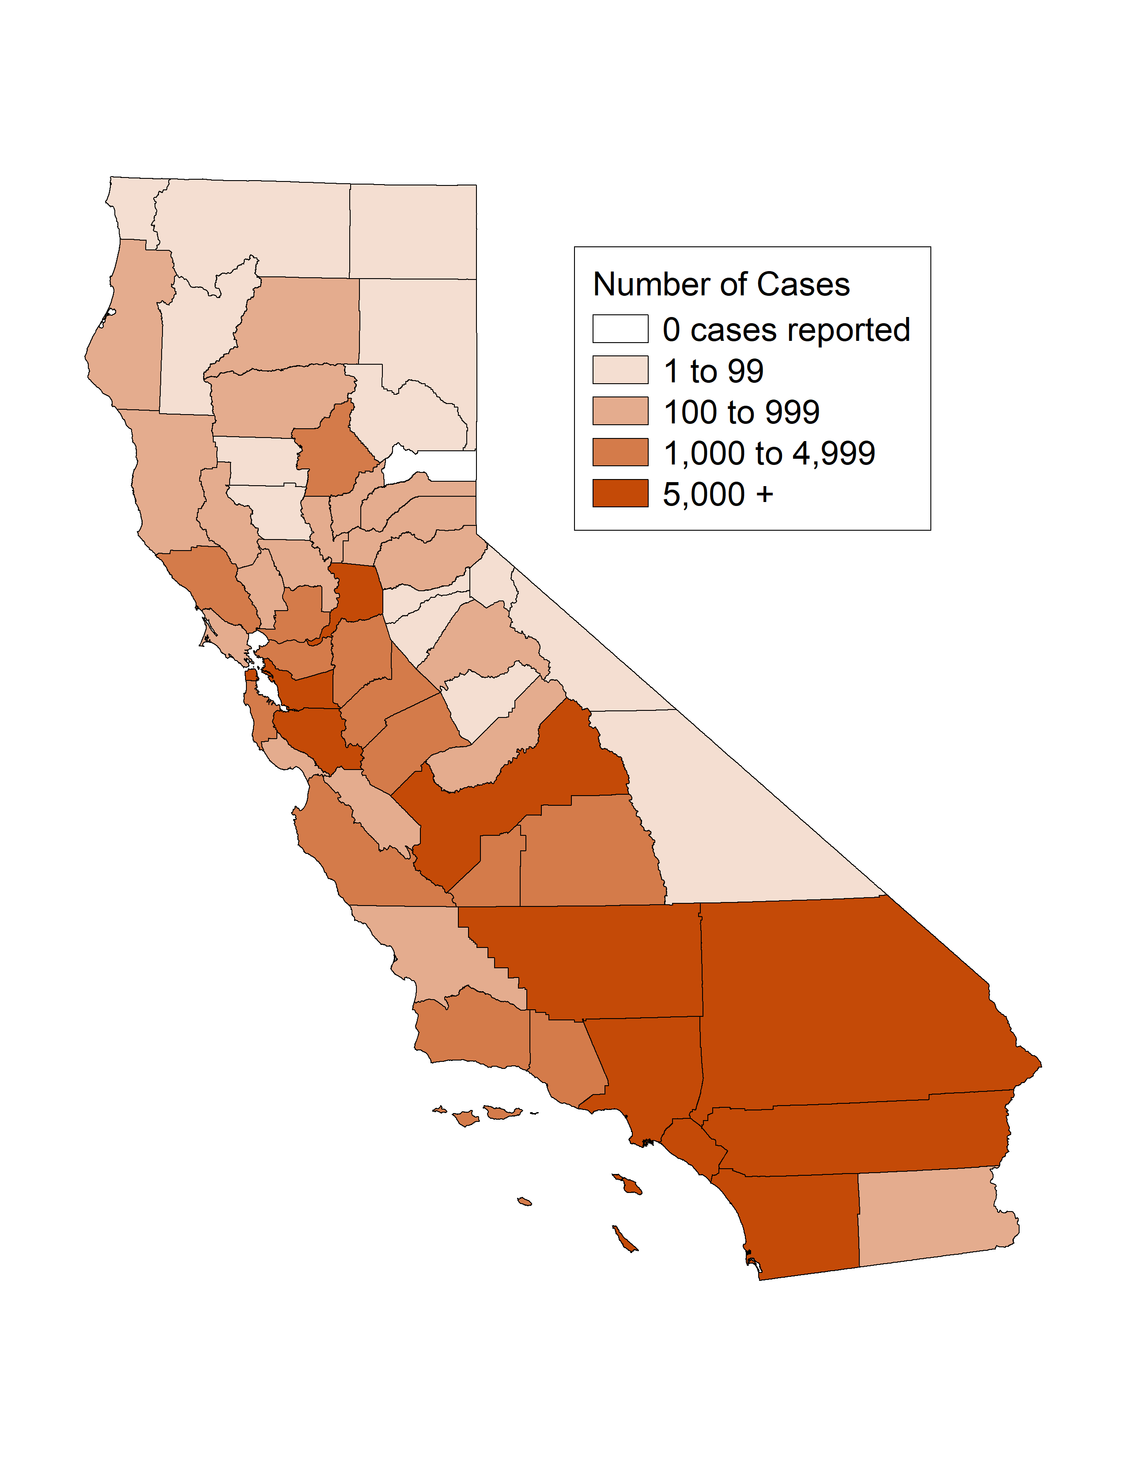
Chlamydia, Case Counts and Incidence Rates by County, California, 2021
Chlamydia Cases
Chlamydia Rates

Slide 14
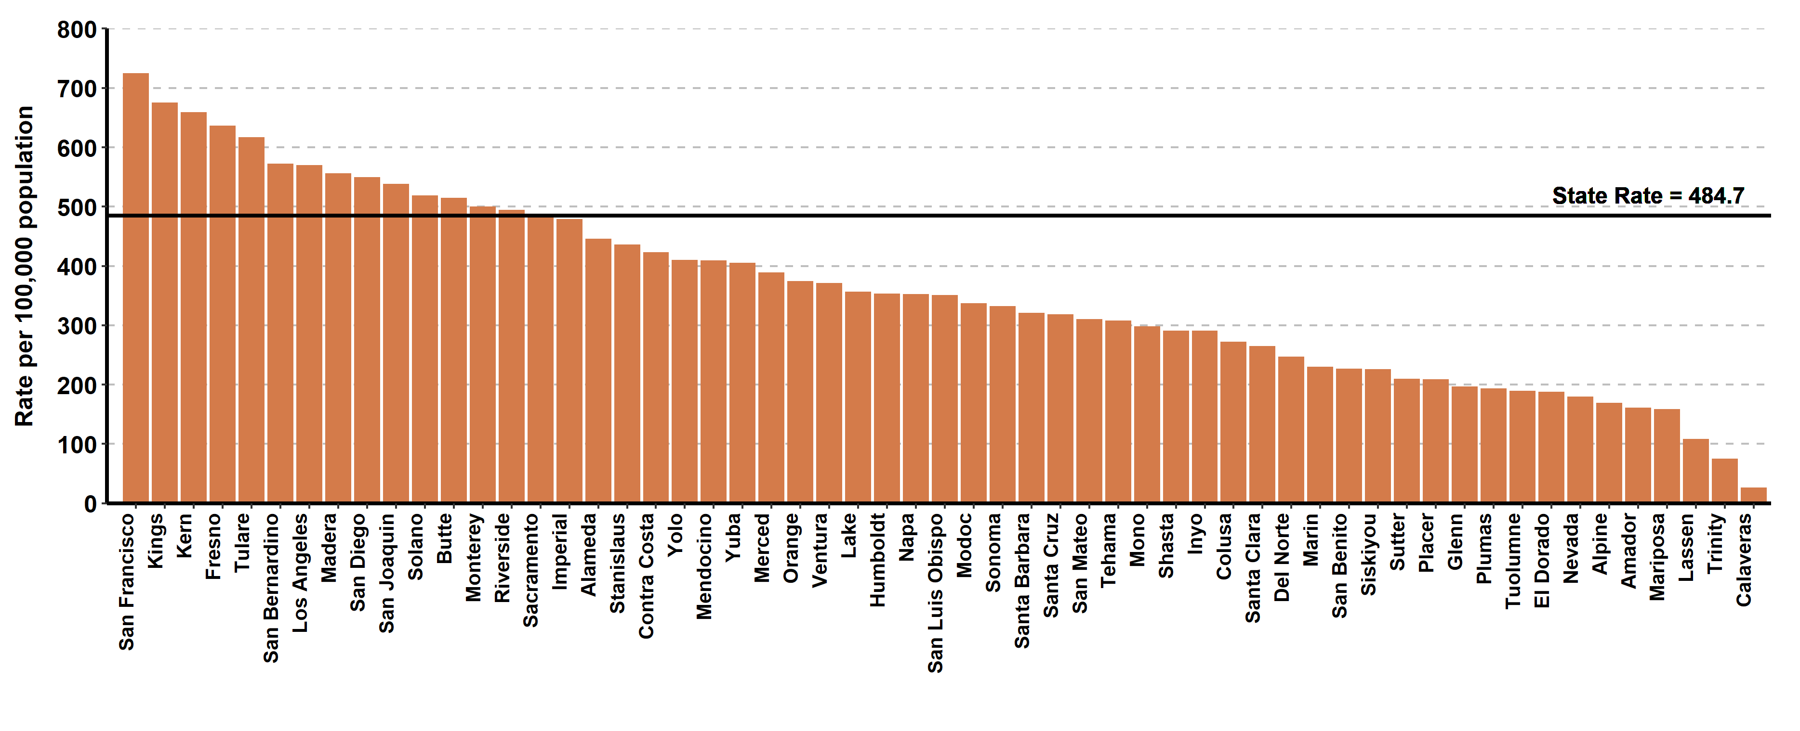
Chlamydia, Ranked Incidence Rates by County, California, 2021
This figure excludes counties with zero cases (1 county had zero cases in 2021)

Slide 15
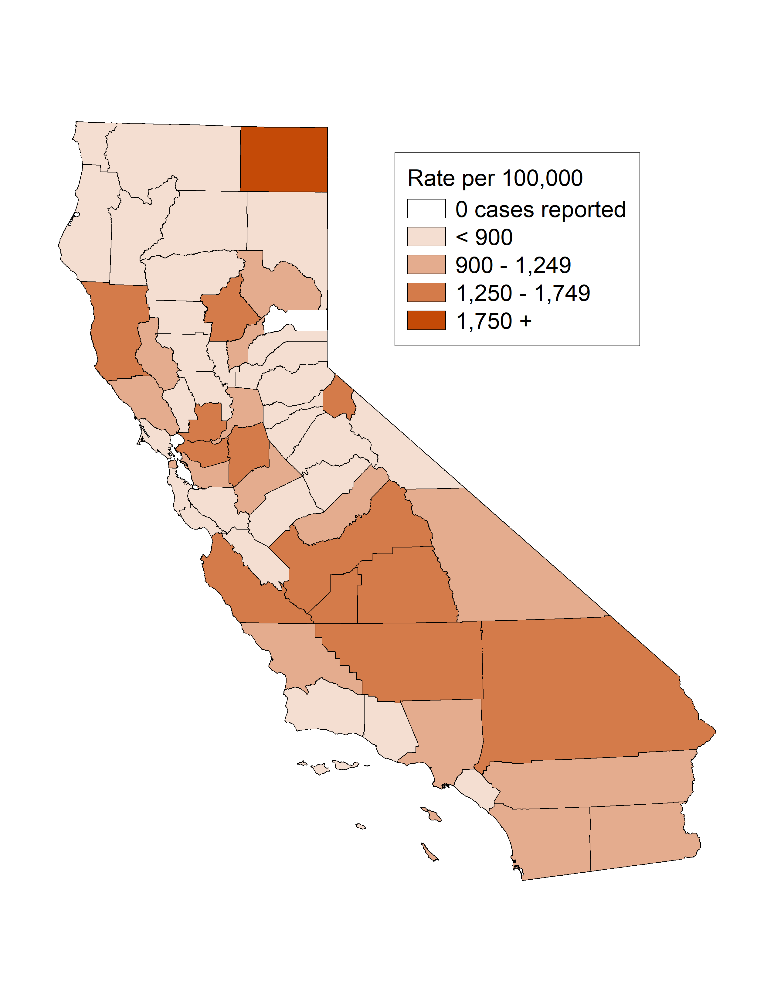
Chlamydia among Youth Ages 15-19, Incidence Rates by County, California, 2021

Slide 16
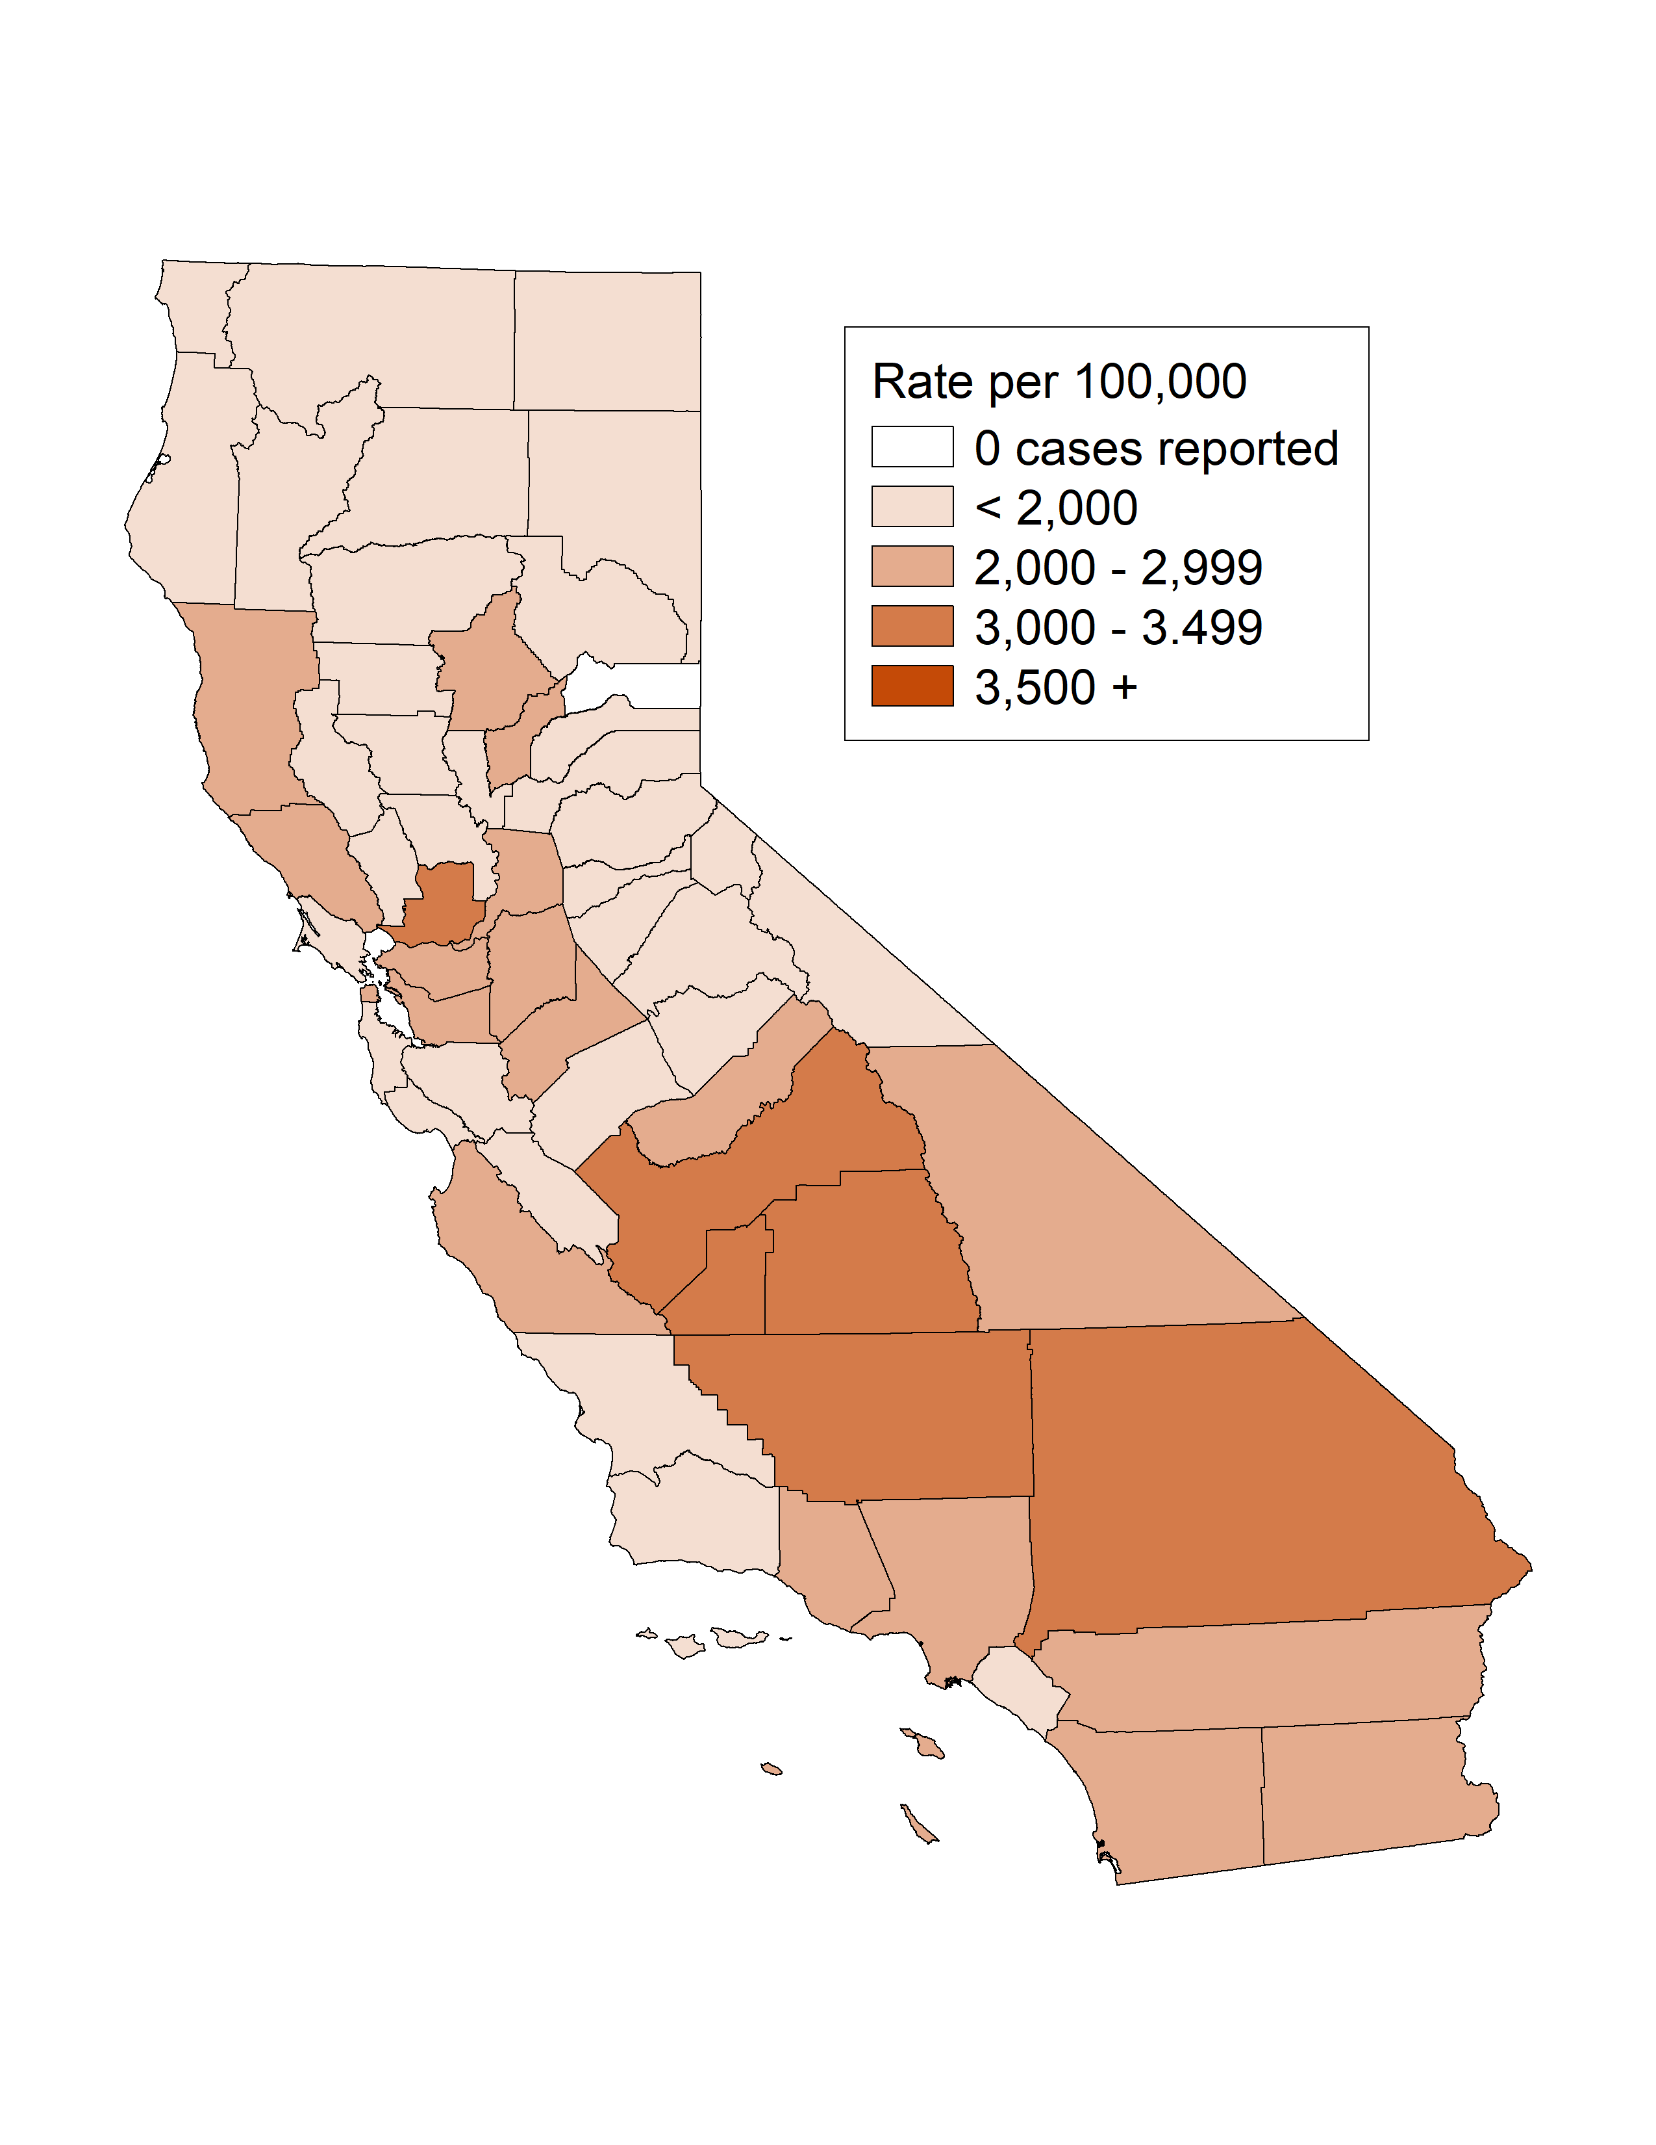
Chlamydia among Females Ages 15-24, Incidence Rates by County, California, 2021

Slide 17
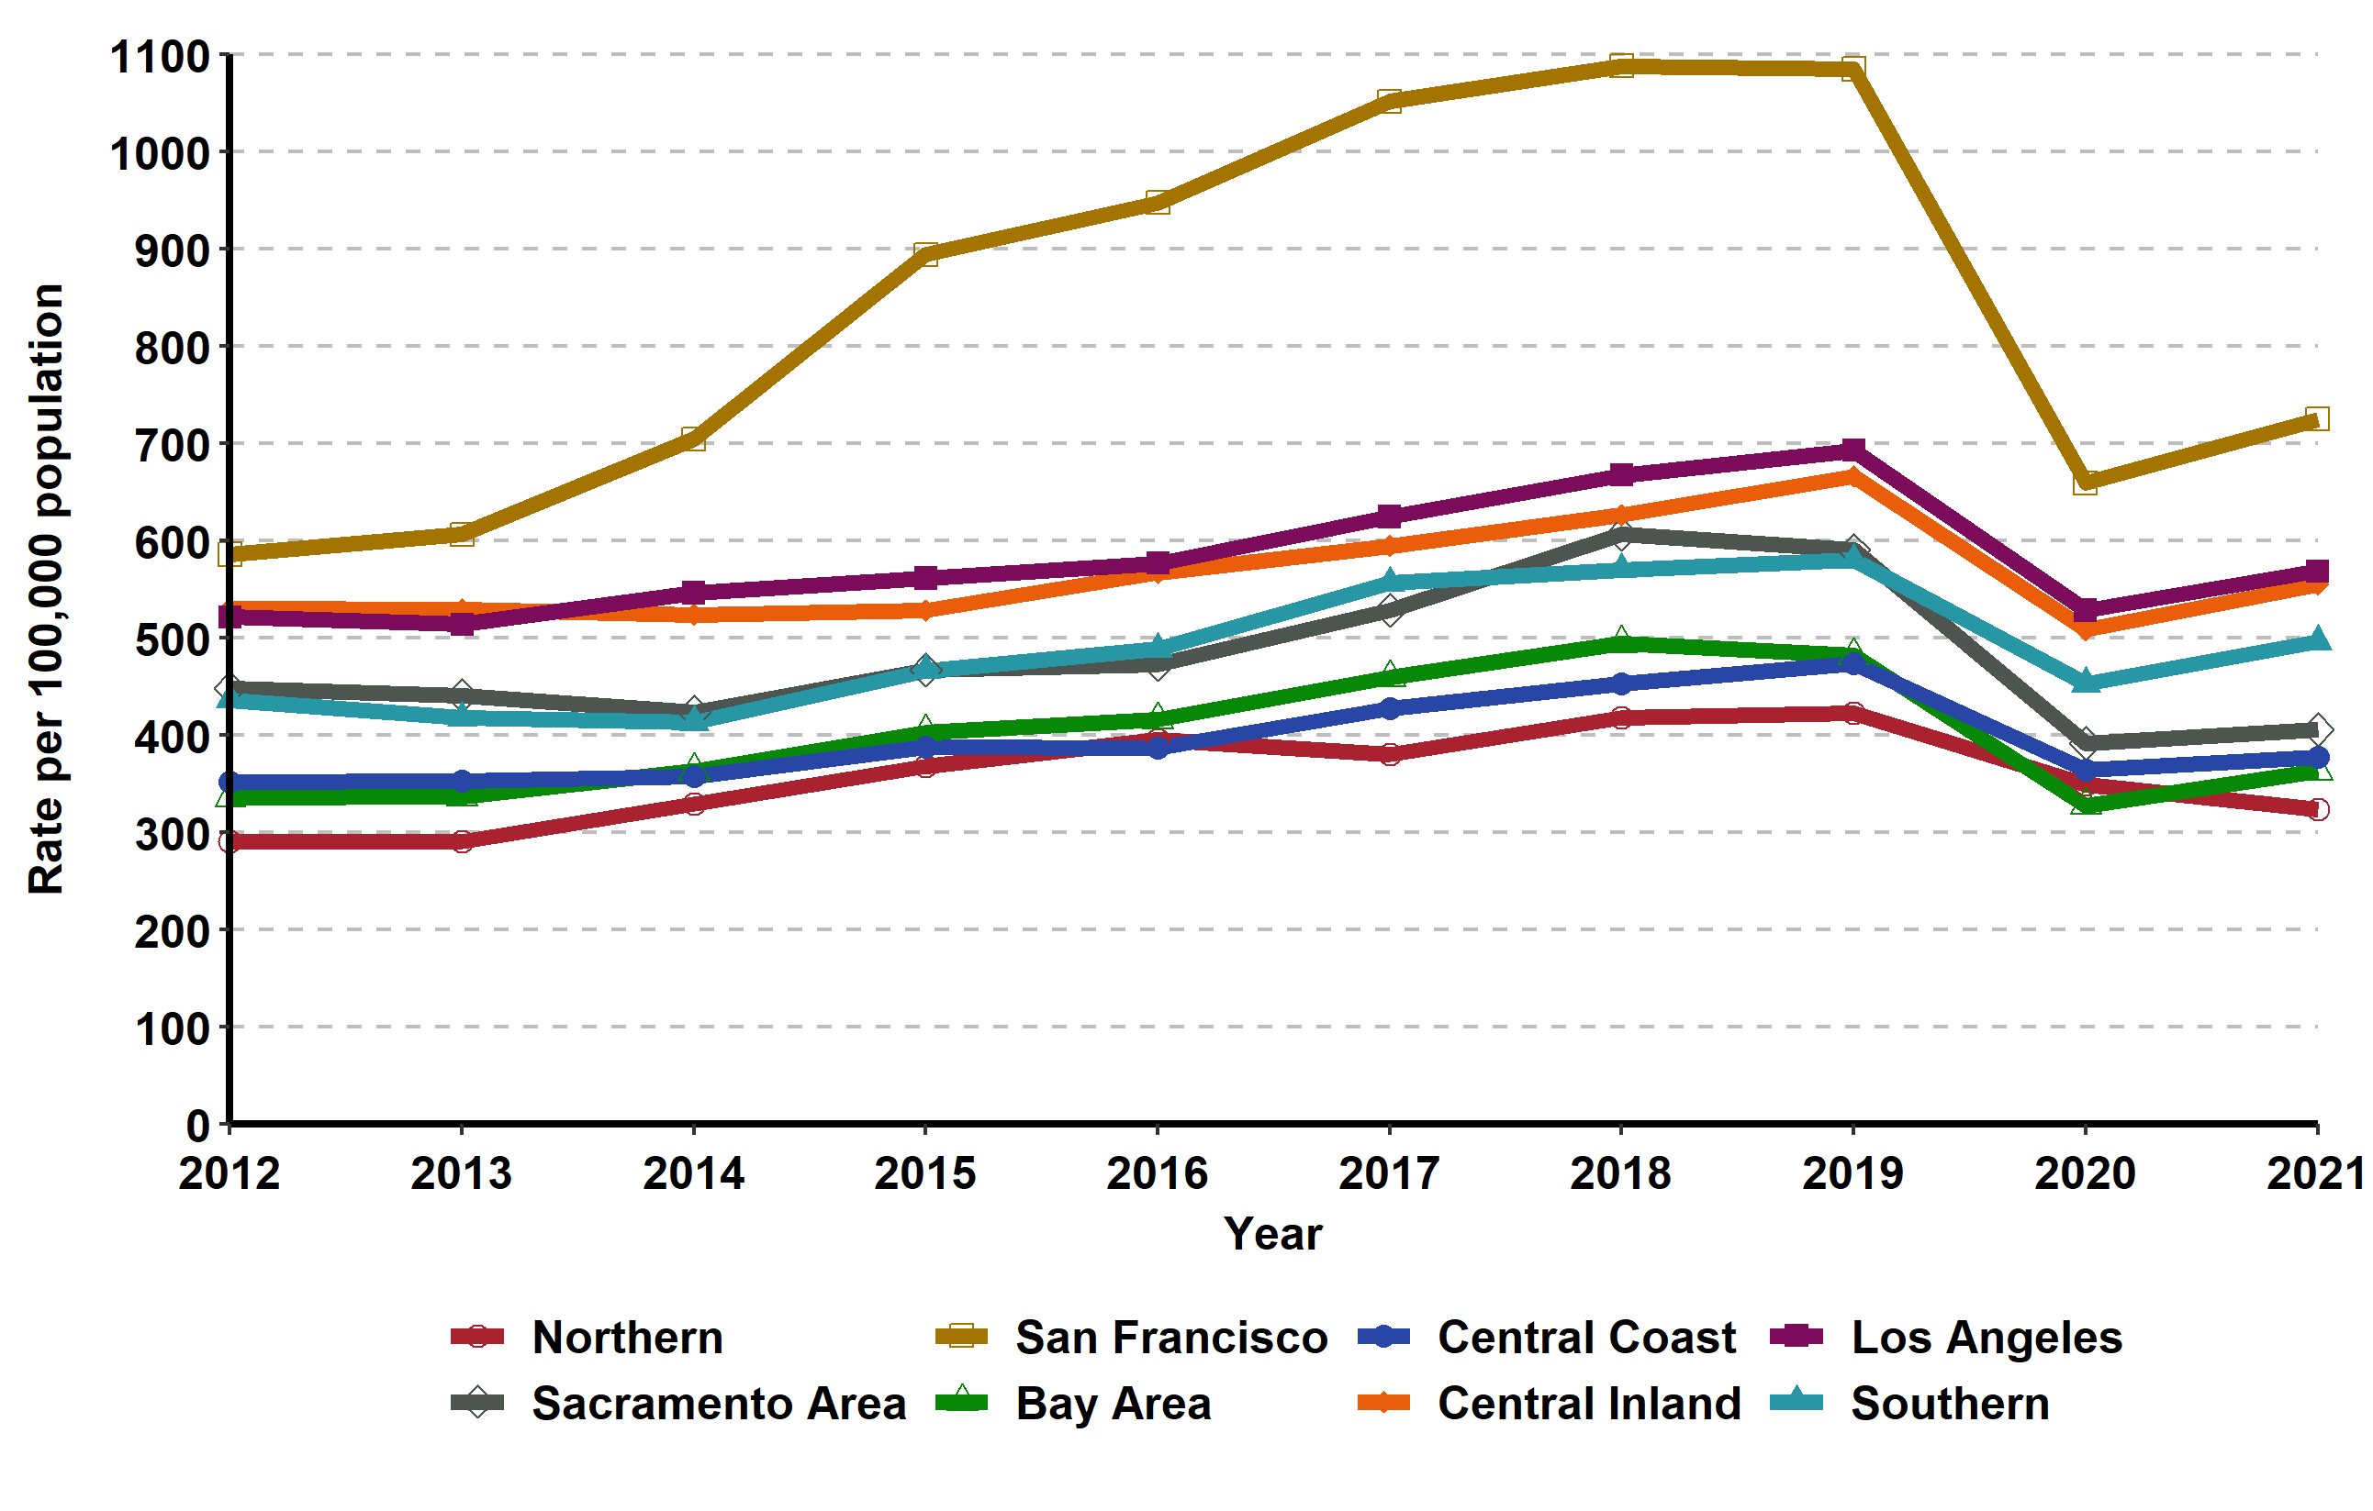
Chlamydia, Incidence Rates by Region, California, 2012–2021

Slide 18
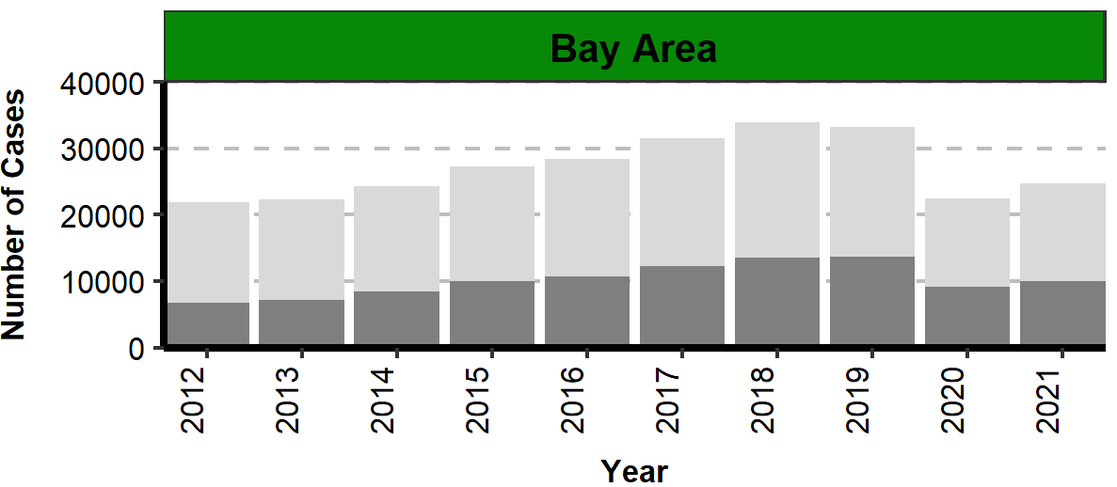
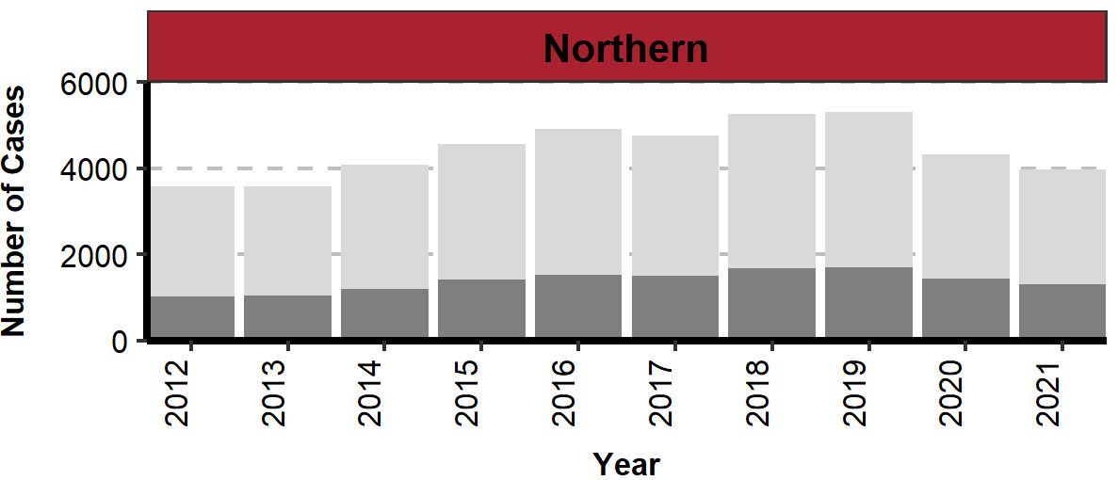
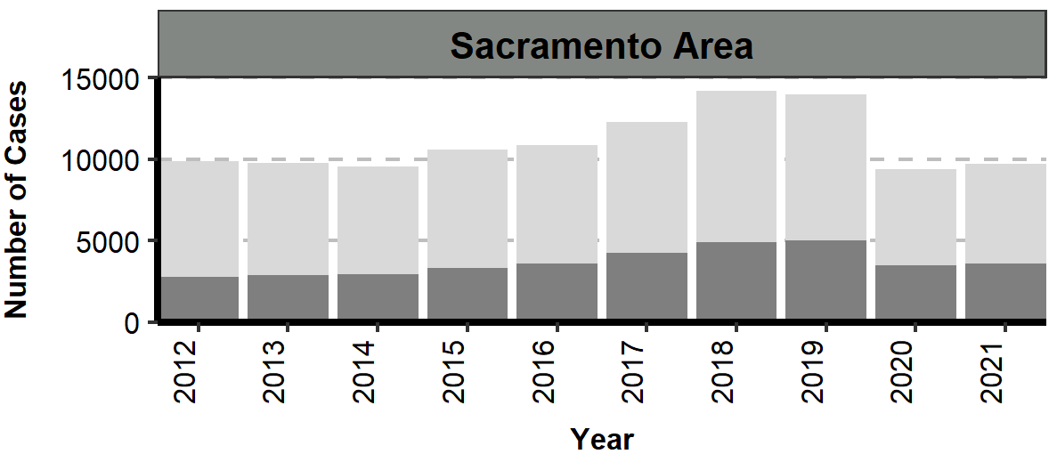
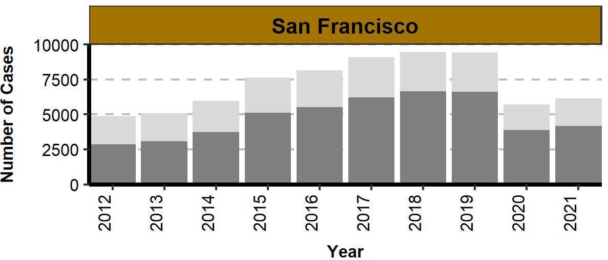
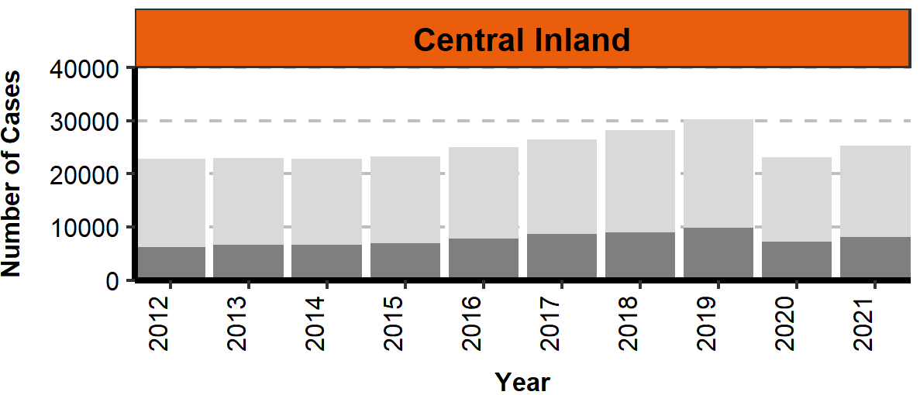
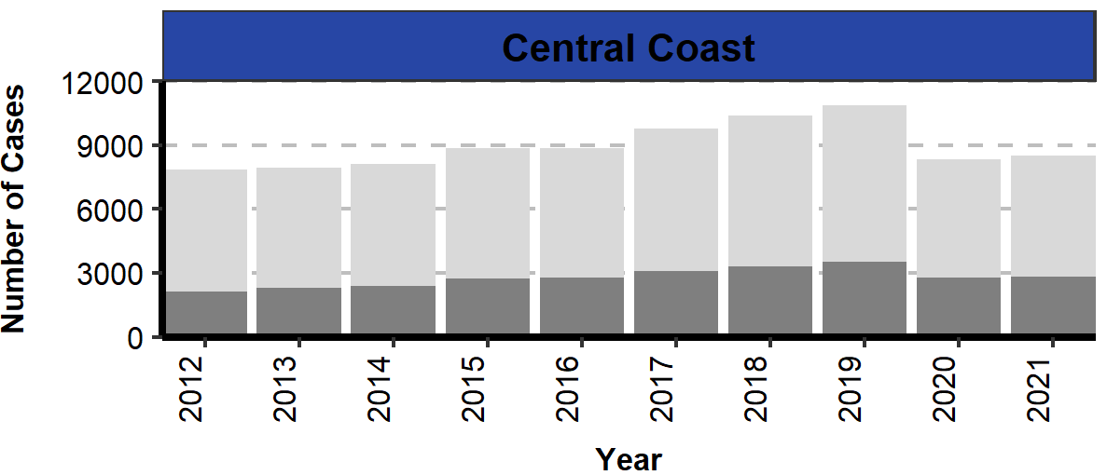
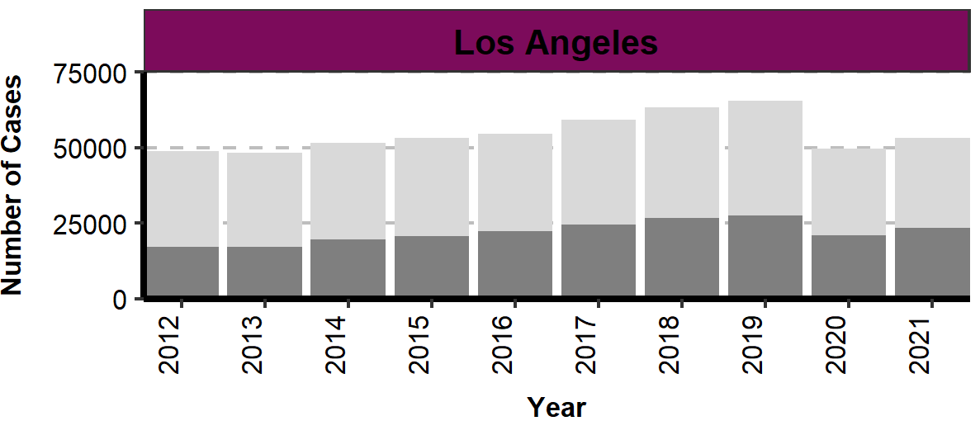
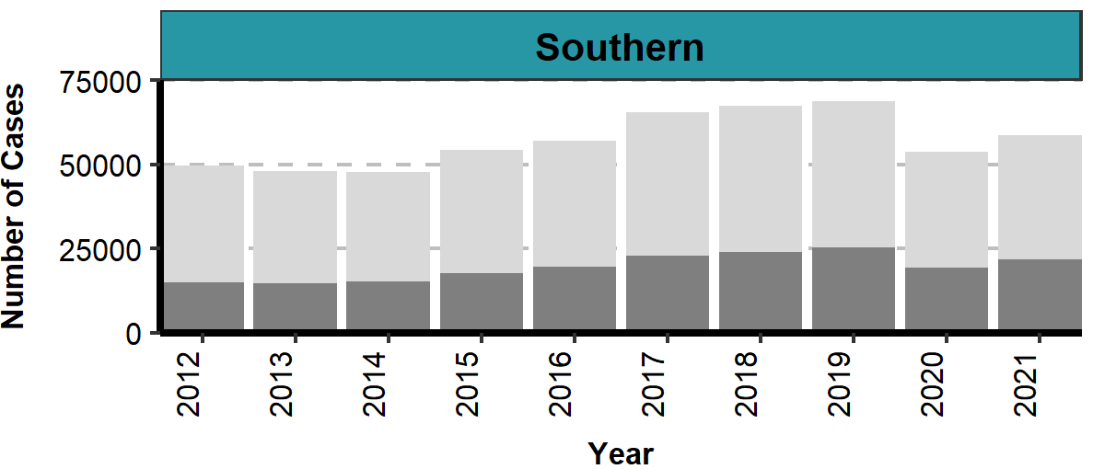
Number of Chlamydia Cases by Region, Gender, and Year, California, 2012–2021

Slide 19
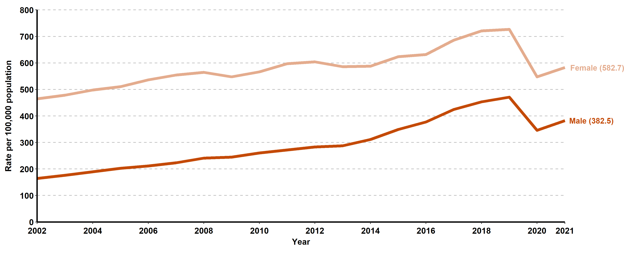
Chlamydia, Incidence Rates by Gender, California, 2002–2021
Screening guidelines recommend routine screening for specific populations, therefore higher rates of reported cases may in part reflect the targeted nature of screening programs.

Slide 20
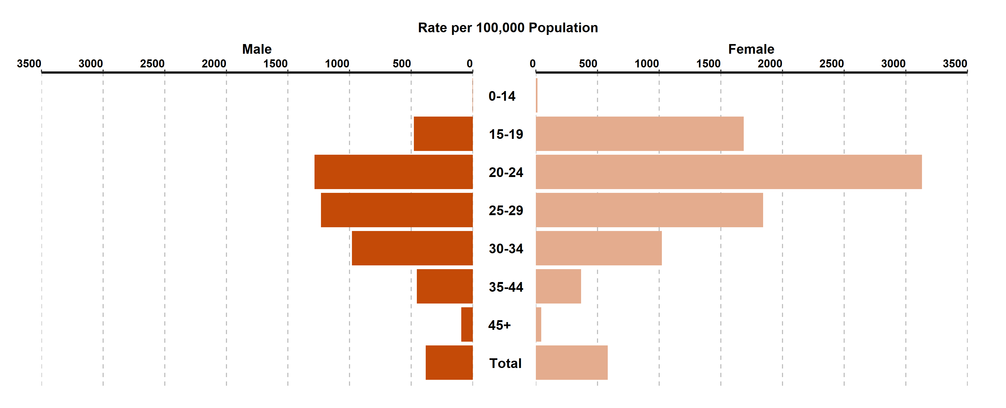
Chlamydia, Incidence Rates by Age Group (in years) and Gender, California, 2021
Age was “Not Specified” for 0.09% of female cases and 0.11% of male cases in 2021.
Screening guidelines recommend routine screening for specific populations, therefore higher rates of reported cases may in part reflect the targeted nature of screening programs.

Slide 21
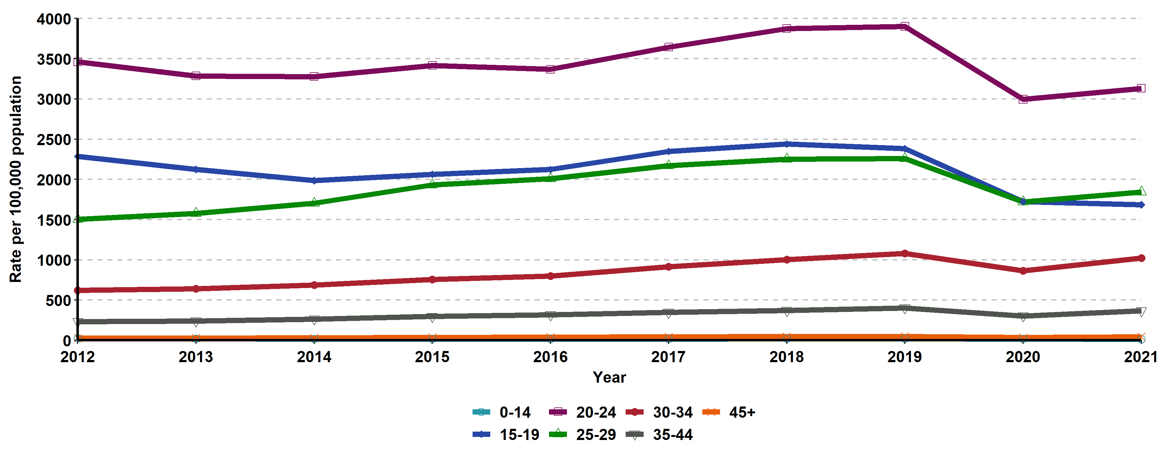
Chlamydia, Incidence Rates for Females by Age Group (in years), California, 2012–2021
Age “Not Specified” ranged from 0.09% to 0.38% of cases for females in any given year.

Slide 22
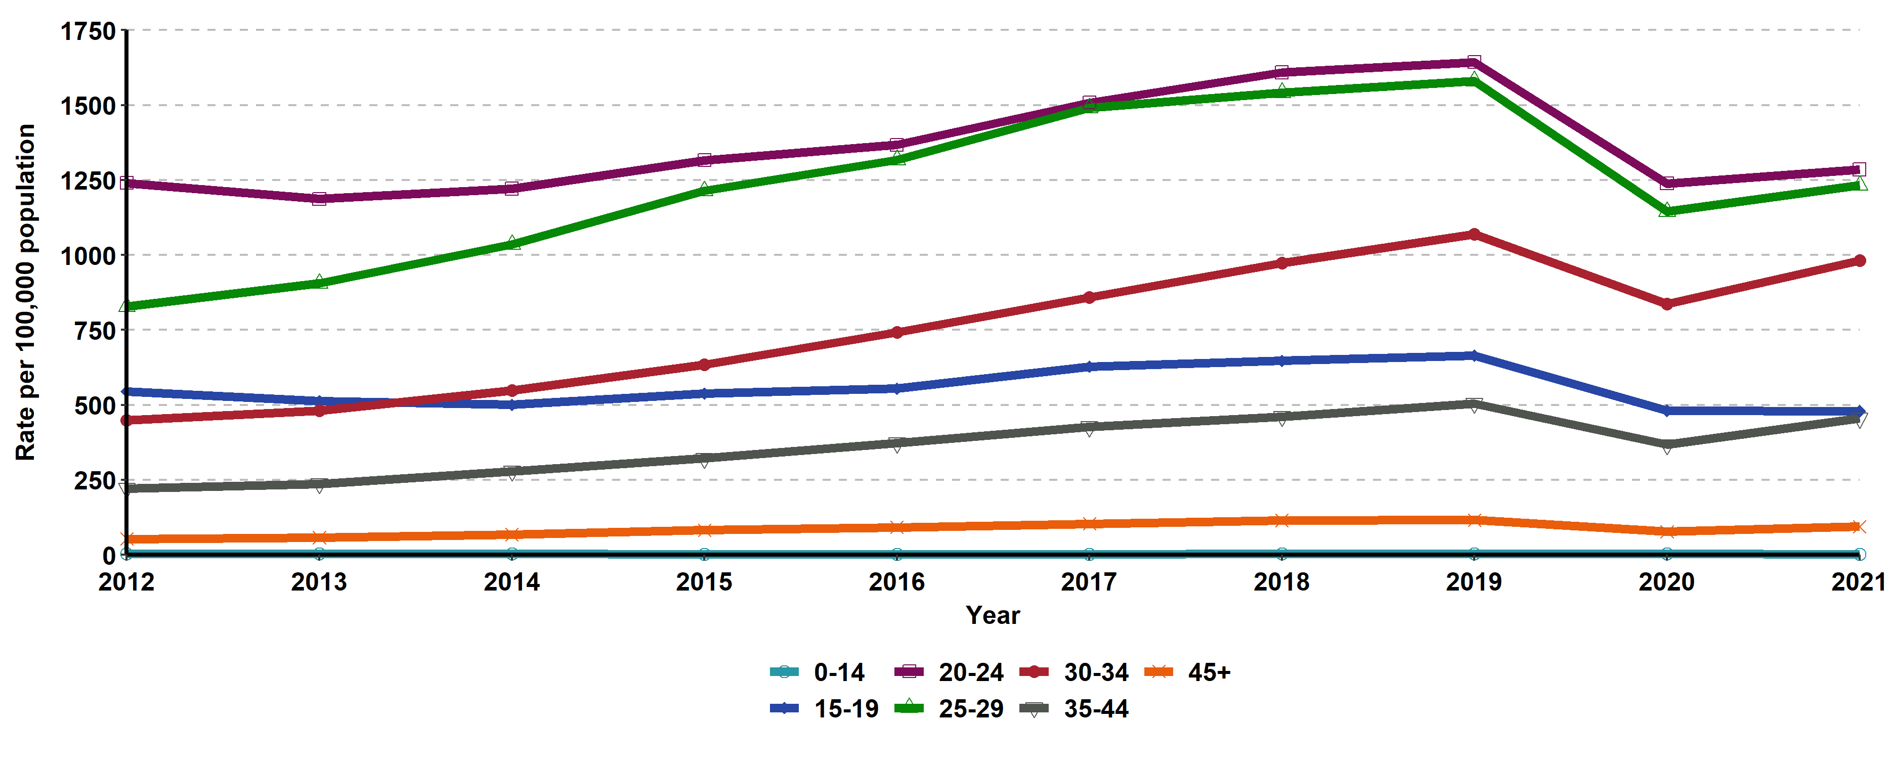
Chlamydia, Incidence Rates for Males by Age Group (in years),
California, 2012–2021
Age “Not Specified” ranged from 0.11% to 0.51% of cases for males in any given year.

Slide 23
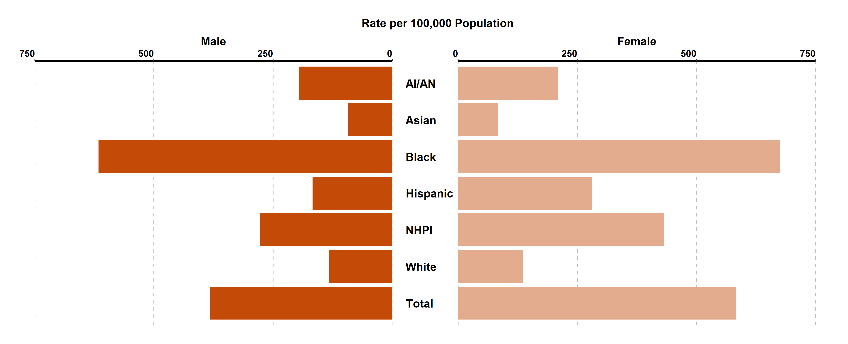
Chlamydia, Incidence Rates by Race/Ethnicity and Gender,
California, 2021
AI/AN = American Indian/Alaska Native, NHPI = Native Hawaiian/ Other Pacific Islander
Race/Ethnicity was “Not Specified” for 54.25% of female cases and 47.12% of male cases in 2021.
Screening guidelines recommend routine screening for specific populations, therefore higher rates of reported cases may in part reflect the targeted nature of screening programs.

Slide 24
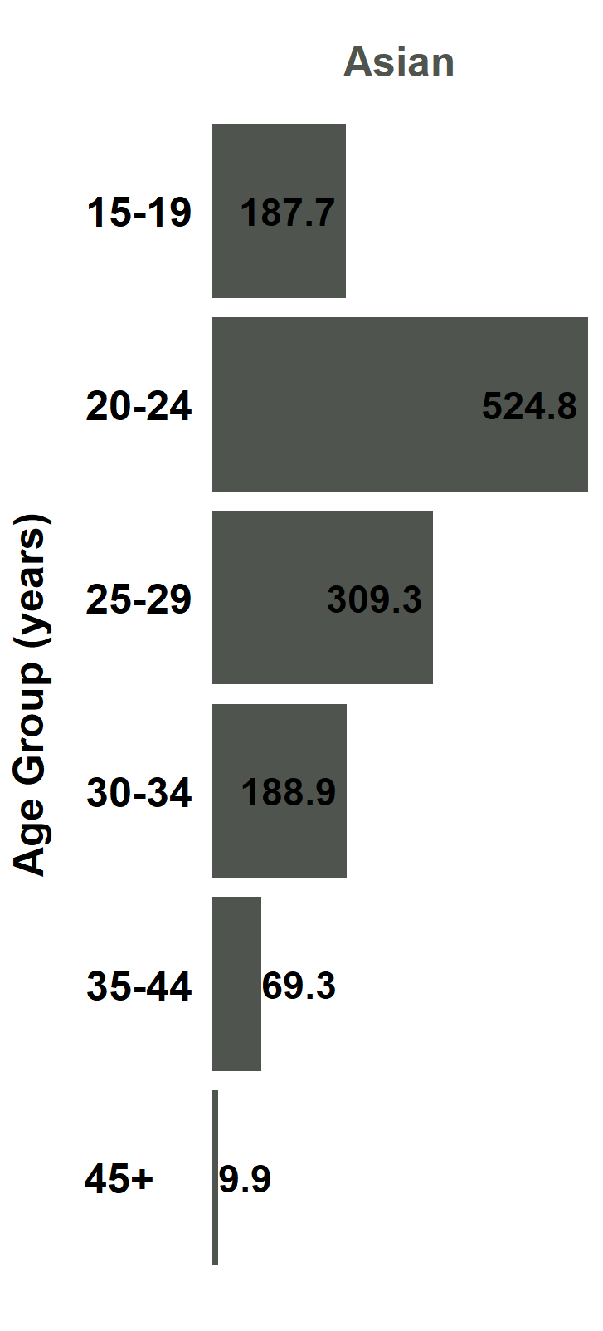
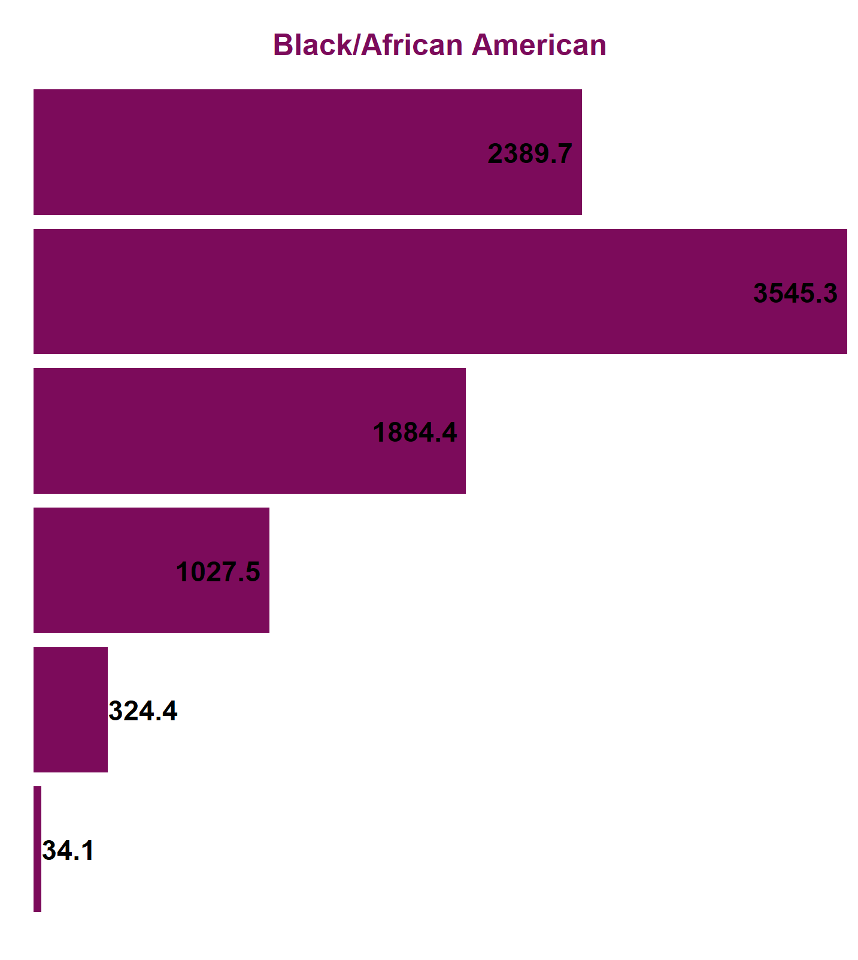
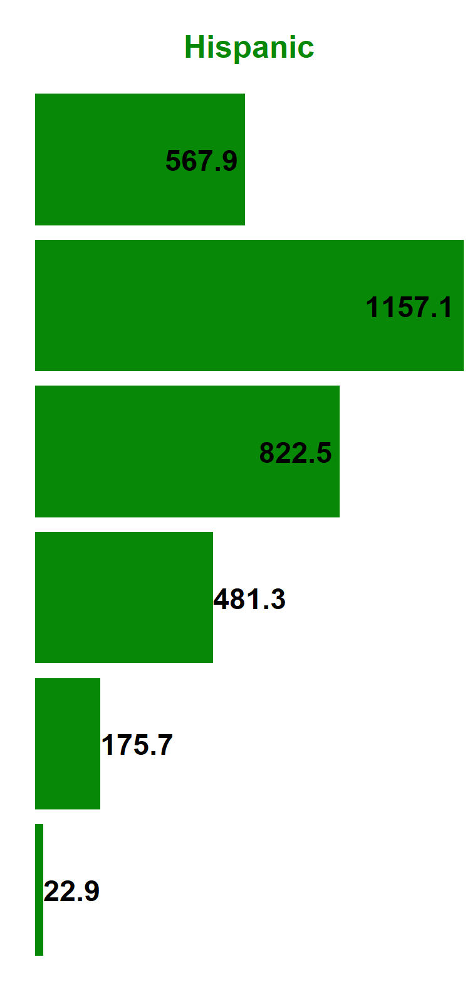
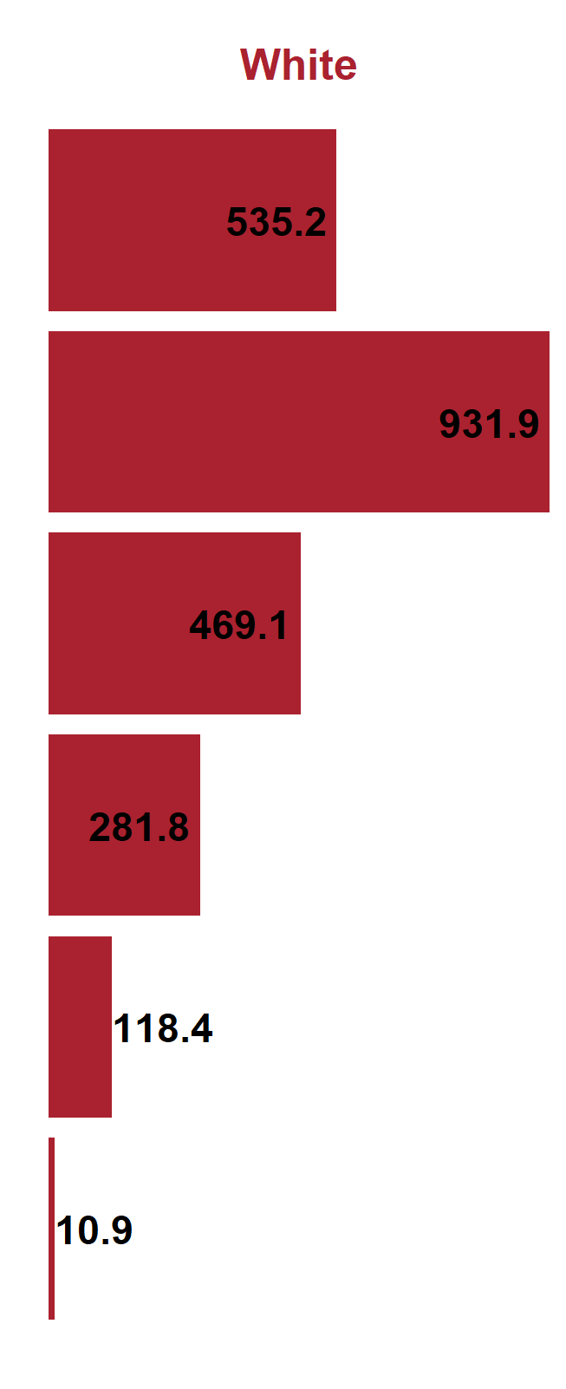
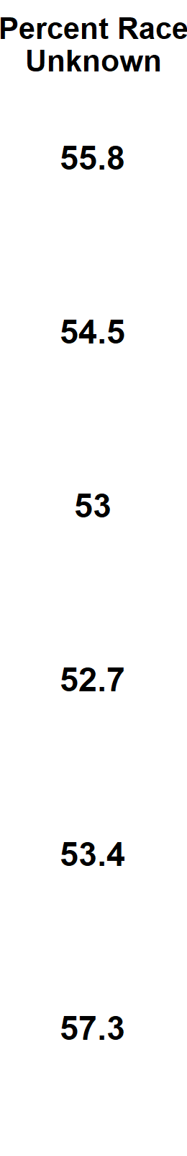
Chlamydia, Female Incidence Rates by Race/Ethnicity and Age Group (in years), California, 2021
American Indian/Alaska Native and Native Hawaiian/ Other Pacific Islander and race-specific data for ages 0-14 were suppressed as per agency Data De-Identification Guidelines (DDG).

Slide 25
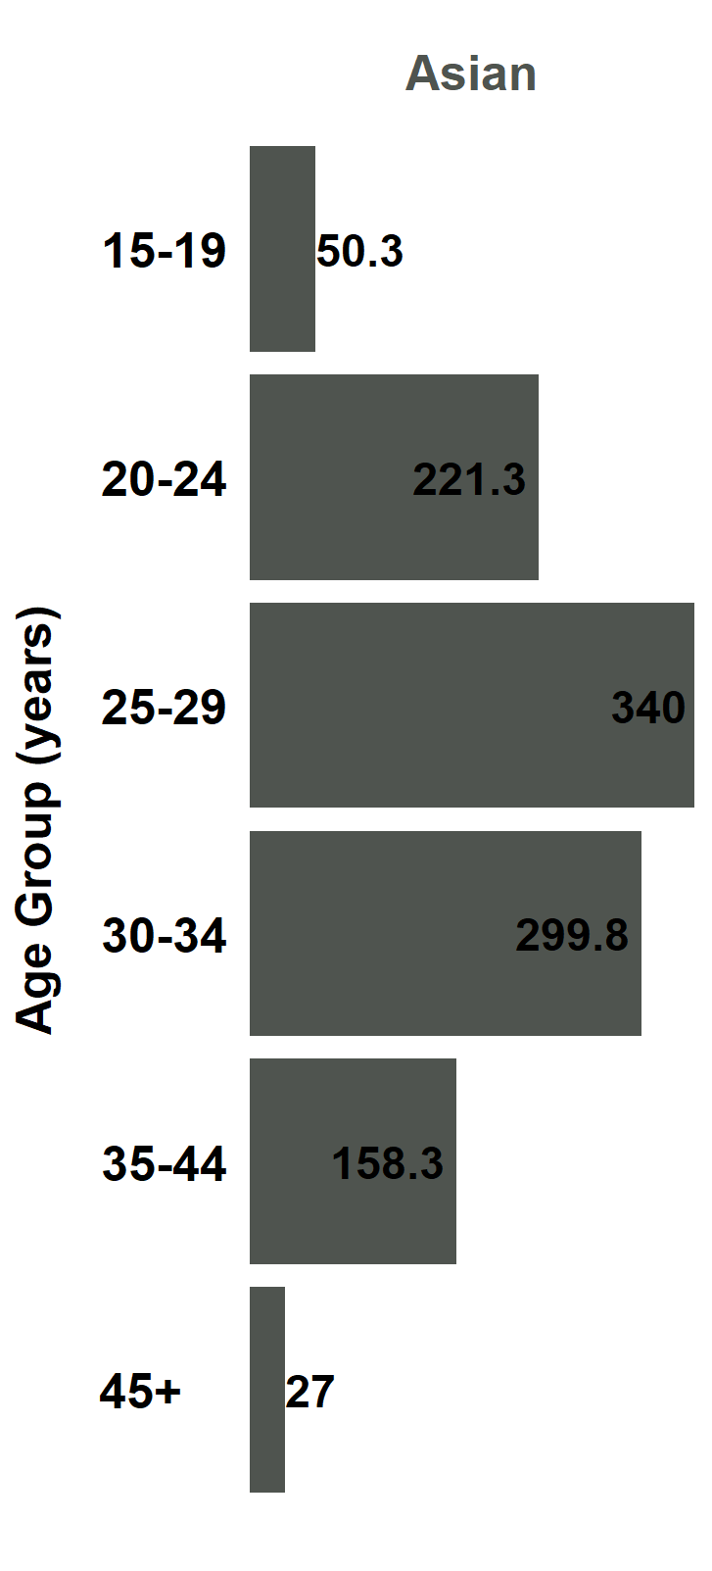
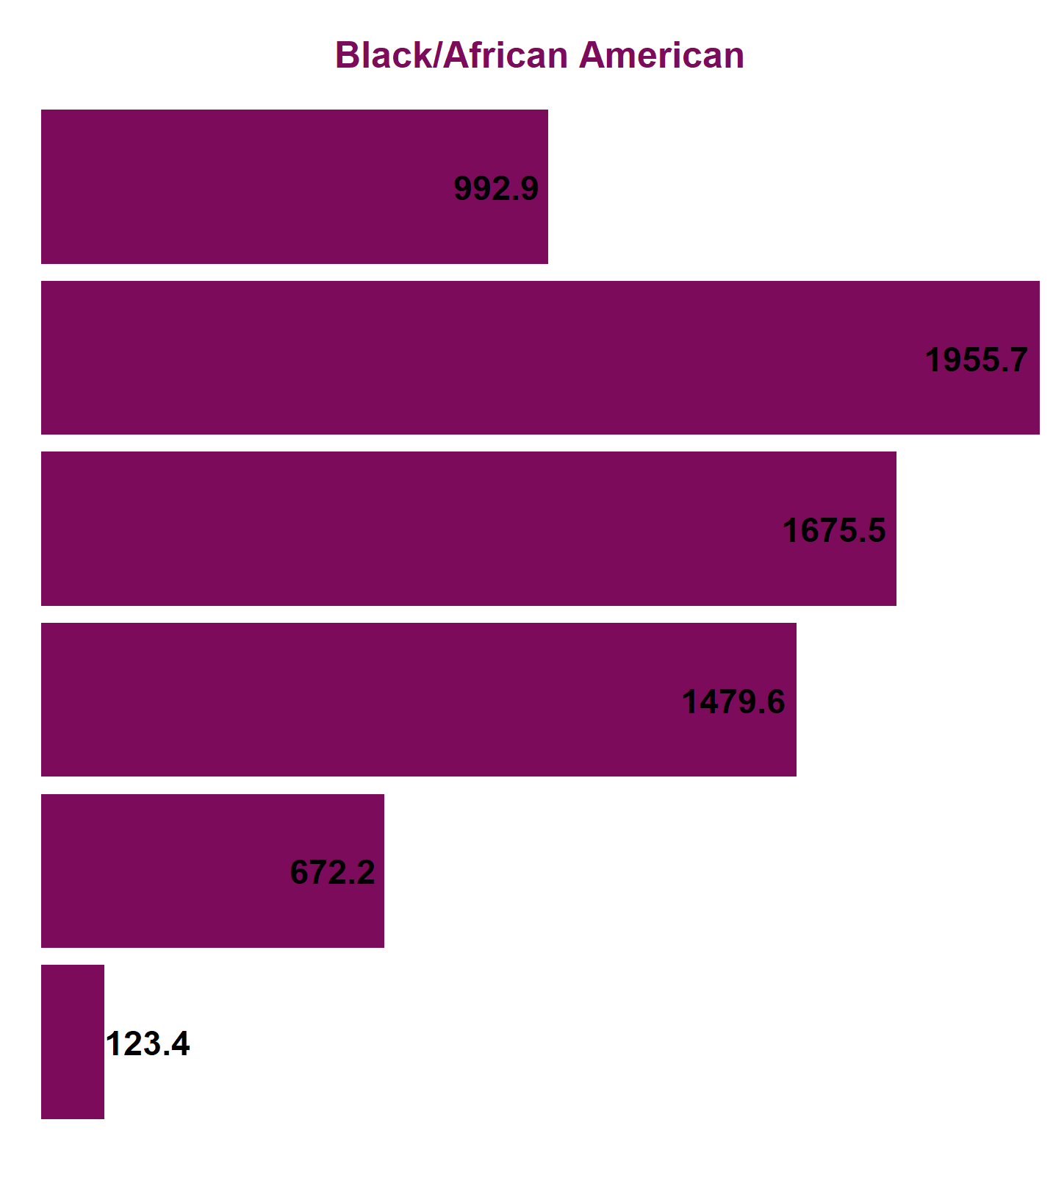
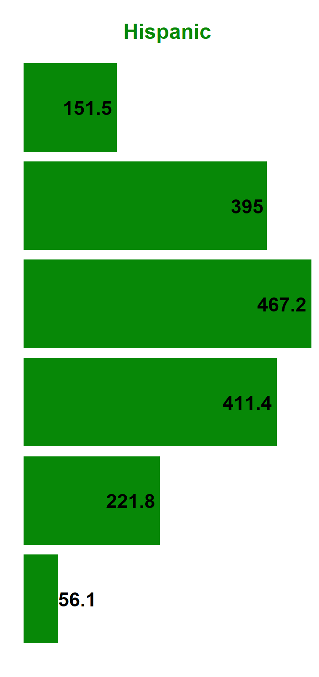
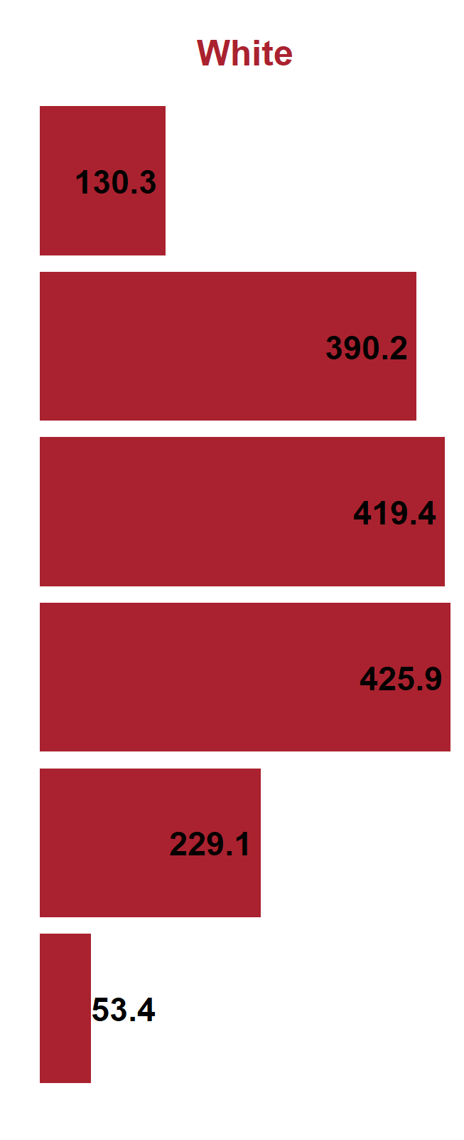
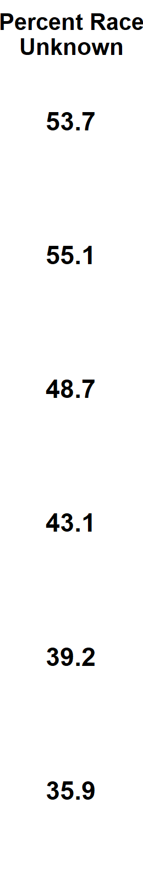
Chlamydia, Male Incidence Rates by Race/Ethnicity and Age Group (in years), California, 2021
American Indian/Alaska Native and Native Hawaiian/ Other Pacific Islander and race-specific data for ages 0-14 were suppressed as per agency Data De-Identification Guidelines (DDG).

Slide 26
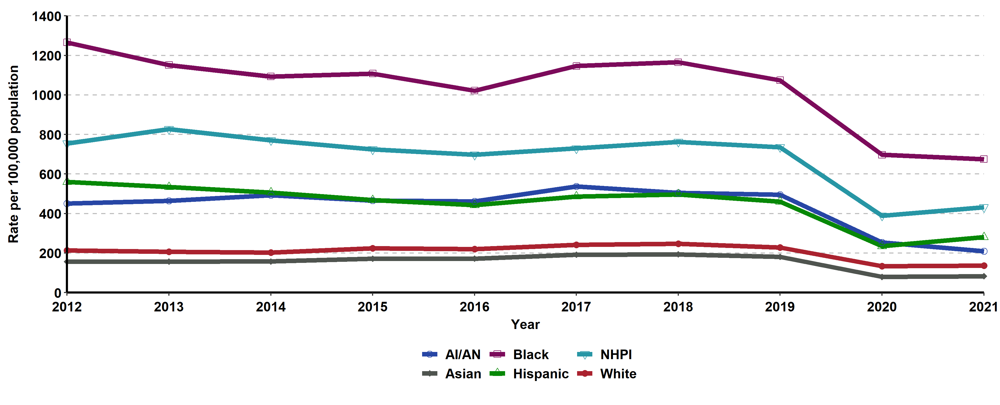
Chlamydia, Incidence Rates for Females by Race/Ethnicity,
California, 2012–2021
AI/AN = American Indian/Alaska Native, NHPI = Native Hawaiian/ Other Pacific Islander.
Race/ethnicity “Not Specified” ranged from 32.35% to 55.68% of cases for females in any given year.

Slide 27
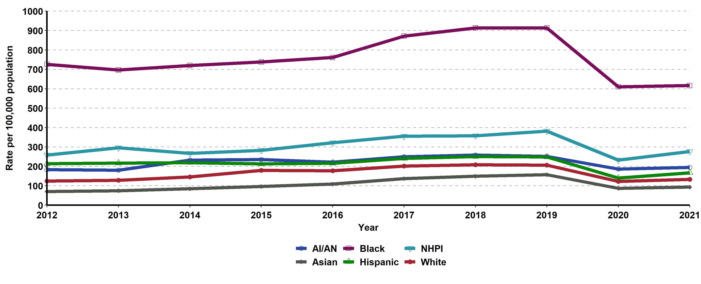
Chlamydia, Incidence Rates for Males by Race/Ethnicity,
California, 2012–2021
AI/AN = American Indian/Alaska Native, NHPI = Native Hawaiian/ Other Pacific Islander.
Race/ethnicity “Not Specified” ranged from 29.37% to 47.76% of cases for males in any given year.

Slide 28
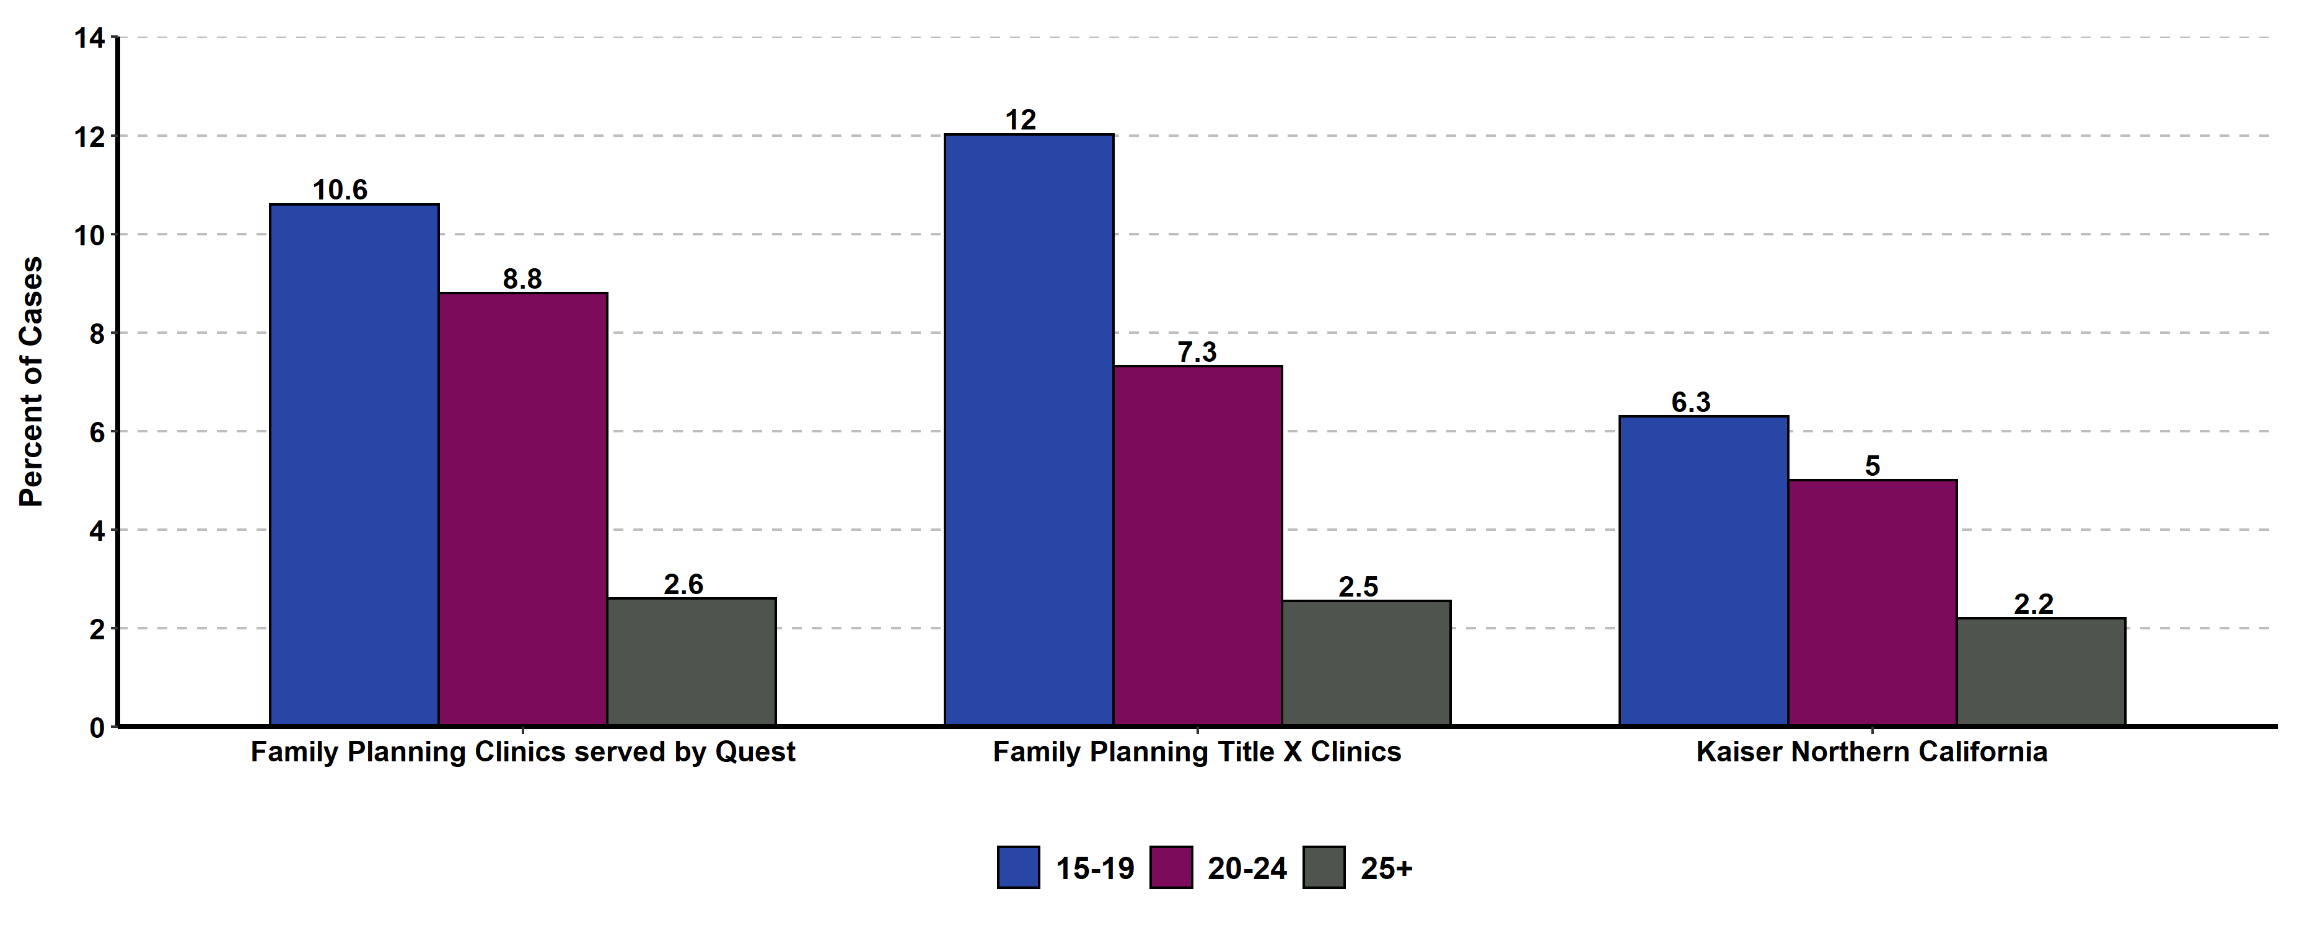
Chlamydia Prevalence Monitoring, Percent Positive for Females of Selected Age Groups, by Health Care Setting, California, 2021
Sources: Kaiser Permanente Northern California, Essential Access Health, Quest Diagnostics

Slide 29
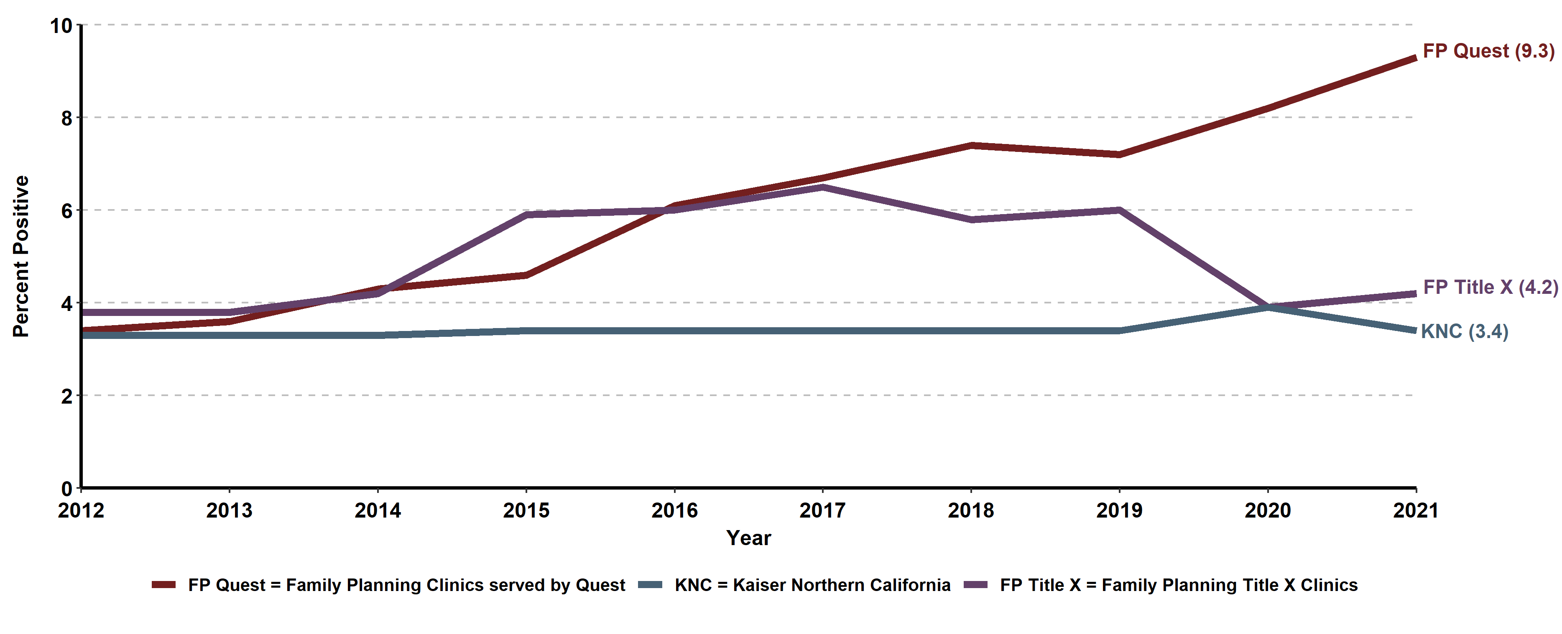
Chlamydia Prevalence Monitoring, Percent Positive for Females, by
Health Care Setting, California, 2012-2021
Sources: Kaiser Permanente Northern California, Essential Access Health, Quest Diagnostics

Slide 30
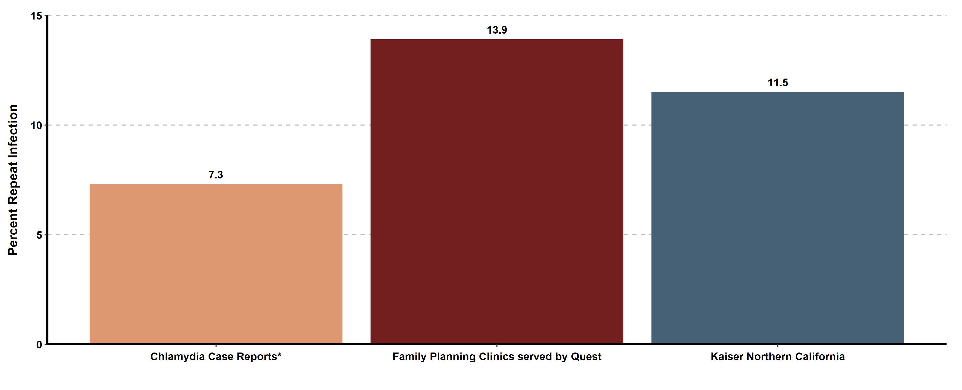
Chlamydia Repeat Infection among Females 1-6 Months after Infection, by Data Source, California, 2021
* Excludes Los Angeles and San Francisco local health jurisdictions

Slide 31
Gonorrhea
(Revised 02/2023)

Slide 32
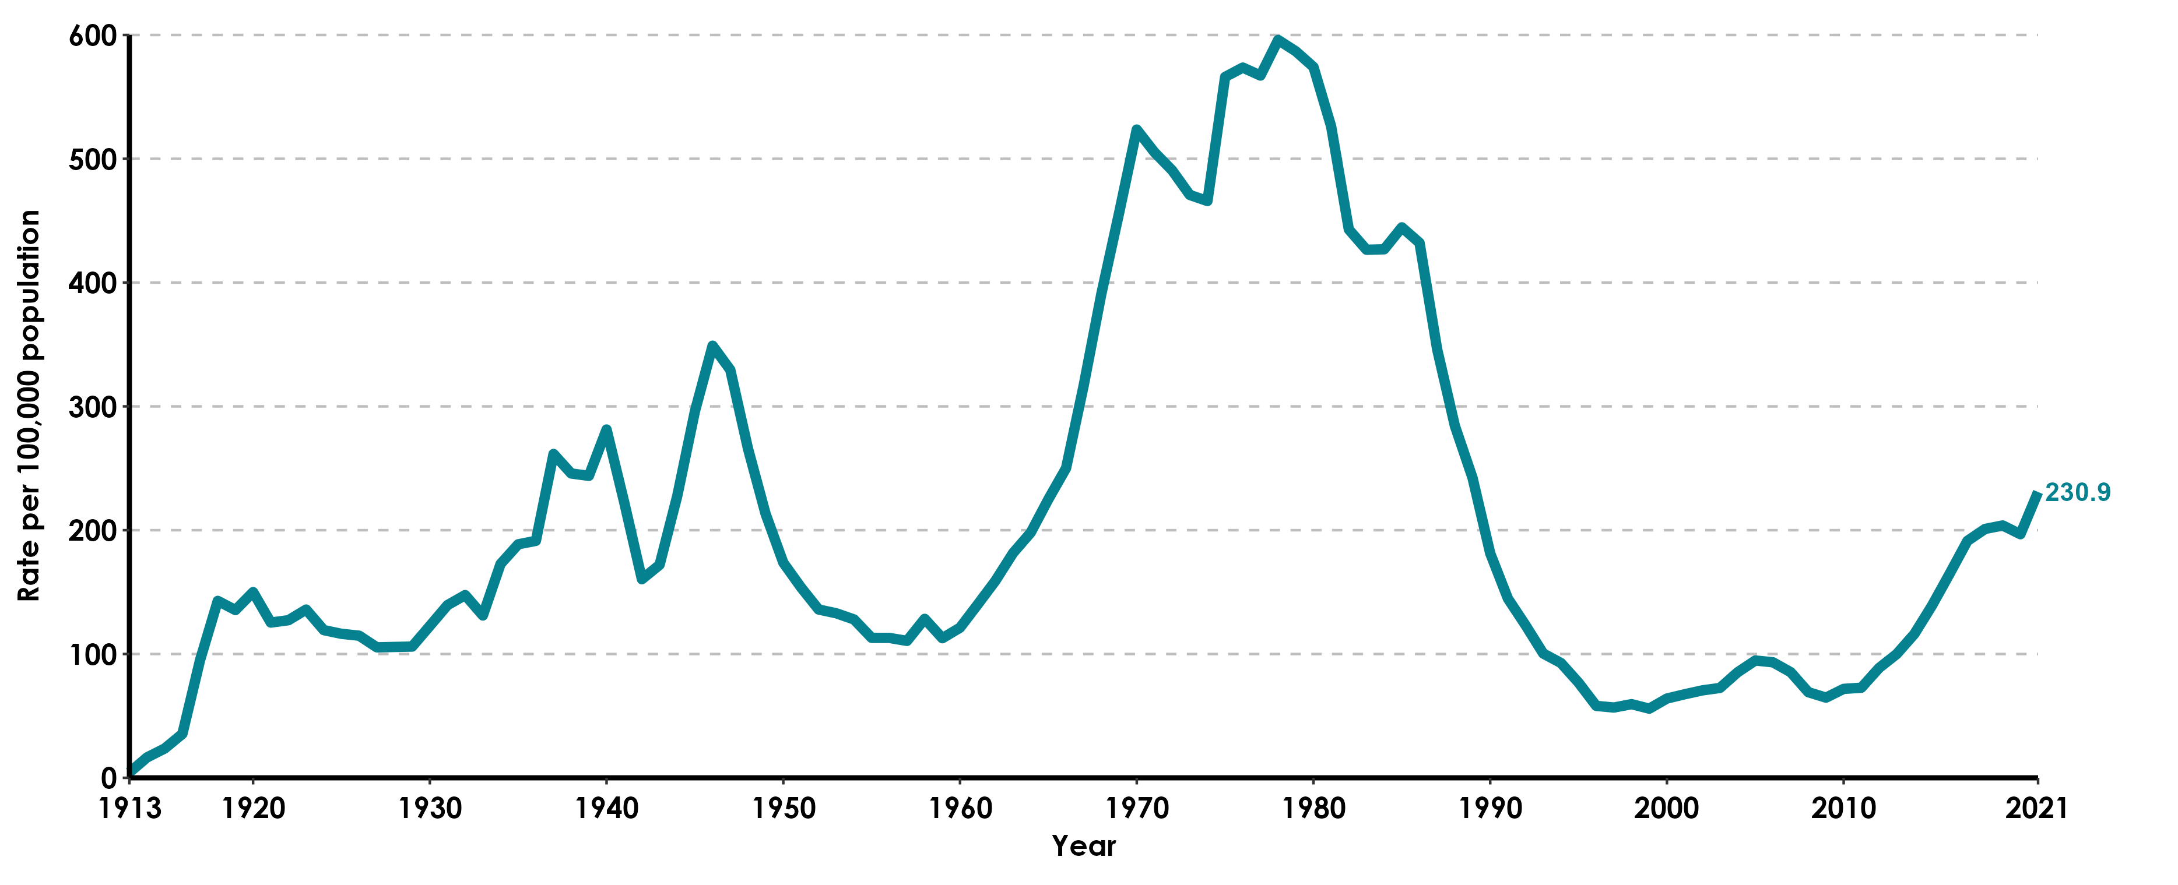
Gonorrhea, California Incidence Rates, 1913–2021

Slide 33
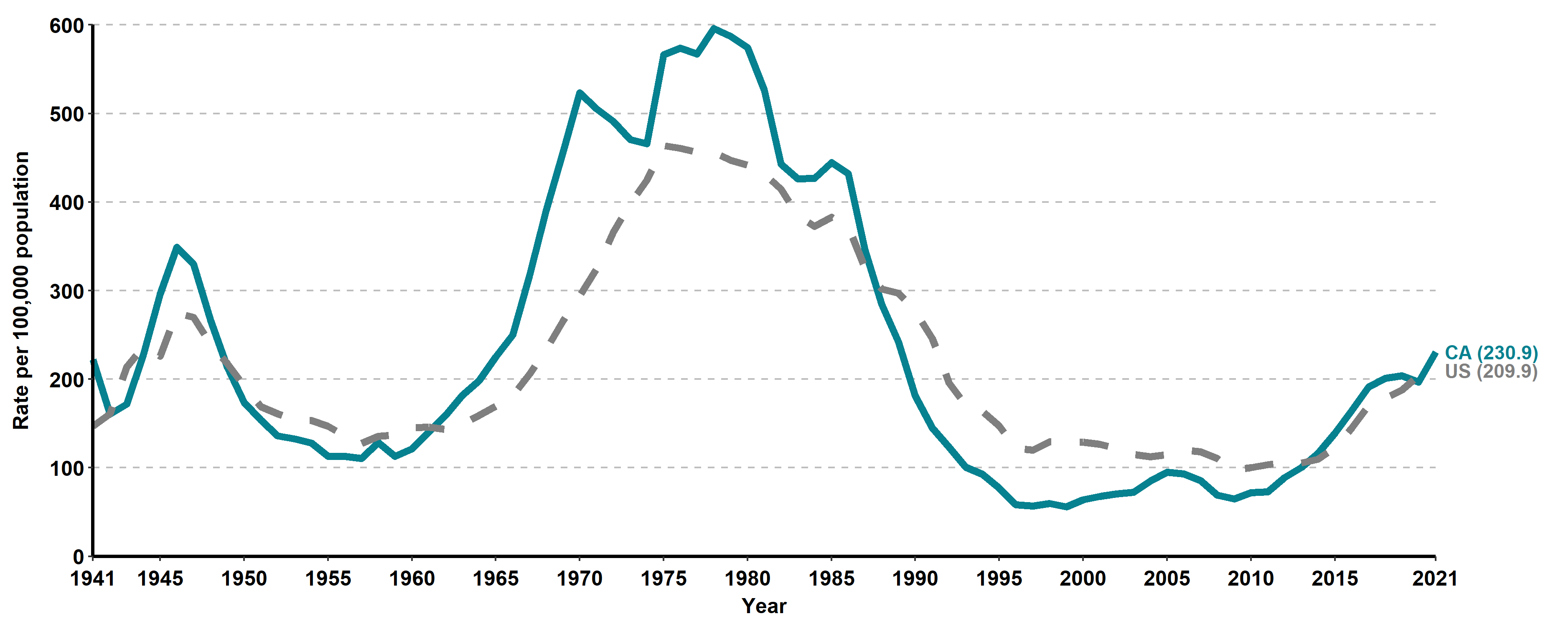
Gonorrhea, California versus United States
Incidence Rates, 1941–2021

Slide 34
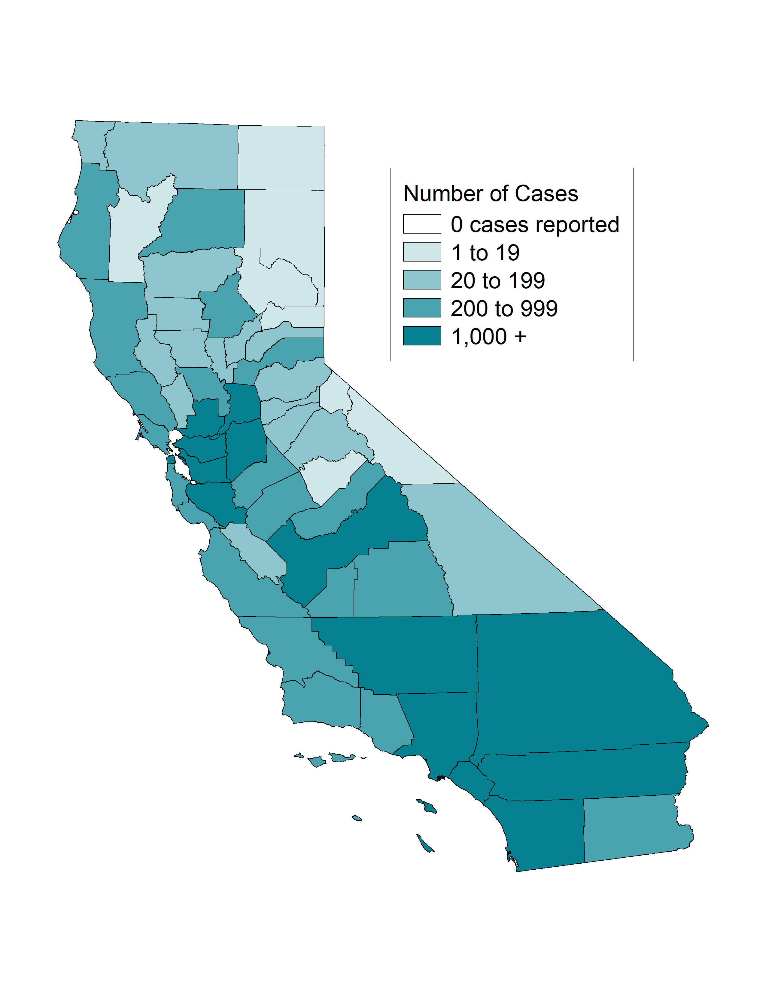
Gonorrhea, Case Counts and Incidence Rates by County, California, 2021
Gonorrhea Cases
Gonorrhea Rates

Slide 35

Gonorrhea, Ranked Incidence Rates by County, California, 2021
This figure excludes counties with zero cases (0 counties had zero cases in 2021)

Slide 36

Gonorrhea among Youth Ages 15-19, Incidence Rates by County, California, 2021

Slide 37

Gonorrhea among Females Ages 15-24, Incidence Rates by County, California, 2021

Slide 38

Gonorrhea, Incidence Rates by Region, California, 2012–2021

Slide 39








Number of Gonorrhea Cases by Region, Gender, and Year
California, 2012–2021

Slide 40

Gonorrhea, Incidence Rates by Gender, California, 2002–2021

Slide 41

Gonorrhea, Incidence Rates by Age Group (in years) and Gender,
California, 2021
Age was “Not Specified” for 0.2% of female cases and 0.15% of male cases in 2021.

Slide 42

Gonorrhea, Incidence Rates for Females by Age Group (in years),
California, 2012–2021
Age “Not Specified” ranged from 0.14% to 0.45% of cases for females in any given year.

Slide 43

Gonorrhea, Incidence Rates for Males by Age Group (in years),
California, 2012–2021
Age “Not Specified” ranged from 0.1% to 0.57% of cases for males in any given year.

Slide 44

Gonorrhea, Incidence Rates by Race/Ethnicity and Gender,
California, 2021
AI/AN = American Indian/Alaska Native, NHPI = Native Hawaiian/Other Pacific Islander.
Race/Ethnicity was “Not Specified” for 35.24% of female cases and 30.51% of male cases in 2021.

Slide 45





Gonorrhea, Female Incidence Rates by Race/Ethnicity and Age Group (in years), California, 2021
American Indian/Alaska Native and Native Hawaiian/ Other Pacific Islander and race-specific data for ages 0-14 were suppressed as per agency Data De-Identification Guidelines (DDG).

Slide 46





Gonorrhea, Male Incidence Rates by Race/Ethnicity and Age Group (in years), California, 2021
American Indian/Alaska Native and Native Hawaiian/ Other Pacific Islander and race-specific data for ages 0-14 were suppressed as per agency Data De-Identification Guidelines (DDG).

Slide 47

Gonorrhea, Incidence Rates for Females by Race/Ethnicity,
California, 2012–2021
AI/AN = American Indian/Alaska Native; NHPI = Native Hawaiian/Other Pacific Islander.
Race/ethnicity “Not Specified” ranged from 21.4% to 35.24% of cases for females in any given year.

Slide 48

Gonorrhea, Incidence Rates for Males by Race/Ethnicity,
California, 2012–2021
AI/AN = American Indian/Alaska Native; NHPI = Native Hawaiian/Other Pacific Islander.
Race/ethnicity “Not Specified” ranged from 19.65% to 30.51% of cases for males in any given year.

Slide 49

Gonorrhea Prevalence Monitoring, Percent Positive for Females of Selected Age Groups, by Health Care Setting, California, 2021
Sources: Kaiser Permanente Northern California, Essential Access Health, Quest Diagnostics)

Slide 50

Gonorrhea Prevalence Monitoring, Percent Positive for Females, by
Health Care Setting, California, 2012-2021
FP Quest=Family Planning Clinics served by Quest, FP Title X = Family Planning Title X Clinics, KNC = Kaiser Northern California
Source: Kaiser Permanente Northern California, Essential Access Health, Quest Diagnostics

Slide 51

Gonorrhea Repeat Infection among Females 1-6 Months after Infection, by Data Source, California, 2021
* Excludes Los Angeles and San Francisco local health jurisdictions

Slide 52
California Gonococcal
Surveillance System (CGSS)
(Revised 02/2023)

Slide 53

California Gonococcal Surveillance System (CGSS), HIV Status among Sampled and Interviewed Men Who Had Sex with Men* Cases, California, 2021
* Includes men who had sex with men only and men who had sex with men and women
N does not include HIV status unknown or refused to state: 23 cases in 2021

Slide 54

California Gonococcal Surveillance System (CGSS), HIV PrEP Use among Sampled and Interviewed HIV Negative Men Who Had Sex with Men* Cases, California, 2021
* Includes men who had sex with men only and men who had sex with men and women
N does not include PrEP status unknown or refused to state: 5 cases in 2021

Slide 55

California Gonococcal Surveillance System (CGSS), Anatomic Site of Infection among Sampled and Interviewed Cases, by Gender and Gender of Sex Partners, California, 2021
Genital includes urine, urethral, and other unspecified “genital” sites.
MSM includes Men who had sex with Men only. MSMW includes Men who had sex with both Men and Women.
MSW includes Men who had sex with Women only.

Slide 56

California Gonococcal Surveillance System (CGSS), Percent of Sampled and Interviewed Cases Who Reported Meeting Sex Partners at Specified Venues, by Gender and Gender of Sex Partners, California, 2021
MSM includes Men who had sex with Men only. MSMW includes Men who had sex with both Men and Women.
MSW includes Men who had sex with Women only. MSU includes Men whose sex partners’ gender(s) was/were unknown.

Slide 57

California Gonococcal Surveillance System (CGSS), Percent of Sampled and Interviewed Cases Who Reported Methamphetamine Use, by Gender and Gender of Sex Partners, California, 2021
MSM includes Men who had sex with Men only.
MSMW includes Men who had sex with both Men and Women. MSW includes Men who had sex with Women only.
MSU includes Men with unknown gender of sex partners.

Slide 58

California Gonococcal Surveillance System (CGSS), Percent of Sampled and Interviewed Cases Who Reported Correctional History*, by Gender and Gender of Sex Partners, California, 2021
* Responded “Yes” to being in jail, juvenile hall, prison, incarcerated, on probation, or had an incarcerated partner in the 12 months prior to diagnosis.
MSM includes Men who had sex with Men only. MSMW includes Men who had sex with both Men and Women.
MSW includes Men who had sex with Women only. MSU includes Men with unknown gender of sex partners.

Slide 59
Gonococcal Isolate Surveillance
Project (GISP)
(Revised 02/2023)

Slide 60

Gonococcal Isolate Surveillance Project (GISP), Percent of Neisseria Gonorrhoeae Isolates Obtained from Men Who Had Sex with Men in California GISP STD Clinic Sites, 1992-2021
MSM includes Men who had sex with Men only.
STD Clinic Sites: Long Beach (discontinued in 2007), Los Angeles (added in 2003), Orange, San Diego, San Francisco (discontinued mid-2019)

Slide 61

Gonococcal Isolate Surveillance Project (GISP), Percent of Neisseria Gonorrhoeae Isolates with Decreased Susceptibility or Resistance to Ciprofloxacin in California GISP STD Clinic Sites, 1992-2021
Resistant isolates had minimum inhibitory concentrations (MICs) ≥ 1 μg ciprofloxacin/mL. Isolates with decreased susceptibility had MICs of 0.125 – 0.5 μg ciprofloxacin/mL.
STD Clinic Sites: Long Beach (discontinued in 2007), Los Angeles (added in 2003), Orange, San Diego, San Francisco (discontinued mid-2019)

Slide 62

Gonococcal Isolate Surveillance Project (GISP), Percent of Neisseria Gonorrhoeae Isolates with CDC "Alert" Values for Azithromycin in California GISP STD Clinic Sites, 1992-2021
"Alert" values were set by CDC as markers to look at possible decreased susceptibility. Azithromycin alerts had minimum inhibitory concentrations (MICs) ≥ 2.0 μg/mL.
STD Clinic Sites: Long Beach (discontinued in 2007), Los Angeles (added in 2003), Orange, San Diego, San Francisco (discontinued mid-2019)

Slide 63

Gonococcal Isolate Surveillance Project (GISP), Percent of Neisseria Gonorrhoeae Isolates with CDC "Alert" Values for Azithromycin, by Gender and Gender of Sex Partners, in California GISP STD Clinic Sites, 1992-2021
MSM includes Men who had sex with Men only. MSW includes Men who had sex with Women only.
"Alert" values were set by CDC as markers to look at possible decreased susceptibility. Azithromycin alerts had minimum inhibitory concentrations (MICs) ≥ 2.0 μg/mL.
STD Clinic Sites: Long Beach (discontinued in 2007), Los Angeles (added in 2003), Orange, San Diego, San Francisco (discontinued mid-2019)

Slide 64

Gonococcal Isolate Surveillance Project (GISP), Percent of Neisseria Gonorrhoeae Isolates with CDC "Alert" Values for Selected Cephalosporins in California GISP STD Clinic Sites, 1992-2021
Cefixime susceptibility testing was not performed in 2007-2008.
“Alert” values were set by CDC as markers to look at possible decreased susceptibility. Cefixime alerts had minimum inhibitory concentrations (MICs) ≥ 0.25 μg/mL. Ceftriaxone alerts have MICs ≥ 0.125 μg/mL.
STD Clinic Sites: Long Beach (discontinued in 2007), Los Angeles (added in 2003), Orange, San Diego, San Francisco (discontinued mid-2019)

Slide 65

Gonococcal Isolate Surveillance Project (GISP), Percent of Neisseria Gonorrhoeae Isolates with CDC "Alert" Values for Selected Cephalosporins, by Gender and Gender of Sex Partners, in California GISP STD Clinic Sites, 1992-2021
Cefixime susceptibility testing was not performed in 2007-2008.
MSM includes Men who had sex with Men only. MSW includes Men who had sex with Women only.
STD Clinic Sites: Long Beach (discontinued in 2007), Los Angeles (added in 2003), Orange, San Diego, San Francisco (discontinued mid-2019)

Slide 66
Syphilis by Stage
Total Syphilis
Primary & Secondary Syphilis
Early Syphilis
Congenital Syphilis
(Revised 02/2023)

Slide 67
Total Syphilis
(Revised 02/2023)

Slide 68

Total Syphilis (all stages), California Incidence Rates, 1913–2021

Slide 69

Syphilis Incidence Rates by Stage, California, 2012–2021

Slide 70

Neurosyphilis Case Count and Percent of All Syphilis Cases,
California Project Area‡, 2012–2021
‡California Project Area (CPA) excludes Los Angeles and San Francisco local health jurisdictions.

Slide 71

Ocular Syphilis Case Count and Percent of All Syphilis Cases,
California Project Area‡, 2012–2021
California Project Area (CPA) excludes Los Angeles and San Francisco local health jurisdictions.
Trends in ocular syphilis should be interpreted with caution due to inconsistent data collection of eye-related symptoms over time and data systems.

Slide 72
Primary & Secondary Syphilis
(Revised 02/2023)

Slide 73

Primary & Secondary Syphilis, California versus United States
Incidence Rates, 1941–2021

Slide 74


Primary & Secondary Syphilis, Case Counts and Incidence Rates by
County, California, 2021
P&S Syphilis Cases
P&S Syphilis Rates
* P&S syphilis includes primary and secondary syphilis.

Slide 75

Primary & Secondary Syphilis, Ranked Incidence Rates by County,
California, 2021
This figure excludes counties with zero cases (3 counties had zero cases in 2021)

Slide 76


Primary & Secondary Syphilis among Females Ages 15-44,
Case Counts and Incidence Rates by County, California, 2021
P&S Syphilis Female Age 15-44 Cases
P&S Syphilis Female Age 15-44 Rates
* P&S syphilis includes primary and secondary syphilis.

Slide 77

Primary & Secondary Syphilis, Incidence Rates by Region,
California, 2012–2021

Slide 78








Number of Primary & Secondary Syphilis Cases by Region, Gender, Gender of Sex Partners, and Year, California, 2012–2021
MSM includes Men who had sex with Men only. MSMW includes Men who had sex with both Men and Women. MSU includes Men with unknown gender of sex partners. MSW includes Men who had sex with Women only

Slide 79

Primary & Secondary Syphilis, Case Counts by Gender or by Gender and Gender of Sex Partners, California, 2002-2021
MSM includes Men who had sex with Men only.
MSMW includes Men who had sex with both Men and Women.

Slide 80

Primary & Secondary Syphilis, Incidence Rates by Gender,
California, 2002–2021
*Healthy People 2030 does not have a primary & secondary syphilis target for men.

Slide 81

Primary & Secondary Syphilis, Incidence Rates by Age Group (in years) and Gender, California, 2021
Age was “Not Specified” for 0.05% of female cases and 0% of male cases in 2021.

Slide 82

Primary & Secondary Syphilis, Incidence Rates for Females by Age
Group (in years), California, 2012–2021
Age “Not Specified” ranged from 0% to 0.13% of cases for females in any given year.

Slide 83

Primary & Secondary Syphilis, Incidence Rates for Males by Age
Group (in years), California, 2012–2021
Age “Not Specified” ranged from 0% to 0.06% of cases for males in any given year.

Slide 84

Primary & Secondary Syphilis, Incidence Rates by Race/Ethnicity and
Gender, California, 2021
AI/AN = American Indian/Alaska Native; NHPI = Native Hawaiian/Other Pacific Islander.
Race/Ethnicity was “Not Specified” for 15.41% of female cases and 9.98% of male cases in 2021.

Slide 85




Primary & Secondary Syphilis, Female Incidence Rates by Race/Ethnicity and Age Group (in years), California, 2021
American Indian/Alaska Native and Native Hawaiian/Other Pacific Islander and race-specific data for ages 0-14 were suppressed as per agency Data De-Identification Guidelines (DDG).

Slide 86




Primary & Secondary Syphilis, Male Incidence Rates by Race/Ethnicity and Age Group (in years), California, 2021
American Indian/Alaska Native and Native Hawaiian/Other Pacific Islander and race-specific data for ages 0-14 were suppressed as per agency Data De-Identification Guidelines (DDG).

Slide 87

Primary & Secondary Syphilis, Incidence Rates for Females by
Race/Ethnicity, California, 2012–2021
AI/AN = American Indian/Alaska Native; NHPI = Native Hawaiian/Other Pacific Islander.
Race/ethnicity “Not Specified” ranged from 3.42% to 15.41% of cases for females in any given year.

Slide 88

Primary & Secondary Syphilis, Incidence Rates for Males by
Race/Ethnicity, California, 2012–2021
AI/AN = American Indian/Alaska Native; NHPI = Native Hawaiian/Other Pacific Islander.
Race/ethnicity “Not Specified” ranged from 3.24% to 10.95% of cases for males in any given year.

Slide 89

HIV Status among Primary & Secondary Syphilis Men Who Had Sex with Men* Cases, California, 2021
MSM includes Men who had sex with Men only.
N does not include HIV status unknown or refused to state: 299 cases in 2021

Slide 90

Percent of Interviewed Primary & Secondary Syphilis Men Who Had Sex with Men Cases Who Reported Meeting Sex Partners at Specified Venues, California, 2012–2021
MSM includes Men who had sex with Men only.

Slide 91

Percent of Interviewed Primary & Secondary Syphilis Men Who Had Sex with Women Cases Who Reported Meeting Sex Partners at Specified Venues, California, 2012–2021

Slide 92

Percent of Interviewed Primary & Secondary Syphilis Female Cases Who Reported Meeting Sex Partners at Specified Venues, California, 2012–2021
Bathhouses/Sex Clubs have been excluded as each year were 0% of cases.

Slide 93

Percent of Interviewed Primary & Secondary Syphilis Cases Who Reported Methamphetamine Use, by Gender and Gender of Sex Partners, California, 2012-2021
MSM includes Men who report only Men as the gender of their sex partners;
MSMW includes Men who report both Men and Women as the gender of their sex partners;
MSW includes Men who report only Women as the gender of their sex partners;

Slide 94

Primary & Secondary Syphilis, Incidence Rates for Males by Gender of Sex Partners, California, 2012-2021
MSM includes Men who had sex with Men only. MSMW includes Men who had sex with both Men and Women.
Estimates for MSM population were calculated from the American Community Survey (ACS) data (2009-2013) and estimated to be 5.7% of the Male population in California.
Grey et al. Estimating the Population Sizes of Men Who Have Sex With Men in US States and Counties Using Data From the American Community Survey. 2016. JMIR Public Health Surveillance. https://publichealth.jmir.org/2016/1/e14/

Slide 95

Primary & Secondary Syphilis Incidence Rates by Gender Identity, California, 2016-2021
Transgender population estimates were calculated using Herman, J.L., Flores, A.R., O’Neill, K.K. (2022). How Many Adults and Youth Identify as Transgender in the United States? The Williams Institute, UCLA School of Law

Slide 96
Early Syphilis
(Revised 02/2023)

Slide 97

Early Syphilis*, California versus United States
Incidence Rates, 1941–2021
* Early syphilis includes primary, secondary, and early non-primary non-secondary syphilis.

Slide 98

Early Syphilis*, Case Counts and Incidence Rates by
County, California, 2021
Early Syphilis Cases
Early Syphilis Rates
* Early syphilis includes primary, secondary, and early non-primary non-secondary syphilis.

Slide 99

Early Syphilis*, Ranked Incidence Rates by County, California, 2021
* Early syphilis includes primary, secondary, and early non-primary non-secondary syphilis.
This figure excludes counties with zero cases (3 counties had zero cases in 2021)

Slide 100


Early Syphilis*, Incidence Rates by County and Gender,
California, 2021
Early Syphilis Female Rates
Early Syphilis Male Rates
* Early syphilis includes primary, secondary, and early non-primary non-secondary syphilis.
Different scales are displayed for female versus male rate ranges.

Slide 101


Early Syphilis* among Females Ages 15-44, Case Counts and Incidence Rates by County, California, 2021
Early Syphilis Female Ages 15-44 Cases
Early Syphilis Female Ages 15-44 Rates
* Early syphilis includes primary, secondary, and early non-primary non-secondary syphilis.

Slide 102
Early Syphilis*, Incidence Rates by Region, California, 2012–2021
* Early syphilis includes primary, secondary, and early non-primary non-secondary syphilis.

Slide 103








Number of Early Syphilis* Cases by Region, Gender, Gender of Sex Partners, and Year, California, 2012–2021
MSM includes Men who had sex with Men only. MSMW includes Men who had sex with both Men and Women. MSU includes Men with unknown gender of sex partners. MSW includes Men who had sex with Women only
* Early syphilis includes primary, secondary, and early non-primary non-secondary syphilis.

Slide 104

Early Syphilis*, Case Counts by Gender, California, 2002-2021
* Early syphilis includes primary, secondary, and early non-primary non-secondary syphilis.

Slide 105

Early Syphilis*, Male Case Counts by Gender of Sex Partners, California, 2002-2021
* Early syphilis includes primary, secondary, and early non-primary non-secondary syphilis.
MSM includes Men who had sex with Men only. MSMW includes Men who had sex with both Men and Women.
MSU includes Men with unknown gender of sex partners. MSW includes Men who had sex with Women only

Slide 106

Early Syphilis*, Cases by Gender and Gender of Sex Partners, California, 2021
* Early syphilis includes primary, secondary, and early non-primary non-secondary syphilis.
MSM includes Men who had sex with Men only. MSMW includes Men who had sex with both Men and Women.
MSU includes Men with unknown gender of sex partners. MSW includes Men who had sex with Women only

Slide 107

Early Syphilis*, Incidence Rates by and Gender, California, 2002-2021
* Early syphilis includes primary, secondary, and early non-primary non-secondary syphilis.
Age was “Not Specified” for 0.05% of female cases and 0% of male cases in 2021.

Slide 108

Early Syphilis*, Incidence Rates by Age Group (in years) and Gender, California, 2021
* Early syphilis includes primary, secondary, and early non-primary non-secondary syphilis.
Age was “Not Specified” for 0.05% of female cases and 0% of male cases in 2021.

Slide 109

Early Syphilis*, Incidence Rates for Females by Age Group (in years), California, 2012–2021
* Early syphilis includes primary, secondary, and early non-primary non-secondary syphilis.
Age “Not Specified” ranged from 0% to 0.07% of cases for females in any given year.

Slide 110

Early Syphilis*, Incidence Rates for Males by Age Group (in years),
California, 2012–2021
* Early syphilis includes primary, secondary, and early non-primary non-secondary syphilis.
Age “Not Specified” ranged from 0% to 0.06% of cases for males in any given year.

Slide 111

Early Syphilis*, Incidence Rates by Race/Ethnicity and Gender,
California, 2021
AI/AN = American Indian/Alaska Native; NHPI = Native Hawaiian/Other Pacific Islander.
* Early syphilis includes primary, secondary, and early non-primary non-secondary syphilis.
Race/Ethnicity was “Not Specified” for 14.17% of female cases and 8.64% of male cases in 2021.

Slide 112




Early Syphilis*, Female Incidence Rates by Race/Ethnicity and Age Group (in years), California, 2021
* Early syphilis includes primary, secondary, and early non-primary non-secondary syphilis.
American Indian/Alaska Native and Native Hawaiian/Other Pacific Islander and race-specific data for ages 0-14 were suppressed as per agency Data De-Identification Guidelines (DDG).

Slide 113




Early Syphilis*, Male Incidence Rates by Race/Ethnicity and Age Group (in years), California, 2021
* Early syphilis includes primary, secondary, and early non-primary non-secondary syphilis.
American Indian/Alaska Native and Native Hawaiian/Other Pacific Islander and race-specific data for ages 0-14 were suppressed as per agency Data De-Identification Guidelines (DDG).

Slide 114

Early Syphilis*, Incidence Rates for Females by Race/Ethnicity,
California, 2012–2021
* Early syphilis includes primary, secondary, and early non-primary non-secondary syphilis.
AI/AN = American Indian/Alaska Native; NHPI = Native Hawaiian/Other Pacific Islander.
Race/ethnicity “Not Specified” ranged from 2.88% to 14.17% of cases for females in any given year.

Slide 115

Early Syphilis*, Incidence Rates for Males by Race/Ethnicity,
California, 2012–2021
* Early syphilis includes primary, secondary, and early non-primary non-secondary syphilis.
AI/AN = American Indian/Alaska Native; NHPI = Native Hawaiian/Other Pacific Islander.
Race/ethnicity “Not Specified” ranged from 3.24% to 10.95% of cases for males in any given year.

Slide 116

HIV Status among Early Syphilis* Men Who Had Sex with Men Cases, California, 2021
* Early syphilis includes primary, secondary, and early non-primary non-secondary syphilis.
MSM includes Men who had sex with Men only.
N does not include HIV status unknown or refused to state: 641 cases in 2021.

Slide 117

HIV PrEP Use among Early Syphilis* HIV Negative Men Who Had Sex with Men Cases, California Project Area‡, 2021
* Early syphilis includes primary, secondary, and early non-primary non-secondary syphilis.
‡California Project Area (CPA) excludes Los Angeles and San Francisco local health jurisdictions.
MSM includes Men who had sex with Men only.
PrEP=Pre-exposure prophylaxis. N does not include PrEP status unknown or refused to state: 268 cases in 2021.

Slide 118

Early Syphilis*, Incidence Rates by Sex, Gender of Sex Partners, and HIV Status, California, 2021
* Early syphilis includes primary, secondary, and early non-primary non-secondary syphilis.
MSM includes Men who had sex with Men and Men who had sex with both Men and Women.

Slide 119

Percent of Interviewed Early Syphilis* Men Who Had Sex with Men Cases Who Reported Meeting Sex Partners at Specified Venues, California, 2012–2021
* Early syphilis includes primary, secondary, and early non-primary non-secondary syphilis.
MSM includes Men who had sex with Men only.

Slide 120

Percent of Interviewed Early Syphilis* Men Who Had Sex with Women Cases Who Reported Meeting Sex Partners at Specified Venues, California, 2012–2021
* Early syphilis includes primary, secondary, and early non-primary non-secondary syphilis.

Slide 121

Percent of Interviewed Early Syphilis* Female Cases Who Reported Meeting Sex Partners at Specified Venues, California, 2012–2021
* Early syphilis includes primary, secondary, and early non-primary non-secondary syphilis.
Bathhouses/Sex Clubs have been excluded as each year was under 1% of cases.

Slide 122

Percent of Interviewed Early Syphilis* Syphilis Cases Who Reported Methamphetamine Use, by Gender and Gender of Sex Partners, California, 2012-2021
* Early syphilis includes primary, secondary, and early non-primary non-secondary syphilis.
MSM includes Men who had sex with Men only. MSMW includes Men who had sex with both Men and Women. MSW includes Men who had sex with Women only.

Slide 123

Early Syphilis*, Incidence Rates for Males by Gender of Sex Partners, California, 2012-2021
* Early syphilis includes primary, secondary, and early non-primary non-secondary syphilis.
MSM includes Men who had sex with Men only. MSMW includes Men who had sex with both Men and Women.
Estimates for MSM population were calcuated from the American Community Survey (ACS) data (2009-2013) and estimated to be 5.7% of the Male population in California.
Grey et al. Estimating the Population Sizes of Men Who Have Sex With Men in US States and Counties Using Data From the American Community Survey. 2016. JMIR Public Health Surveillance. https://publichealth.jmir.org/2016/1/e14/

Slide 124

Early Syphilis* Incidence Rates by Gender Identity, California, 2016-2021
* Early syphilis includes primary, secondary, and early non-primary non-secondary syphilis.
Transgender population estimates were calculated using Herman, J.L., Flores, A.R., O’Neill, K.K. (2022). How Many Adults and Youth Identify as Transgender in the United States? The Williams Institute, UCLA School of Law

Slide 125
Congenital Syphilis
(Revised 02/2023)

Slide 126

Congenital Syphilis (all stages), California Incidence Rates, 1941–2021

Slide 127

Congenital Syphilis, California versus United States
Incidence Rates, 1963–2021
The Modified Kaufman Criteria were used through 1989. The CDC Case Definition (MMWR 1989; 48: 828) was used effective January 1, 1990. California data prior to 1985 include all cases of congenital syphilis, regardless of age.

Slide 128


Congenital Syphilis, Case Counts and Incidence Rates by County,
California, 2021
Congenital Syphilis Cases
Congenital Syphilis Rates

Slide 129

Congenital Syphilis, Ranked Incidence Rates by County,
California, 2021
This figure excludes counties with zero cases (24 counties had zero cases in 2021)

Slide 130

Congenital Syphilis, Cases by Vital Status and Presence of
Signs/Symptoms, California, 2012-2021
Alive, no signs of CS includes cases that were alive but were missing documentation of signs/symptoms.
Of the 528 total CS cases in 2021, 424 were alive with no signs, 53 were alive with signs of CS, 49 were stillbirths or neonatal deaths.

Slide 131

Congenital Syphilis Stillbirths or Neonatal Deaths, California, 2012-2021

Slide 132

Congenital Syphilis, Stillbirth versus Live Birth Case Counts, California, 1990-2021

Slide 133

Congenital Syphilis versus Female Primary & Secondary Syphilis Incidence Rates, California, 1990-2021
P&S rates include Primary and Secondary Syphilis Rates

Slide 134
Early Syphilis* Incidence Rates among Women Age (15-44) & Congenital Syphilis Incidence Rates, by County, California, 2021
Early Syphilis Female Ages 15-44 Rates
Congenital Syphilis Rates
* Early syphilis includes primary, secondary, and early non-primary non-secondary syphilis.

Slide 135

Congenital Syphilis Cases and Early Syphilis* Incidence Rates among Females Ages 15-44, California, 2012-2021
* Early syphilis includes primary, secondary, and early non-primary non-secondary syphilis.

Slide 136

Congenital Syphilis Cases and Syphilis (all stages*) Incidence Rates among Females Ages 15-44, California, 2012-2021
* Includes primary, secondary, early non-primary non-secondary, and unknown duration or late syphilis.

Slide 137

Congenital Syphilis Cases and Female Early Syphilis* Cases by Pregnancy Status, California, 2012-2021
* Early syphilis includes primary, secondary, and early non-primary non-secondary syphilis.

Slide 138

Congenital Syphilis Cases and Female Syphilis (all stages*) Cases by Pregnancy Status, California, 2012-2021
* Includes primary, secondary, early non-primary non-secondary, and unknown duration or late syphilis.

Slide 139

Congenital Syphilis Cases and Females Ages 15-44 Early Syphilis* Cases by Pregnancy Status, California, 2012-2021
* Early syphilis includes primary, secondary, and early non-primary non-secondary syphilis.

Slide 140

Congenital Syphilis Cases and Females Ages 15-44 Syphilis (all stages*) Cases by Pregnancy Status, California, 2012-2021
* Includes primary, secondary, early non-primary non-secondary, and unknown duration or late syphilis.

Slide 141

Female Early Syphilis* and Congenital Syphilis Cases, California, 2012–2021
* Early syphilis includes primary, secondary, and early non-primary non-secondary syphilis.

Slide 142

Female Syphilis (all stages*) and Congenital Syphilis Cases, California, 2012–2021
* Includes primary, secondary, early non-primary non-secondary, and unknown duration or late syphilis.

Slide 143

Congenital Syphilis, Incidence Rates for Females by Race/Ethnicity,
California, 2012–2021
Data were excluded for American Indian/Alaska Native and Native Hawaiian/Other Pacific Islander due to small number of cases causing unstable rates.

Slide 144

Congenital Syphilis, Incidence Rates by Race/Ethnicity, California, 2021
Data were excluded for American Indian/Alaska Native and Native Hawaiian/Other Pacific Islander due to small number of cases causing unstable rates.

Slide 145

Risk Factors Reported by Mothers of CS Infants, California Project Area (CPA), 2021
These data do not include Los Angeles or San Francisco local health jurisdictions.
*Prenatal care information was collected from CS cases in the CPA (N=405).
Additional risk information were collected through CS quality assurance review of case interview records (N=175 interviewed/405 (43.2) total CS cases in CPA).

Slide 146
California County Map

