Slide 1




California School Immunization Requirements
Organization Name
Presenter Name
Date
Notes:
Welcome!
Instructors: feel free to replace the icons with your organization logo or other image.

Slide 2
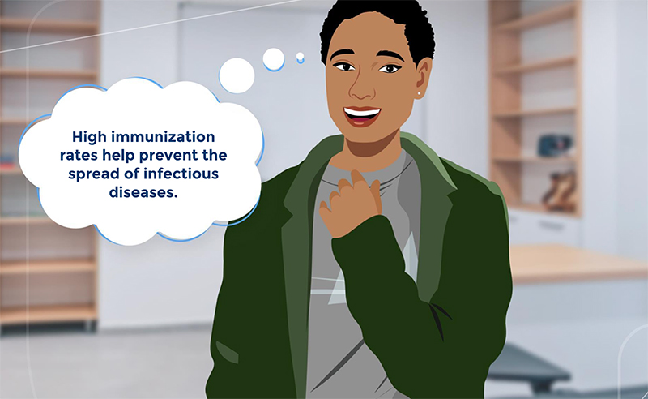
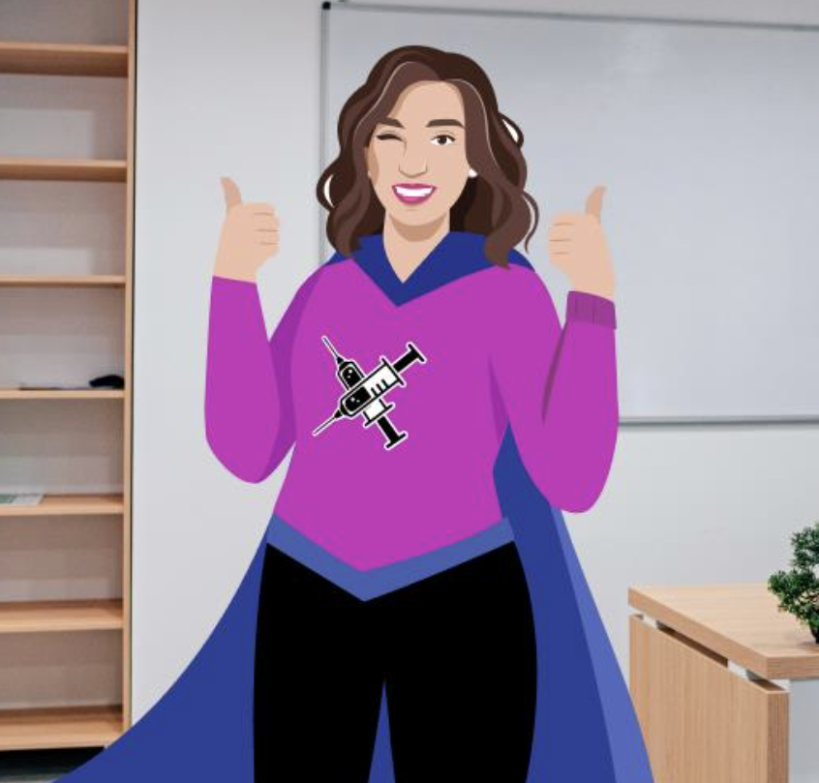
Becoming Immunization Champions
Your organization name
Instructors: See the notes section for more information.
Notes:
Thank you all for becoming Immunization Champions and helping to keep our children safe from preventable diseases.
These slides will emphasize what is covered in the immunization trainings posted at Training for Schools (ca.gov) - these trainings should also be viewed by all staff tasked with checking and documenting immunizations required for school entry.

Slide 3

It’s the Law
Check student immunization records and ensure they meet requirements before school starts.
Your organization name
Instructors: See the notes section for more information.
Notes:
This poster can be posted in your office or at the front desks of schools and enrollment sites. The file is available on the ShotsforSchool website. Printed copies may be available at some local health departments.

Slide 4
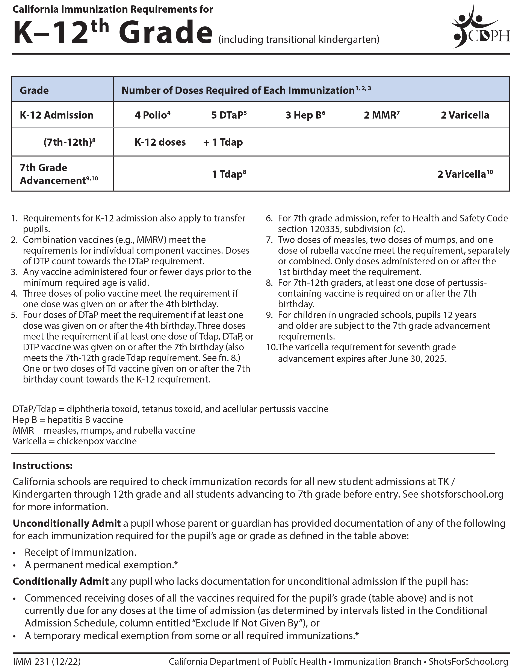
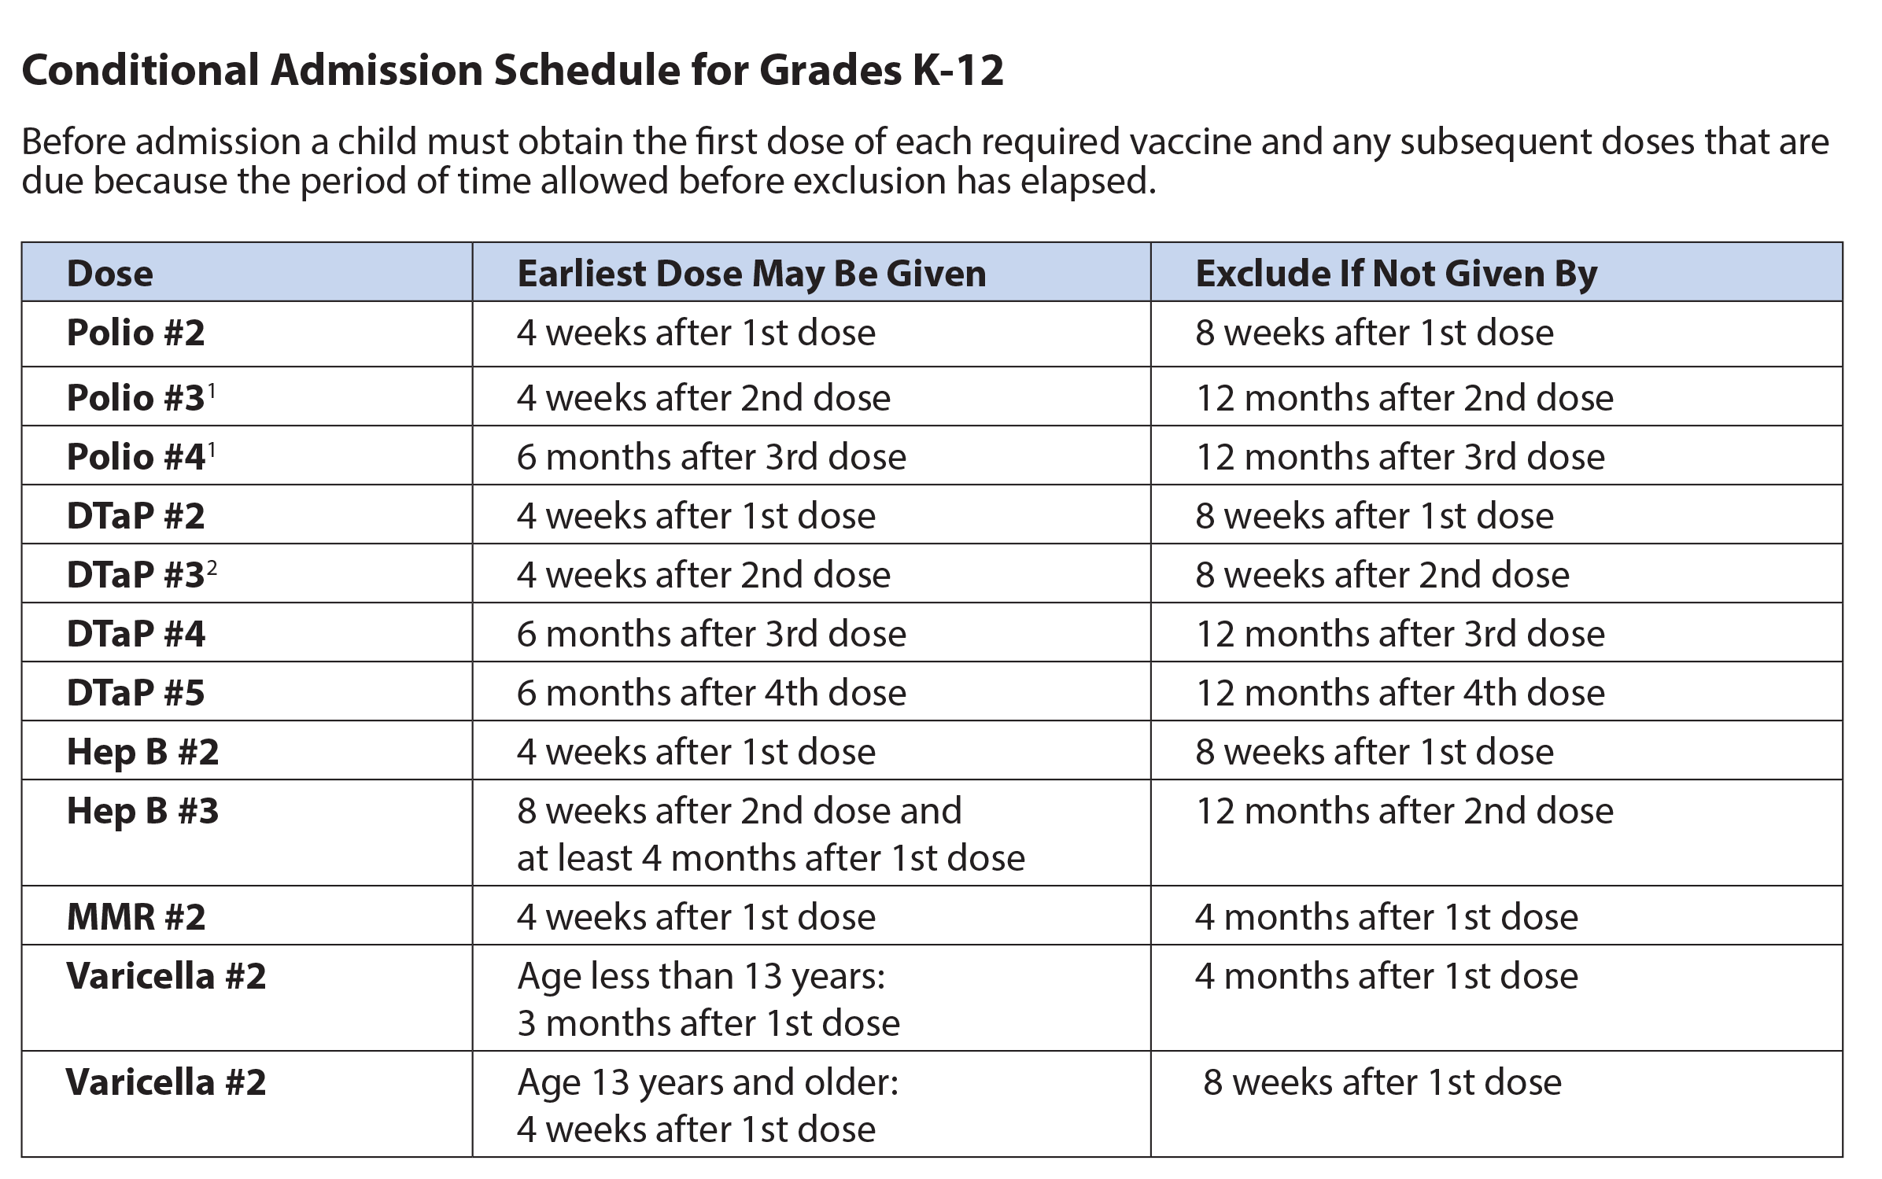
School Guide
Notes:
Quick reference.
The laws are summarized in the School Guide. You all have copies.
We'll be using different parts of this guide throughout this training:
Table with requirements
Footnotes
Definitions
Conditional Admission table

Slide 5
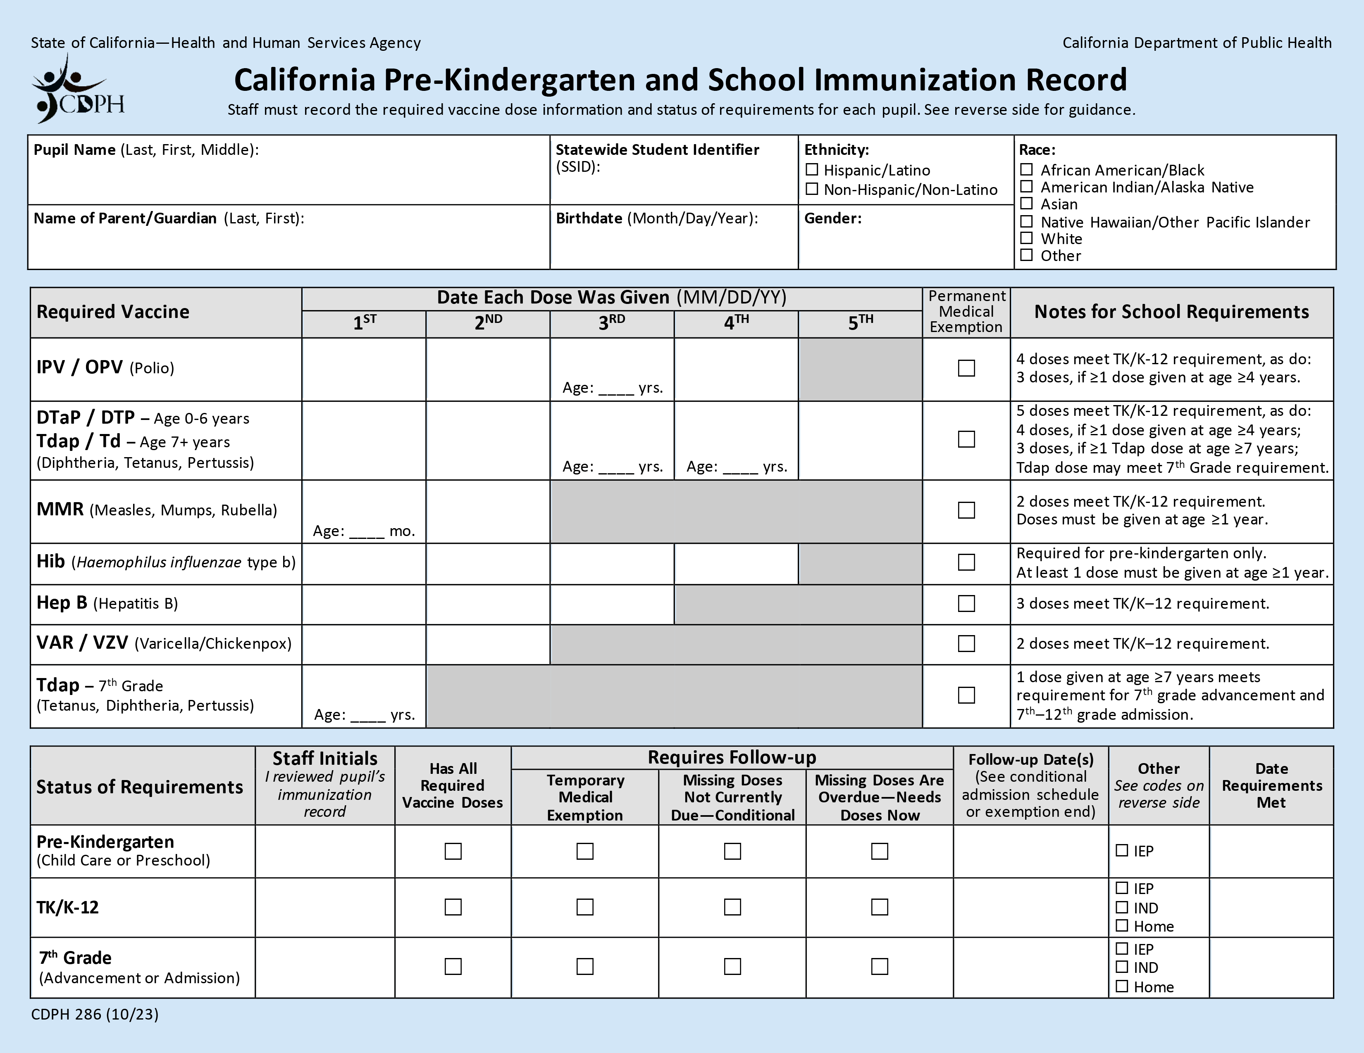
Blue Card
Notes:
Quick reference.
You all also have copies of the California Pre-K and School Immunization Record, also known as the Blue Card.
The requirements are also summarized in the Notes section of the Blue Card. We'll refer to these as we go through a few student scenarios.
Some of your schools may have Student Immunization Information Systems, but for the purpose of this training we're going to use the paper Blue Cards to create records.

Slide 6
Steps for Processing Records
Ask for child’s immunization record.
Transfer dates for doses to a Blue Card.
Determine if requirements are met.
  Can the student be admitted to school?
Complete Status of Requirements section.
Notes:
These are the four basic steps to processing immunization records

Slide 7


Can A Student Attend School?
Unconditional Admission
Has all required doses OR
Permanent medical exemption (PME) for missing doses OR
Other: Alternative School programs (IND, IEP, Home)
Conditional Admission
Temporary medical exemption (TME) for missing doses OR
Missing doses are not due yet and has at least 1 dose of every required vaccine
X
Do Not Admit
Missing doses are overdue
Notes:
Note to instructor: "Conditional Admission" and "Do Not Admit" sections are timed to appear when you click the mouse.
It is your job to determine which category students fall under and if they can attend school or not. There are six categories under which students can fall and here they are:
Unconditional Admission means that students have met all requirements and can attend school.
Has all required doses OR
Permanent medical exemption (PME) for missing doses
Other: Alternative School programs (IND, IEP, Home). Students in home-based private schools or independent study programs who do not receive classroom-based instruction are not subject to the requirements. Also, students should receive services identified in their individualized education program (IEP) regardless of their immunization status. You'll still keep a Blue Card for these students with any immunization information they provide.
Conditional Admission means that students may attend school on the condition they get the remaining doses when they are due.
4. Temporary medical exemption (TME) for missing doses OR
5. Missing doses are not due yet (has at least 1 dose of every required vaccine)
Students may not be admitted to school if they are in this last category...
6. Missing doses are overdue

Slide 8
Let’s Practice
TK, Kindergarten, 2nd Grade Admission
August 15, 2024
Notes:
Let's practice going through the steps and determining which category each student falls under and if they may be admitted to school.
For this overall training, we'll say that school begins on August 15, 2024.

Slide 9
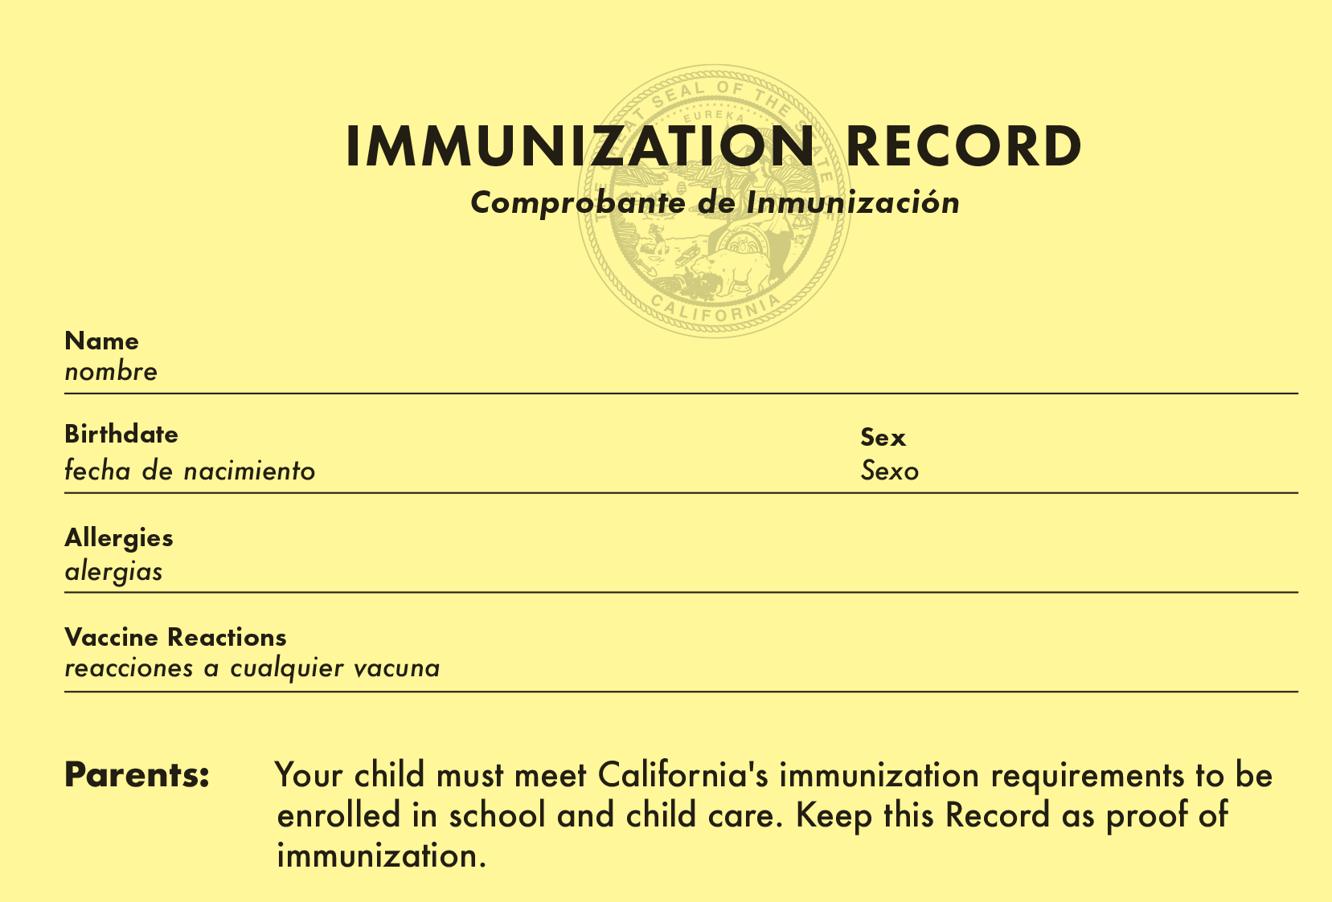
Student 1
Kindergarten Admission
Student One
06/22/2019
Female
None
None
Required: Name, Birthdate, Vaccine, Date Given, Health Care Provider
Instructors: See the notes section for more information.
Notes:
Here's our first example: an immunization record (yellow card) for a student starting Kindergarten.
Let’s start filling out a Blue Card with this information.
Note: when you receive a child’s immunization record, check for all these required elements: Name, Birthdate, Vaccine, Date Given, Health Care Provider
Vaccines and dates are on the next slide.
(To save time, Student 1 can be presented as a demonstration of steps rather than having the class fill out the Blue Card for this student.)

Slide 10
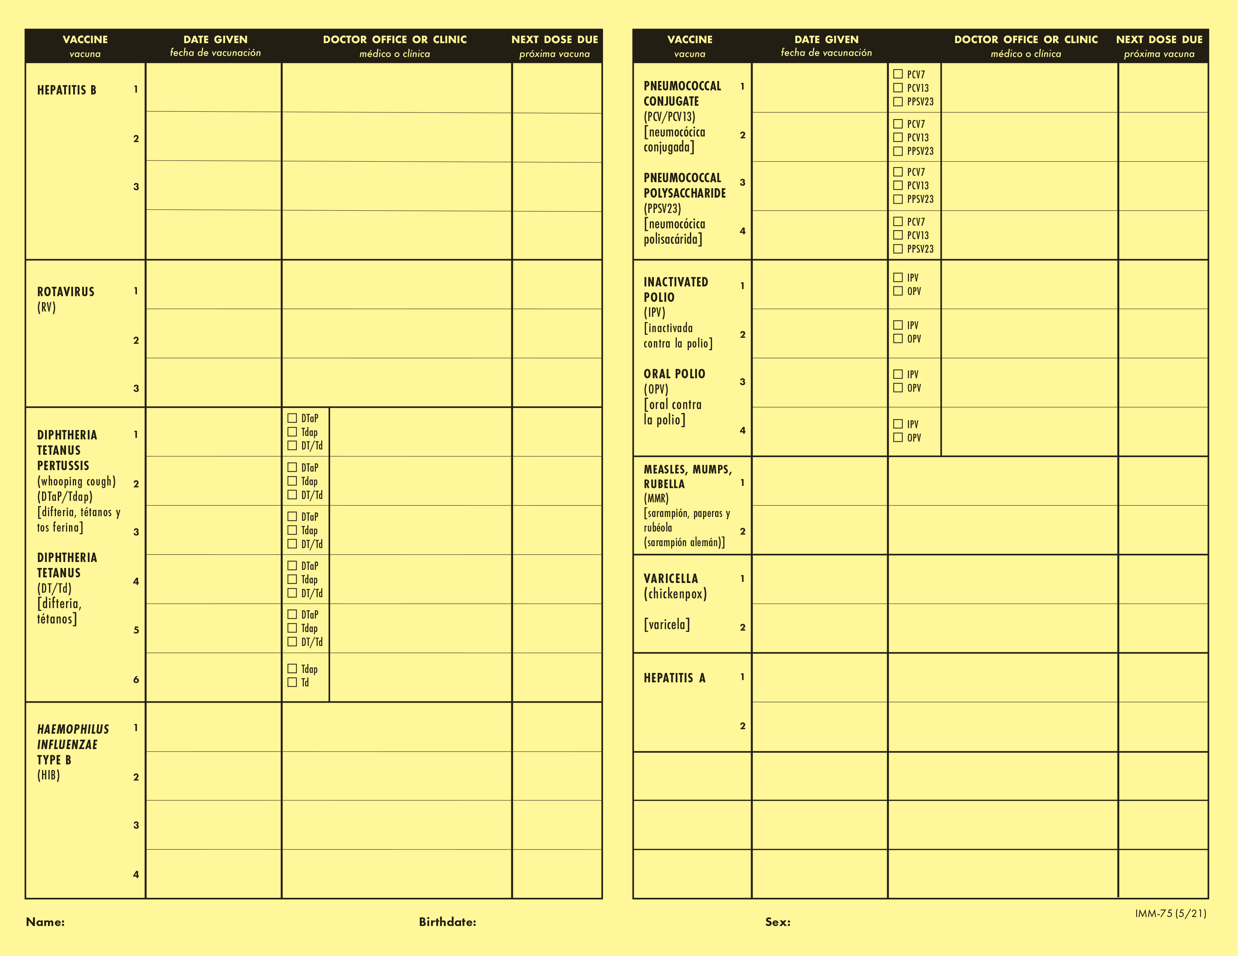
Student 1: Immunization Record
Hepatitis B
08/23/19
Happy Pediatrics
08/23/19
Happy Pediatrics
11/19/19
Happy Pediatrics
11/19/19
Happy Pediatrics
03/21/24
Happy Pediatrics
02/11/20
Happy Pediatrics
08/23/19
Happy Pediatrics
08/23/19
Happy Pediatrics
11/19/19
Happy Pediatrics
11/19/19
Happy Pediatrics
02/11/20
Happy Pediatrics
02/11/20
Happy Pediatrics
08/23/19
Happy Pediatrics
03/21/24
Happy Pediatrics
11/19/19
Happy Pediatrics
06/20/20
Happy Pediatrics
02/11/20
Happy Pediatrics
03/21/24
Happy Pediatrics
03/21/24
Happy Pediatrics
06/20/20
Happy Pediatrics
03/21/24
Happy Pediatrics
06/20/20
Happy Pediatrics
08/23/19
Happy Pediatrics
03/21/24
Happy Pediatrics
11/19/19
Happy Pediatrics
02/11/20
Happy Pediatrics
06/20/20
Happy Pediatrics
Instructors: See the notes section for more information.
Notes:
This side of the record shows the vaccines and dates.
Start transferring the dates for the doses to the Blue Card.

Slide 11
Student 1: Check Requirements
08/23/19
11/19/19
02/11/20
03/21/24
08/23/19
11/19/19
02/11/20
03/21/24
4
06/20/20
03/21/24
11
08/23/19
11/19/19
02/11/20
06/20/20
08/23/19
11/19/19
03/21/24
06/20/20
03/21/24
DTaP #4: at age 4, so 4 doses meet the requirement
MMR #1: 2 days before the 1st birthday (4-day grace period)
Instructors: See the notes section for more information.
Notes:
This is what the filled out Blue Card should look like.
Refer to notes section of the Blue Card to review requirements for each row:
IPV: 4 doses, meets requirement
DTaP: Fourth dose given at age 4, so 4 doses meet the requirement.
MMR: Check the age requirement. First dose given just before the 1st birthday. There is a 4-day grace period, so this still meets the age requirement for MMR so the two doses meet the requirement.
Hib: not required, but good to include on record
Hep B: 3 doses meets requirement
Varicella: 2 doses meet the requirement
Tdap: not required for kindergarten entry
Birth date: 06/22/2019

Slide 12
Has All Required Vaccine Doses: Unconditional
One, Student
123456789
X
One, Parent
06/22/2019
Female
X
08/23/19
11/19/19
02/11/20
03/21/24
08/23/19
11/19/19
02/11/20
03/21/24
4
06/20/20
03/21/24
11
08/23/19
11/19/19
02/11/20
06/20/20
08/23/19
11/19/19
03/21/24
06/20/20
03/21/24
NN
X
08/22/24
Instructors: See the notes section for more information.
Notes:
This is what the filled out Blue Card should look like.
Student 1 may be unconditionally admitted. No follow-up required. They’re done until the next grade span at 7th grade.

Slide 13
Student 2
TK Admission
Notes:
Student #2 is registering for TK.

Slide 14
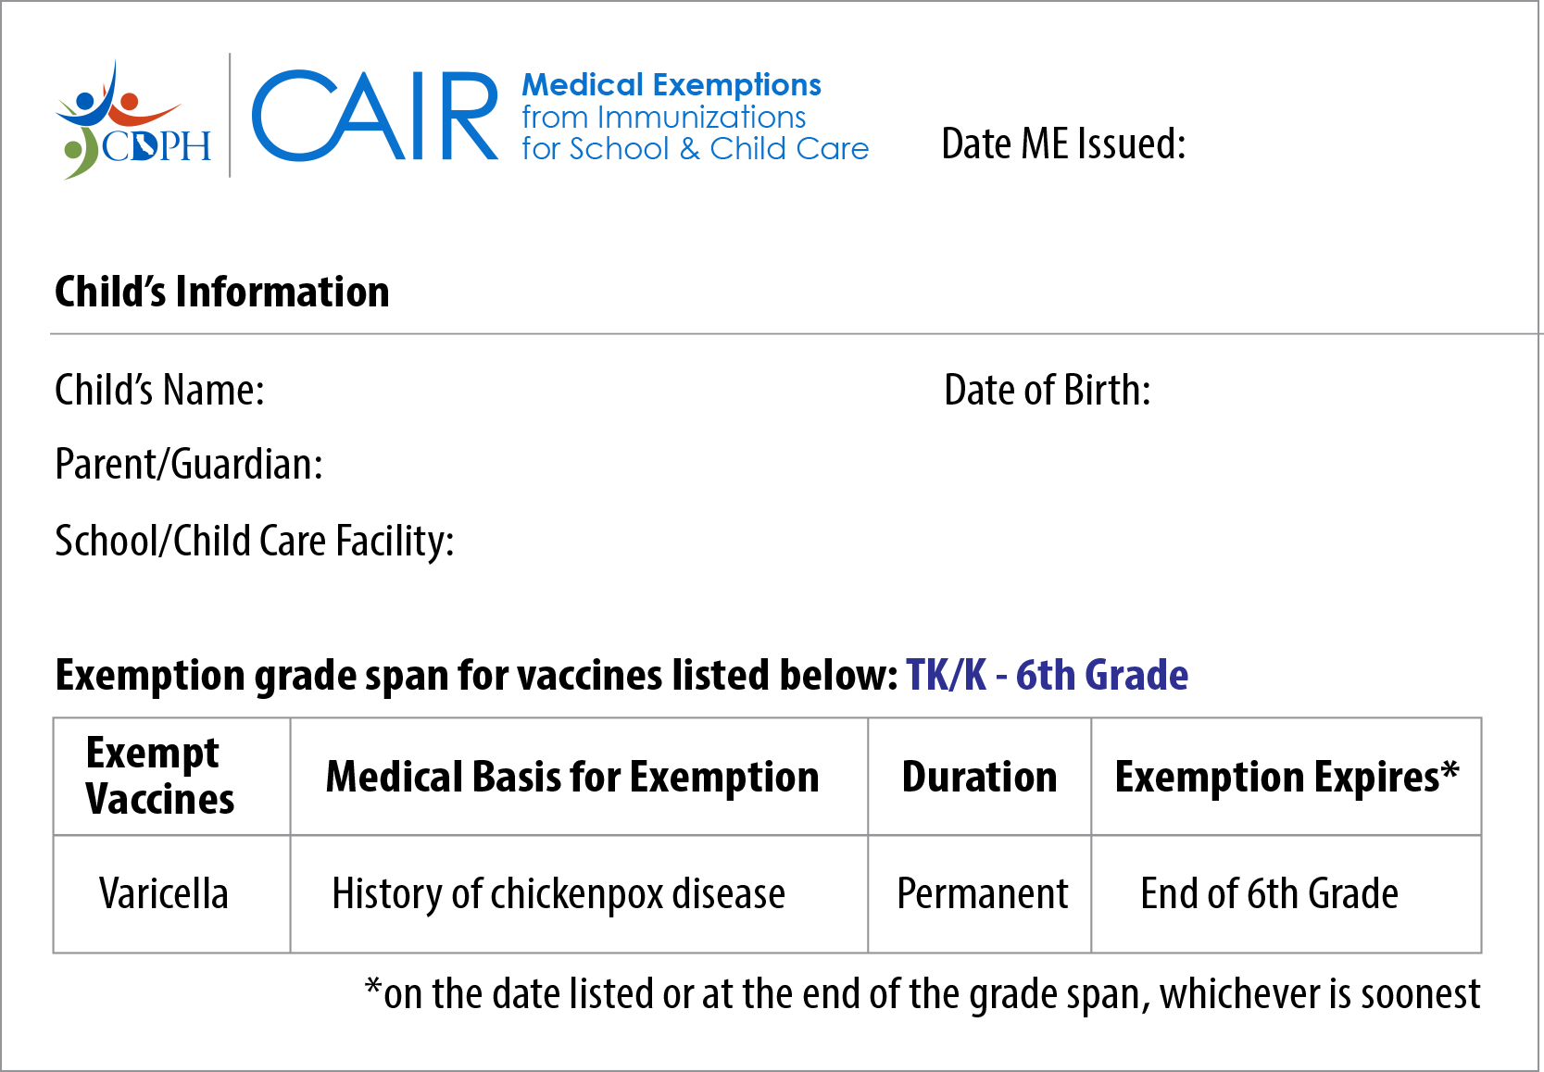
Student 2 (PME)
Permanent Medical Exemption
8/15/24
Student Two
10/10/2019
Parent Two
Happy Kids Elementary
(1234567)
Instructors: See the notes section for more information.
Notes:
The parents have supplied a medical exemption.
Starting January 1, 2021, all new exemptions must be issued from the CAIR-ME website.
This is a representation of a Permanent Medical Exemption (PME) from CAIR-ME, not an exact copy.
Things to check for a valid PME:
Issue date
Child’s information
School’s information
Grade span
Exempt vaccines and expiration.
Use this name and birth date to fill out the Blue Card (since it will not be shown on immunization record on next slide).

Slide 15
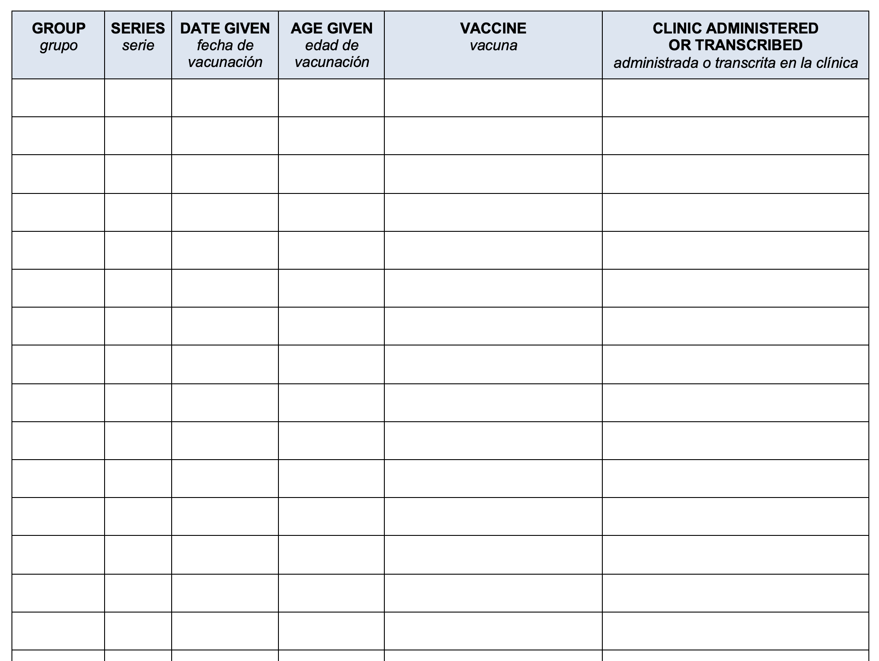
Student 2: Immunization Record (page 1)
COVID
1 of 3
12/01/21
2yrs 1mo 22d
Pfizer Pediatric COVID-19
La Clinica de la Raza
COVID
2 of 3
11/19/22
3yrs 1mo 9d
Pfizer Pediatric COVID-19
La Clinica de la Raza
DTaP
1 of 5
12/23/19
0yrs 2mo 13d
Pediarix
La Clinica de la Raza
DTaP
2 of 5
02/19/20
0yrs 4mo 9d
Pediarix
La Clinica de la Raza
DTaP
3 of 5
04/11/20
0yrs 6mo 1d
Pediarix
La Clinica de la Raza
DTaP
4 of 5
01/21/21
1yrs 3mo 11d
Brand not specified
La Clinica de la Raza
DTaP
5 of 5
08/10/24
4yrs 10mo 0d
Kinrix
La Clinica de la Raza
Hep A
1 of 2
10/23/20
1yrs 0mo 13d
Vaqta
La Clinica de la Raza
Hep A
2 of 2
08/19/21
1yrs 10mo 9d
Vaqta
La Clinica de la Raza
Hep B
1 of 3
12/23/19
0yrs 2mo 13d
Pediarix
La Clinica de la Raza
Hep B
2 of 3
02/19/20
0yrs 4mo 9d
Pediarix
La Clinica de la Raza
Hep B
3 of 3
04/11/20
0yrs 6mo 1d
Pediarix
La Clinica de la Raza
Hib
1 of 4
12/23/19
0yrs 2mo 13d
PedvaxHIB
La Clinica de la Raza
Hib
2 of 4
02/19/20
0yrs 4mo 9d
PedvaxHIB
La Clinica de la Raza
Hib
3 of 4
10/23/20
1yrs 0mo 13d
PedvaxHIB
La Clinica de la Raza
Instructors: See the notes section for more information.
Notes:
This is page one of a cropped sample record from the California Immunization Registry.
Transfer the dates to the Blue Card.

Slide 16
Student 2: Immunization Record (page 2)
MMR
1 of 2
10/23/20
1yrs 0mo 13d
M-M-R II
La Clinica de la Raza
MMR
2 of 2
08/10/24
4yrs 10mo 0d
M-M-R II
La Clinica de la Raza
PCV
1 of 4
12/23/19
0yrs 2mo 13d
Prevnar 13
La Clinica de la Raza
PCV
2 of 4
02/19/20
0yrs 4mo 9d
Prevnar 13
La Clinica de la Raza
PCV
3 of 4
04/11/20
0yrs 6mo 1d
Prevnar 13
La Clinica de la Raza
PCV
4 of 4
10/23/20
1yrs 0mo 13d
Prevnar 13
La Clinica de la Raza
Polio
1 of 4
12/23/19
0yrs 2mo 13d
Pediarix
La Clinica de la Raza
Polio
2 of 4
02/19/20
0yrs 4mo 9d
Pediarix
La Clinica de la Raza
Polio
3 of 4
04/11/20
0yrs 6mo 1d
Pediarix
La Clinica de la Raza
Polio
4 of 4
08/10/24
4yrs 10mo 0d
Kinrix
La Clinica de la Raza
RV
1 of 3
12/23/19
0yrs 2mo 13d
Rotarix
La Clinica de la Raza
RV
2 of 3
02/19/20
0yrs 4mo 9d
Rotarix
La Clinica de la Raza
Flu
11/11/21
2yrs 1mo 1d
Brand not specified
La Clinica de la Raza
Flu
11/05/22
3yrs 0mo 26d
Brand not specified
La Clinica de la Raza
Flu
10/30/23
4yrs 0mo 20d
Brand not specified
La Clinica de la Raza
Instructors: See the notes section for more information.
Notes:
Transfer the dates for the remaining immunizations from page 2 of the record.

Slide 17
Student 2: Check Requirements
12/23/19
02/19/20
04/11/20
08/10/24
12/23/19
02/19/20
04/11/20
01/21/21
08/10/24
10/23/20
08/10/24
12/23/19
02/19/20
10/23/20
12/23/19
02/19/20
04/11/20
Missing varicella doses
Instructors: See the notes section for more information.
Notes:
After filling out all of the dates, we see that this student is missing varicella vaccine doses, but has all the other required vaccines.
Remember the PME that was issued? This student is exempt from varicella.

Slide 18
PME + All Other Doses: Unconditional
Two, Student
123456789
X
X
Two, Parent
10/10/2019
Male
12/23/19
02/19/20
04/11/20
08/10/24
12/23/19
02/19/19
04/11/20
01/21/21
08/10/24
10/23/20
08/10/24
12/23/19
02/19/20
10/23/20
10/10/19
12/23/19
04/11/20
X
NN
08/22/24
Instructors: See the notes section for more information.
Notes:
The PME meets the requirements for the missing varicella doses and the student has all other required doses. This student may be admitted unconditionally.
Add an “x” in the PME column for varicella
In the Status of Requirements section, add your initials, do not mark “Has All Required Vaccine Doses” because the student is missing varicella. Add the date.
Student 2 may be admitted unconditionally. Unconditional admission means no follow-up is required. They’re done until the next grade span at 7th grade, or prior to that if their exemption is revoked.

Slide 19
Student 3
TK Admission
Notes:
Note to instructor, Students 3 and 4 will be using the same basic immunization history (both missing doses, but one with a TME and one without).

Slide 20
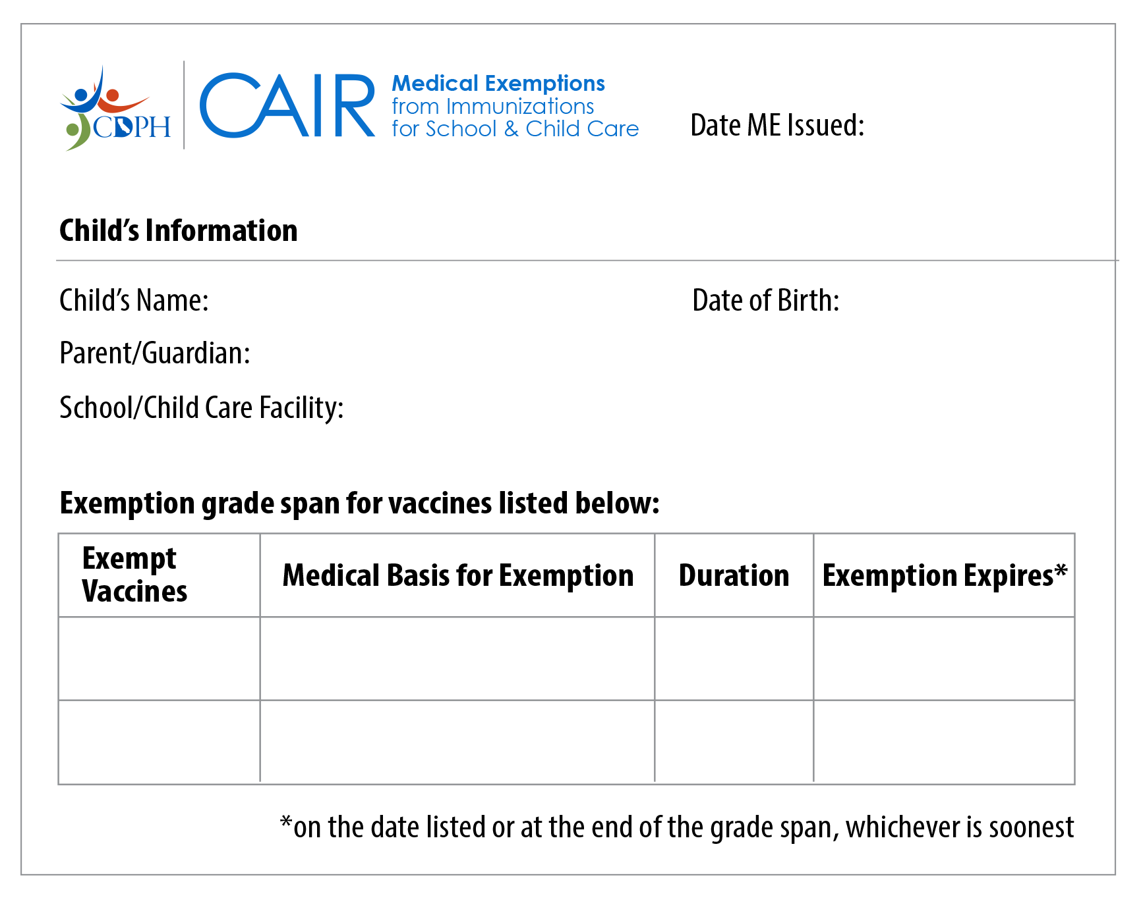
Student 3 (TME)
Temporary Medical Exemption
08/15/24
Student Three
02/11/2020
Parent Three
Champions Elementary
TK/K-6th Grade
Varicella
Temporary
12/15/24
IPV
Temporary
12/15/24
Instructors: See the notes section for more information.
Notes:
This student is registering for TK and has a medical exemption issued from CAIR ME. We can see that it is a temporary medical exemption or TME.
The student is exempt from varicella and polio vaccines until the expiration date.
Please make a note of this expiration date as you’ll need it for following up for continued attendance.

Slide 21
Student 3 (Immunization Record page 1)
Name: Student Four | DOB: 2/11/2020 | MRN:1234567 | PCP: Becca Monte, MD
Current Immunizations
COVID-19 Vaccine
Dates on file: 11/05/2022, 06/07/2022, 12/04/2021, 11/11/2021
Diphtheria, Tetanus, Pertussis (DTaP) Vaccine
Dates on file: 02/27/2024, 05/15/2021, 08/29/2020, 06/24/2020, 04/19/2020
Flu Vaccine
Dates on file: 10/27/2023, 10/17/2022, 10/28/2021,
10/10/2020
Haemophilus influenza type B (HIB) Vaccine
Dates on file: 05/15/2021, 09/29/20
Hepatitis A Vaccine
Dates on file: 08/21/2021, 02/22/2021
Hepatitis B Vaccine
Dates on file: 10/25/2020, 03/15/2020,
02/12/2020
Instructors: See the notes section for more information.
Notes:
Sample record from Electronic Health Record (EHR).
Transfer the dates for doses to the Blue Card.
Note that the dates go in order of most recent first.

Slide 22
Student 3 (Immunization Record page 2)
Measles, Mumps, Rubella (MMR) Vaccine
Dates on file: 12/30/2023, 02/14/2021
Pneumonia vaccine (pneumococcal) Vaccine
Dates on file: 02/14/2021, 08/29/2020, 06/24/2020, 04/19/2020
Polio (IPV) Vaccine
Dates on file: 02/27/2024, 08/21/2021
Rotavirus Vaccine
Dates on file: 08/29/2020, 06/24/2020, 04/19/2020
Varicella (Chickenpox) Vaccine
Dates on file: 07/30/2024
Instructors: See the notes section for more information.
Notes:
Now, transfer the dates for required doses on page 2.

Slide 23
Student 3: Check Requirements
08/21/21
02/27/24
04/19/20
06/24/20
08/29/20
05/15/21
02/27/24
02/14/21
12/30/23
09/29/20
05/15/21
02/12/20
03/15/20
10/25/20
07/30/24
Missing polio vaccine and varicella #2
Instructors: See the notes section for more information.
Notes:
After filling out all of the dates, we see that the student is missing:
3rd and 4th doses of polio vaccine, and
2nd dose of varicella
They have all the other required vaccines.

Slide 24
TME + All Other Doses: Conditional
Three, Student
123456789
X
X
Three, Parent
02/11/2020
Female
Deadline
Polio #3, Varicella #2
12/15/24
Follow-Up
11/15/24
08/21/21
02/27/24
04/19/20
06/24/20
08/29/20
05/15/21
02/27/24
02/14/21
12/30/23
09/29/20
05/15/21
02/12/20
03/15/20
10/25/20
07/30/24
NN
X
11/15/24
Instructors: See the notes section for more information.
Notes:
Remember that this student has a TME for the missing doses and they have all other required doses.
We'll process this student differently than the Permanent Medical Exemption scenario.
Student 3 may be admitted Conditionally.
Follow-up is required before the TME expires.
We made a note of the exemption expiration date in December. This is the deadline.
It’s best to send a reminder about a month before the deadline. We'll show you how to do this with the next student.
In the Status of Requirements section:
Add your initials, and mark “Temporary Medical Exemption”.
Add the follow-up date.
Parents will need to show proof of receiving the missing doses or a new TME before the expiration date in order for the student to continue to attend school.

Slide 25
Student 4
TK Admission

Slide 26
Student 4: No TME
08/21/21
02/27/24
04/19/20
06/24/20
08/29/20
05/15/21
02/27/24
02/14/21
12/30/23
09/29/20
05/15/21
02/12/20
03/15/20
10/25/20
07/30/24
Missing polio vaccine and varicella #2
Instructors: See the notes section for more information.
Notes:
For Student 4, let’s re-use the same record as Student 3. This time without the TME.
All the dates are filled out the same way as before with missing doses for polio and varicella vaccines.

Slide 27
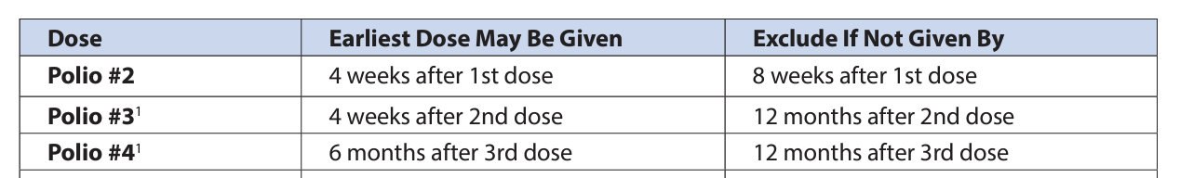
Student 4: Check Due Date
Polio #2:
02/27/24
12 months
Polio #3:
Deadline: 02/27/25
Varicella #2:
Deadline: 11/30/24
Varicella #1: 07/30/24
4 months
Instructors: See the notes section for more information.
Notes:
This time, we’ll need to use the Conditional Admission Schedule to figure out the deadlines for the missing doses.
Polio #3 is not due until 12 months after the 2nd dose.
Varicella #2 is not due until 4 months after the 1st dose.
Checking the Blue Card
Polio #2 was given on Feb 27, 2024. Polio #3 is due 12 months later which is February 27, 2025. So the deadline for Polio #3 is not until next year.
Varicella #1 was given on July 30, 2024. Varicella #2 is due 4 months later which is November 20, 2024. So, the deadline for varicella #2 is not until November.
Both doses are not due before school starts on August 15, 2024.
Can this child be admitted to school?
Yes, since the missing doses are not due before school starts, Student 4 may be admitted conditionally. They may attend school on the “condition” that the receive the missing doses by the deadline.
Now let’s try to figure out when the best follow-up date is.

Slide 28
Student 4: Earliest Dose May Be Given
Footnote 1:
Only 3 doses of polio needed if 1 dose was on or after 4th birthday
Final dose: at least 6 months after the 2nd dose
Instructors: See the notes section for more information.
Notes:
Usually we start sending reminders at least 1 month before the deadline. But for deadlines several months away, you can also use the timing under the Earliest Dose May Be Given column to start sending reminders.
Before we do that, let's take a look at footnote #1 for Polio #3 on the Conditional Admission Schedule.
It states that only 3 doses of polio vaccine are needed if the student received 1 dose on or after their 4th birthday.
Referring back to the child's birth date, the student is already 4 years old, so the 3rd dose will be the last dose.
The footnote also states that the earliest this final dose can be given is 6 months after the 2nd dose.
Varicella #2 can be given as early as 3 months after the first dose.

Slide 29
Student 4: Set Follow-Up Date
Polio #2:
02/27/24
6-11 months
Polio #3:
Deadline: 02/27/25
Reminder: 08/27/24
Varicella #2:
Deadline: 11/30/24
Reminder: 10/30/24
Varicella #1: 07/30/24
3 months
Instructors: See the notes section for more information.
Notes:
Now let's apply this information to set follow-up dates for Student 4.
Polio # 3: Based on the footnote from the Conditional Admission Schedule, you could start sending a reminder as early as 6 months after the 2nd dose (and up until the month before the deadline, 11 months after the 2nd dose). Let's use the 6-month date of August 27, 2024.
Varicella #2 can be given 3 months after the first dose. That’s on October 30th, 1 month before the deadline.
Use the earlier follow-up date (circled) to send a reminder to parents about the deadlines for both vaccines.

Slide 30
Missing Doses Not Due: Conditional
Four, Student
123456789
X
X
Four, Parent
02/11/2020
Female
08/21/21
02/27/24
04/19/20
06/24/20
08/29/20
05/15/21
02/27/24
02/14/21
12/30/23
09/29/20
05/15/21
02/12/20
03/15/20
10/25/20
07/30/24
NN
X
08/27/24
Instructors: See the notes section for more information.
Notes:
Since we determined the missing doses are not due yet, Student 4 may be admitted conditionally. Mark the Missing Doses Not Currently Due column and add the follow-up date for when you will send a reminder.
Note to instructor: Participants can cross out prior status to conserve blue cards.

Slide 31
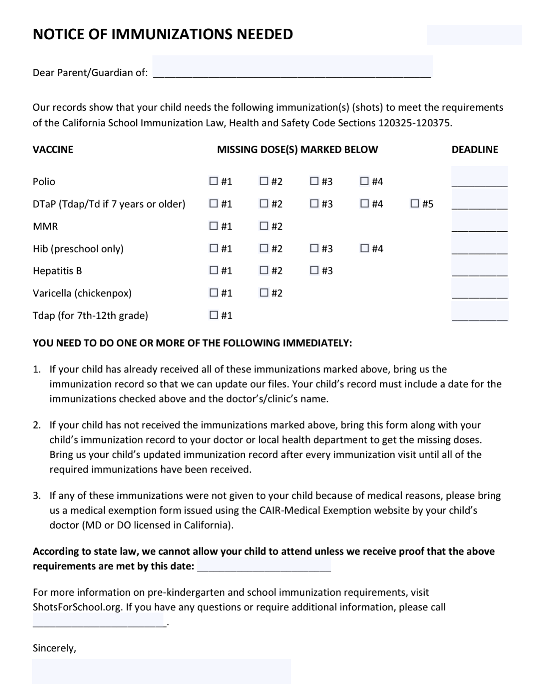
Send a Reminder
8/27/24
Student Four
X
02/27/25
X
11/30/24
Polio #3
Deadline: 02/27/25
Reminder: 08/27/24
Varicella #2:
Deadline: 11/30/24
Reminder: 10/30/24
11/30/24
1-888-867-5309
Your Name
Instructors: See the notes section for more information.
Notes:
When it's time to follow-up, fill out a Notice of Immunizations Needed letter and send it to parents. This template can be downloaded in multiple languages from the Shots for School website.
Copy the deadline dates over that we already calculated on the sticky note.
At the bottom where it states that "according to state law, we cannot allow your child to attend unless we receive proof that the above requirements are met by this date", insert the earliest deadline. In Student 4's case, this is the deadline for varicella vaccine in November.

Slide 32
Receive Final Doses: Unconditional
Four, Student
123456789
X
X
Four, Parent
02/11/2020
Female
08/21/21
02/27/24
11/29/24
4
04/19/20
06/24/20
08/29/20
05/15/21
02/27/24
02/14/21
12/30/23
09/29/20
05/15/21
02/12/20
03/15/20
10/25/20
07/30/24
11/29/24
NN
X
X
10/30/24
11/30/24
Instructors: See the notes section for more information.
Notes:
When you receive an updated immunization record, fill in the missing doses on the Blue Card.
If, for example, as a result of the notice you sent, you received an updated immunization record showing the student received a dose of polio vaccine and a dose of varicella vaccine on November 29, 2024:
Add the date for polio #3 and age. Next, take a look at the notes section. It says that 3 doses meet the requirement if at least one dose was given at 4 years of age or older. This is the case for our student, so the polio requirement is met.
Add the date for varicella #2. Now, all requirements have been met.
Student 4's status now changes to unconditional. They may attend school with no further follow-up until 7th grade.
Update the Status of Requirements section by crossing out the “x” in the Missing Doses Not Currently Due column and the Follow-Up Date.
Put an "x" in the Has All Required Vaccine Doses column and add the date when you received the updated records and requirements were met.

Slide 33
Student 5
2nd Grade Admission
Notes:
Student entring 2nd grade.

Slide 34
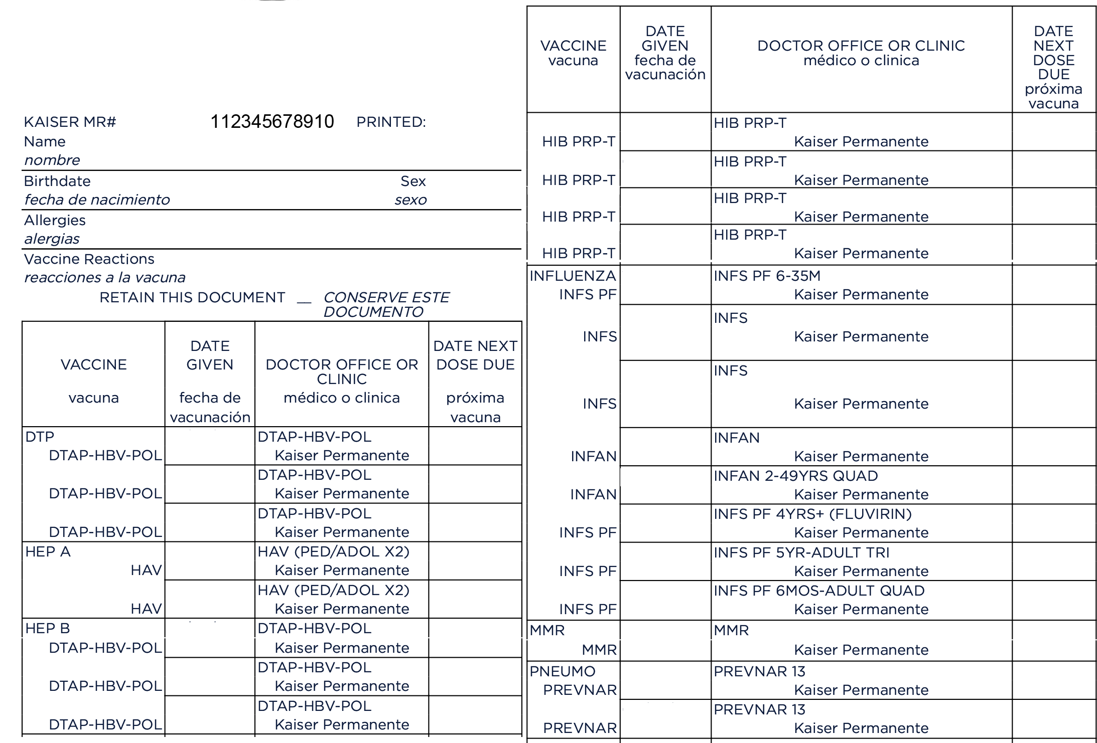
Student 5: Immunization Record (page 1)
08/20/22
01/26/17
Student Five
M
03/23/17
11/26/2016
05/17/17
06/29/18
10/19/17
11/29/17
11/12/18
01/26/17
10/31/19
03/23/17
12/15/20
05/17/17
11/13/21
11/29/17
10/27/22
06/29/18
09/30/23
01/26/17
11/29/17
03/23/17
01/26/17
05/17/17
03/23/17
Instructors: See the notes section for more information.
Notes:
Note to presenter: You may want to print this slide and the next as a handout since it may be difficult to read in a presentation.
This is a close to real-life example of a record, showing that it can be confusing with combination vaccines, product brand names, and abbreviations. We’ll include a link at the end of the presentation to a guide that can help.
Notice that the combination vaccines are listed under all vaccine types included in the combination vaccine. For example, DTAP-HBV-POL combination vaccine is listed under DTP, Hep B and Polio vaccine sections.
Transfer dates to the Blue Card.

Slide 35
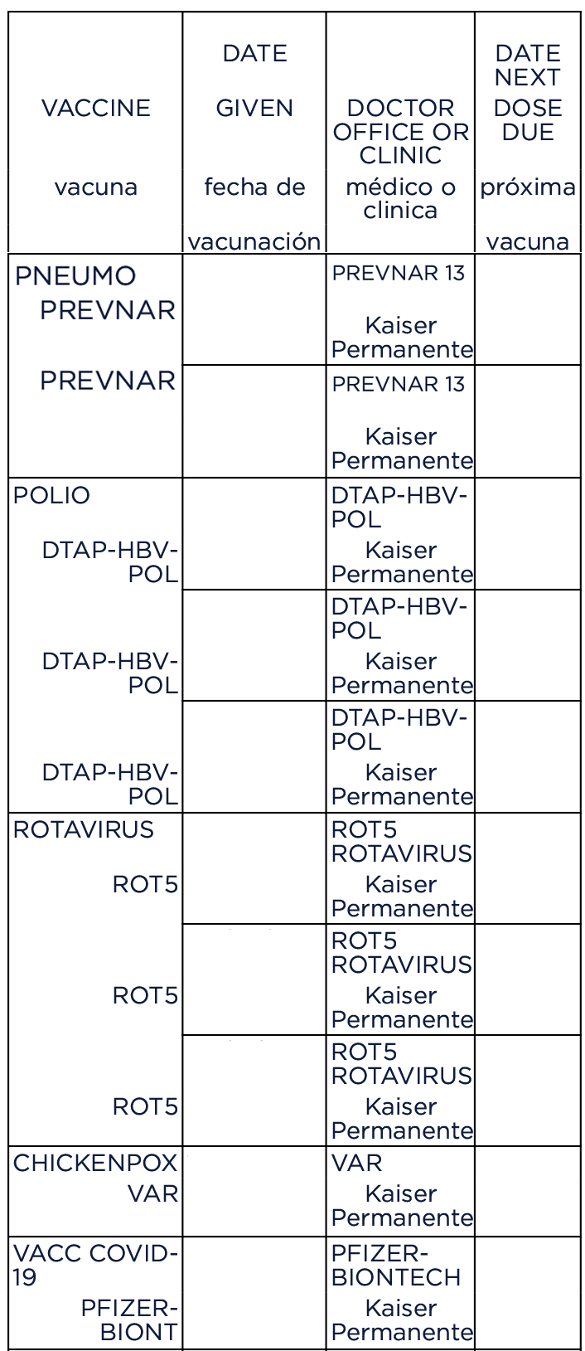
Student 5: Immunization Record (page 2)
01/26/17
03/23/17
05/17/17
02/27/21
01/26/17
03/23/17
05/17/17
11/29/17
11/29/17
12/03/21
Instructors: See the notes section for more information.
Notes:
Note: the polio component of the combination vaccine is located on this page.
Transfer the rest of the dates to the Blue Card.

Slide 36
Student 5: Check Requirements
01/26/17
03/23/17
05/17/17
02/27/21
01/26/17
03/23/17
05/17/17
11/29/1712
01/26/17
03/23/17
05/17/17
06/29/18
01/26/17
03/23/17
05/17/17
11/29/17
Missing DTaP #4, MMR #2 and varicella #2
Instructors: See the notes section for more information.
Notes:
After filling out all of the dates, we see that the student is missing the 4th dose of DTaP, 2nd doses of MMR and varicella vaccines, but has all the other required vaccines.
Just like the previous student, we’ll have to check the due dates for the missing doses.

Slide 37
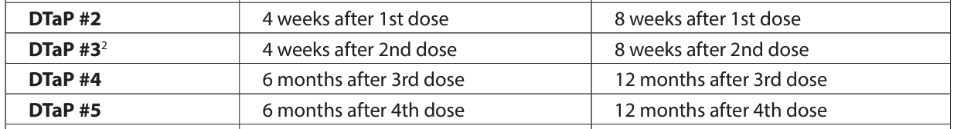
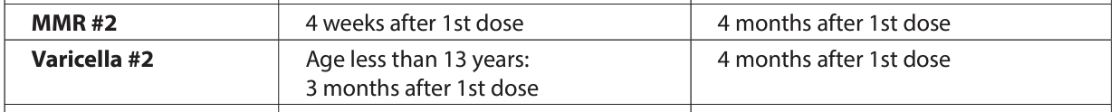
Student 5: Check Due Date
Deadline
DTaP #4:
5/17/18
MMR #2, Varicella #2:
5/29/18
DTaP #3
5/17/17
12 months
MMR #1,
Varicella #1
11/29/17
4 months
OVERDUE
Instructors: See the notes section for more information.
Notes:
Referring to the Conditional Admission Schedule deadlines (Exclude if Not Given By dates)…
DTaP #4 is due 12 months after the 3rd dose. This date has passed.
MMR #2 and Varicella #2 are due 4 months after the 1st dose. These dates have also passed.
This means that all of the next doses are overdue.
Can Student 5 be admitted to school? (advance to next slide before answering question)

Slide 38
Missing Doses Overdue: Don’t Admit
X
Five, Student
123456789
X
X
Five, Parent
11/26/2016
Male
01/26/17
03/23/17
05/17/17
02/27/21
01/26/17
03/23/17
05/17/17
11/29/1712
01/26/17
03/23/17
05/17/17
06/29/18
01/26/17
03/23/17
05/17/17
11/29/17
NN
X
Instructors: See the notes section for more information.
Notes:
No, Student 5 cannot be admitted to school until they show proof of having received the overdue doses. They are currently not in compliance with CA law.
Fill out the Notice of Immunizations Needed letter and give it to the family to take to their doctor to receive the missing doses.
In the Status of Requirements section, add your initials, and mark “Missing Doses Are Overdue.”

Slide 39
Proof of Missing Doses: Unconditional
Five, Student
123456789
X
X
Five, Parent
11/26/2016
Male
01/26/17
03/23/17
05/17/17
02/27/21
01/26/17
03/23/17
05/17/17
08/15/24
8
11/29/1712
08/15/24
01/26/17
03/23/17
05/17/17
06/29/18
01/26/17
03/23/17
05/17/17
11/29/17
08/15/24
NN
X
X
08/16/24
Instructors: See the notes section for more information.
Notes:
Once you receive an updated immunization record for the overdue doses...
If, for example, as a result of the notice you sent to the family, you received an updated immunization record showing the student received a doses of DTaP, MMR and Varicella on August 15, 2024:
Add the dates to the Blue Card.
Check the notes section to see if requirements are met.
DTaP: 4 doses meet requirement if at least one dose was given at age 4 years or older. Check!
MMR#2: both doses must be given at age 1 year or older. Check!
Varicella: 2 doses meet the requirement. Check!
In the Status of Requirements section, cross out the x on the “Missing Doses Are Overdue” column.
Add an “x” to the Has All Required Vaccine Doses” column and the date you received the updated record.
Now, Student 5 may be admitted unconditionally.

Slide 40
Additional Tips
Notes:
Now for a few more general items

Slide 41
Roster of Students Missing Doses
 |  |  | If Missing Doses, Mark the Category (Reason) |  |  |  |  |  |  | Mark Missing Vaccines
# | Student | Has All Required Doses | PME | IEP | IND | Home | Conditional | TME | Overdue | Polio | DTaP | MMR | HepB | VAR
1. | Student Two |  | X |  |  |  |  |  |  |  |  |  |  | X
2. | Student Three |  |  |  |  |  |  | X |  | X |  |  |  | X
3. | Student Four |  |  |  |  |  | X |  |  | X |  |  |  | X
4. | Student Five |  |  |  |  |  |  |  | X |  | X | X |  | X
Instructors: See the notes section for more information.
Notes:
It's helpful to list all the students who are missing doses to have as an easy reference during outbreaks and Immunization Reporting to the California Department of Public Health (CDPH).
Remember the 6 categories we went over at the beginning when we were on slide 7? There's a column for each one on the Worksheet.
You'll need to report the number of kindergarten and 7th grade students in each of the 6 categories to CDPH in the fall.

Slide 42
Special Situations
Transfer students within U.S.:
  May allow up to 30 school days for records to arrive
  When records arrive, if missing doses: may allow up to 10-school day deadline
Students in foster care or experiencing homelessness:
  Enroll immediately, even if immunization records are missing or unavailable. Follow up according to conditional admission schedule
18+ years old: Not subject to requirements
Instructors: See the notes section for more information.
Notes:
For transfer students:
If immunization record is not available at the time of admission, admit for up to 30 school days while waiting for records to arrive from previous school.
After 30 school days, exclude the student until parents can submit documentation of required doses.
If you get the folder from the other school and see missing doses, you may allow up to 10 school days for parents to show those doses were given. Exclude the student after the deadline (no more than 10 school days).
For foster care and students experiencing homelessness:
Enroll students immediately, even if immunization records are missing or unavailable at the time of enrollment. They can typically be considered transfer students and so can have up to 30 school days to show proof of immunization. For homeless students, it's important for the homeless liaison to work with them immediately to help connect them with health care services and follow up according to the conditional admission schedule. Once records arrive, follow the normal process. Students who do not have proof of meeting the requirements are subject to exclusion until proof of immunizations are submitted.
For those 18+ years old:
These students are not subject to requirements. You can still recommend these students finish catching up on missing vaccines.

Slide 43
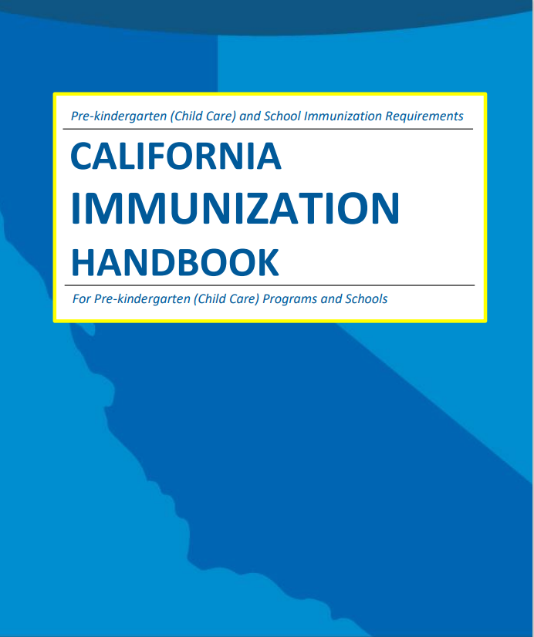
More Special Situations
Dose given too early:
  If the dose date is before Earliest Dose
  May be Given date, the dose still counts.
Missing Hep B at 7th grade:
  Students must complete the series after 7th grade:
  when next considered to be an admission at 8th-12th grade OR
  at 8th grade: if ever attended K in CA or considered an admission to any grade except 7th at any time after 7/1/2019
OPV and international students:
  Doses of OPV given on or after April 1, 2016, do not count.
  The student must show proof of IPV.
Instructors: See the notes section for more information.
Notes:
These topics can be covered with more advanced groups or skipped for beginners.
Intervals too small (example: 3rd Hep B dose for student admitted conditionally was given too early): If a dose is given before the earliest dose may be given date on the conditional admission schedule, it still counts towards the requirement. See California Immunization Handbook pages 10-11 for additional details about which doses to check the timing of.
Missing dose of Hep B at 7th grade admission or advancement: After 7th grade, students are required to continue the series:
if and when next considered to be an admission at 8th-12th grade OR
at 8th grade entry: if ever attended K in CA or considered an admission to any grade except 7th at any time on or after 7/1/19.
Students would follow the conditional admission schedule until the series is complete.
For international students, any doses of OPV given on or after April 1, 2016 do not count. The student must show proof of IPV. Referenced on pages 9 and 11 of the CA Immunization Handbook.

Slide 44
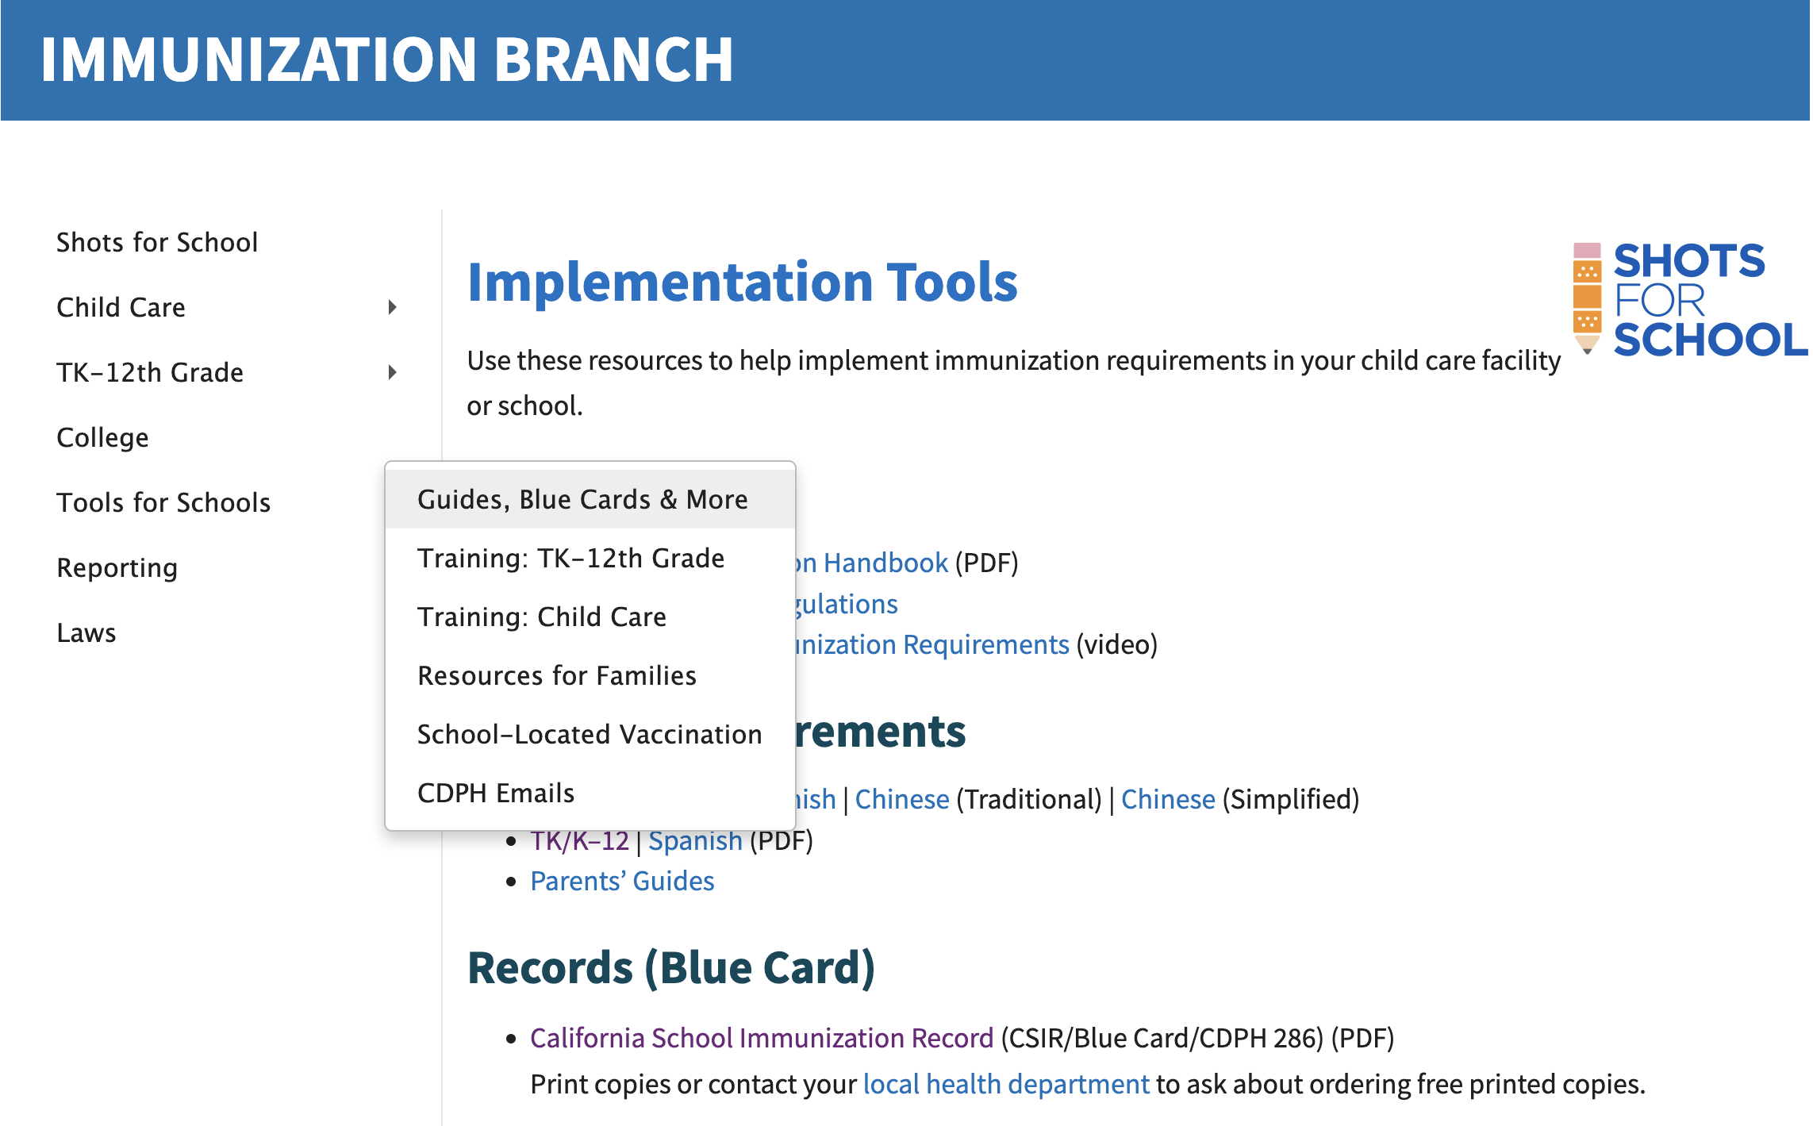
ShotsForSchool.org
Instructors: See the notes section for more information.
Notes:
You can find all the resources that we used in this training and more on the Shots For School website.
Most can be found by selecting the Tools for Schools section in the navigation, and the Guides, Blue Cards & More section.

Slide 45
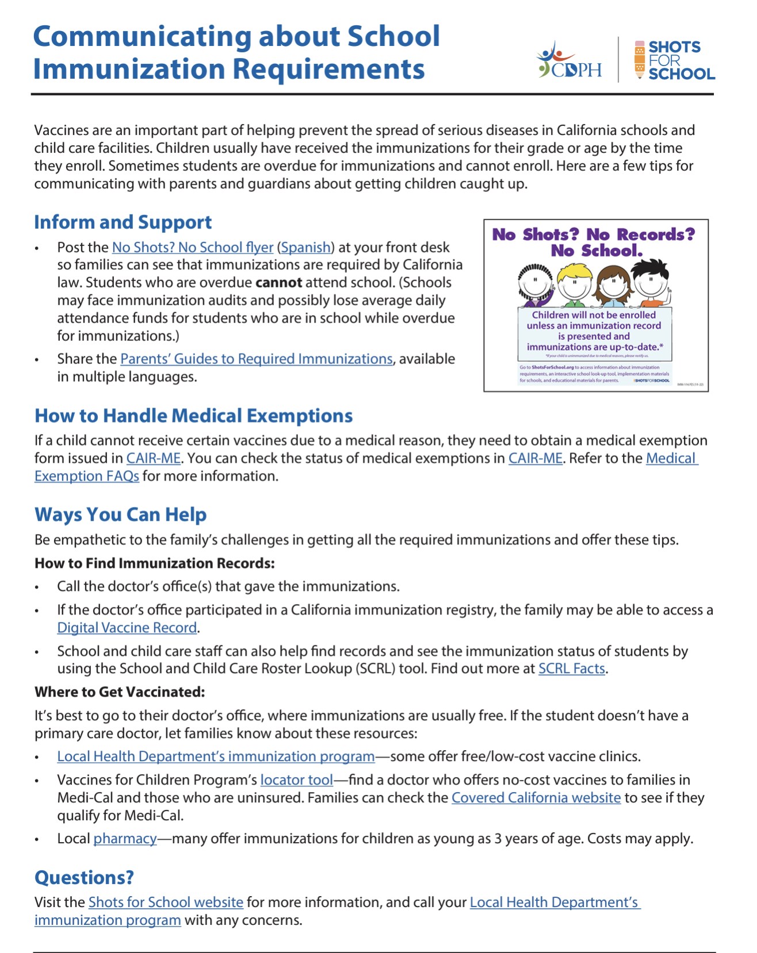
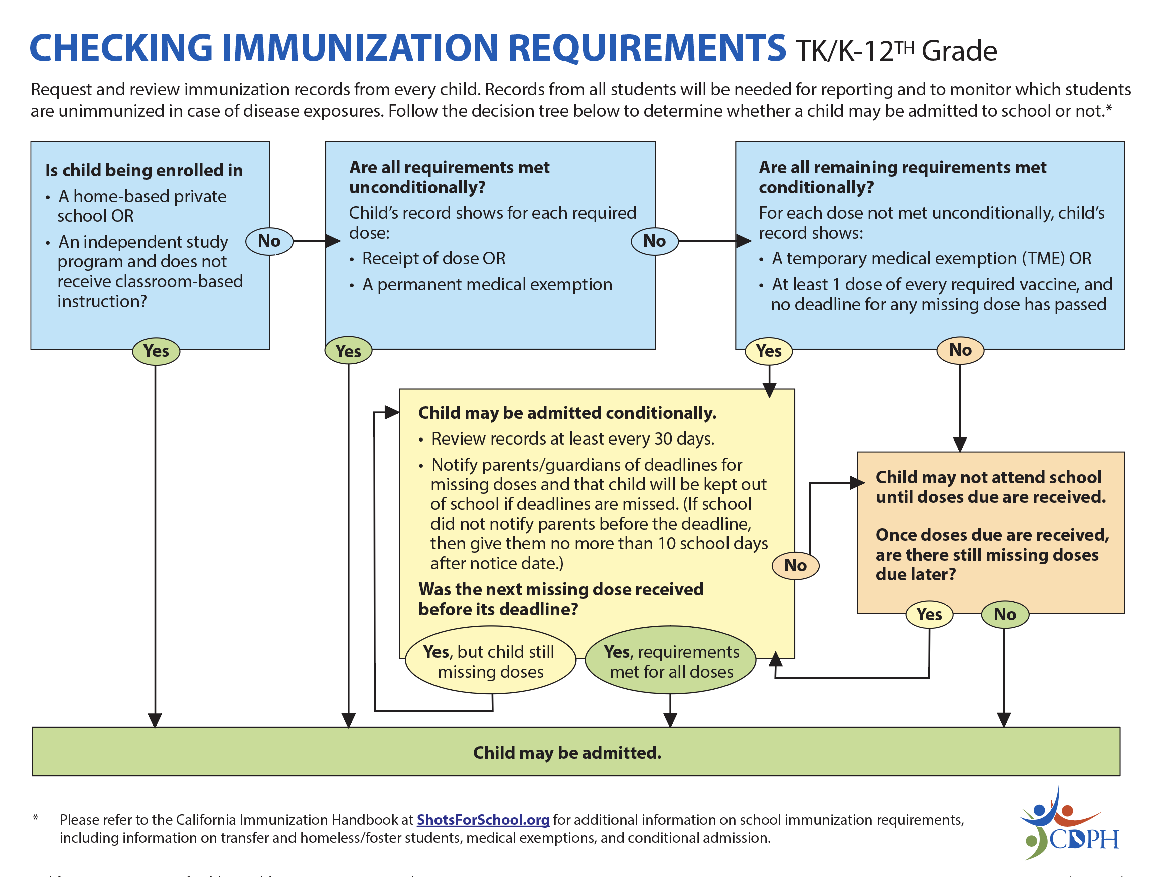
Resources
Instructors: See the notes section for more information.
Notes:
Resources include tips for communicating with parents about the immunization requirements and this decision tree that helps guide you through the process of checking records that we went through today.

Slide 46

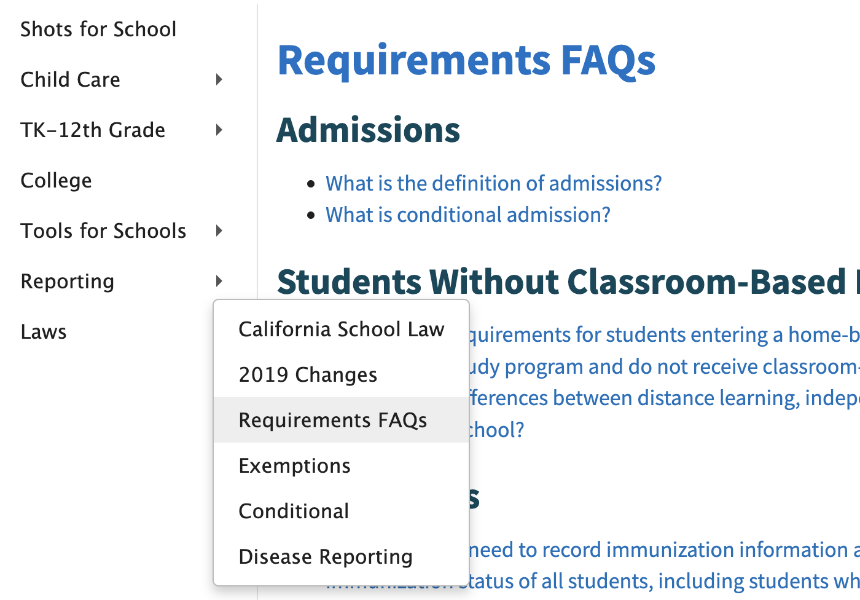
Answers
Send questions to [your email]
Instructors: See the notes section for more information.
Notes:
If you need more answers,
check out the California Immunization Handbook in the Tools for School section, or
FAQs in the Laws section of the Shots for School website or
Send me an email (instructor: fill in the email on the slide with your local contact) or
Email Shotsforschool@cdph.ca.gov

Slide 47

Other Helpful Websites
Check medical exemptions at:
CAIR-ME.CDPH.CA.gov
Determine if a student meets all immunization requirements using the School & Child Care Roster Lookup (SCRL) :
CAIRhub.CDPH.CA.gov

Slide 48
Thank You!

