Slide 1
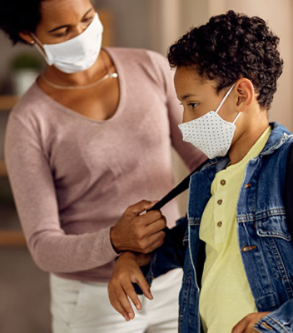


SAFE AND SUCCESSFUL SCHOOLS
August 25, 2021

Slide 2
Agenda
Summary of the Science
Status of the 2021-22 School Year
Hot Topics
SAFE SCHOOLS FOR ALL

Slide 3
1. Summary of the Science
SAFE SCHOOLS FOR ALL

Slide 4
Starting Point: Importance of In-Person Instruction
Research validates that we must keep schools open to promote the mental, social-emotional, and academic well-being of students.
SAFE SCHOOLS FOR ALL
Notes:
References:
https://www.cdc.gov/mmwr/volumes/70/wr/mm7011a1.htm
https://www.nwea.org/content/uploads/2021/07/Learning-during-COVID-19-Reading-and-math-achievement-in-the-2020-2021-school-year.research-brief-1.pdf

Slide 5
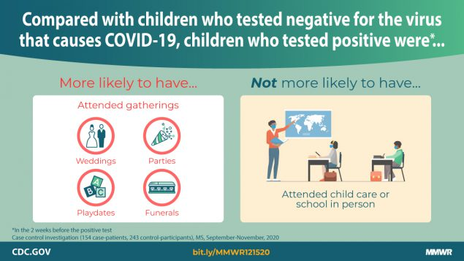
CDC: In-Person School Is A Lower-Risk Activity
Note: Based on a December 2020 study.
SAFE SCHOOLS FOR ALL

Slide 6

Key Safety Layers: Making Schools the Safest Places in the Community
Outdoors When Possible and Improve
Indoor Air Quality
All 12+ in School Are Vaccinated
Sick Stay Home and/or Are Tested
Wear Masks Indoors and Clean Hands

Slide 7
How Have Things Changed with the Delta Variant?
Key Factors | What We Know
Transmissibility | X Delta is more than 2x as contagious as previous variants. This is leading to the current surge in infections.
Virulence and Severity of Symptoms | O Still learning about this. Right now, children continue to develop severe symptoms less often than adults, as with previous variants. Delta’s increased transmissibility means more cases of all types, including cases with severe symptoms. Unvaccinated people are more likely to have severe symptoms.
Vaccine Effectiveness | ✓ Vaccines are effective against Delta. Less than 1% of vaccinated people experience a “breakthrough infection” (i.e., if you know 100+ people, you are likely to know someone) and less than .005% of COVID hospitalizations have been vaccinated people. Unvaccinated are 11x more likely to get COVID. Those with breakthrough infections appear to be infectious for a shorter period of time.
SAFE SCHOOLS FOR ALL
Notes:
References:
https://www.cdph.ca.gov/Programs/CID/DCDC/Pages/COVID-19/COVID-Variants.aspx
https://www.cdc.gov/coronavirus/2019-ncov/variants/delta-variant.html
https://www.cdc.gov/vaccines/covid-19/health-departments/breakthrough-cases.html
https://health.ucdavis.edu/coronavirus/covid-19-information/delta-variant.html

Slide 8
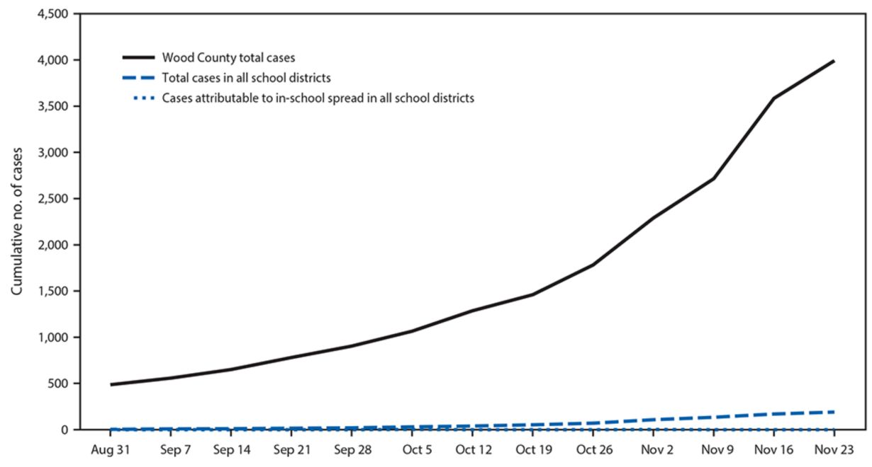
Case Study: Wood County, WI
The following case study conducted in Fall 2020 demonstrates the low risk associated with schools and the importance of focusing on in-school transmissions.
COVID in the Community
COVID Associated with Schools
COVID Because of Schools
Note: Dotted Line Barely Visible
SAFE SCHOOLS FOR ALL
Notes:
References:
https://www.cdc.gov/mmwr/volumes/70/wr/mm7004e3.htm

Slide 9
School-Associated vs. In-School Transmissions
Key Objectives: Minimize in-school transmissions and maximize in-person instruction.
Mitigating Virus in the Community
Preventing the Virus from Getting into School
(School-Associated Cases)
Minimizing In-School Transmission
Schools Can Help:
Educate families about vaccines
Host school-based vaccine clinics
Note: Vaccinated students do not need to quarantine
Top Priorities:
Educate families about symptoms and staying home
Conduct screening testing
Isolate positive cases
Identify and test exposed students
Top Priorities:
Enforce universal masking
Maximize vaccinations
Good ventilation
Good hand hygiene
Conduct response testing and contact tracing
SAFE SCHOOLS FOR ALL

Slide 10
Helping Families Understand the News
With the scientific context in mind, here is a primer for helping families read the headlines.
Headline | Context | Takeaways
“LAUSD Reports 3,255 Student Back-to-School COVID Cases” | Over 350,000 tests were conducted, representing an overall rate of 0.8%. Cases were identified before they entered the classroom. | As a testing hub, schools may detect many cases in children, without in-school transmission. School-associated cases are often a sign that the school is screening out COVID. Check the denominator.
“Is the Delta Variant More Dangerous for Children? A Growing Number of Kids Are Very Sick” | Nationwide surge. COVID patients are generally younger because at-risk adults are vaccinated. Higher pediatric cases in places with low vaccination rates and mask requirements not allowed. | Delta’s transmissibility means that there are more cases of all types (including cases with acute symptoms). Delta primarily impacts the unvaccinated, and children make up a greater proportion of the unvaccinated population. Vaccinations and masks are key and CA policies create safety.
“Bay Area Schools Face Coronavirus Cases and Quarantines: ‘Parents Are Overwhelmed’” | Schools are identifying cases, conducting contact tracing, and sending notifications. | Schools are creating safe spaces through layered approaches. The same cases are being encountered in stores, restaurants, and other public places. The difference is schools have safety measures in place, including testing and contact tracing.
SAFE SCHOOLS FOR ALL
Notes:
References:
https://www.latimes.com/california/story/2021-08-17/lausd-reports-3255-student-back-to-school-covid-cases
https://www.nbcnews.com/health/health-news/delta-variant-more-dangerous-children-growing-number-kids-are-very-n1276035
https://www.sfchronicle.com/bayarea/article/Bay-Area-schools-face-coronavirus-cases-and-16401971.php

Slide 11
2. Status of the 2021-22 School Year
SAFE SCHOOLS FOR ALL

Slide 12
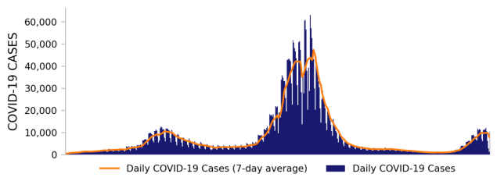
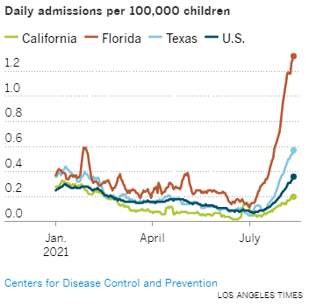
Current Outlook
Over 90% of new cases in California are the Delta variant.
We are still very far from the Winter Surge and seeing signs that growth is slowing. Nevertheless, schools must plan and prepare for continued elevated rates.
We should learn from the experience of what is happening nationally.
SAFE SCHOOLS FOR ALL
Notes:
References:
https://www.cdph.ca.gov/Programs/CID/DCDC/Pages/COVID-19/COVID-Variants.aspx
https://covid.cdc.gov/covid-data-tracker/#variant-proportions
https://www.latimes.com/california/story/2021-08-14/kids-covid-hospitalization-rates

Slide 13
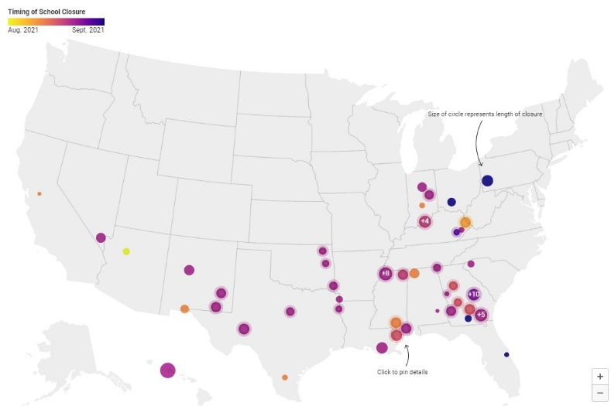
National and State Context
The school year has not started for many students, but here is a preliminary snapshot.
No Delays in California Due to COVID-19. Although some schools in other states have started the year in distance learning or delayed start dates, California schools appear to have started according to schedule. 17 of the 20 largest districts in the state have opened, and the other three are on schedule.
California School Closures Have Been Minimal. Nationally and in California, schools are struggling to manage the Delta variant. However, although schools in other states are closing for in-person instruction due to outbreaks, closures in California have been minimal to date (see right).
Above: Snapshot of school closures as of 8/23. Note: Schools in the Northwest, Midwest, and Northeast typically start in September.
SAFE SCHOOLS FOR ALL
Notes:
References:
https://cai.burbio.com/school-opening-tracker/

Slide 14
Wide-Angle Lens: What Patterns Are We Seeing?
Pattern #1: School-associated cases caused by non-school social events.
Example: A suburban high school experienced high levels of cases due to a back-to-school party held the week before school.
Example: Multiple rural high schools in the same community experienced high levels of cases due to attendance at a local fair.
Pattern #2: Cases caused by symptomatic individuals who went to school while sick.
Example: Two outbreaks associated with individuals (adults and children) coming to school with symptoms, leading to some in-school transmission.
Pattern #3: Staffing shortages caused by low rates of vaccination among staff.
Example: Multiple schools report staffing shortages due to vaccination rates estimated below 70% among staff.
Pattern #4: Difficulty ramping up testing capacity at sufficient speed.
Example: Multiple school districts with a desire to ramp up testing immediately, but unable to because of a sudden national surge in testing demand.
SAFE SCHOOLS FOR ALL

Slide 15
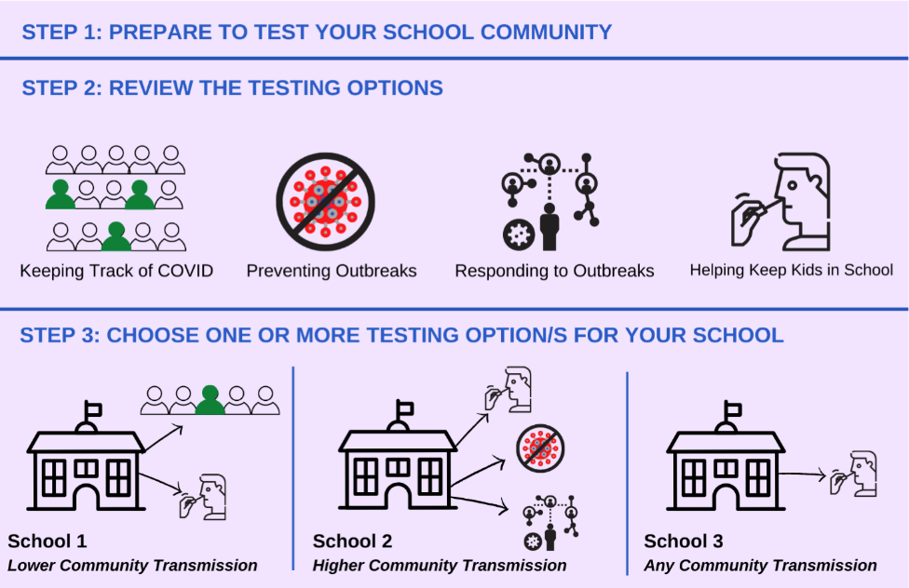
COVID-19 Testing
The state offers multiple no-cost testing options to all schools – traditional, charter, and private – and many have signed up.
Overview:
Options including PCR, antigen, and pooled-testing programs
684 school districts (of 1,037) onboarded
444 school districts (of 1,037) receiving personnel grants on an equity basis
Over 1,000,000 PCR test kits shipped
Over 2,000,000 antigen test kits shipped
CDPH K-12 School-Based COVID-19 Testing Strategies and Interest Form available at:
https://testing.covid19.ca.gov/school-testing/
SAFE SCHOOLS FOR ALL
Notes:
Resources:
https://testing.covid19.ca.gov/school-testing/

Slide 16
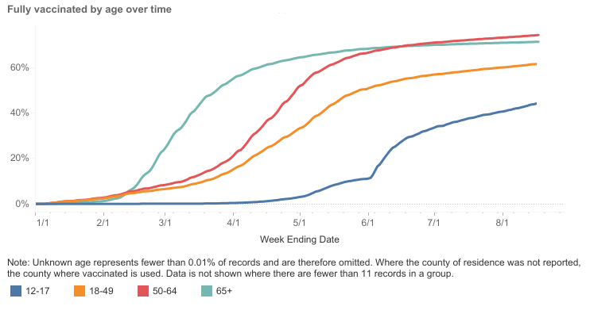
Vaccines
Vaccines substantially reduce the need for quarantines, especially in middle and high schools.
Outreach and Engagement. Assets are available to help promote vaccines (see Google Drive link in references):
Sample back-to-school flyers
Model content for newsletters and school marquees
Social media posts and recorded testimonials
School-Located Clinics. Resources are available to:
Request mobile or pop-up clinics
Request a pharmacy to come to your school
Request volunteers
Become a vaccine provider and receive a grant of up to $55,000
74.4%
71.4%
61.7%
44.3%
Authorization for ages 5-11 expected by mid-winter.
86.3% of counties report establishing school-located clinics for the 2021-22 school year.
SAFE SCHOOLS FOR ALL
Notes:
References:
https://covid19.ca.gov/vaccination-progress-data/
https://www.nbcnews.com/news/us-news/after-fda-approves-pfizer-vaccine-several-steps-remain-kids-under-n1277476
Resources:
https://drive.google.com/drive/folders/1U0km8ZvTtVGxzDf6umQ4M6sfczIYNNyt
https://toolkit.covid19.ca.gov/partners/
https://www.shotsforschool.org/k-12/clinics/

Slide 17
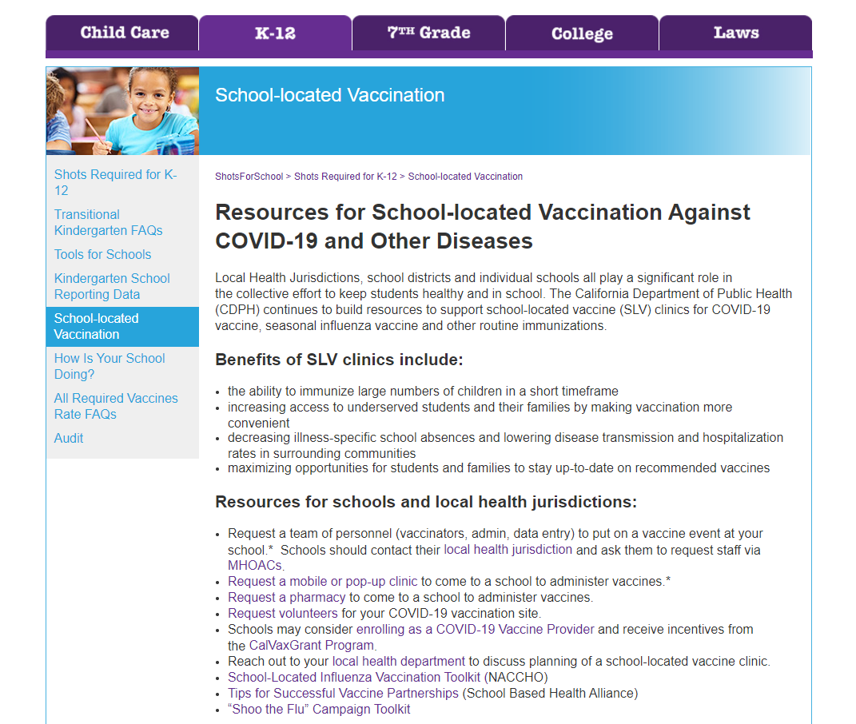
Vaccines (cont.)
If you want help setting up a school-located clinic, please visit:
https://www.shotsforschool.org/k-12/clinics/
Notes:
Resources:
https://www.shotsforschool.org/k-12/clinics/

Slide 18

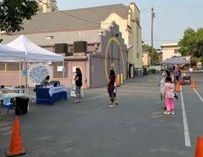
State Supports + Rapid Response
In addition to no-cost testing, the state has multiple supports available for schools.
636 LEAs serving 4,754,519 pupils have been provided technical assistance for returning to in-person instruction.
407 LEAs have been provided technical assistance on outbreak mitigation.
73 LEAs have been provided onsite consultation.
Strike teams with testing and vaccine resources have been and are being deployed to schools with the most acute challenges. Please note: strike team capacity is limited.
Pictured to the right: an on-site testing clinic that was stood up the next school day after a surge in cases, which included 15-minute rapid testing and free take-home test kits.
SAFE SCHOOLS FOR ALL
Notes:
Resources:
https://schools.covid19.ca.gov/

Slide 19
3. Hot Topics
SAFE SCHOOLS FOR ALL

Slide 20
Quarantines
General Rule: Throughout the pandemic, quarantine was recommended for anyone who had been within 6 feet of a positive case for 15 minutes or more.
Modified Rule: CDPH recommends a targeted approach in the context of masking, as does the CDC. Under ‘Modified Quarantine’, a student may remain in class after a possible exposure if:
  Both students were wearing a mask;
  The exposed student remains asymptomatic;
  The exposed student undergoes twice weekly testing; and
  The exposed student refrains from extracurricular activities.
Rationale: Apply what we have learned about COVID to maximize instructional time, recognizing that masking and testing create additional safety layers.
Tips:
Expand testing capacity to meet the testing recommendation.
If you have not yet, establish seating charts to help track exposures.
Where possible, create stable groups to limit the number of students exposed.
Adhere to the recommendation as closely as possible, consistent with the rationale.
SAFE SCHOOLS FOR ALL
Notes:
Resources:
https://www.cdph.ca.gov/Programs/CID/DCDC/Pages/COVID-19/K-12-Guidance-2021-22-School-Year.aspx

Slide 21
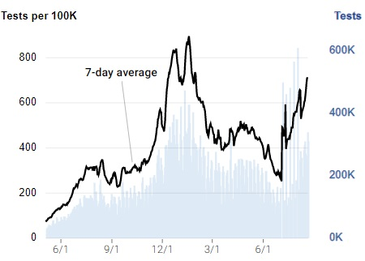
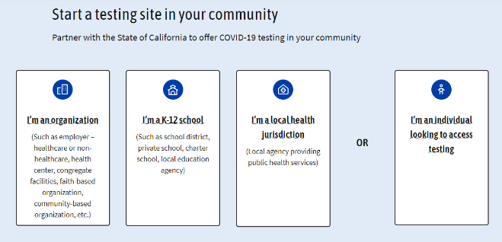
Testing
Act Now. School communities across the nation were hoping for less need for COVID precautions this school year. Delta’s arrival has created a need for more testing capacity in many schools.
Onboarding and Scaling Take Time. It can take weeks to establish the testing capacity you need. Be prepared.
Heightened Demand. With Delta, testing demand has spiked (see right), so you will be competing with others.
National Supply Chain Challenges. Some major manufacturers ramped down their production capacity shortly before the surge.
Let the State Help. The state can help at no cost – the earlier, the better. Please visit https://testing.covid19.ca.gov/get-started/.
SAFE SCHOOLS FOR ALL
Notes:
References:
https://www.nytimes.com/2021/08/20/us/abbott-covid-tests.html
Resources:
https://testing.covid19.ca.gov/get-started/

Slide 22
Staffing
One of the key challenges facing schools is when cases and quarantines cause staffing shortages that, in turn, disrupt the ability to stay open for in-person instruction.
Key Measures to Consider:
Ensure Staff Are Vaccinated or Tested Weekly. Consistent with the August 11 public health order, encourage and ensure all staff are vaccinated or tested weekly.
Employ the Guidance for Vaccinated People. According to the May 12 public health order, fully vaccinated individuals do not need to quarantine if asymptomatic.
Recruit Retired Staff and Others to Meet Short-Term Needs. The Governor issued an executive order on August 16 that makes it easier for schools to bring back recently retired K-12 teachers and staff.
SAFE SCHOOLS FOR ALL
Notes:
Resources:
https://www.cdph.ca.gov/Programs/CID/DCDC/Pages/COVID-19/Order-of-the-State-Public-Health-Officer-Vaccine-Verification-for-Workers-in-Schools.aspx
https://www.cdph.ca.gov/Programs/CID/DCDC/Pages/COVID-19/COVID-19-Public-Health-Recommendations-for-Fully-Vaccinated-People.aspx
https://www.gov.ca.gov/wp-content/uploads/2021/08/8.16.21-EO-N-12-21.pdf

Slide 23
Additional Resources for Strategic Prevention
Additional “How to” Materials to Support:
Mask requirements
Safety during recess, meals, music, art, and PE
Awareness of symptoms
Limiting exposures
Safety on buses and other transportation
Vaccine education for families
U.S. ED COVID-19 Strategies for Safely Reopening Schools
CCEE Health and Safety Guidebook
LPI Resources for Reopening Schools
American Academy of Pediatrics: Guidance for Safe Schools
SAFE SCHOOLS FOR ALL
Notes:
Resources:
https://www2.ed.gov/documents/coronavirus/reopening.pdf
https://ccee-ca.org/resources/professional-learning/new-health-and-safety-guidebook/
https://reopening.learningpolicyinstitute.org/tools-and-guidance-for-schools
https://www.aap.org/en/pages/2019-novel-coronavirus-covid-19-infections/clinical-guidance/covid-19-planning-considerations-return-to-in-person-education-in-schools/

Slide 24

If You Have Questions, Please Ask
If you need help or advice, please reach out at the Safe Schools Hub:
schools.covid19.ca.gov
Notes:
Resources:
https://schools.covid19.ca.gov/

Slide 25
THANK YOU

