Slide 1
Congenital Syphilis
California STD Surveillance 2020

Slide 2
Congenital Syphilis, California Incidence Rates, 1940–2020
(Revised 04/2022)

Slide 3
Congenital Syphilis, California versus United States Incidence Rates, 1963–2020
California
United
States
2030 Healthy People Objective (33.9)
Note: The Modified Kaufman Criteria were used through 1989. The CDC Case Definition (MMWR 1989; 48: 828) was used effective January 1, 1990. California data prior to 1985 include all cases of congenital syphilis, regardless of age.
(Revised 04/2022)

Slide 4
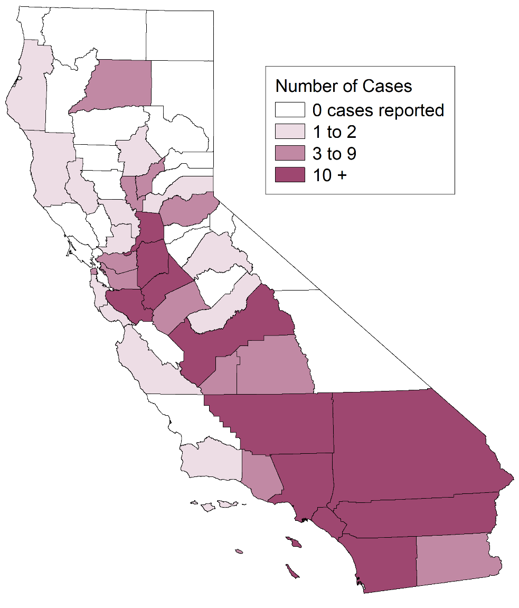
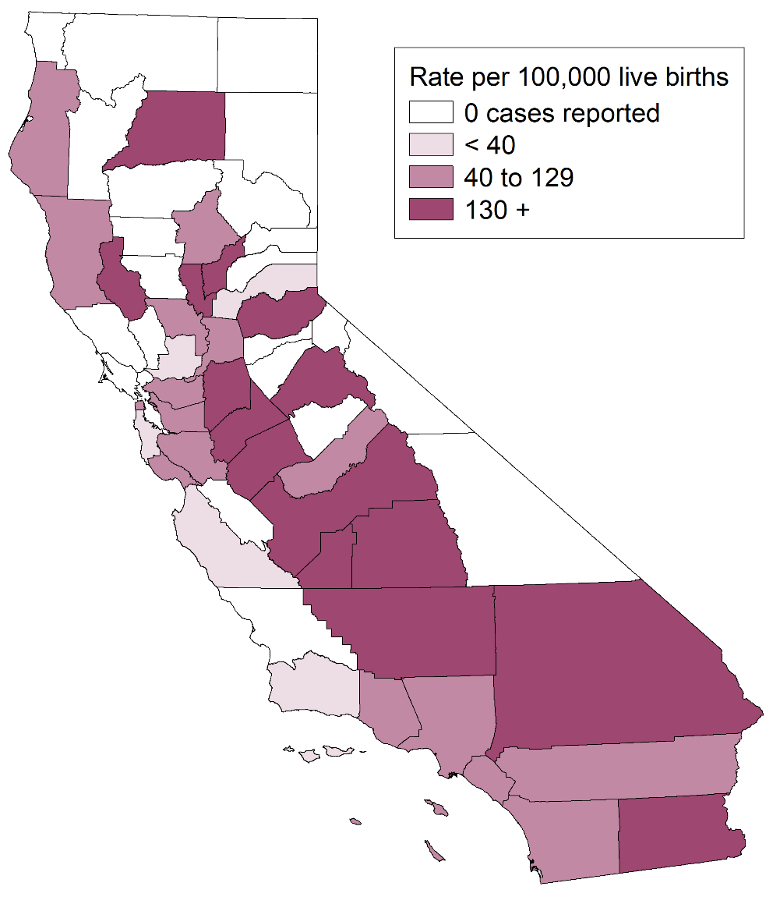
Congenital Syphilis, Case Counts and Incidence Rates by County, California, 2020
Congenital Syphilis Cases
Congenital Syphilis Rates
(Revised 04/2022)

Slide 5
Congenital Syphilis, Ranked Incidence Rates by County, California, 2020
Note: Excludes counties with no cases (22 counties in 2020).
(Revised 04/2022)

Slide 6
Congenital Syphilis, Cases by Vital Status and Presence of Signs/Symptoms, California, 2011–2020
Alive, no signs of CS
Alive, signs of CS
Stillbirth or Neonatal death
Note: Alive, no signs/symptoms includes alive with missing documentation on signs/symptoms.
Of the 483 total cases in 2020, 390 alive with no signs, 62 alive with signs of CS, 31 stillbirth or neonatal death
(Revised 04/2022)

Slide 7
Congenital Syphilis Stillbirths or Neonatal Deaths, California, 2011–2020
(Revised 04/2022)

Slide 8
Congenital Syphilis, Stillbirths versus Live Birth Case Counts, California, 1990–2020
(Revised 04/2022)

Slide 9
Congenital Syphilis versus Female Primary & Secondary Syphilis Incidence Rates, California, 1980–2020
Note: Incidence rates for congenital syphilis were per 100,000 live births.
(Revised 04/2022)

Slide 10
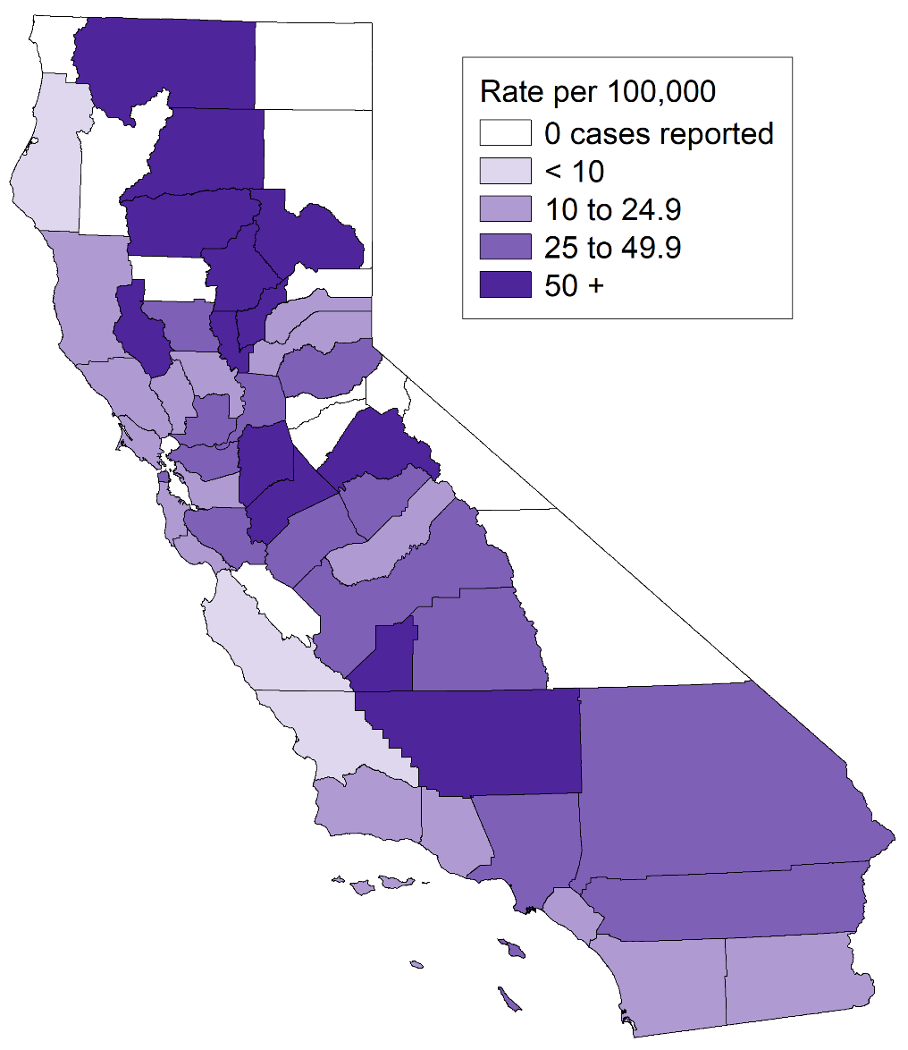
Early Syphilis* Incidence Rates among Females of Childbearing Age (15-44) & Congenital Syphilis Incidence Rates, by County, California, 2020
Early Syphilis Females Age 15-44 Rates
Congenital Syphilis Rates
* Early syphilis includes primary, secondary, and early non-primary non-secondary syphilis.
(Revised 04/2022)

Slide 11
Congenital Syphilis Cases and Childbearing Age (15-44) Female Early Syphilis* Incidence Rates, California, 2011–2020
Early Syphilis Rate per 100,000 Females Number of Congenital
of Childbearing Age (15-44 years) Syphilis Cases
* Early syphilis includes primary, secondary, and early non-primary non-secondary syphilis.
(Revised 04/2022)

Slide 12
Congenital Syphilis Cases and Childbearing Age (15-44) Female Syphilis (all stages*) Incidence Rates, California, 2011–2020
Syphilis Rate per 100,000 Females Number of Congenital
of Childbearing Age (15-44 years) Syphilis Cases
* Includes primary, secondary, early non-primary non-secondary, and unknown duration or late syphilis.
(Revised 04/2022)

Slide 13
Congenital Syphilis Cases and Female Early Syphilis* Cases by Pregnancy Status, California, 2011–2020
* Early syphilis includes primary, secondary, and early non-primary non-secondary syphilis.
(Revised 04/2022)

Slide 14
Congenital Syphilis Cases and Female Syphilis (all stages*) Cases by Pregnancy Status, California, 2011–2020
* Includes primary, secondary, early non-primary non-secondary, and unknown duration or late syphilis.
(Revised 04/2022)

Slide 15
Congenital Syphilis Cases and Females of Childbearing Age (15-44) Early Syphilis* Cases by Pregnancy Status, California, 2011–2020
* Early syphilis includes primary, secondary, and early non-primary non-secondary syphilis.
(Revised 04/2022)

Slide 16
Congenital Syphilis Cases and Females of Childbearing Age (15-44) Syphilis* Cases by Pregnancy Status, California, 2011–2020
* Includes primary, secondary, early non-primary non-secondary, and unknown duration or late syphilis.
(Revised 04/2022)

Slide 17
Female Early Syphilis* and Congenital Syphilis Cases California, 2011–2020
* Early syphilis includes primary, secondary, and early non-primary non-secondary syphilis.
(Revised 04/2022)

Slide 18
Female Syphilis (all stages*) and Congenital Syphilis Cases California, 2011–2020
* Includes primary, secondary, early non-primary non-secondary, and unknown duration or late syphilis.
(Revised 04/2022)

Slide 19
Congenital Syphilis, Incidence Rates by Race/Ethnicity of Mother California, 2011–2020
Note: A/PI = Asian/Pacific Islander
Data excluded for American Indian/Alaska Native due to small numbers of cases causing unstable rates.
(Revised 04/2022)

Slide 20
Congenital Syphilis, Case Counts and Incidence Rates by Race/Ethnicity of Mother, California, 2020
Note: Data excluded for American Indian/Alaska Native and unknown race/ethnicity due to small numbers of cases causing unstable rates.
(Revised 04/2022)

