Slide 1
Congenital Syphilis
California STD Surveillance 2019

Slide 2
Congenital Syphilis, California Incidence Rates, 1940–2019
(Revised 11/2020)

Slide 3
Congenital Syphilis, California versus United States Incidence Rates,
1963–2019
California
United
States
2020 Objective
(9.6)
Note: The Modified Kaufman Criteria were used through 1989. The CDC Case Definition (MMWR 1989; 48: 828) was used effective January 1, 1990. California data prior to 1985 include all cases of congenital syphilis, regardless of age.
(Revised 11/2020)

Slide 4
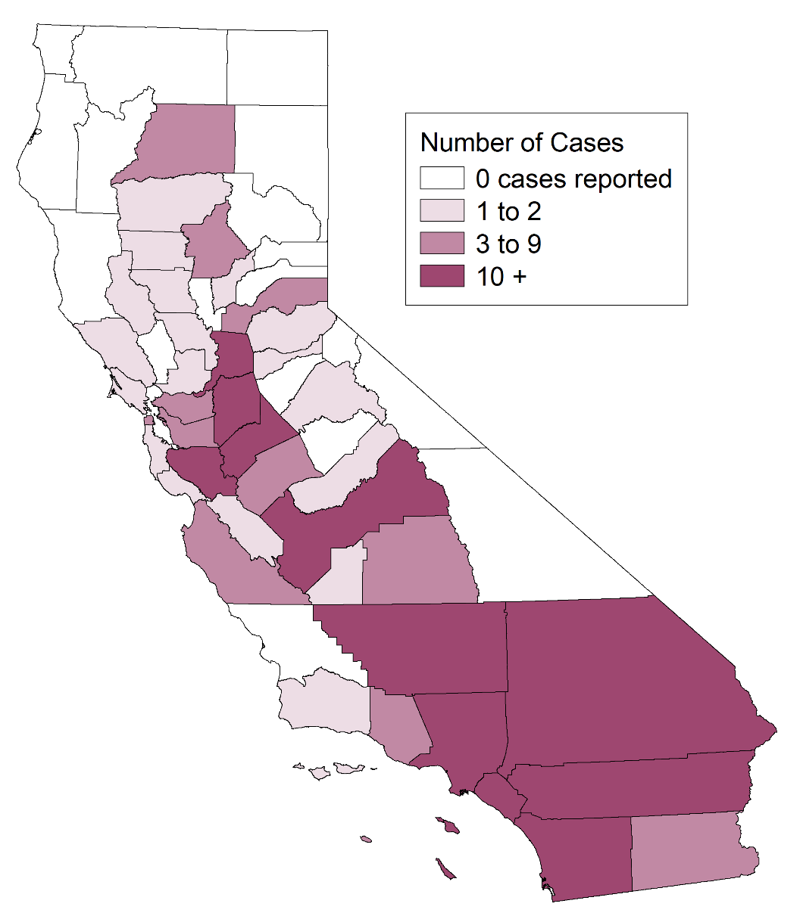
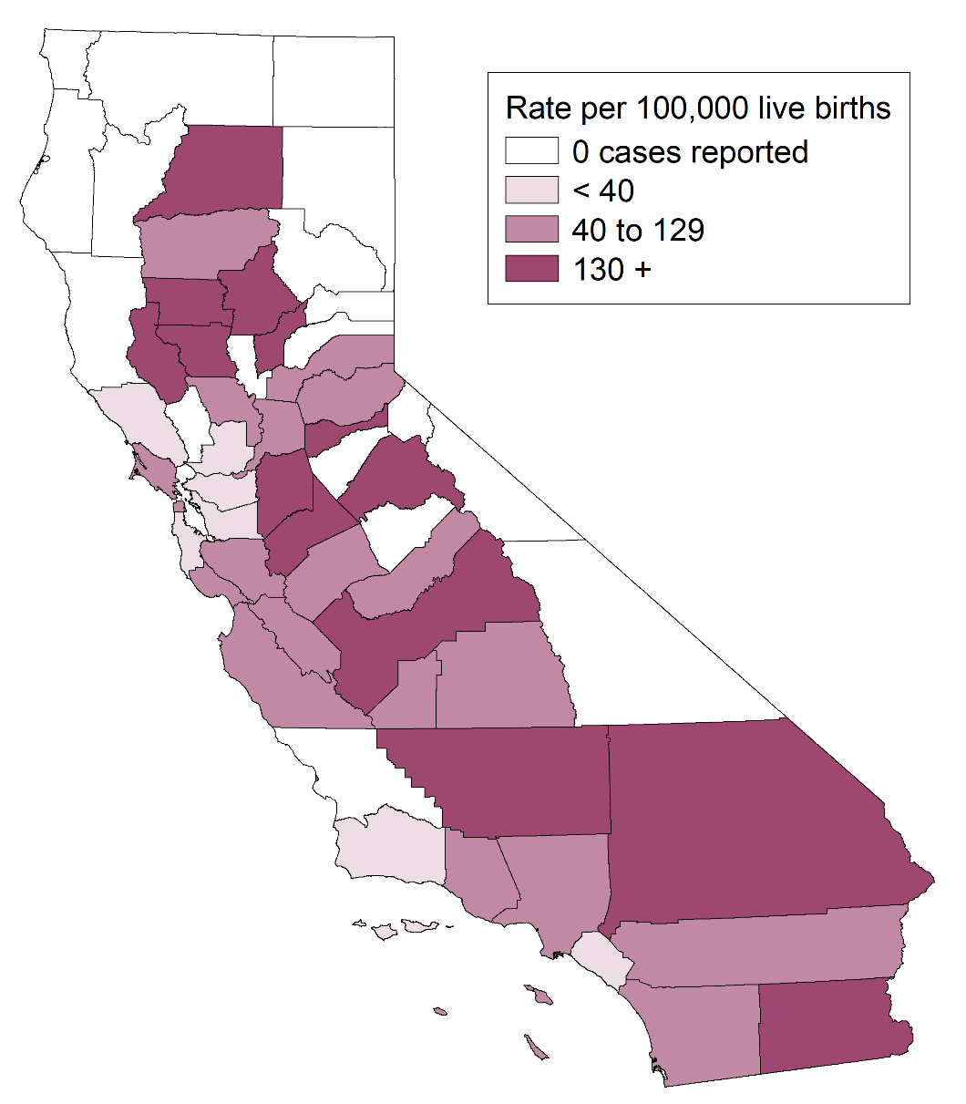
Congenital Syphilis, Case Counts and Incidence Rates by County,
California, 2019
Congenital Syphilis Cases
Congenital Syphilis Rates
(Revised 11/2020)

Slide 5
Congenital Syphilis, Ranked Incidence Rates by County,
California, 2019
Note: Excludes counties with no cases (18 counties in 2019).
(Revised 11/2020)

Slide 6
Congenital Syphilis, Cases by Vital Status and Presence of Signs/Symptoms, California, 2010–2019
Alive, no signs of CS
Alive, signs of CS
Stillbirth or neonatal death
Note: Alive, no signs/symptoms includes alive with missing documentation on signs/symptoms.
Of the 444 total cases in 2019, 345 alive with no signs, 56 alive with signs of CS, 43 stillbirth or neonatal death.
(Revised 11/2020)

Slide 7
Congenital Syphilis Stillbirths, California, 2011–2019
(Revised 11/2020)

Slide 8
Congenital Syphilis, Stillbirth versus Live Birth Case Counts,
California, 1990–2019
(Revised 11/2020)

Slide 9
Congenital Syphilis versus Female Primary & Secondary Syphilis Incidence Rates, California, 1980–2019
Note: Incidence rates for congenital syphilis are per 100,000 live births.
(Revised 11/2020)

Slide 10
Congenital Syphilis Cases versus Childbearing Age (15-44) Female Early Syphilis* Incidence Rates, California, 2010–2019
Early Syphilis Rate per 100,000 Females Number of Congenital
of Childbearing Age (15-44 years) Syphilis Cases
* Early syphilis includes primary, secondary, and early non-primary non-secondary syphilis.
(Revised 11/2020)

Slide 11
Congenital Syphilis Cases versus Childbearing Age (15-44) Female Syphilis (all stages*) Incidence Rates, California, 2010–2019
Syphilis Rate per 100,000 Females Number of Congenital
of Childbearing Age (15-44 years) Syphilis Cases
* Includes primary, secondary, early non-primary non-secondary, and unknown duration or late syphilis.
(Revised 11/2020)

Slide 12
Congenital Syphilis Cases versus Female Early Syphilis* Cases by Pregnancy Status, California, 2010–2019
* Early syphilis includes primary, secondary, and early non-primary non-secondary syphilis.
(Revised 11/2020)

Slide 13
Congenital Syphilis Cases versus Female Syphilis (all stages*) Cases by Pregnancy Status, California, 2010–2019
* Includes primary, secondary, early non-primary non-secondary, and unknown duration or late syphilis.
(Revised 11/2020)

Slide 14
Congenital Syphilis Cases versus Females of Childbearing Age (15-44) Early Syphilis* Cases by Pregnancy Status, California, 2010–2019
* Early syphilis includes primary, secondary, and early non-primary non-secondary syphilis.
(Revised 11/2020)

Slide 15
Congenital Syphilis Cases versus Females of Childbearing Age (15-44) Syphilis* Cases by Pregnancy Status, California, 2010–2019
* Includes primary, secondary, early non-primary non-secondary, and unknown duration or late syphilis.
(Revised 11/2020)

Slide 16
Female Early Syphilis* and Congenital Syphilis Cases
California, 2010–2019
* Early syphilis includes primary, secondary, and early non-primary non-secondary syphilis.
(Revised 11/2020)

Slide 17
Female Syphilis (all stages*) and Congenital Syphilis Cases
California, 2010–2019
* Includes primary, secondary, early non-primary non-secondary, and unknown duration or late syphilis.
(Revised 11/2020)

Slide 18
Congenital Syphilis, Incidence Rates by Race/Ethnicity of Mother California, 2010–2019
Note: A/PI = Asian/Pacific Islander
Data excluded for American Indian/Alaska Native due to small numbers of cases causing unstable rates.
(Revised 11/2020)

Slide 19
Congenital Syphilis, Case Counts and Incidence Rates by Race/Ethnicity of Mother, California, 2019
Note: Data excluded for American Indian/Alaska Native and unknown race/ethnicity due to small numbers of cases causing unstable rates.
(Revised 11/2020)

