Slide 1
Gonorrhea
California STD Surveillance 2019

Slide 2
Gonorrhea, California Incidence Rates, 1913–2019
(Revised 11/2020)

Slide 3
Gonorrhea, California versus United States Incidence Rates, 1941–2019
California
United States
(Revised 11/2020)

Slide 4
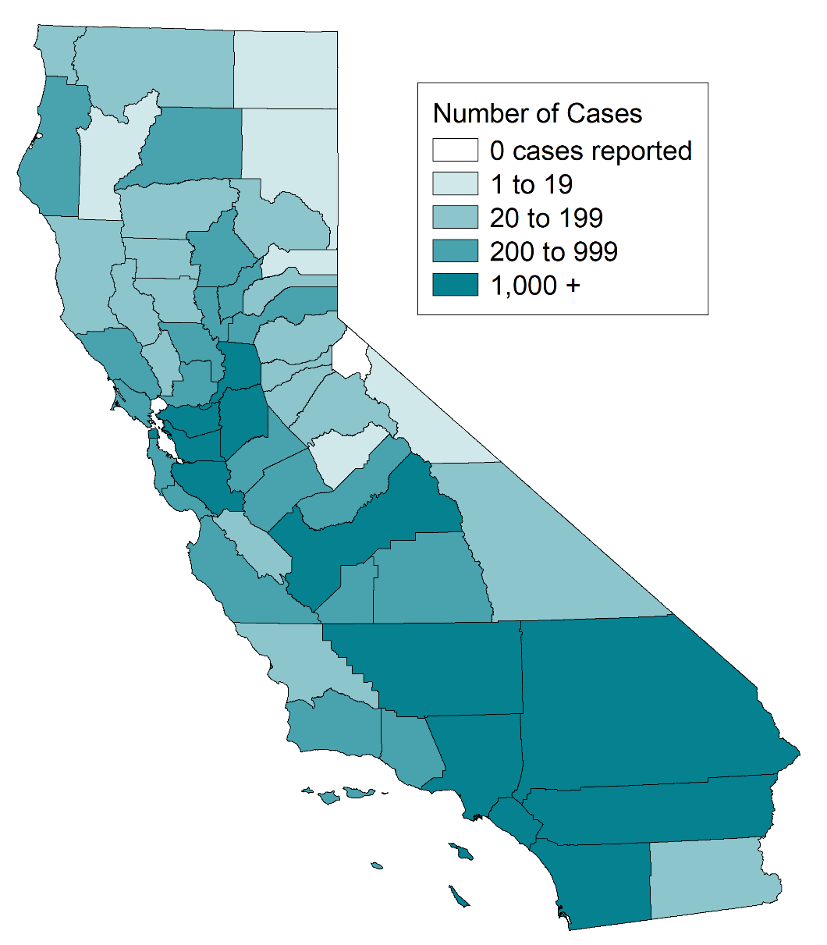
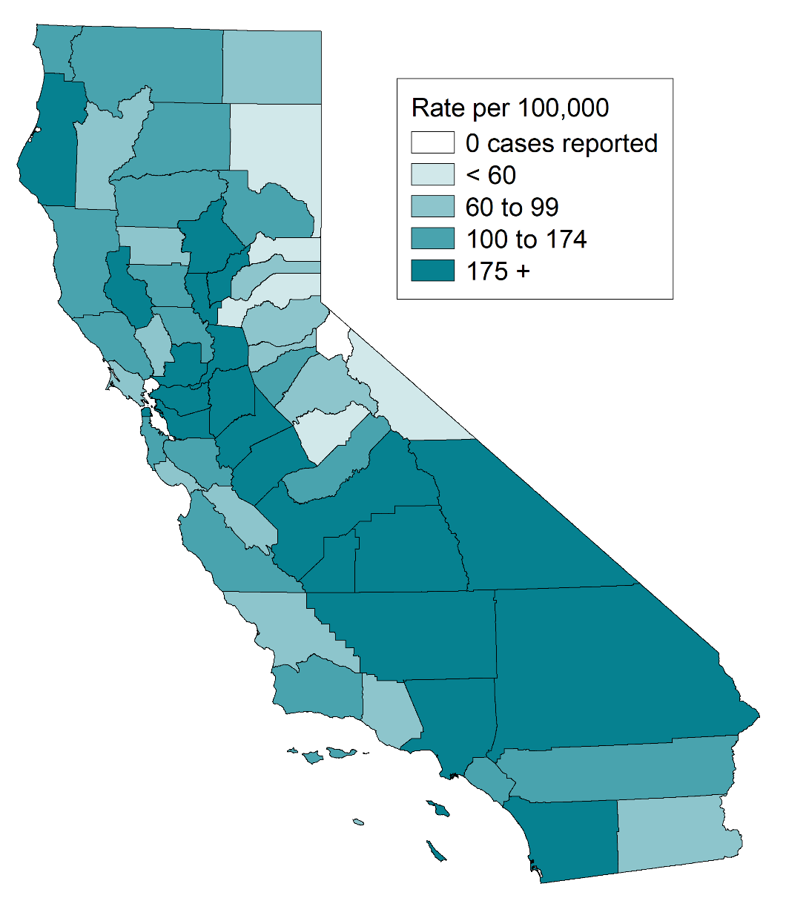
Gonorrhea, Case Counts and Incidence Rates by County, California, 2019
Gonorrhea Cases
Gonorrhea Rates
(Revised 11/2020)

Slide 5
Gonorrhea, Ranked Incidence Rates by County, California, 2019
Note: Excludes counties with no cases (1 county in 2019).
(Revised 11/2020)

Slide 6
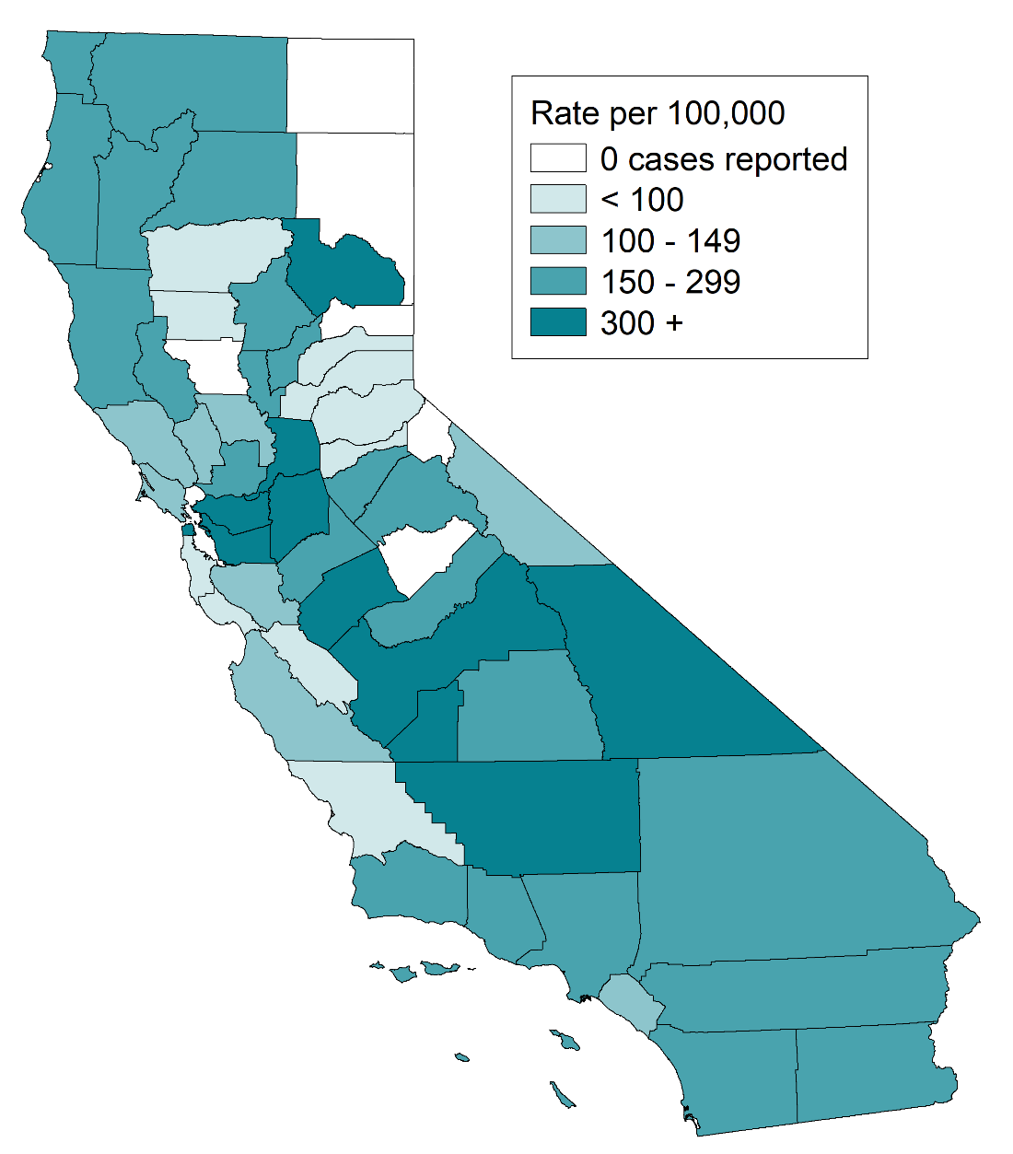
Gonorrhea among Youth Ages 15-19, Incidence Rates by County, California, 2019
(Revised 11/2020)

Slide 7
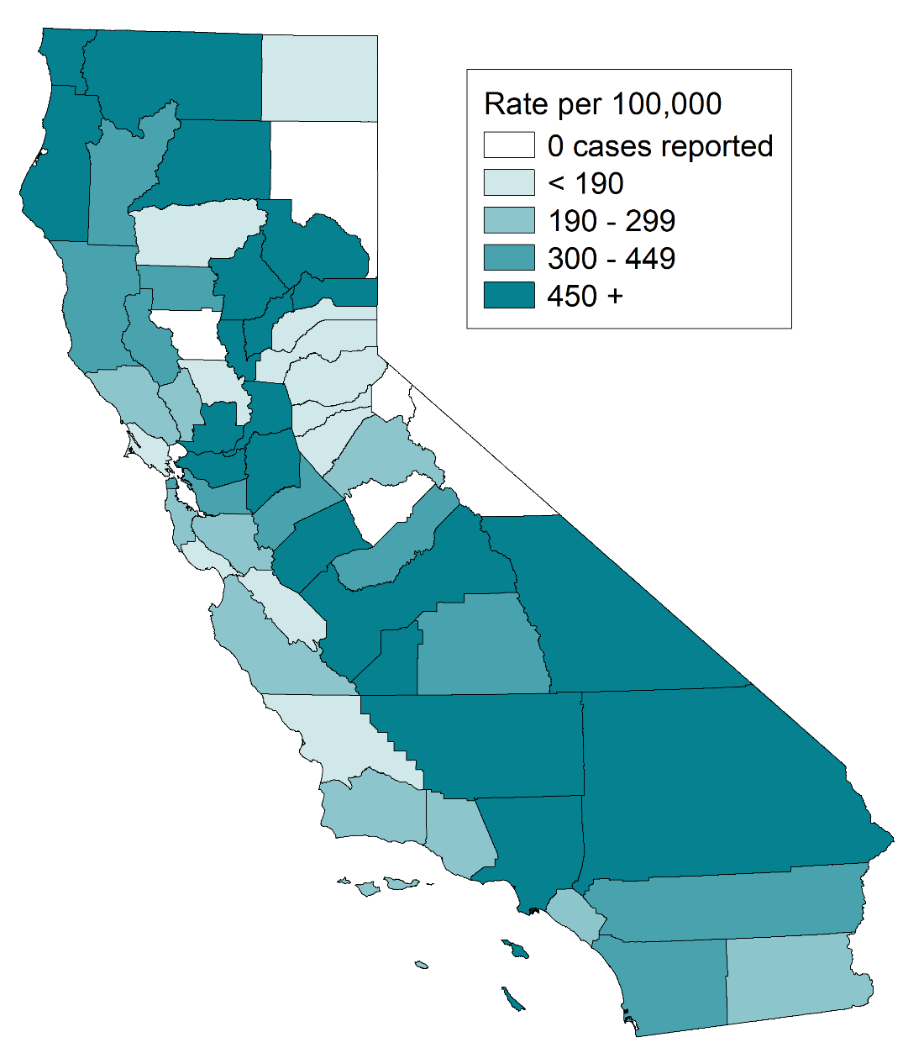
Gonorrhea among Females Ages 15-24, Incidence Rates by County, California, 2019
(Revised 11/2020)

Slide 8
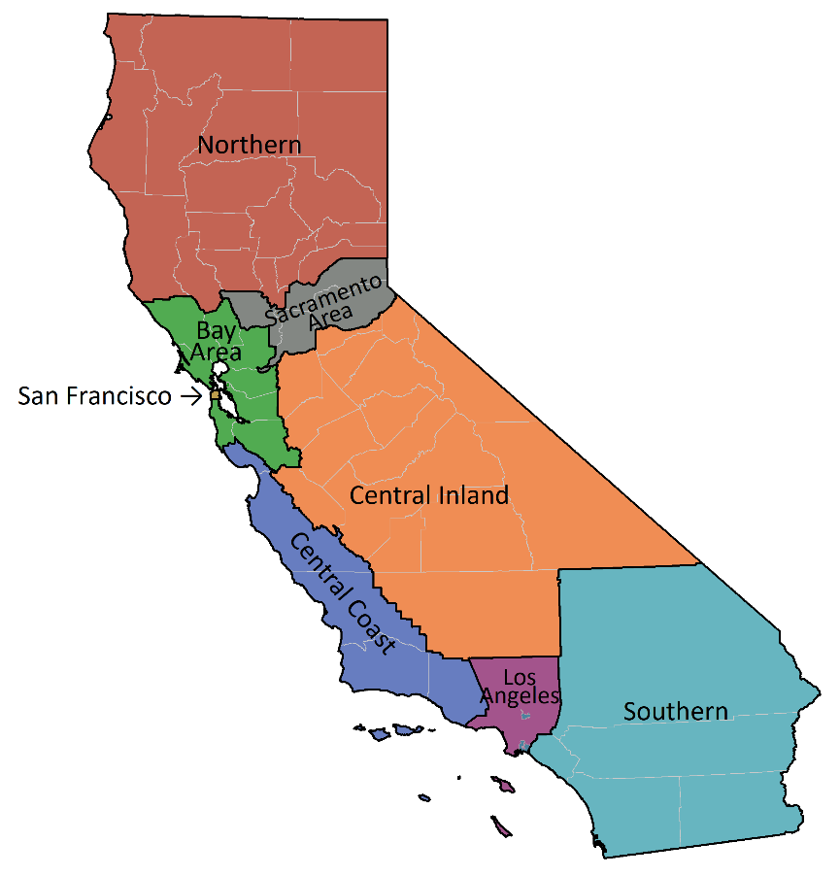
Gonorrhea, Incidence Rates by Region, California, 2010–2019
(Revised 11/2020)

Slide 9
Number of Gonorrhea Cases by Region, Gender, and Year California, 2010–2019
(Revised 11/2020)

Slide 10
Gonorrhea, Incidence Rates by Gender, California, 1990–2019
(Revised 11/2020)

Slide 11
Gonorrhea, Incidence Rates by Age Group (in years) and Gender, California, 2019
Male Rate per 100,000 Female
Note: Age was “Not Specified” for 0.2% of female cases and 0.2% of male cases for the given year.
(Revised 11/2020)

Slide 12
Gonorrhea, Incidence Rates for Females by Age Group (in years), California, 2010–2019
Note: Age “Not Specified” ranged from 0.1% to 0.5% of cases for females in any given year.
(Revised 11/2020)

Slide 13
Gonorrhea, Incidence Rates for Males by Age Group (in years), California, 2010–2019
Note: Age “Not Specified” ranged from 0.1% to 0.6% of cases for males in any given year.
(Revised 11/2020)

Slide 14
Gonorrhea, Incidence Rates by Race/Ethnicity and Gender, California, 2019
Male Rate per 100,000 Female
AI/AN = American Indian/Alaska Native, A/PI = Asian/Pacific Islander
Note: Race/Ethnicity was “Not Specified” for 24.9% of female cases and 22.3% of male cases for the given year.
(Revised 11/2020)

Slide 15
Gonorrhea, Female Incidence Rates by Race/Ethnicity and Age Group (in years), California, 2019
Age Group
(years)
A/PI Black/African American Hispanic White
% Race
Unknown
Rates per 100,000 population
Note: A/PI = Asian/Pacific Islander
American Indian/Alaska Native and race-specific data for ages 0-14 are suppressed as per agency Data De-Identification Guidelines (DDG).
(Revised 11/2020)

Slide 16
Gonorrhea, Male Incidence Rates by Race/Ethnicity and Age Group (in years), California, 2019
Age Group
(years)
A/PI Black/African American Hispanic White
% Race
Unknown
Rates per 100,000 population
Note: A/PI = Asian/Pacific Islander
American Indian/Alaska Native and race-specific data for ages 0-14 are suppressed as per agency Data De-Identification Guidelines (DDG).
(Revised 11/2020)

Slide 17
Gonorrhea, Incidence Rates for Females by Race/Ethnicity, California, 2010–2019
Note: AI/AN = American Indian/Alaska Native, A/PI = Asian/Pacific Islander.
Race/ethnicity “Not Specified” ranged from 21.5% to 31.6% of cases for females in any given year.
(Revised 11/2020)

Slide 18
Gonorrhea, Incidence Rates for Males by Race/Ethnicity, California, 2010–2019
Note: AI/AN = American Indian/Alaska Native, A/PI = Asian/Pacific Islander.
Race/ethnicity “Not Specified” ranged from 19.7% to 26.5% of cases for males in any given year.
(Revised 11/2020)

Slide 19
Gonorrhea Prevalence Monitoring, Percent Positive for Females of Selected Age Groups, by Health Care Setting, California, 2019
* 2019 data not yet available for Kaiser Northern California, thus 2018 is presented.
Source: Kaiser Permanente Northern California, Essential Access, Quest Diagnostics
(Revised 12/2020)

Slide 20
Gonorrhea Prevalence Monitoring, Percent Positive for Females, by Health Care Setting, California, 2010–2019
FP Quest = Family Planning Clinics served by Quest
FP Title X = Family Planning Title X Clinics
KNC = Kaiser Northern California
Source: Kaiser Permanente Northern California, Essential Access, Quest Diagnostics
(Revised 12/2020)

Slide 21
Gonorrhea Repeat Infection* among Females 1-6 months after Infection, by Data Source, California, 2019
* Percent of first repeat case report or positive test result within 1-6 months. Case report and family planning data include all initial infections that occurred in 2019, with repeat infections captured through the first half of 2020. Kaiser Northern California care data were limited to initial infections and repeat infections within 2018 (2019 data was not available)..
† Excludes Los Angeles , and San Francisco.
(Revised 12/2020)

Slide 22
California Gonococcal Surveillance System (CGSS)
California STD Surveillance 2019

Slide 23
California Gonococcal Surveillance System (CGSS), HIV Status among Sampled and Interviewed Men who Have Sex with Men* Cases, California, 2019
(N=256)
* Includes men who have sex with men only and men who have sex with men and women.
Note: N does not include HIV status unknown or refused to state: 16 cases in 2019.
(Revised 11/2020)

Slide 24
California Gonococcal Surveillance System (CGSS), HIV PrEP Use among Sampled and Interviewed HIV Negative Men who Have Sex with Men* Cases, California, 2019
(N=179)
* Includes men who have sex with men only and men who have sex with men and women.
Note: PrEP = Pre-exposure prophylaxis.
N does not include PrEP status unknown or refused to state: 2 cases in 2019.
(Revised 11/2020)

Slide 25
California Gonococcal Surveillance System (CGSS), Anatomic Site of Infection among Sampled and Interviewed Cases, by Sexual Orientation, California, 2019
249 169 260 # Cases
Note: Does not include 24 cases in 2019 without anatomic site of infection.
Genital includes urine, urethral, and other unspecified “genital” sites.
MSM= Men who have sex with men only and men who have sex with men and women
MSW=Men who have sex with women only
(Revised 11/2020)

Slide 26
California Gonococcal Surveillance System (CGSS), Percent of Sampled and Interviewed Cases who Reported Meeting Sex Partners at Specified Venues, by Sexual Orientation, California, 2019
* MSM= Men who have sex with men only and men who have sex with men and women
MSW=Men who have sex with women only
(Revised 11/2020)

Slide 27
California Gonococcal Surveillance System (CGSS), Percent of Sampled and Interviewed Cases Who Reported Methamphetamine Use, by Sexual Orientation, California, 2019
* MSM only = Men who have sex with men only
MSW=Men who have sex with women only
MSM&W=Men who have sex with men and women
(Revised 11/2020)

Slide 28
California Gonococcal Surveillance System (CGSS), Percent of Sampled and Interviewed Cases Who Reported Correctional History*, by Sexual Orientation, California, 2019
* Responded “Yes” to being in jail, juvenile hall, prison, incarcerated, on probation, or had an incarcerated partner in the 12 months prior to diagnosis.
MSM= Men who have sex with men only and men who have sex with men and women
MSW=Men who have sex with women only
(Revised 11/2020)

