Slide 1
Chlamydia
California STD Surveillance 2019

Slide 2
Chlamydia, California versus United States Incidence Rates, 1990–2019
California
United States
(Revised 11/2020)

Slide 3
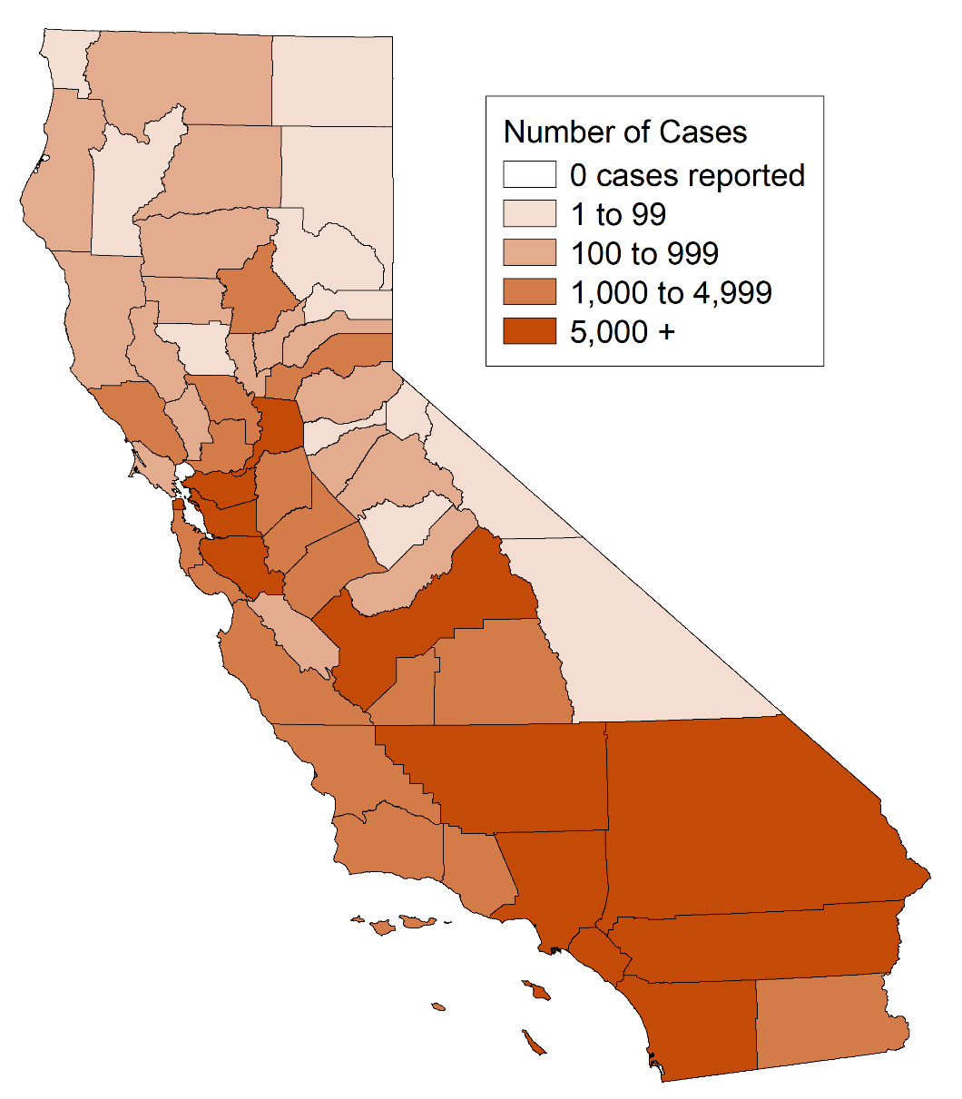
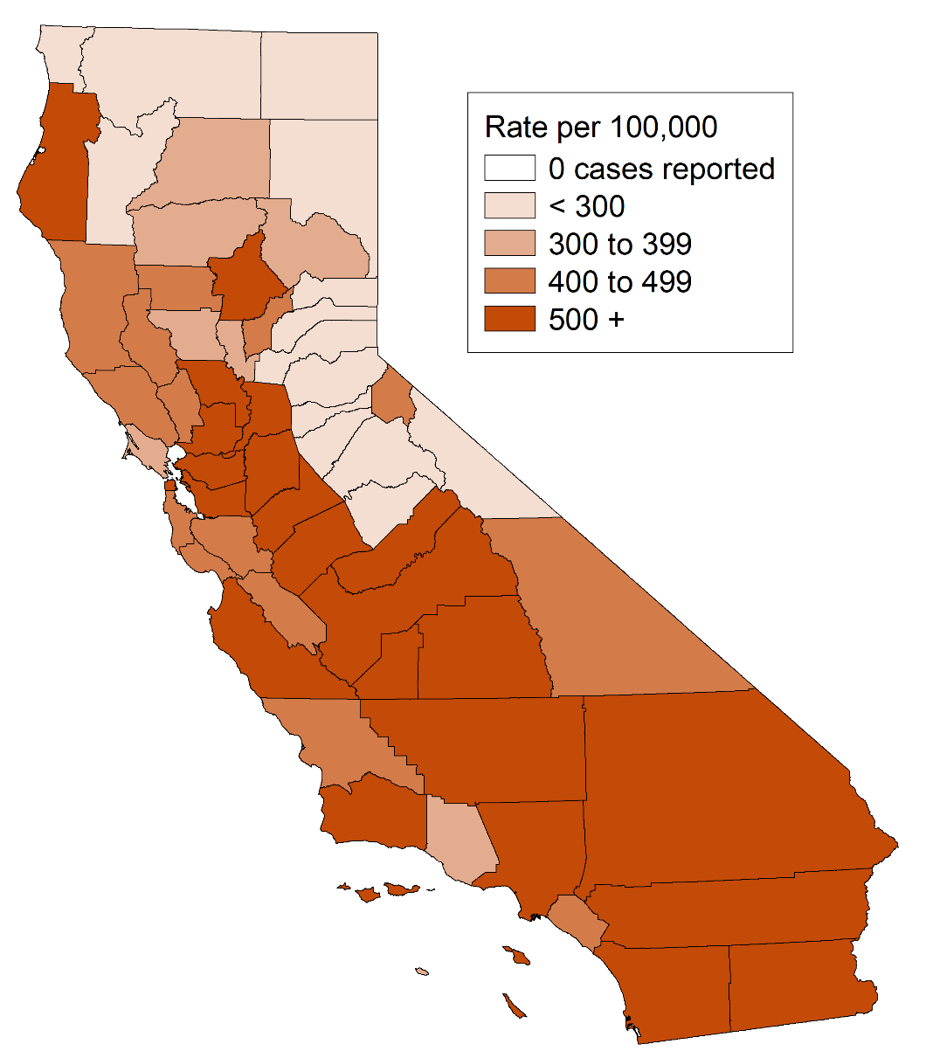
Chlamydia, Case Counts and Incidence Rates by County, California, 2019
Chlamydia Cases
Chlamydia Rates
(Revised 11/2020)

Slide 4
Chlamydia, Ranked Incidence Rates by County, California, 2019
Note: Excludes counties with no cases (none in 2019).
(Revised 11/2020)

Slide 5
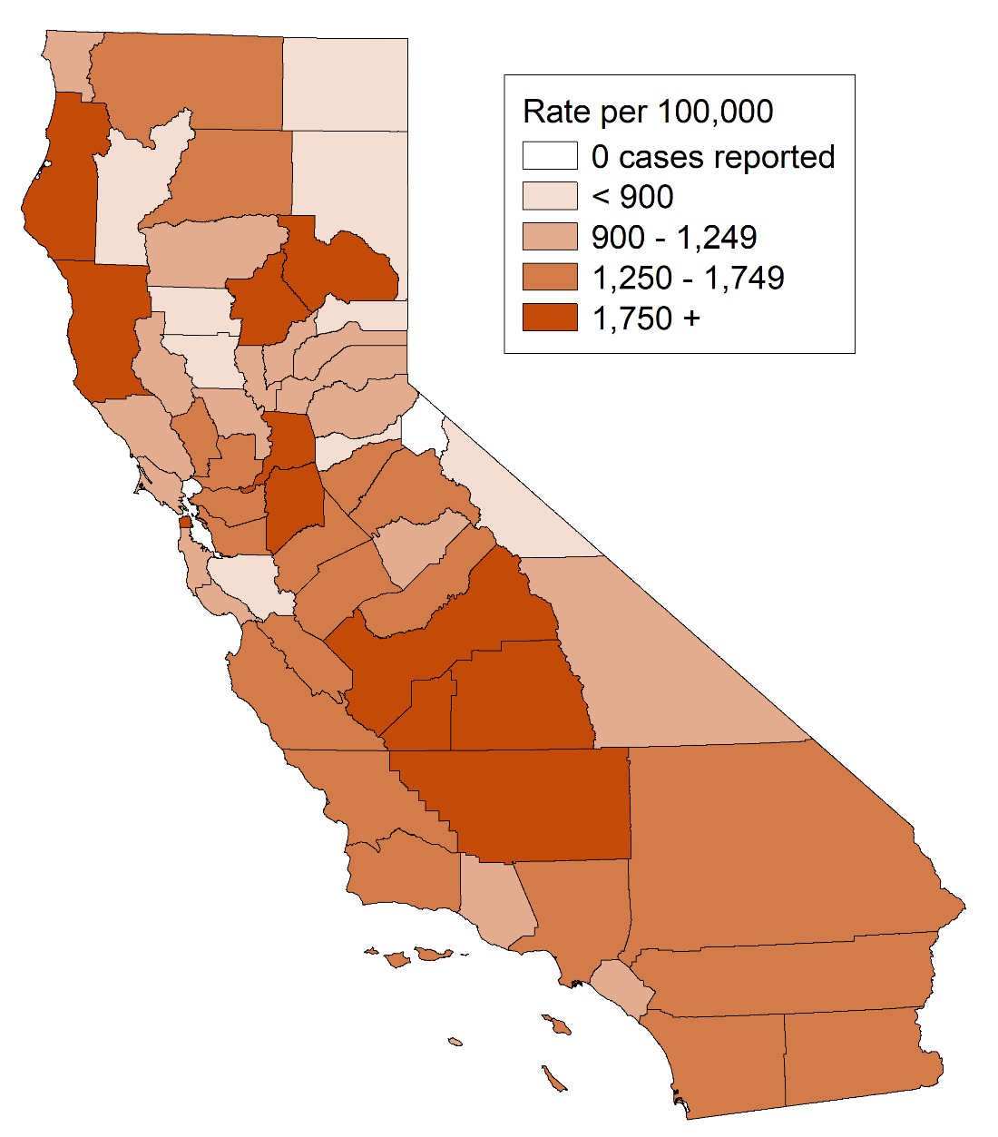
Chlamydia among Youth Ages 15-19, Incidence Rates by County, California, 2019
(Revised 11/2020)

Slide 6
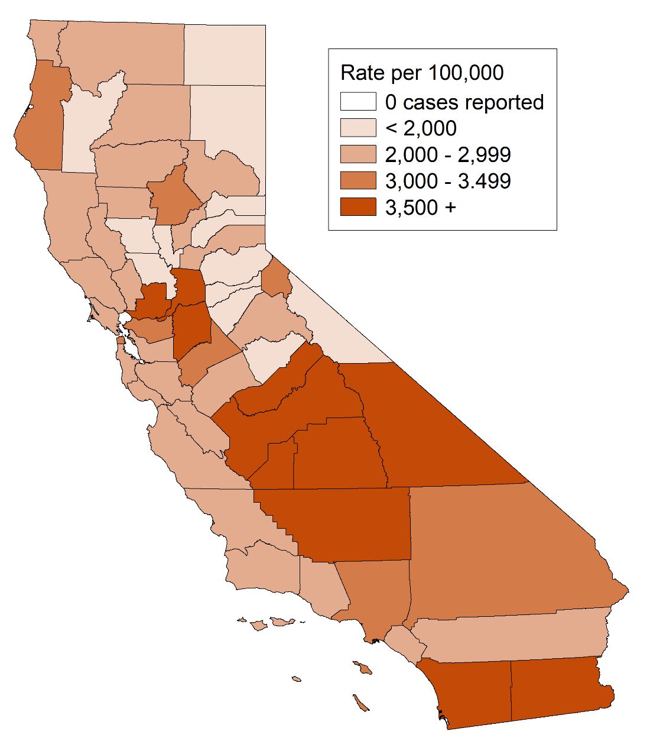
Chlamydia among Females Ages 15-24, Incidence Rates by County, California, 2019
(Revised 11/2020)

Slide 7
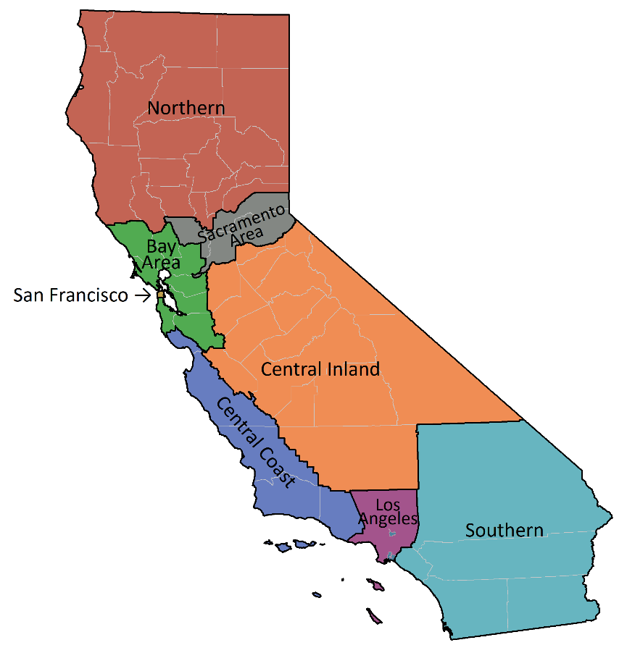
Chlamydia, Incidence Rates by Region, California, 2010–2019
(Revised 11/2020)

Slide 8
Number of Chlamydia Cases by Region, Gender, and Year California, 2010–2019
(Revised 11/2020)

Slide 9
Chlamydia, Incidence Rates by Gender, California, 1990–2019
Note: Screening guidelines recommend routine screening for specific populations, therefore higher rates of reported cases may in part reflect the targeted nature of screening programs.
(Revised 11/2020)

Slide 10
Chlamydia, Incidence Rates by Age Group (in years) and Gender, California, 2019
Male Rate per 100,000 Female
Note: Age was “Not Specified” for 0.2% of female cases and 0.2% of male cases for the given year.
Screening guidelines recommend routine screening for specific populations, therefore higher rates of reported cases may in part reflect the targeted nature of screening programs.
(Revised 11/2020)

Slide 11
Chlamydia, Incidence Rates for Females by Age Group (in years), California, 2010–2019
Note: Age “Not Specified” ranged from 0.2% to 0.4% of cases for females in any given year.
(Revised 11/2020)

Slide 12
Chlamydia, Incidence Rates for Males by Age Group (in years), California, 2010–2019
Note: Age “Not Specified” ranged from 0.1% to 0.5% of cases for males in any given year.
(Revised 11/2020)

Slide 13
Chlamydia, Incidence Rates by Race/Ethnicity and Gender, California, 2019
Male Rate per 100,000 Female
AI/AN = American Indian/Alaska Native, A/PI = Asian/Pacific Islander
Note: Race/Ethnicity was “Not Specified” for 40.5% of female cases and 35.4% of male cases for the given year..
Screening guidelines recommend routine screening for specific populations, therefore higher rates of reported cases may in part reflect the targeted nature of screening programs.
(Revised 11/2020)

Slide 14
Chlamydia, Female Incidence Rates by Race/Ethnicity and Age Group (in years), California, 2019
Age Group
(years)
A/PI Black/African American Hispanic White
% Race
Unknown
Rates per 100,000 population
Note: A/PI = Asian/Pacific Islander
American Indian/Alaska Native and race-specific data for ages 0-14 are suppressed as per agency Data De-Identification Guidelines (DDG).
(Revised 11/2020)

Slide 15
Chlamydia, Male Incidence Rates by Race/Ethnicity and Age Group (in years), California, 2019
Age Group
(years)
A/PI Black/African American Hispanic White
% Race
Unknown
Rates per 100,000 population
Note: A/PI = Asian/Pacific Islander
American Indian/Alaska Native and race-specific data for ages 0-14 are suppressed as per agency Data De-Identification Guidelines (DDG).
(Revised 11/2020)

Slide 16
Chlamydia, Incidence Rates for Females by Race/Ethnicity, California, 2010–2019
Note: AI/AN = American Indian/Alaska Native, A/PI = Asian/Pacific Islander.
Race/ethnicity “Not Specified” ranged from 32.4% to 41.3% of cases for females in any given year.
(Revised 11/2020)

Slide 17
Chlamydia, Incidence Rates for Males by Race/Ethnicity, California, 2010–2019
Note: AI/AN = American Indian/Alaska Native, A/PI = Asian/Pacific Islander.
Race/ethnicity “Not Specified” ranged from 29.5% to 38.5% of cases for males in any given year.
(Revised 11/2020)

Slide 18
Chlamydia Prevalence Monitoring, Percent Positive for Females of Selected Age Groups, by Health Care Setting, California, 2019
* 2019 data not yet available for Kaiser Northern California, thus 2018 is presented.
Source: Kaiser Permanente Northern California, Essential Access, Quest Diagnostics
(Revised 12/2020)

Slide 19
Chlamydia Prevalence Monitoring, Percent Positive for Females, by Health Care Setting, California, 2010–2019
FP Quest = Family Planning Clinics served by Quest
FP Title X = Family Planning Title X Clinics
KNC = Kaiser Northern California
Source: Kaiser Permanente Northern California, Essential Access, Quest Diagnostics
(Revised 12/2020)

Slide 20
Chlamydia Repeat Infection* among Females 1-6 months after Infection, by Data Source, California, 2019
* Percent of first repeat case report or positive test result within 1-6 months. Case report and family planning data include all initial infections that occurred in 2019, with repeat infections captured through the first half of 2020. Kaiser Northern California care data were limited to initial infections and repeat infections within 2018 (2019 data was not available)..
† Excludes Los Angeles , and San Francisco.
(Revised 12/2020)

