Slide 1
Revised CSTE Case Definition for Acute and Chronic Hepatitis C, 2016
CalREDIE Local Users Call
December 2, 2015
Rachel McLean, MPH
California Department of Public Health

Slide 2
Why Change the Hepatitis C Case Definition?
HCV antibody, RNA tests more accurate
Anti-HCV signal-to-cutoff ratio information often missing
HCV RIBA (confirmatory antibody test) no longer manufactured or used
Change HCV testing algorithm emphasizes antibody reflexing to RNA
Implementation of ELR
Limited resources for HCV surveillance

Slide 3
What are the key changes?
Changes (∆)
Threshold for acute ALT levels reduced from >400IU/L to >200IU/L
Timeframe for documented Anti-HCV seroconversion increased from 6 to 12 months
Counts anti-HCV+ in infant <18 mos. of age as PROBABLE chronic HCV
Additions (+)
Acute PROBABLE hepatitis C
HCV antigen listed, if the test is FDA approved
Removals (-)
Hepatitis C antibody signal-to-cutoff (s/co) ratio
Need for negative HAV / HBV serology to identify acute HCV cases
ALT above normal for chronic, probable cases
HCV RIBA

Slide 4
Clinical Criteria for Hepatitis C Case Classification
Similar to clinical presentation described in 2012 acute case definition
Changes (∆)
Lower ALT criteria (200 IU/L) meets criteria (2012 case definition: 400 IU/L)
2016 Clinical Criteria
Illness with discrete onset of any signs or symptoms consistent with acute viral hepatitis
AND
Jaundice
OR
Peak ALT > 200IU/L during period of acute illness
Notes:
No previous diagnosis of HCV

Slide 5
Laboratory Criteria for Hepatitis C for Case Classification
Additions (+)
New: HCV antigen listed, if FDA approved
Removals (-)
Anti-HCV signal-to-cutoff ratio
HCV RIBA
Need for absence of IgM to hepatitis A (IgM anti-HAV) and IgM hepatitis B core antigen (IgM anti-HBc)
2016 Lab Criteria
Positive test for antibodies to Hepatitis C
Hepatitis C Virus Detection Test

Slide 6
Hepatitis C Case Classifications 1
Meets clinical criteria AND has a positive HCV detection test
OR
Documented negative HCV antibody, HCV antigen or NAT test result followed within 12 months by a positive result of any of these tests
Acute, Confirmed
Acute, Probable
Meets clinical criteria AND has a positive anti-HCV antibody test, but has no report of a positive HCV detection test AND
Does not have test conversion within 12 month or has no report of test conversion

Slide 7
Hepatitis C Case Classifications 2
Does not meet clinical criteria or has no report of clinical criteria
AND
Does not have test conversion within 12 months or has no report of test conversion
AND
Has a positive HCV detection test
Chronic, Confirmed
Chronic, Probable
Does not meet clinical criteria or has no report of clinical criteria
AND
Does not have test conversion within 12 months or has no report of test conversion
AND
Has a positive anti-HCV antibody test, but no report of a positive HCV detection test

Slide 8
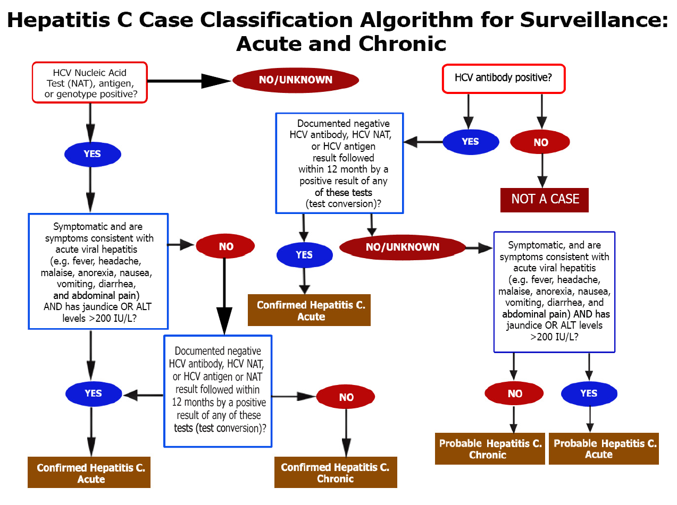
Hepatitis C Case Classification Algorithm for Surveillance: Acute and Chronic

Slide 9
HCV Case Classification, 2016
Discrete Onset of at least one Symptom¹ AND Either Jaundice OR ALT>200 IU/L
 | No OR Unknown | Yes
HCV Antibody Positive ONLY² | Probable, Chronic | Probable, Acute
Any HCV Nucleic Acid Test Positive³ | Confirmed, Chronic | Confirmed, Acute⁴

Slide 10
HCV Case Classification, 2016 Endnotes
¹ Symptoms include either fever, headache, malaise, anorexia, nausea, vomiting, diarrhea, or abdominal pain ² Any antibody result, regardless of the signal-to-cutoff ratio; includes rapid tests ³ Nucleic Acid Tests for HCV include Quantitative HCV RNA tests, Qualitative HCV RNA tests, and HCV Genotype tests ⁴ Automatically classify as Confirmed, Acute for a seroconversion; if a negative HCV lab test is followed within 12 months by a positive HCV lab test

Slide 11
New Case Surveillance Criteria
A new case is an incident case that has not previously been reported as meeting case criteria for hepatitis C
New acute hepatitis C infection
Newly diagnosed chronic hepatitis C infection

Slide 12
Case Reclassification
Acute: Probable → Confirmed
Probable acute cases may become confirmed acute if subsequent HCV detection tests (RNA, antigen, genotype) is reported in same year
Acute (Probable or Confirmed) → Chronic
Acute may become reclassified as a confirmed chronic case if subsequent HCV detection tests are reported one year or longer after acute onset
Confirmed acute cases do not become probable chronic cases

Slide 13
Implications of New CSTE Case Definitions for HCV Surveillance
Simpler criteria for case classification
Better standardization of data across LHJs with varying levels of resources
Definitions better reflect clinical criteria and testing recommendations
Likely will identify more acute cases
Will increase the number of chronic cases, as anyone anti-HCV+ will be a case
Data more “usable”

Slide 14
Next Steps
Changes to CDPH Acute Hepatitis B/C Case Investigation Form, CalREDIE Acute Hepatitis B/C – Clinical Case Investigation Tabs
Updated CalREDIE Users Guide
Slides, letter, updated guidelines to be sent to laboratories, CD controllers, CalREDIE users, etc. and posted to CalREDIE website
New acute and chronic hepatitis C case definitions become effective January 1, 2016

Slide 15
Contact Information
Rachel McLean, MPH
Viral Hepatitis Prevention Coordinator, STD Control Branch
(510-620-3403 / Rachel.McLean@cdph.ca.gov)
Cynthia Yen, MPH
Epidemiologist, Immunization Branch (Acute Hepatitis B/C)
(510-620-3987 / Cynthia.Yen@cdph.ca.gov)
Sarah New, MPH
Viral Hepatitis Epidemiologist (Chronic Hepatitis B/C)
(510-620-6277 / Sarah.New@cdph.ca.gov)
Jane Yang, MPH
Viral Hepatitis Epidemiologist (Chronic Hepatitis B/C)
(510-620-3409 / Jane.Yang@cdph.ca.gov)

