Slide 1
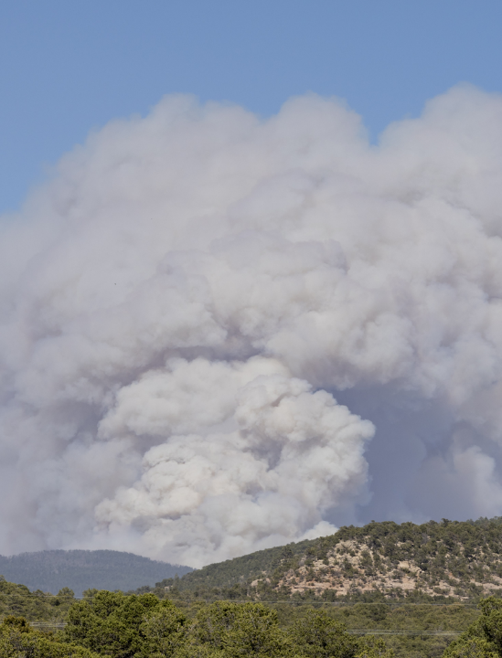
Wildfire Smoke Education Toolkit
Community Health:
Module 2
May 2025

Slide 2
Module 2
Air quality and wildfires
Notes:
Here is a question for the group: In past smoke events, how have you been able to tell how bad the air quality is?
(Pause and allow participants to respond.)
Many people use their senses to tell if the air quality is good or bad, which is valid. In the next section we will talk about different tools and resources that we can use to check the air quality.

Slide 3
Learning goals
Explore ways to check air quality.
Learn about the Air Quality Index (AQI) and how to use it.
Find the AQI on cell phones.
Learn how to use the AirNow website and mobile app.
Notes:
In this module we are going to explore different ways to check air quality. We’re going to learn about the Air Quality Index (also called the AQI) and how to use it. We’re going to find the AQI using our cell phones, and on the AirNow website and mobile app.

Slide 4
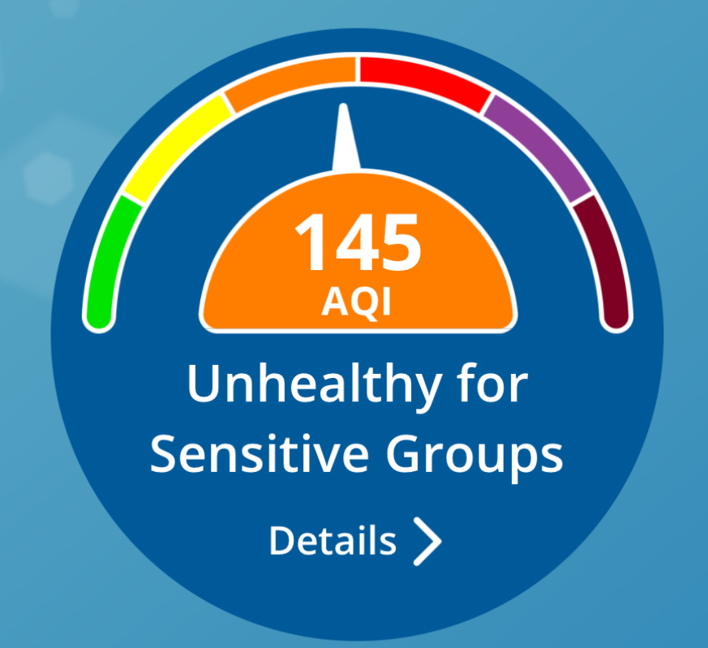
The Air Quality Index (AQI)
The AQI tells you how safe the air is to breathe.
The AQI ranges from green (when the air quality is good) to maroon (when the air quality is hazardous.)
The higher the AQI value, the greater the amount of smoke pollution in the air.
Notes:
What is the Air Quality Index (AQI)? The Air Quality Index (or AQI) is a tool used to report air quality. It tells us how safe the air is to breathe. You may hear about the AQI on TV or see it on your phone's weather app.
The AQI uses colors and numbers to describe the air quality. For example, look at the image on the screen. In the middle of the circle, there is a number. It says 145 and the color that accompanies it is orange, which means the air is unhealthy for sensitive groups. The higher the AQI value, the greater the amount of smoke pollution in the air, and the greater harm to your health.

Slide 5

The more smoke in the air, the higher the AQI.
Lower AQI
Higher AQI
Notes:
Smoke from wildfires makes the air dangerous and can harm your health. The more smoke that is in the air, the higher the AQI. In this slide, the dots in the clouds represent smoke particles in the air. We can see the relationship between the amount of smoke and the colors of the Air Quality Index:
1. When there is very little smoke in the air, the air is good and the AQI is green.
2. When there is a large amount of smoke in the air, the air is hazardous to breathe and the AQI is maroon.”

Slide 6
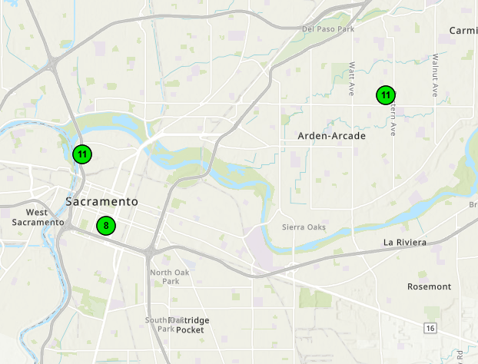
Where does the AQI come from?
Air quality monitors tell us what is in the air, and how harmful the air is.
There are hundreds of air quality monitors across California.
The air monitors near you determine the AQI in your community.
Notes:
The AQI categories are based on the Environmental Protection Agency's standards for healthy air. There are hundreds of air quality monitors across California. Some air quality monitors are set up by the government (including the federal Environmental Protection Agency, the California Air Resources Board, and local air districts), and some are set up by community groups, businesses, and individuals.
Air quality monitors measure what is in the air, and how harmful the air is. On this slide is a map of Sacramento. The green circles show different air quality monitors and the AQI at those locations. Look closely and you’ll see that the AQI is not always the same, since the air is different in each location.
The air monitors near you determine the AQI in your community.

Slide 7
AQI colors and numbers
LEVELS OF CONCERN
VALUES
Good
0 - 50
Unhealthy for very sensitive groups
51 - 100
Unhealthy for sensitive groups
101 - 150
Unhealthy
151 - 200
Very Unhealthy
201 - 300
Dangerous
301 - 500
Notes:
Here's another way to look at the AQI colors and numbers. The AQI ranges from green (when air quality is good) to maroon (when air quality is extremely dangerous). As we said, the AQI uses colors and numbers to describe air quality. The numbers range from 0 to 500.
In the slides that follow, we'll look at what the AQI numbers mean. We will learn what they tell us about air quality and what we should do to protect ourselves.

Slide 8
What does it mean when the AQI is green?
Good (0 – 50)
What does this mean?
Actions to take
Air quality is healthy for everyone
None. It’s a great day to be outside.
Notes:
When the AQI is between 0-50 (marked in green), this indicates good air quality – there is no danger to your health. It’s a great day to be active outside.

Slide 9

What does it mean when the AQI is yellow?
What does this mean?
Actions to take
Unhealthy for very sensitive groups (51 – 100)
Very sensitive groups: Watch for symptoms and take actions as needed.
Air quality can be dangerous for very sensitive groups.
Who is sensitive to wildfire smoke? Who is very sensitive?
Notes:
When the AQI is between 51-100 (marked in yellow) – this means that the air quality is unhealthy for very sensitive groups. For most of us, it's still a good day to be active outdoors. However, some people who are very sensitive to smoke need to be more careful. They should spend less time outside and avoid doing strenuous outdoor activities.
Interactive Discussion:
Ask the group the following questions:
1. Earlier we talked about who is considered "sensitive" to smoke. Can anyone remind us who falls into these groups?
Response: Sensitive groups include children, older adults, pregnant women, people with heart and lung disease, outdoor workers, and people experiencing homelessness.
2. If someone falls into more than one sensitive group, smoke can be even more dangerous to their health. Can anyone remind us of an example of a very sensitive person?
Response: An example of “very sensitive” would be a child with asthma, or a farm worker with high blood pressure. Another example is someone who has more serious heart problems or lung problems may be very sensitive to smoke.
When the AQI is between 51-100, or is marked in yellow, people who are very sensitive to wildfire smoke need to watch for symptoms and take appropriate action.

Slide 10

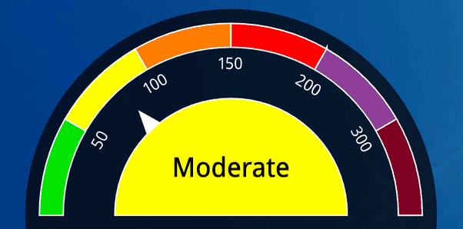
Would you let your child play soccer today? Why or why not?
Notes:
[NOTE: this slide gives an opportunity for interactive discussion, or back and forth conversation with the group, allowing participants to use the information they have learned and apply it to real-life situations.]
Let’s talk about some examples. Imagine your child loves to play soccer. You notice that today’s AQI is 75 (which means the AQI is in the yellow.) Can you help us think about this situation? Would you let your child play soccer today? Why or why not?
[Pause and allow for interactive discussion. Remember, when the AQI is yellow, the air is unhealthy for very sensitive groups. For most of us, it's still a good day to be active outdoors. Most children are sensitive, but not necessarily very sensitive to wildfire smoke. If this is a healthy child, it may be fine for him or her to play outside.]

Slide 11

Your child has asthma
Does this change your decision about letting them play outside today? Why or why not?
Notes:
[NOTE: this slide continues the group discussion.]
Now imagine that your child has asthma. Can you help us think about this? Would you let your child (who has asthma) play soccer today? Why or Why not?
[Pause and allow for interactive discussion. In this scenario, the child has asthma, which means they are in more than one sensitive group. If someone falls into more than one sensitive group, smoke can be even more dangerous to their health. When the AQI is yellow, this means that the air quality is unhealthy for very sensitive groups. For most of us, it's still a good day to be active outdoors. However, some people who are very sensitive to smoke need to be more careful. They should spend less time outside and avoid doing strenuous outdoor activities.]

Slide 12
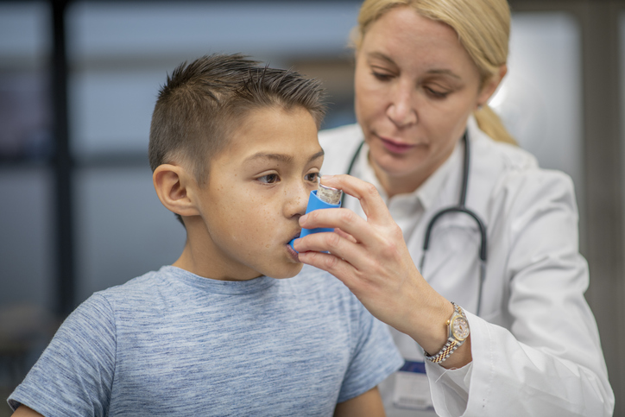
Your child has asthma and has gone to the emergency room several times this year
Does this change your decision about letting them play outside today? Why or why not?
Notes:
[NOTE: this slide continues the group discussion.]
Now, let's imagine that your child has asthma and has been to the emergency room several times this year for his asthma. Does this change your decision about letting him or her play outside?
[Pause and allow for interactive discussion. The difference in this scenario is that the child has been to the doctor several times this year for his asthma. This tells us that he is having difficulty with his asthma. It isn’t under control and is triggered more easily. He may need to take extra steps, like not playing outside on smoky days, to avoid asthma symptoms.]
Remember: All children are sensitive to smoke and are at higher risk than adults for developing lung problems from breathing smoky air. In addition, children with asthma are very sensitive and have to take extra steps to avoid asthma symptoms.
Because children are sensitive to smoke, schools in California follow public health guidelines to improve air quality in classrooms. If you would like to know more about how your child's school cleans the air during smoke events, you can talk to the school principal at your child's school.

Slide 13
What does it mean when the AQI is orange?
What does this mean?
Actions to take
Unhealthy for sensitive groups (101 – 150)
Air quality can be dangerous for sensitive groups.
Sensitive groups: Reduce outdoor activities. Wear a mask outside.
Notes:
Let’s continue looking at the AQI colors and what they mean. When the air quality index is orange, or between 101 and 150, the air quality is unhealthy for people in sensitive groups. Ideally, people in sensitive groups should limit their time outdoors and avoid strenuous activities like running or heavy labor, if possible. Some people who are sensitive to smoke are unable to reduce their time outside due to their work or other commitments. We know that it is not possible for everyone to simply stay home. For sensitive people, protecting themselves with a good mask is the next best option if they need to spend long periods of time outdoors. We will talk more about masks later in the presentation.

Slide 14
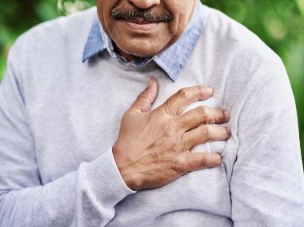
What can someone with heart problems do to protect themselves from smoke?
Unhealthy for sensitive groups (101 – 150)
Notes:
Can anyone tell me, what are some actions a sensitive person (for example, someone with heart problems), could take to reduce their outdoor activities?
[After participants have shared examples] This is such a great discussion, thank you everyone for sharing. [Briefly summarize the conversation and add the following ideas, if needed]:
1. Move planned gatherings and parties from outside to inside
2. Plan indoor activities for your kids, either at home or at a local library or community center
3. If someone has to work outside, there are some things they can do to help protect themselves from the smoke. For example, they can wear a mask, take frequent breaks during the day, try to avoid strenuous activities, after work stay in a place with clean air.

Slide 15
What does it mean when the AQI is red?
What does this mean?
Actions to take
Reduce outdoor activities. Wear a mask outside.
Everyone can experience some health problems.
Unhealthy (151-200)
Notes:
When the AQI is between 151 to 200 (marked in red) – this means that the air quality is dangerous for everyone. Everyone should reduce the amount of time spent outside as much as they are able to. Everyone should try to use a mask when they are outside.
People who are in sensitive groups are even more at risk when they go outside and breathe this unhealthy air. Whenever possible, people in sensitive groups should reduce their time outside even more.

Slide 16
What does it mean when the AQI is purple or maroon?
What does this mean?
Actions to take
The air is very unhealthy and dangerous for everyone.
Avoid outdoor activities. Use a mask when outside.
Very unhealthy (201-300)
Dangerous (301-500)
Notes:
Here we combined the two AQI levels of purple and maroon, because the interpretation is very similar. When the air quality index numbers are between 201-300 or marked purple, this indicates very unhealthy air quality. Any air quality index over 300, marked maroon, indicates very dangerous air quality, and is an emergency situation.
At both of these levels, the air is unhealthy for everyone. The higher this number, the more unhealthy the air. As much as possible, everyone should avoid outdoor activities and wear a mask when outside.

Slide 17



Ways to check air quality
Cell phone
Television
Computer
Notes:
Now that we understand what the AQI is and how to use it, let’s take a closer look at where to find the AQI when we want to know about the air quality around us. There are many places to check air quality.
Cell phones: many people use the weather app on their cell phones to check the air quality. There are also other apps (other than the weather app) that report air quality.
Television: often when there is wildfire smoke in the area, the AQI is reported along with the weather on the news, or in special news reports.
Computer: there are many websites that report the AQI including local county and air district websites, and other government websites.
Regardless of where we look for information on air quality, the information is based on the AQI. In the next few slides, we will take a closer look at the different places where the AQI is reported.

Slide 18

Finding the AQI on cell phones
The AQI is reported on the weather app.
The weather app may look different on an iPhone or an Android phone.
Can you find the AQI on the weather app? Is there another app you like to use to find the AQI?
Notes:
One of the easiest ways to check air quality is through the weather app that comes with some cell phones. The layout of the weather app is different depending on the type of cell phone you have (for example, iPhone or Android.)
Activity 2: How to find the Air Quality Index (AQI) using the weather app on cell phones.
[NOTE: The following activity works best with small groups. If possible, have participants work in groups of 4-6 people.]
Instructions:
1. Ask everyone at the table to take out their cell phones.
2. Ask: What do you usually do in the morning to find out the weather for the day?
3. Find the weather app. Some participants with android phones need to take the following steps: First, enter the app store (may be called "App Store", "Galaxy Store", or "Play Store" on your phone.) Then, search for "weather" and download.
4. Ask: What do you see when you open the app? If you scroll down, what do you see?
5. The AQI may be the first thing you see on the screen. If not, scroll down past the weather information until you see the section that says Air Quality.
6. What is the AQI color and number today? Note that the color may not be obvious. Try to find both the AQI color and the number.
7. If you tap on the map, you can see more information about the AQI color and the AQI in nearby locations.
8. If there are both Android and iPhone users at the table, give everyone a chance to see both.
[After the groups have completed the activity, bring all of the participants back together.]
What did you think? How easy was it to find the AQI in the weather app?

Slide 19

The AirNow website and mobile app
AirNow reports the AQI for places around the country and around the world.
Often recommended by government and public health officials.
AirNow reports the current AQI and a forecast of the AQI for the next day.
You can find AirNow here: https://www.airnow.gov
Notes:
Another place to find information about air quality and the AQI is AirNow. AirNow is a government program, led by the Environmental Protection Agency, and other national and local government agencies. Both the AirNow website and the AirNow mobile app allow you to check the AQI for cities and counties around the country, and places around the world. AirNow is often recommended as the most accurate resource to use during wildfire smoke events.
AirNow reports the current AQI. It also often reports a forecast of the expected AQI for the day. The AQI forecast can be used to help you plan your day. Much like a weather forecast lets you know whether to pack an umbrella or raincoat, an air quality forecast lets you know when you may want to change your outdoor activities, if you can, to reduce the amount of air pollution you breathe in. AirNow also has maps so that you can see where the fires and the smoke are.

Slide 20

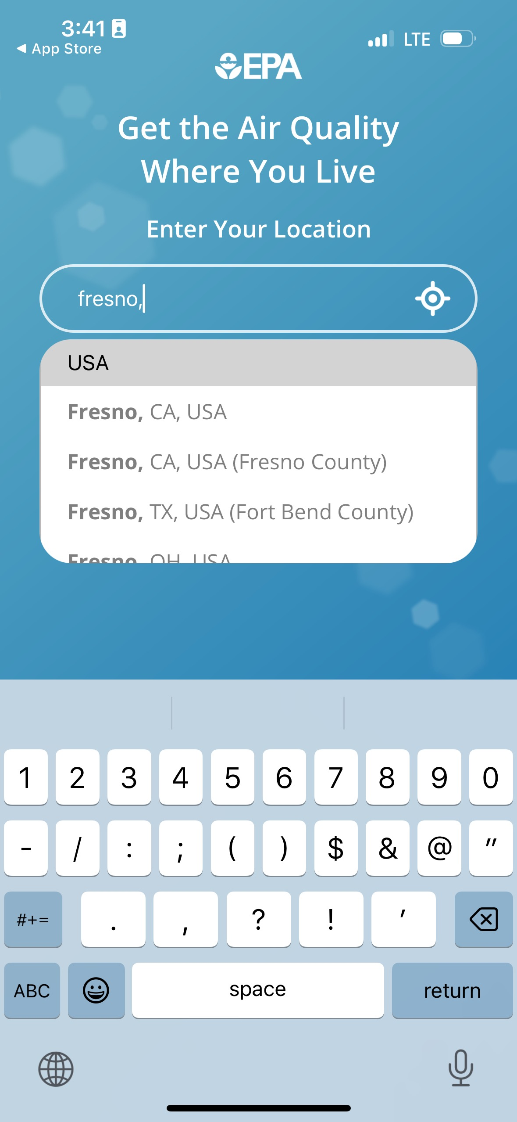
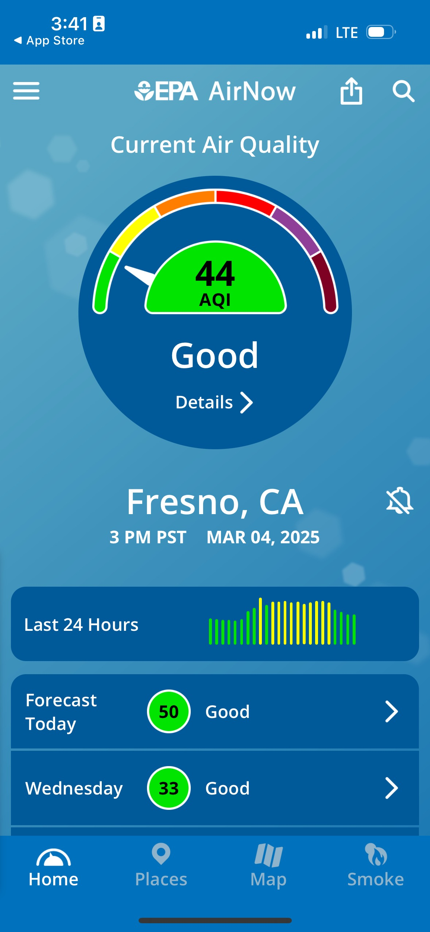
Steps for using the AirNow App
1. Open the AirNow app
2. Enter your location
3. View the AQI forecast
Notes:
Let's learn how to use AirNow! Can you find the AQI??
Activity 3: Using the AirNow mobile app.
[NOTE: It is helpful if some or all of the participants have the app downloaded on their cell phones. Take a few minutes for everyone to find the app, or to partner with someone who has the app on their phone.]
Instructions:
1. Open the AirNow app on your phone. If someone doesn't have the app, please work with someone who does.
2. The first time you use the app, you'll see the following message: “Learn about the air quality where you live. Enter your location.”
Enter your zip code or the name of your city.
You can also use the compass icon in the search bar to find the AQI at your current location. The compass icon is marked with a red circle in step 2 of the slide.
NOTE: the screen shots shown in this slide and the following slide were taken in April 2025. The screens may look different as software is updated.

Slide 21
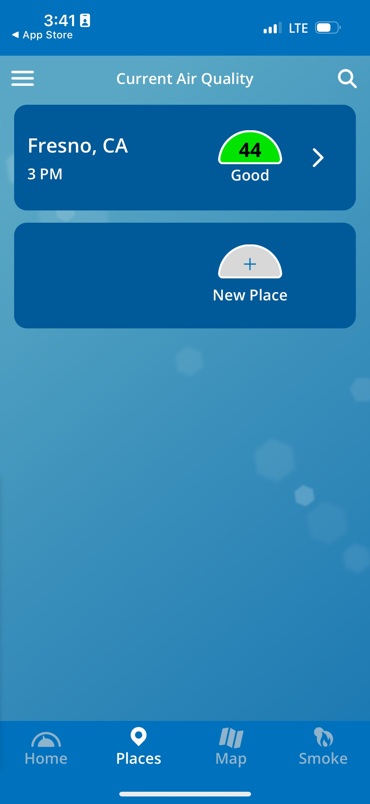
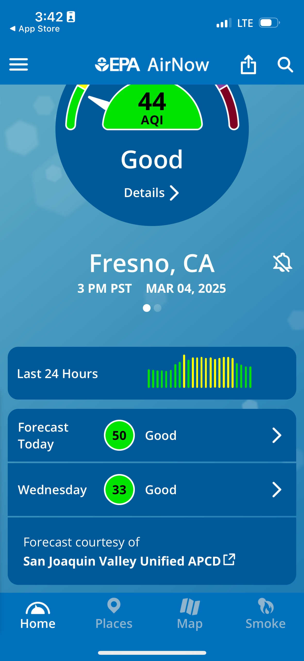
Bonus activity: adding locations
5. Select “New Place”
6. View the AQI forecast
4. Select “Places”
Notes:
Using the menu bar at the bottom of the screen, select “places” to add locations. [NOTE: see the red boxes marked on the slide.]
Try adding a location using a city name or zip code. Sometimes you will need to look up the zip code if you are in an unfamiliar place.
Take a few minutes to practice adding 3 new locations and finding the AQI at each location. At each location, scroll down to find the AQI forecast for the upcoming week. You may find that the AQI forecast is not always available in every location.
What do you think of the app? Is it easy to use? Would you ever use it to look up the AQI?
After using the weather app and AirNow, what do you think of these two apps? How do they compare? Which one do you like better?

Slide 22

What if…..?
Sometimes the AQI reported on the weather App is different than the AQI on AirNow or on a local air district website.
What do you do if the numbers don’t match?
YOUR BEST PROTECTION: If you find the numbers don’t match, use the higher AQI as your guide.
Notes:
You can also find the AQI on local air district websites and from community air monitoring programs. Sometimes when you check different sources, you may find different AQI numbers for the same location.
Why is that? Because sometimes local air districts and others take the AQI and adjust it based on local weather patterns and other information.
For the best protection, always check the highest AQI recorded for the area.

Slide 23
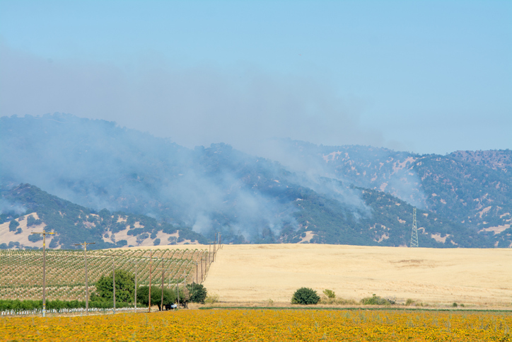
It’s not all about the AQI
Use all your tools:
Check the AQI
Do you see smoke or ash?
Do you smell smoke?
How are you feeling? Do you have any symptoms?
Notes:
The AQI is just one of the tools we have to help us understand if the air is healthy to breathe. We can also look outside. Do you see smoke or ash? Do you smell smoke? How are you feeling? Do you have any symptoms?

Slide 24

Summary
Smoke is dangerous to everyone's health, but for some people it is more dangerous.
The AQI tells us how safe it is to breathe the air around us by using colors and numbers to report air quality.
Use all your tools to help you understand how safe the air is to breathe.
Notes:
Let's review what we have learned so far today:
1. Smoke is dangerous to everyone's health, but for some of us it is more dangerous.
2. The AQI tells us how safe it is to breathe the air around us. The AQI uses colors and numbers to report air quality. The AQI ranges from green (when the air quality is good) to maroon (when the air quality is very dangerous). The higher the AQI value, the higher the level of concern for your health.
3. Let's review what each color indicates… [ask the audience to help you finish the following sentences].
Green is… [Good]
Yellow is… [Unhealthy for very sensitive groups]
Orange is… [Unhealthy for sensitive groups]
Red is… [Unhealthy for everyone]
Purple and maroon are… [Very unhealthy and dangerous for everyone]
4. Use all your tools to help you understand how safe the air is to breathe, and if you need to take actions to protect yourself from wildfire smoke.
Check the AQI using the weather app or the AirNow app.
Do you see smoke or ash? Do you smell smoke?
How are you feeling? Do you have any symptoms?

Slide 25

Reflections
What information was most interesting to you?
How does this information relate to your experiences during wildfire smoke events?
How will you share this information in your community?
What challenges do you think you might have presenting this information?
Notes:
We’d like to take a few minutes to reflect on what we learned in this module about air quality and wildfire smoke.
What information was the most interesting to you?
How does this information relate to your experiences?
How will use this information in your work?
What challenges do you think you might have in presenting this information in your community?

