Slide 1
Chlamydia
(Revised 02/2023)

Slide 2
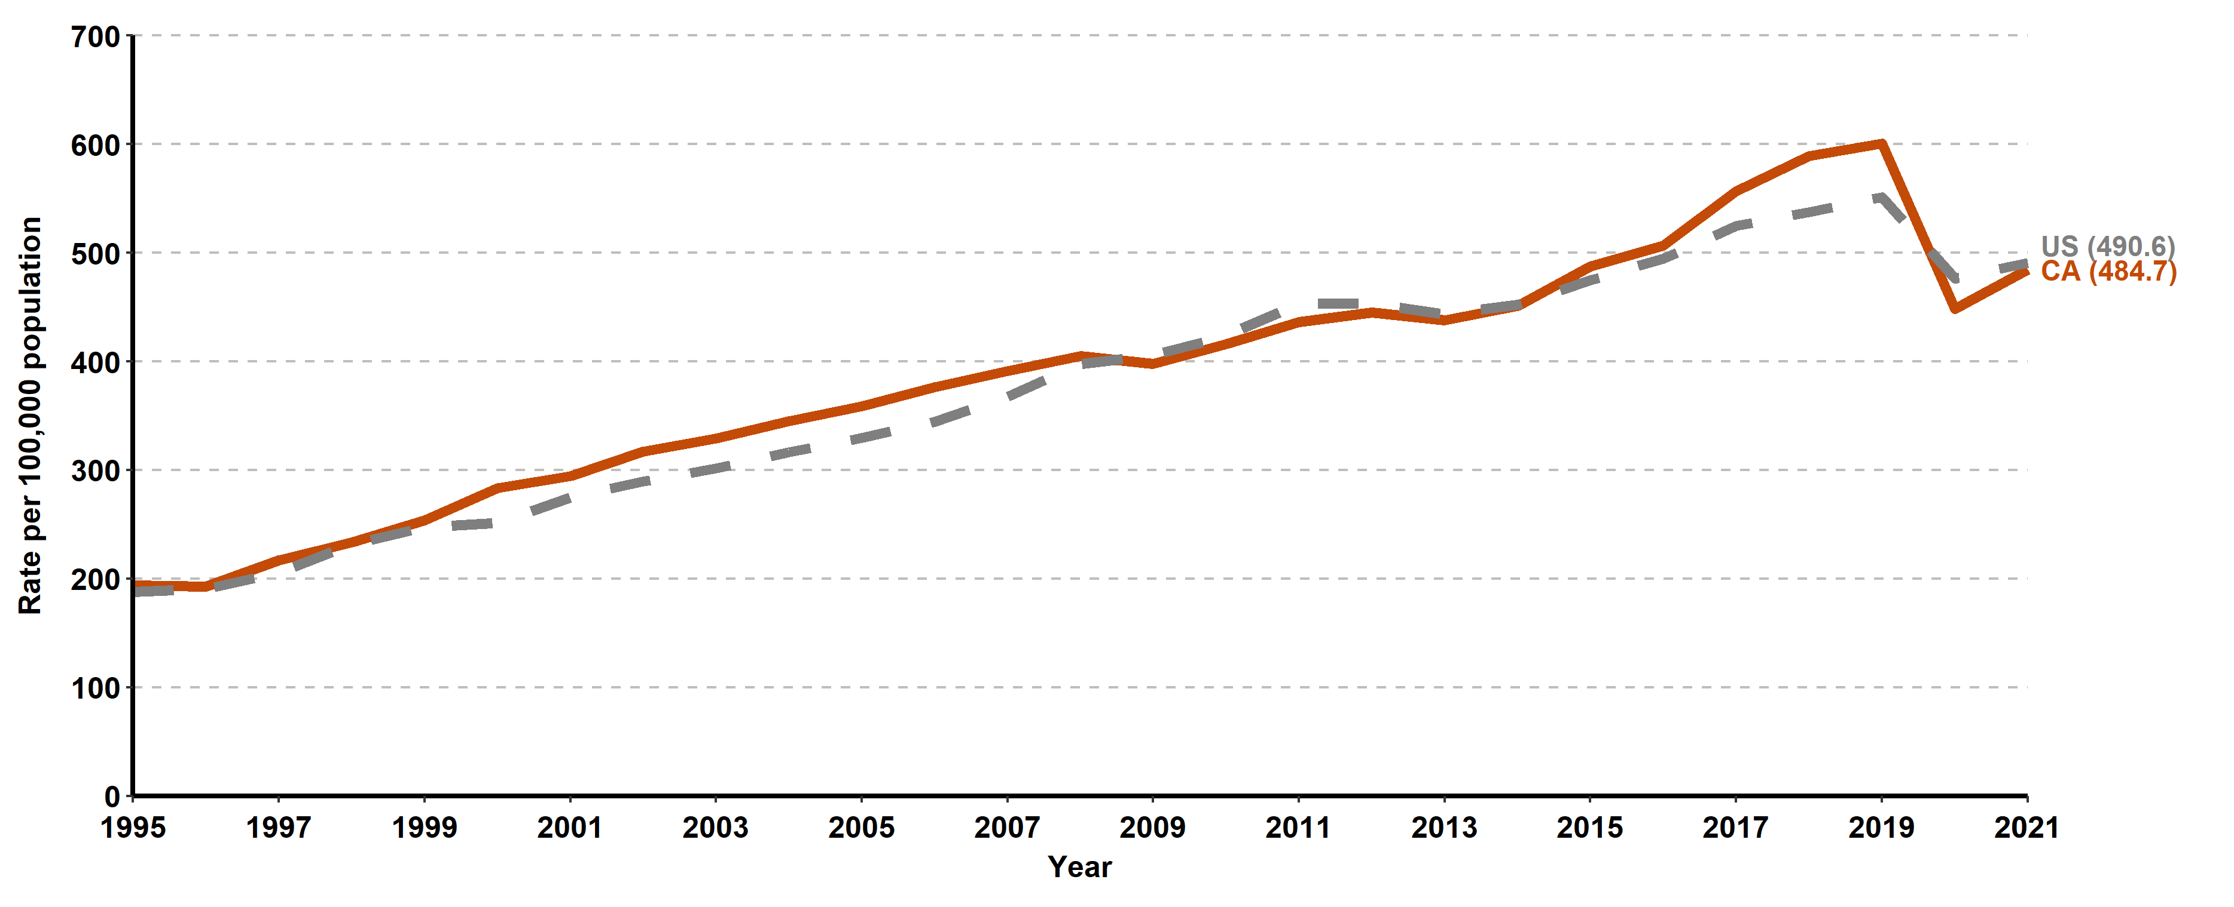
Chlamydia, California versus United States Incidence Rates, 1995–2021

Slide 3
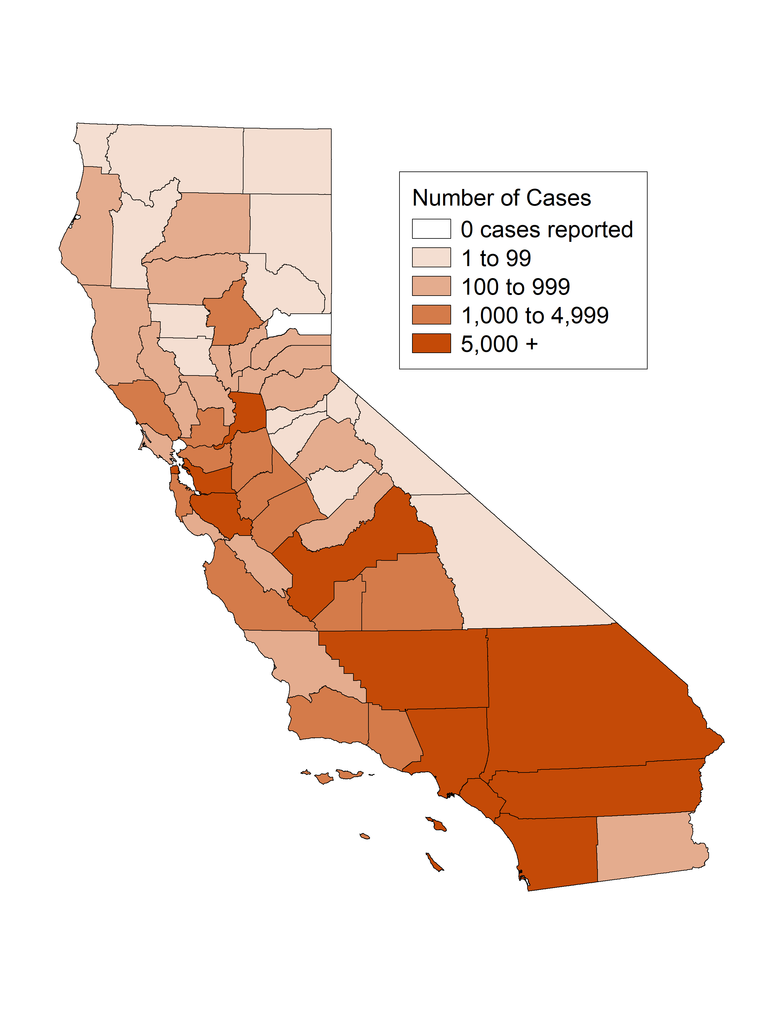
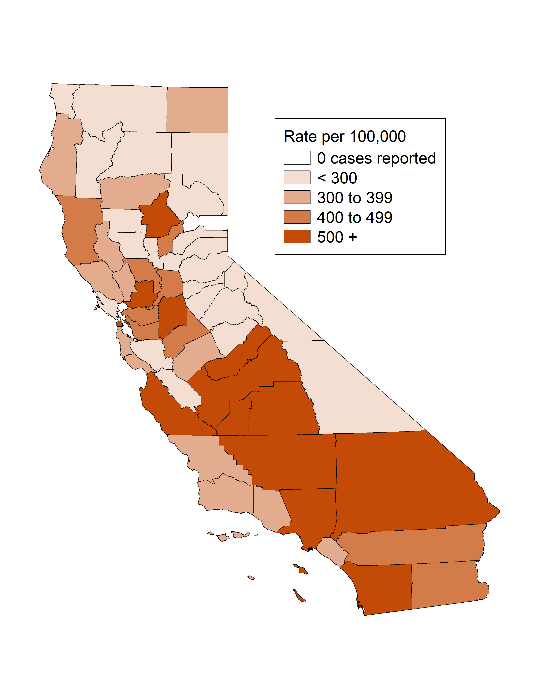
Chlamydia, Case Counts and Incidence Rates by County, California, 2021
Chlamydia Cases
Chlamydia Rates

Slide 4
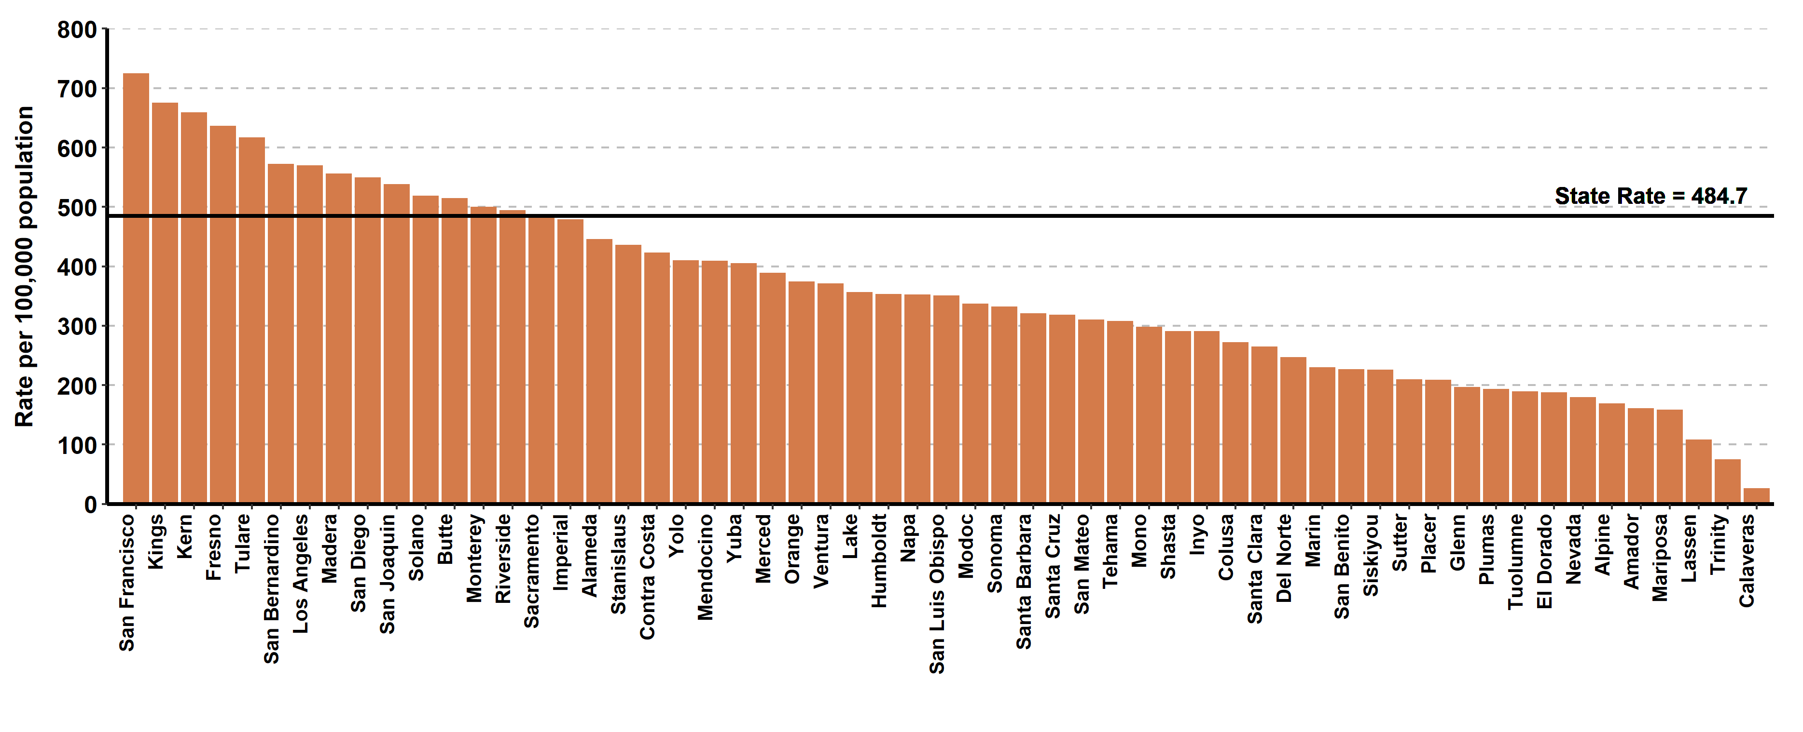
Chlamydia, Ranked Incidence Rates by County, California, 2021
This figure excludes counties with zero cases (1 county had zero cases in 2021)

Slide 5
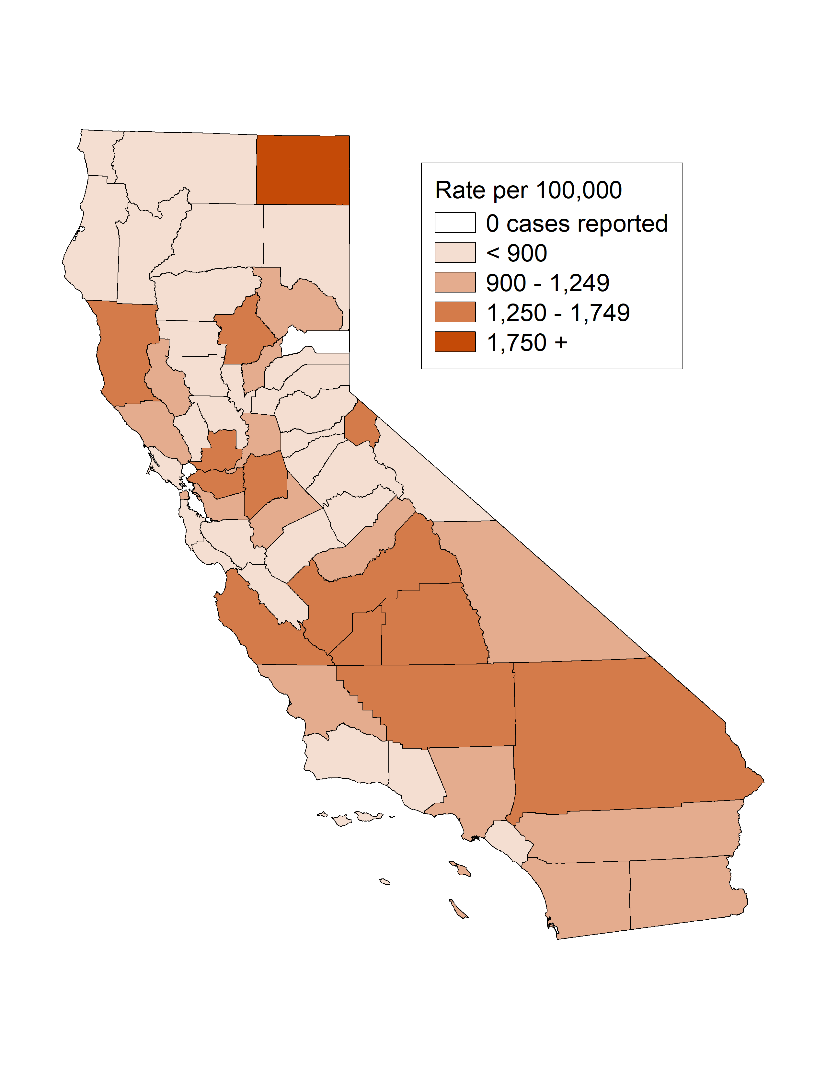
Chlamydia among Youth Ages 15-19, Incidence Rates by County, California, 2021

Slide 6
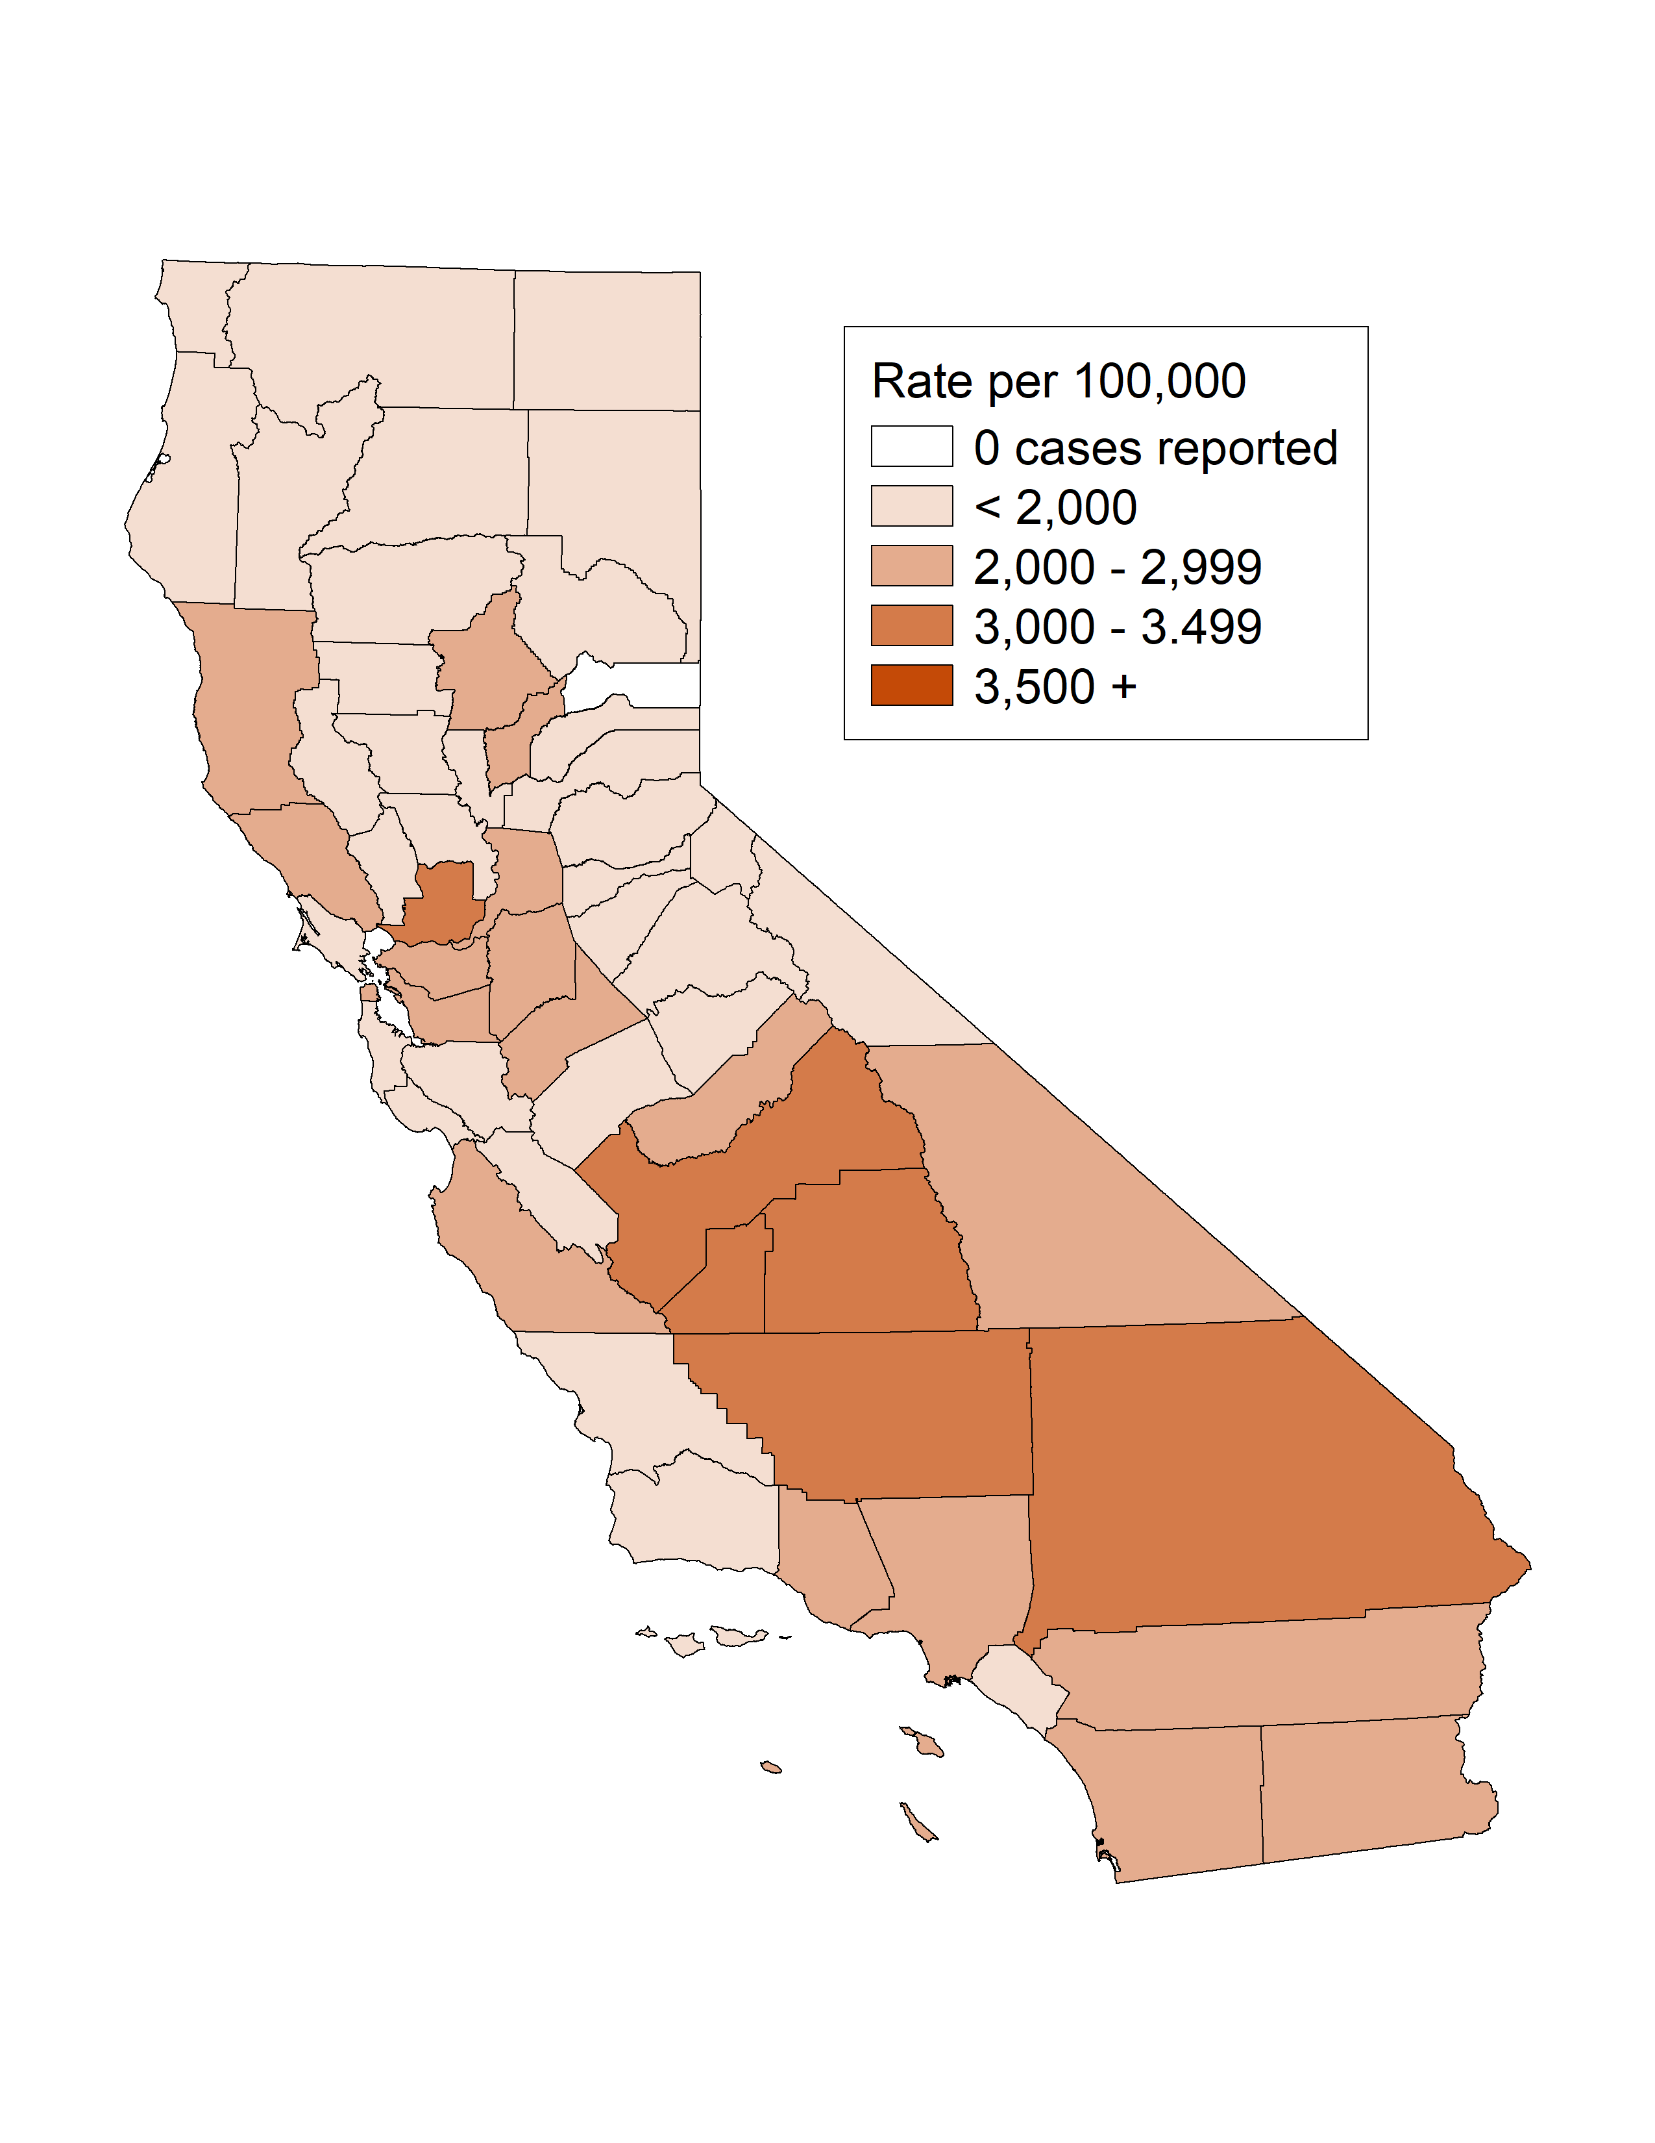
Chlamydia among Females Ages 15-24, Incidence Rates by County, California, 2021

Slide 7
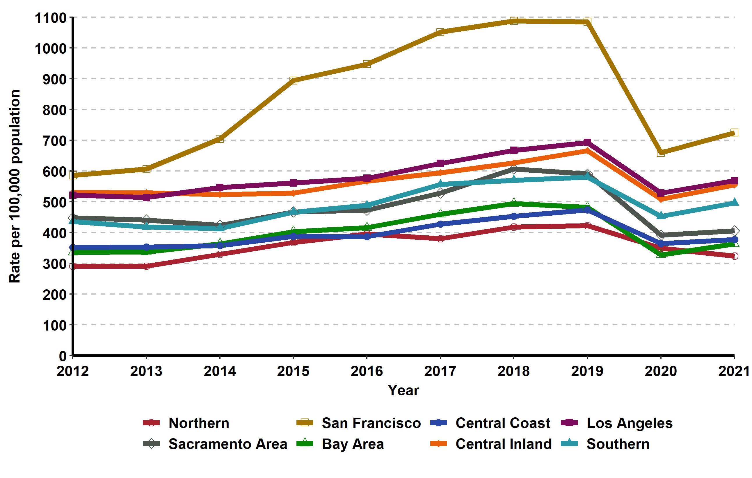
Chlamydia, Incidence Rates by Region, California, 2012–2021

Slide 8
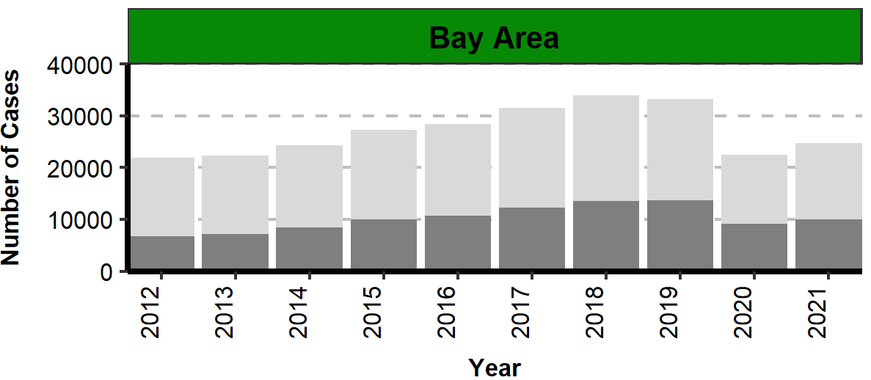
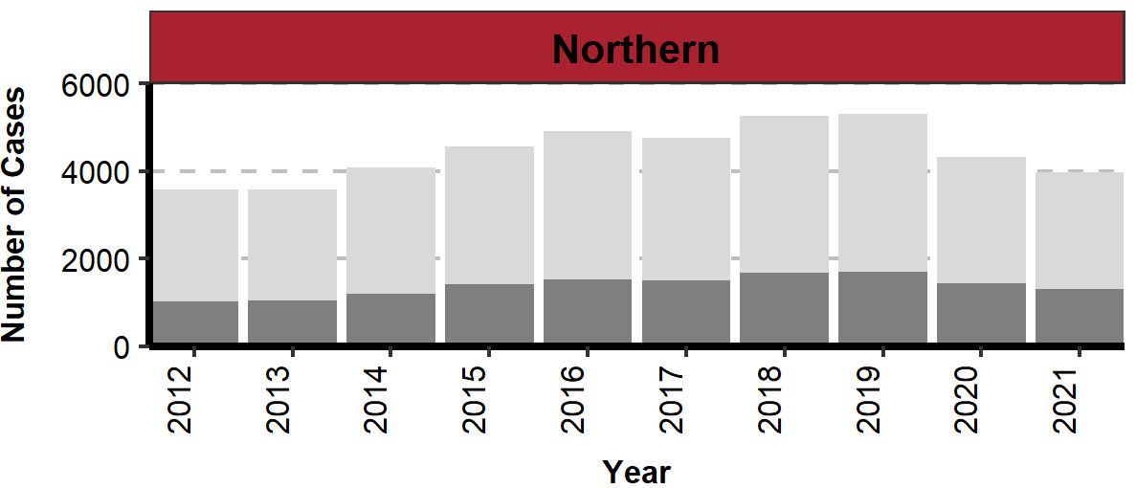
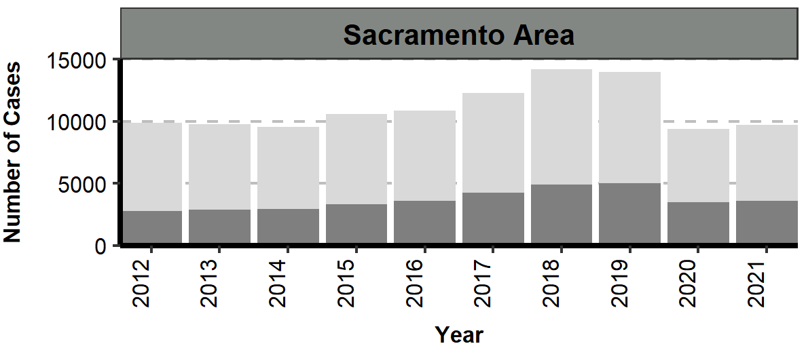
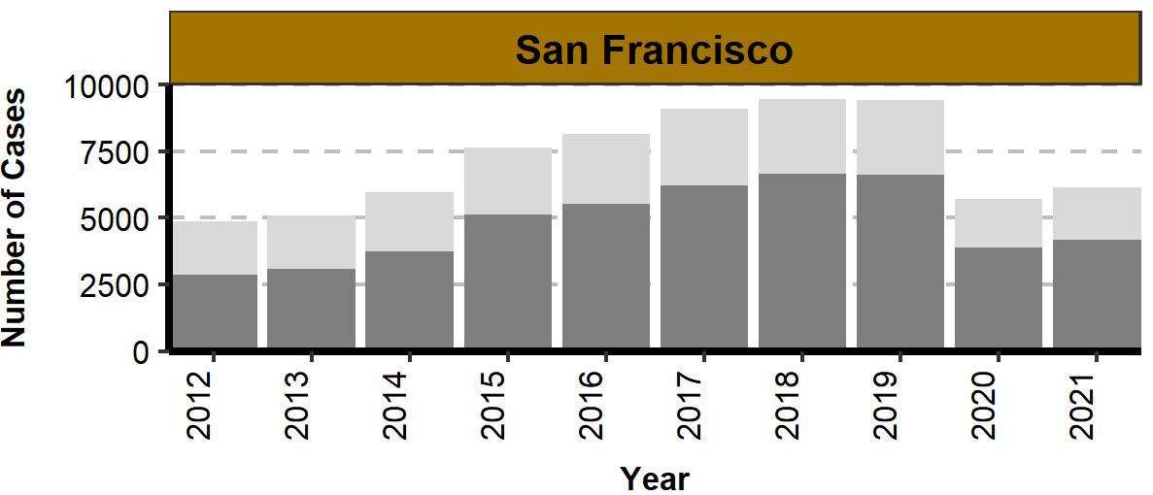
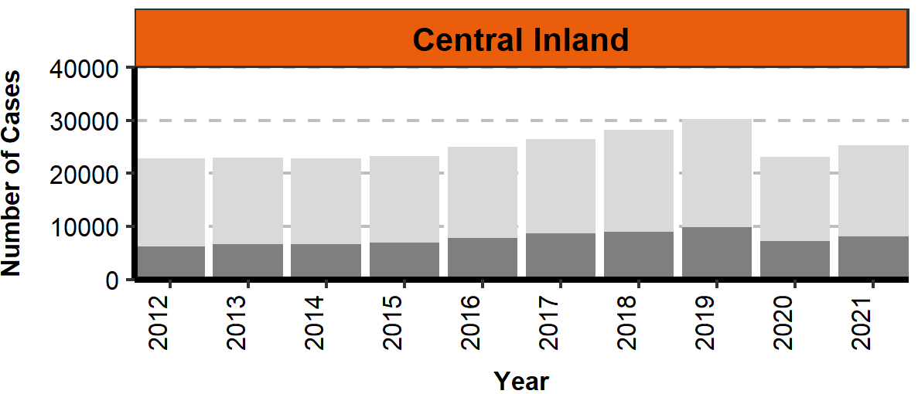
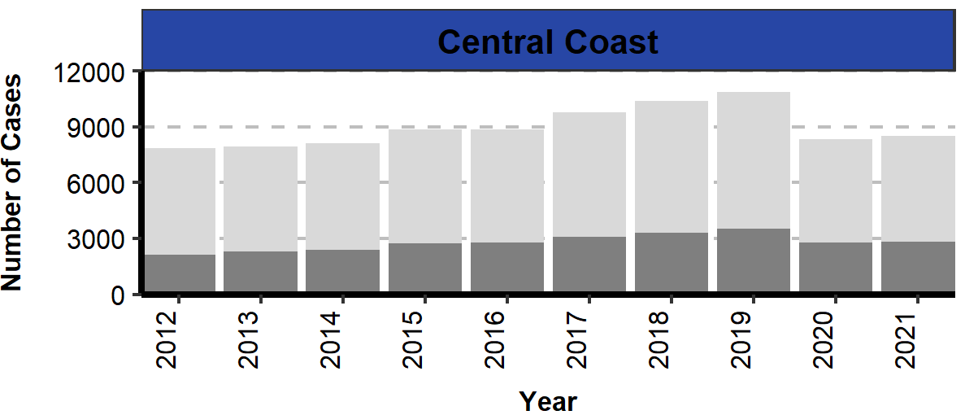
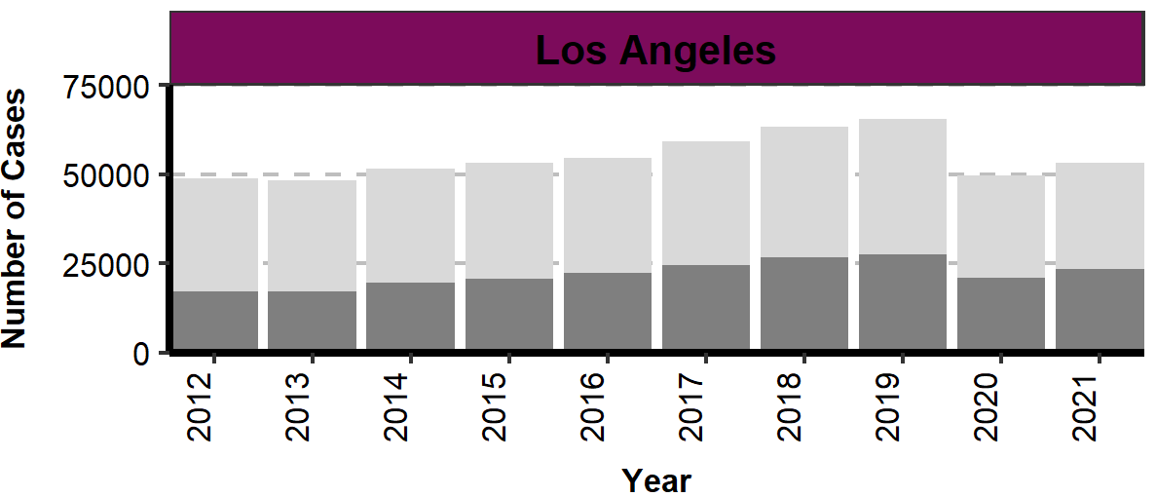
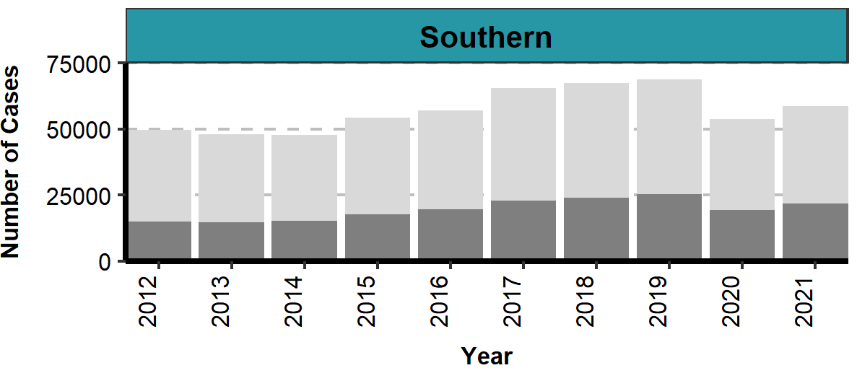
Number of Chlamydia Cases by Region, Gender, and Year, California, 2012–2021

Slide 9
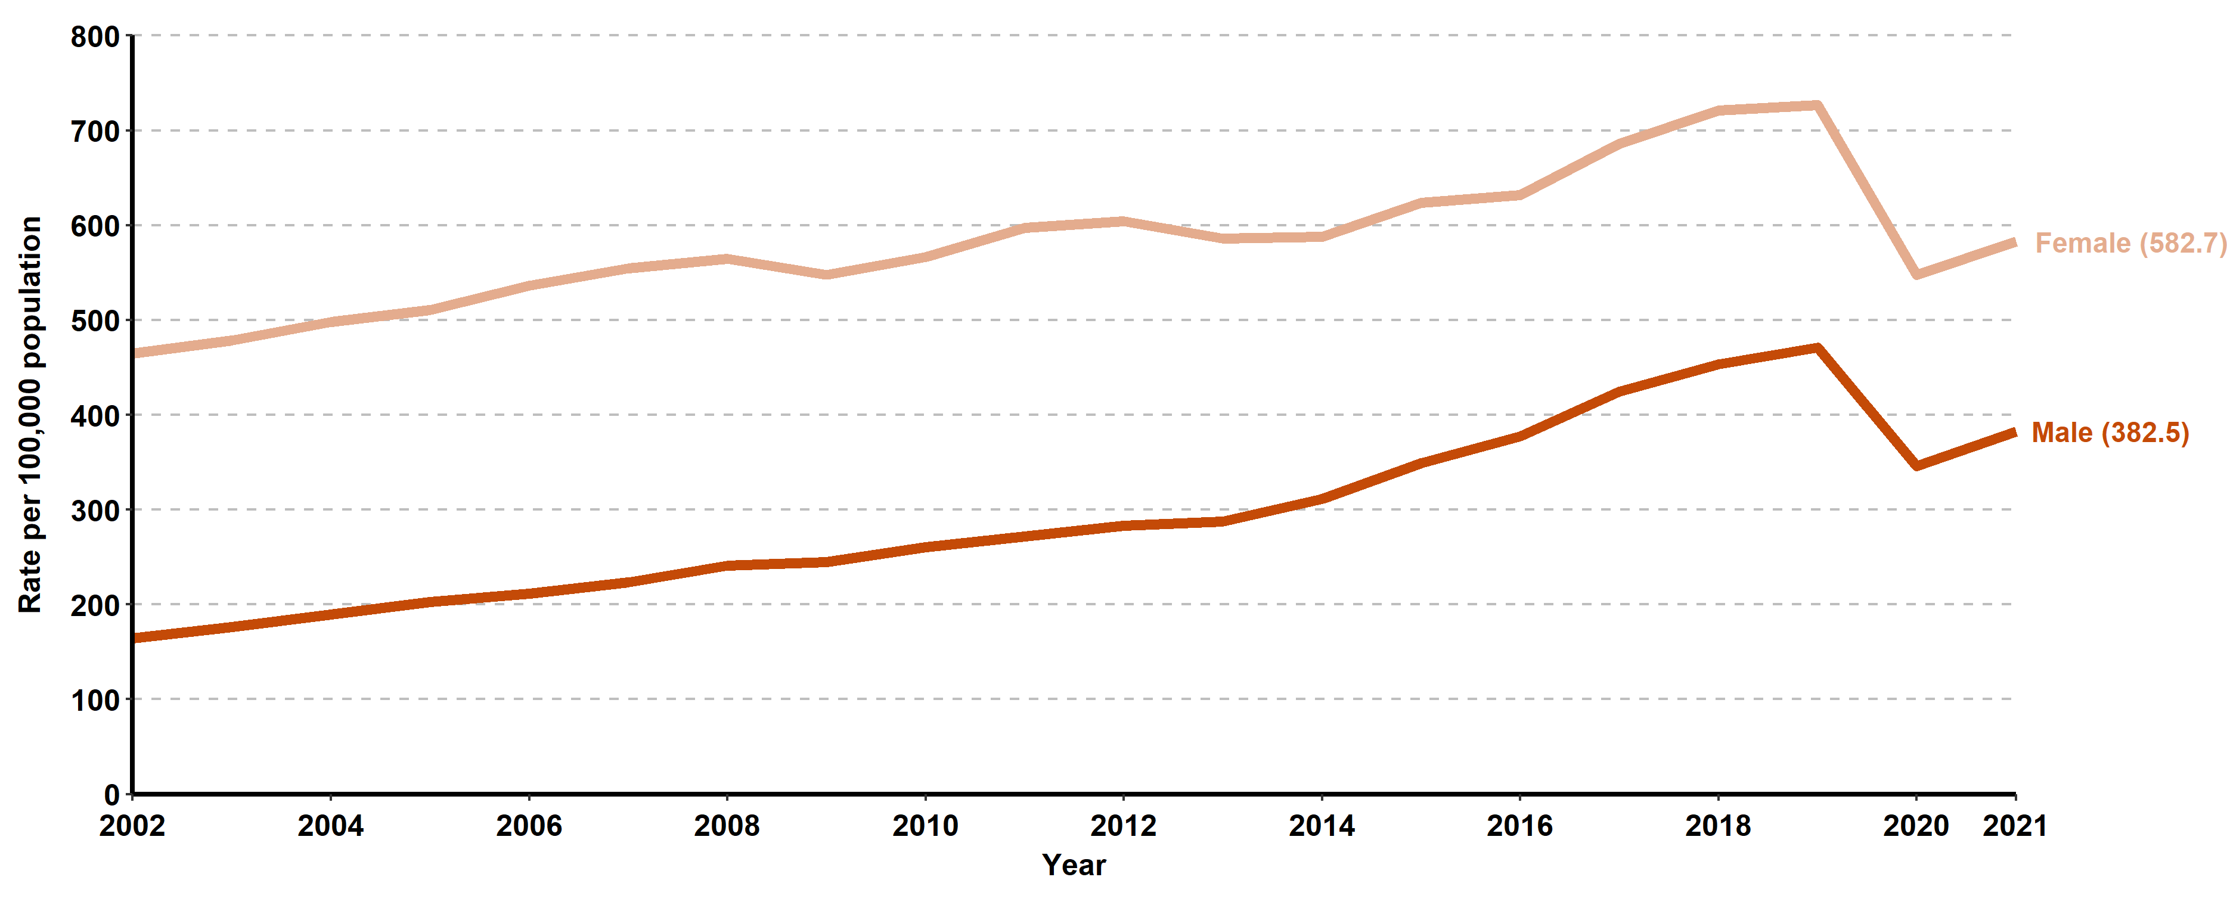
Chlamydia, Incidence Rates by Gender, California, 2002–2021
Screening guidelines recommend routine screening for specific populations, therefore higher rates of reported cases may in part reflect the targeted nature of screening programs.

Slide 10
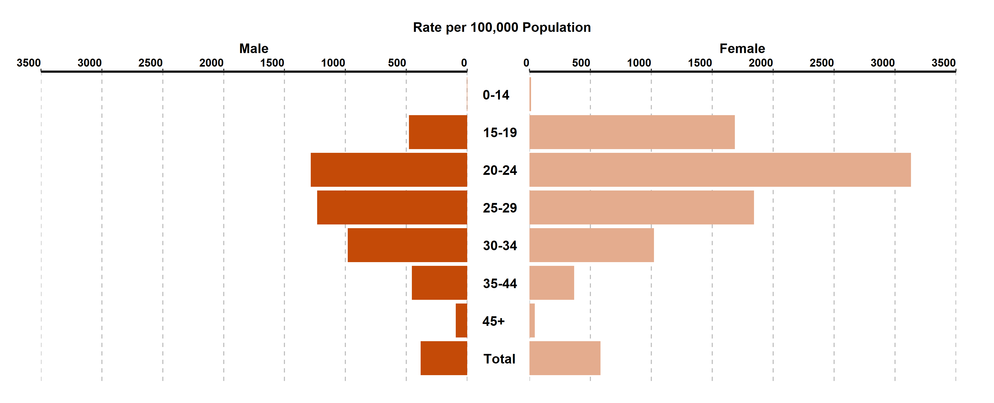
Chlamydia, Incidence Rates by Age Group (in years) and Gender, California, 2021
Age was “Not Specified” for 0.09% of female cases and 0.11% of male cases in 2021.
Screening guidelines recommend routine screening for specific populations, therefore higher rates of reported cases may in part reflect the targeted nature of screening programs.

Slide 11
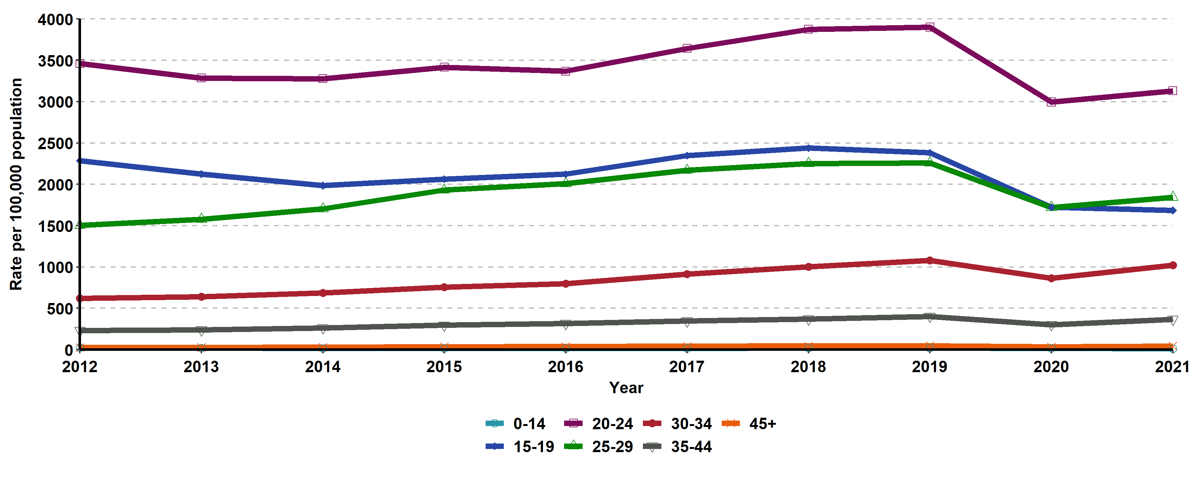
Chlamydia, Incidence Rates for Females by Age Group (in years), California, 2012–2021
Age “Not Specified” ranged from 0.09% to 0.38% of cases for females in any given year.

Slide 12
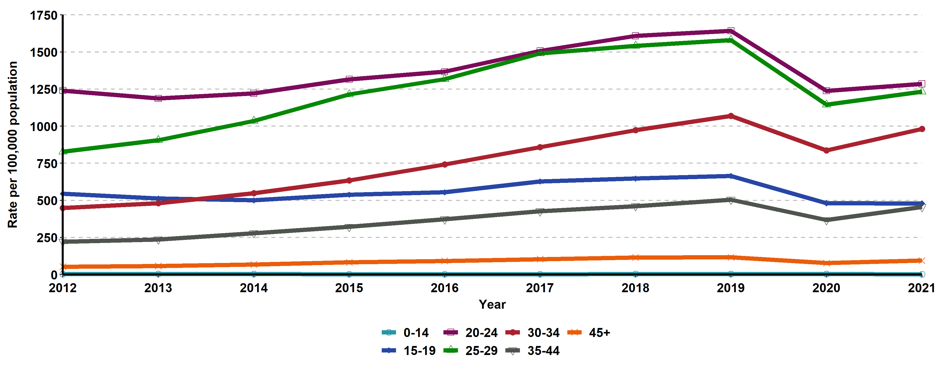
Chlamydia, Incidence Rates for Males by Age Group (in years),
California, 2012–2021
Age “Not Specified” ranged from 0.11% to 0.51% of cases for males in any given year.

Slide 13
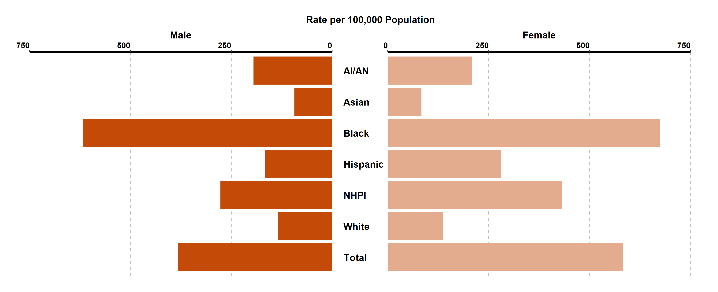
Chlamydia, Incidence Rates by Race/Ethnicity and Gender,
California, 2021
AI/AN = American Indian/Alaska Native, NHPI = Native Hawaiian/ Other Pacific Islander
Race/Ethnicity was “Not Specified” for 54.25% of female cases and 47.12% of male cases in 2021.
Screening guidelines recommend routine screening for specific populations, therefore higher rates of reported cases may in part reflect the targeted nature of screening programs.

Slide 14
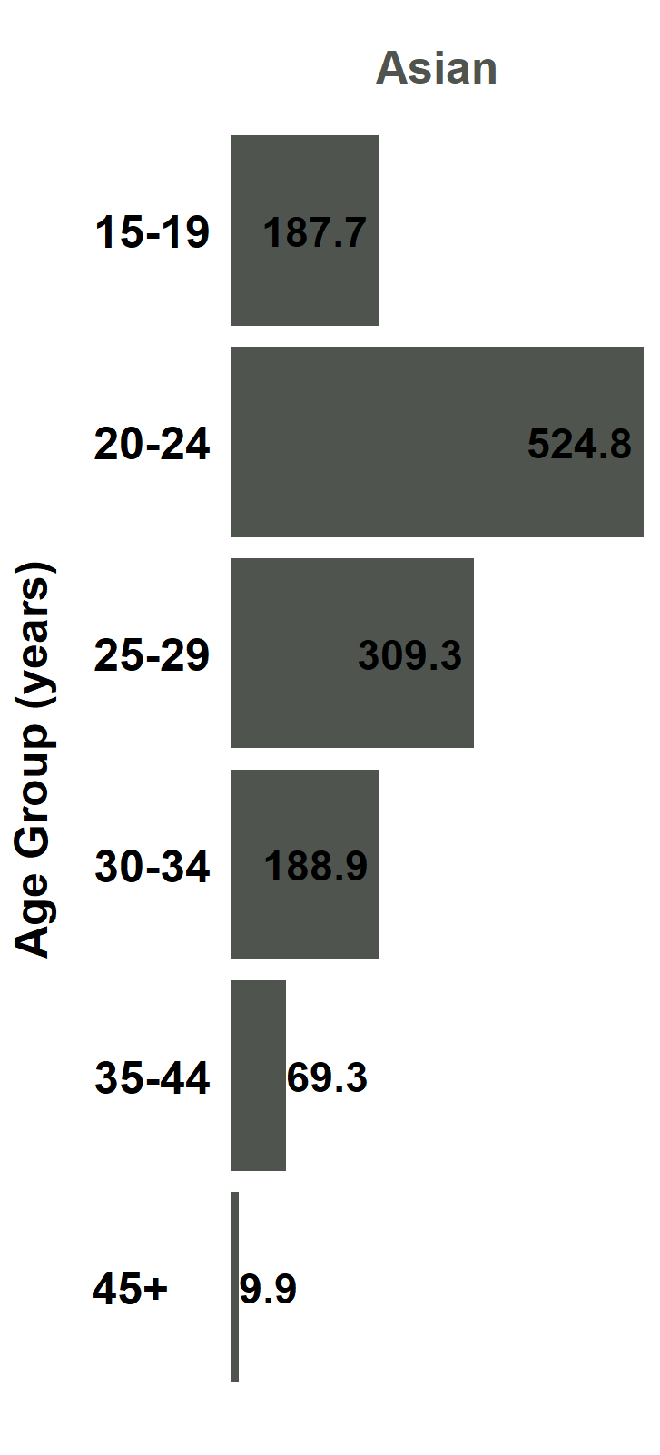
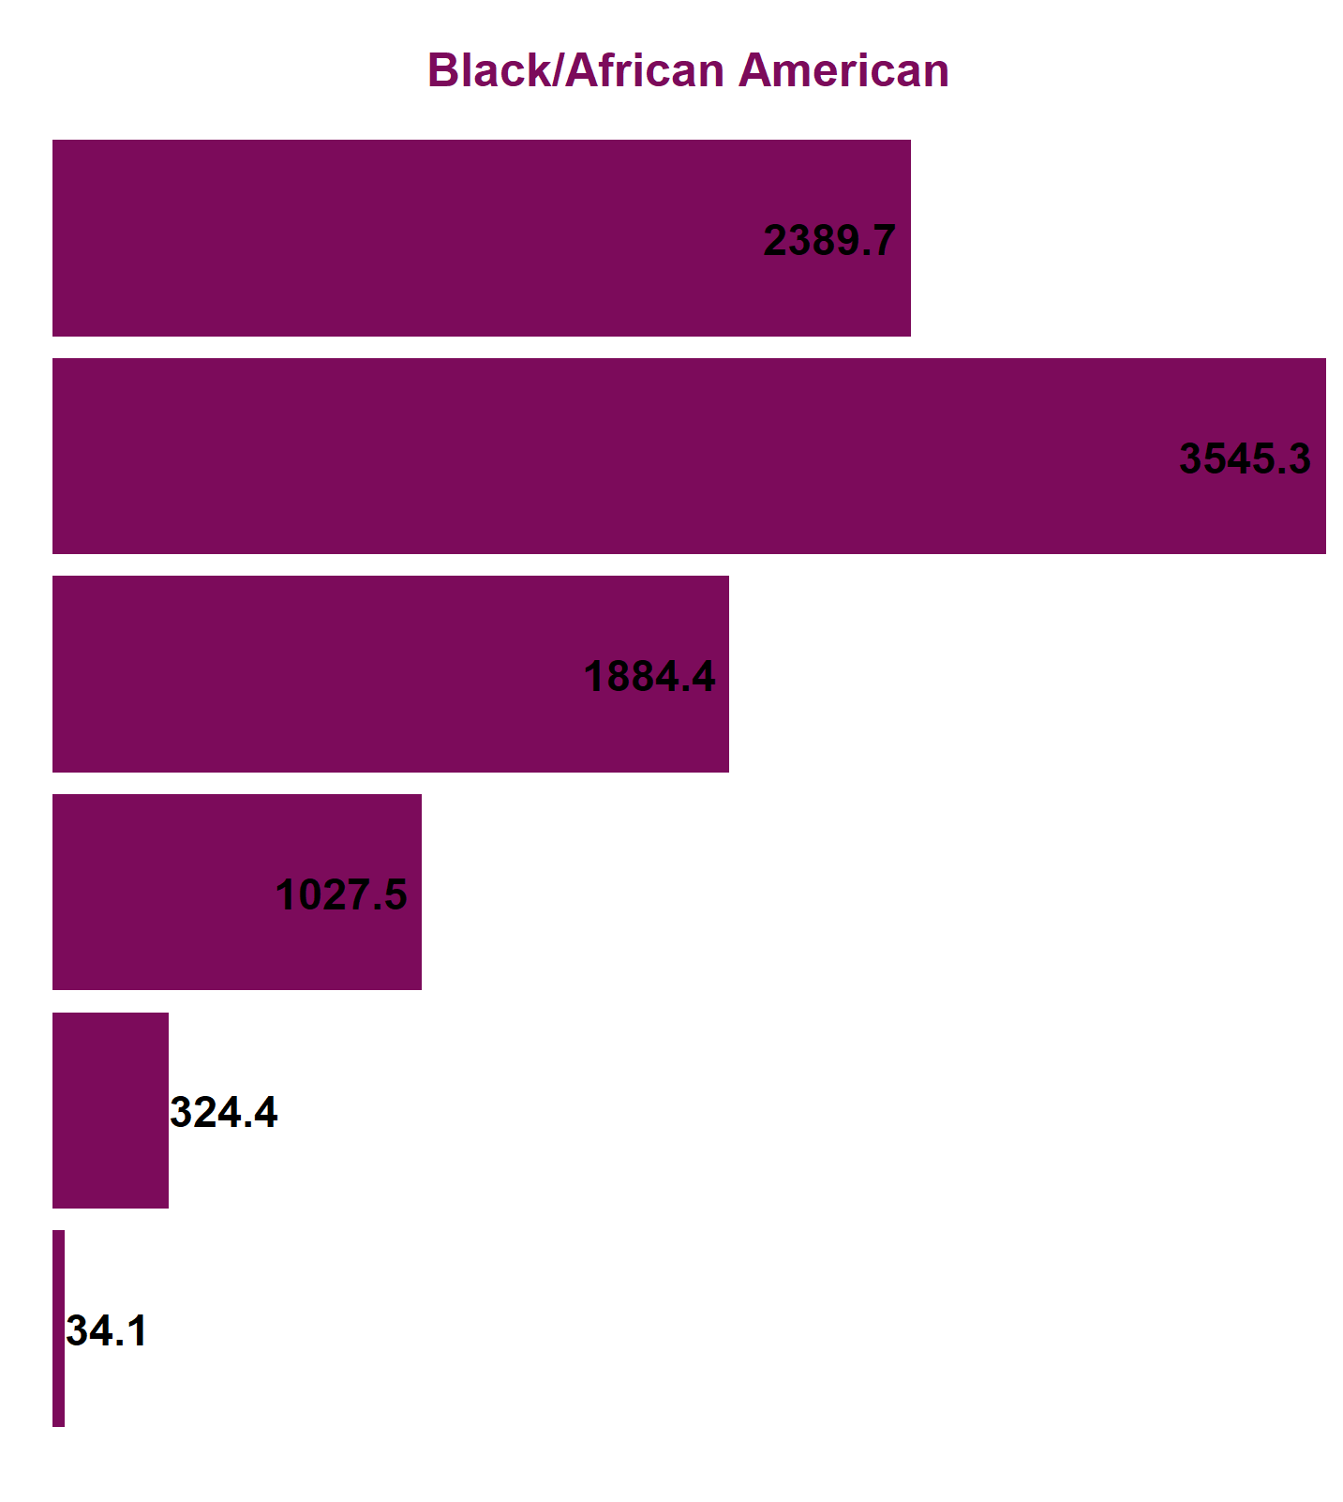
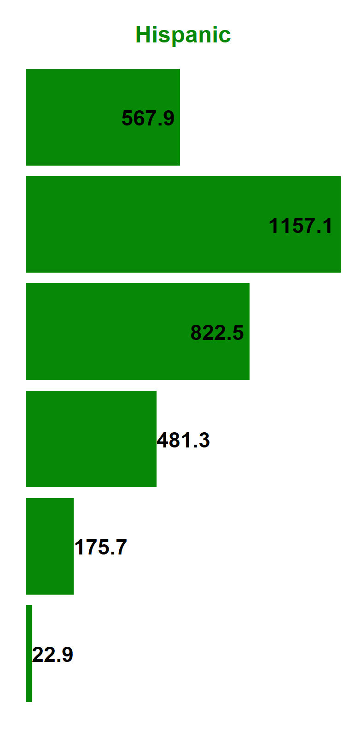
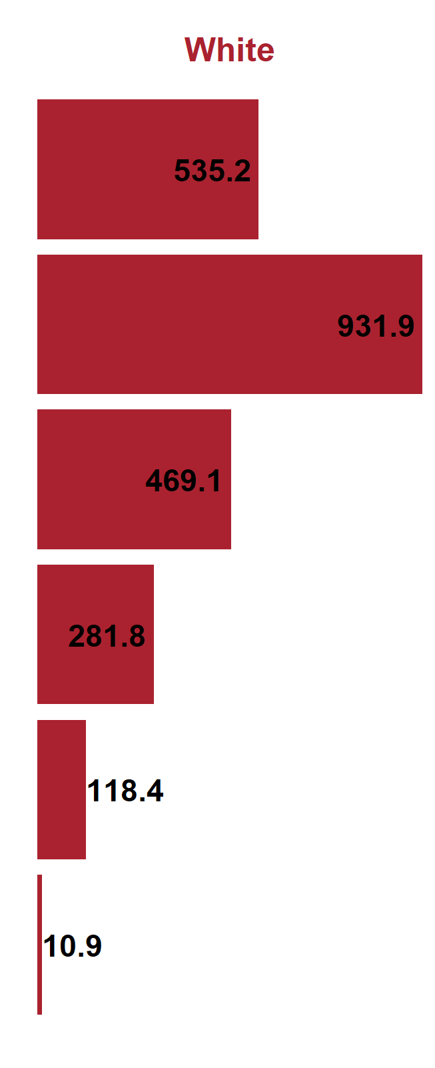
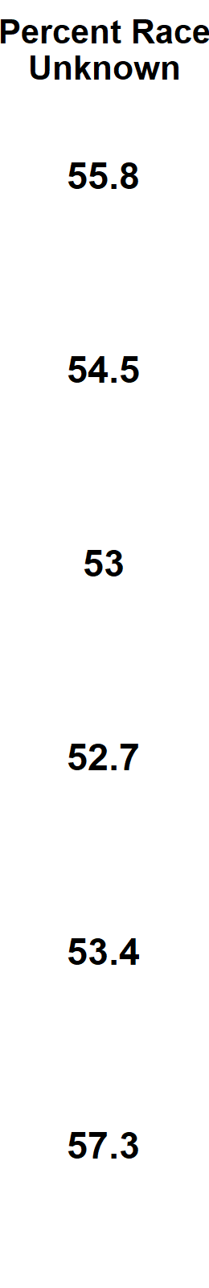
Chlamydia, Female Incidence Rates by Race/Ethnicity and Age Group (in years), California, 2021
American Indian/Alaska Native and Native Hawaiian/ Other Pacific Islander and race-specific data for ages 0-14 were suppressed as per agency Data De-Identification Guidelines (DDG).

Slide 15
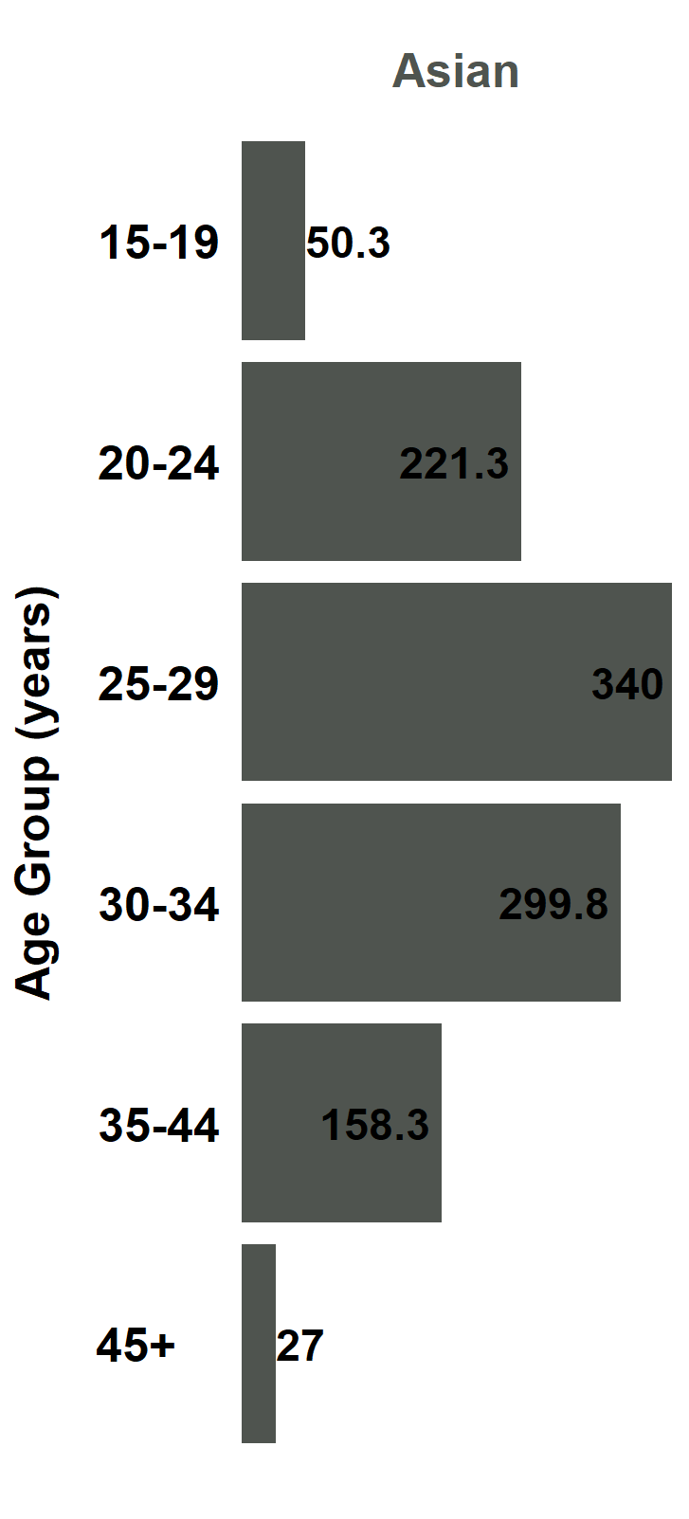
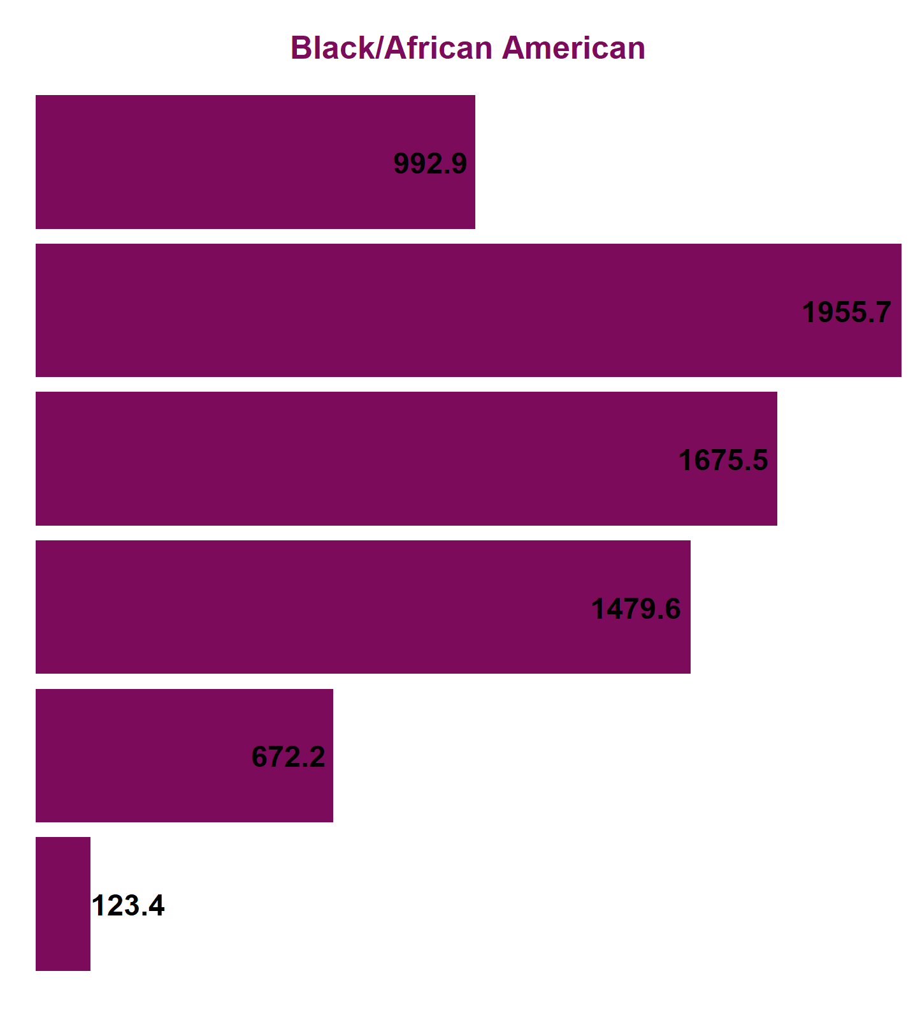
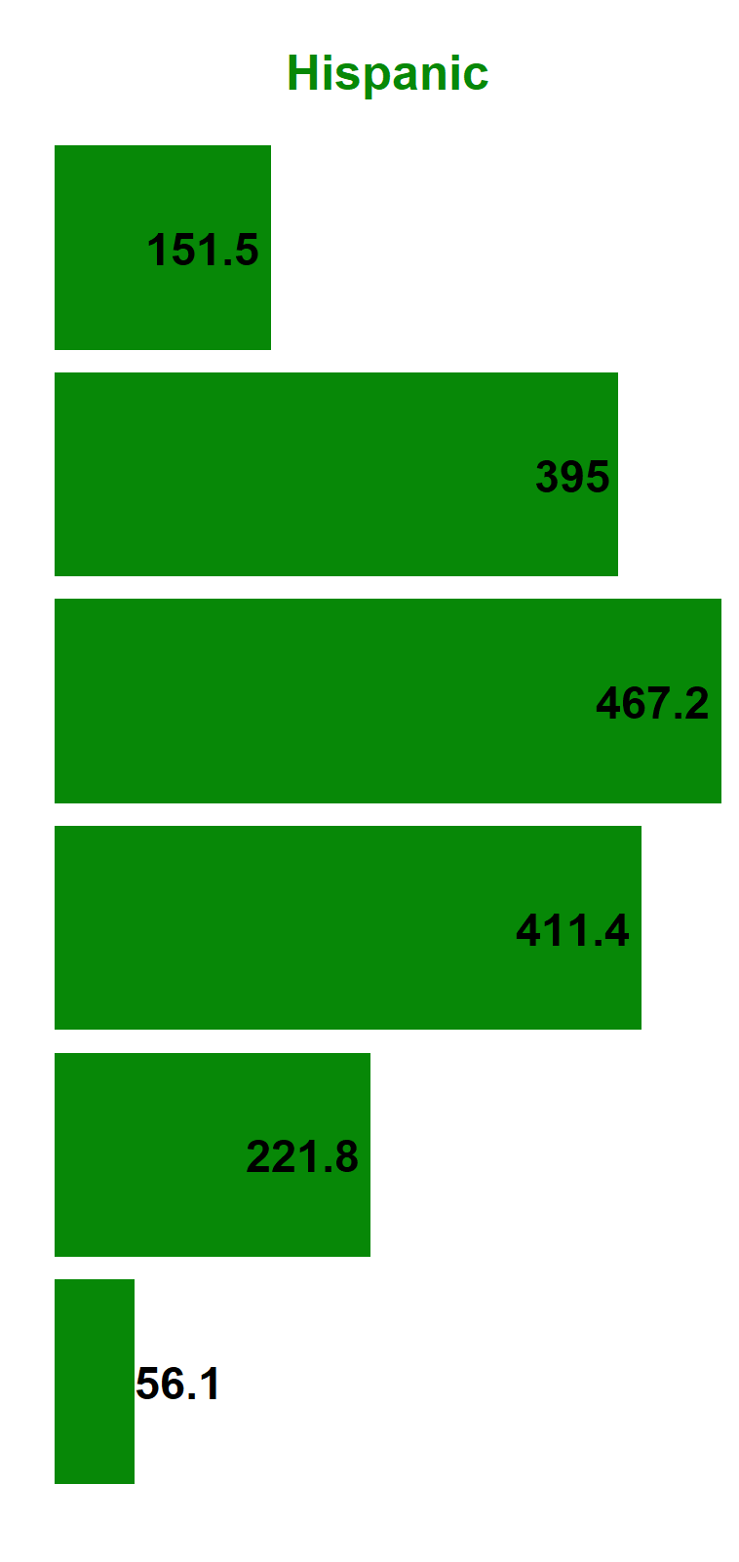
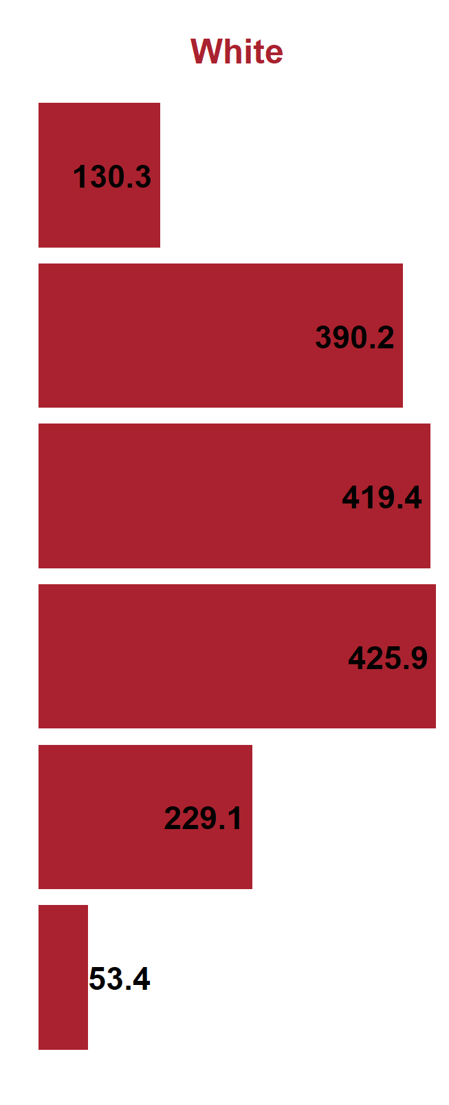
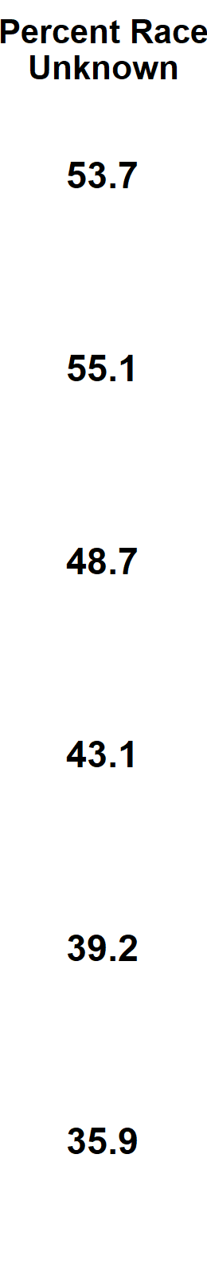
Chlamydia, Male Incidence Rates by Race/Ethnicity and Age Group (in years), California, 2021
American Indian/Alaska Native and Native Hawaiian/ Other Pacific Islander and race-specific data for ages 0-14 were suppressed as per agency Data De-Identification Guidelines (DDG).

Slide 16
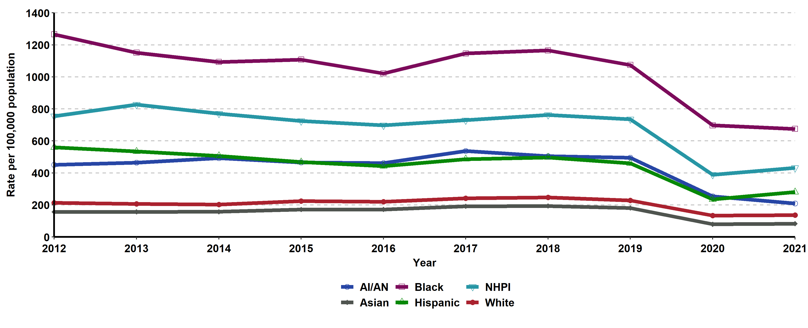
Chlamydia, Incidence Rates for Females by Race/Ethnicity,
California, 2012–2021
AI/AN = American Indian/Alaska Native, NHPI = Native Hawaiian/ Other Pacific Islander.
Race/ethnicity “Not Specified” ranged from 32.35% to 55.68% of cases for females in any given year.

Slide 17
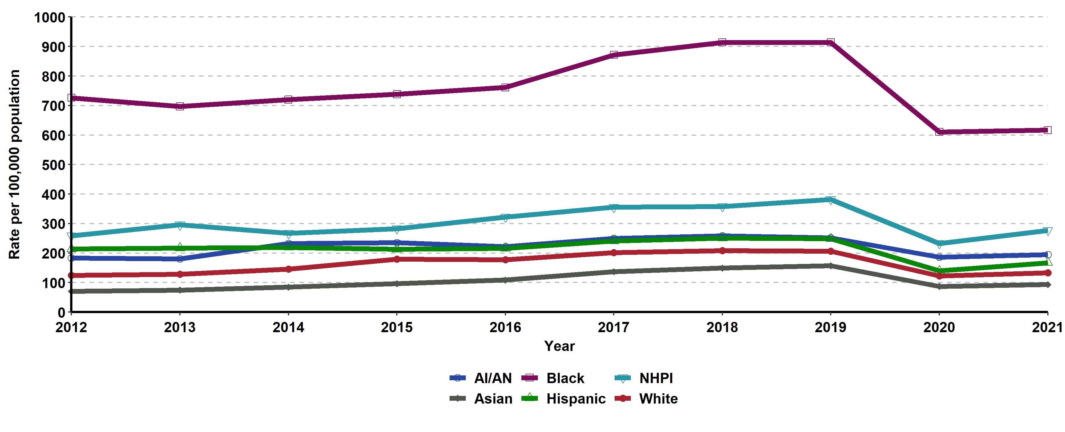
Chlamydia, Incidence Rates for Males by Race/Ethnicity,
California, 2012–2021
AI/AN = American Indian/Alaska Native, NHPI = Native Hawaiian/ Other Pacific Islander.
Race/ethnicity “Not Specified” ranged from 29.37% to 47.76% of cases for males in any given year.

Slide 18
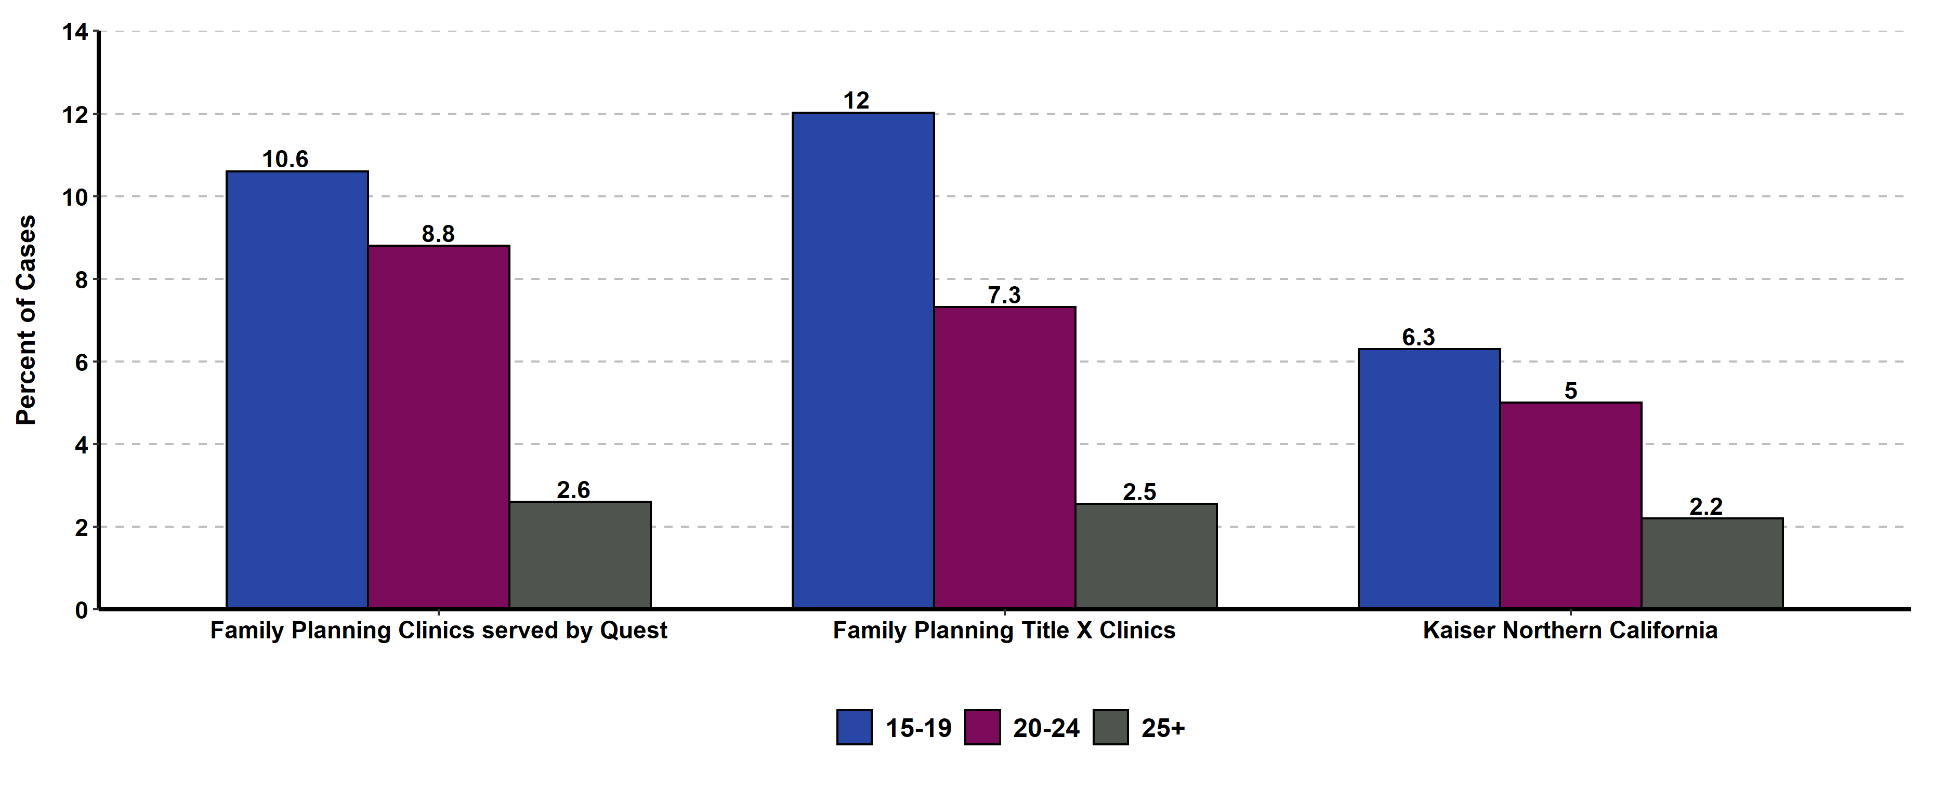
Chlamydia Prevalence Monitoring, Percent Positive for Females of Selected Age Groups, by Health Care Setting, California, 2021
Sources: Kaiser Permanente Northern California, Essential Access Health, Quest Diagnostics

Slide 19
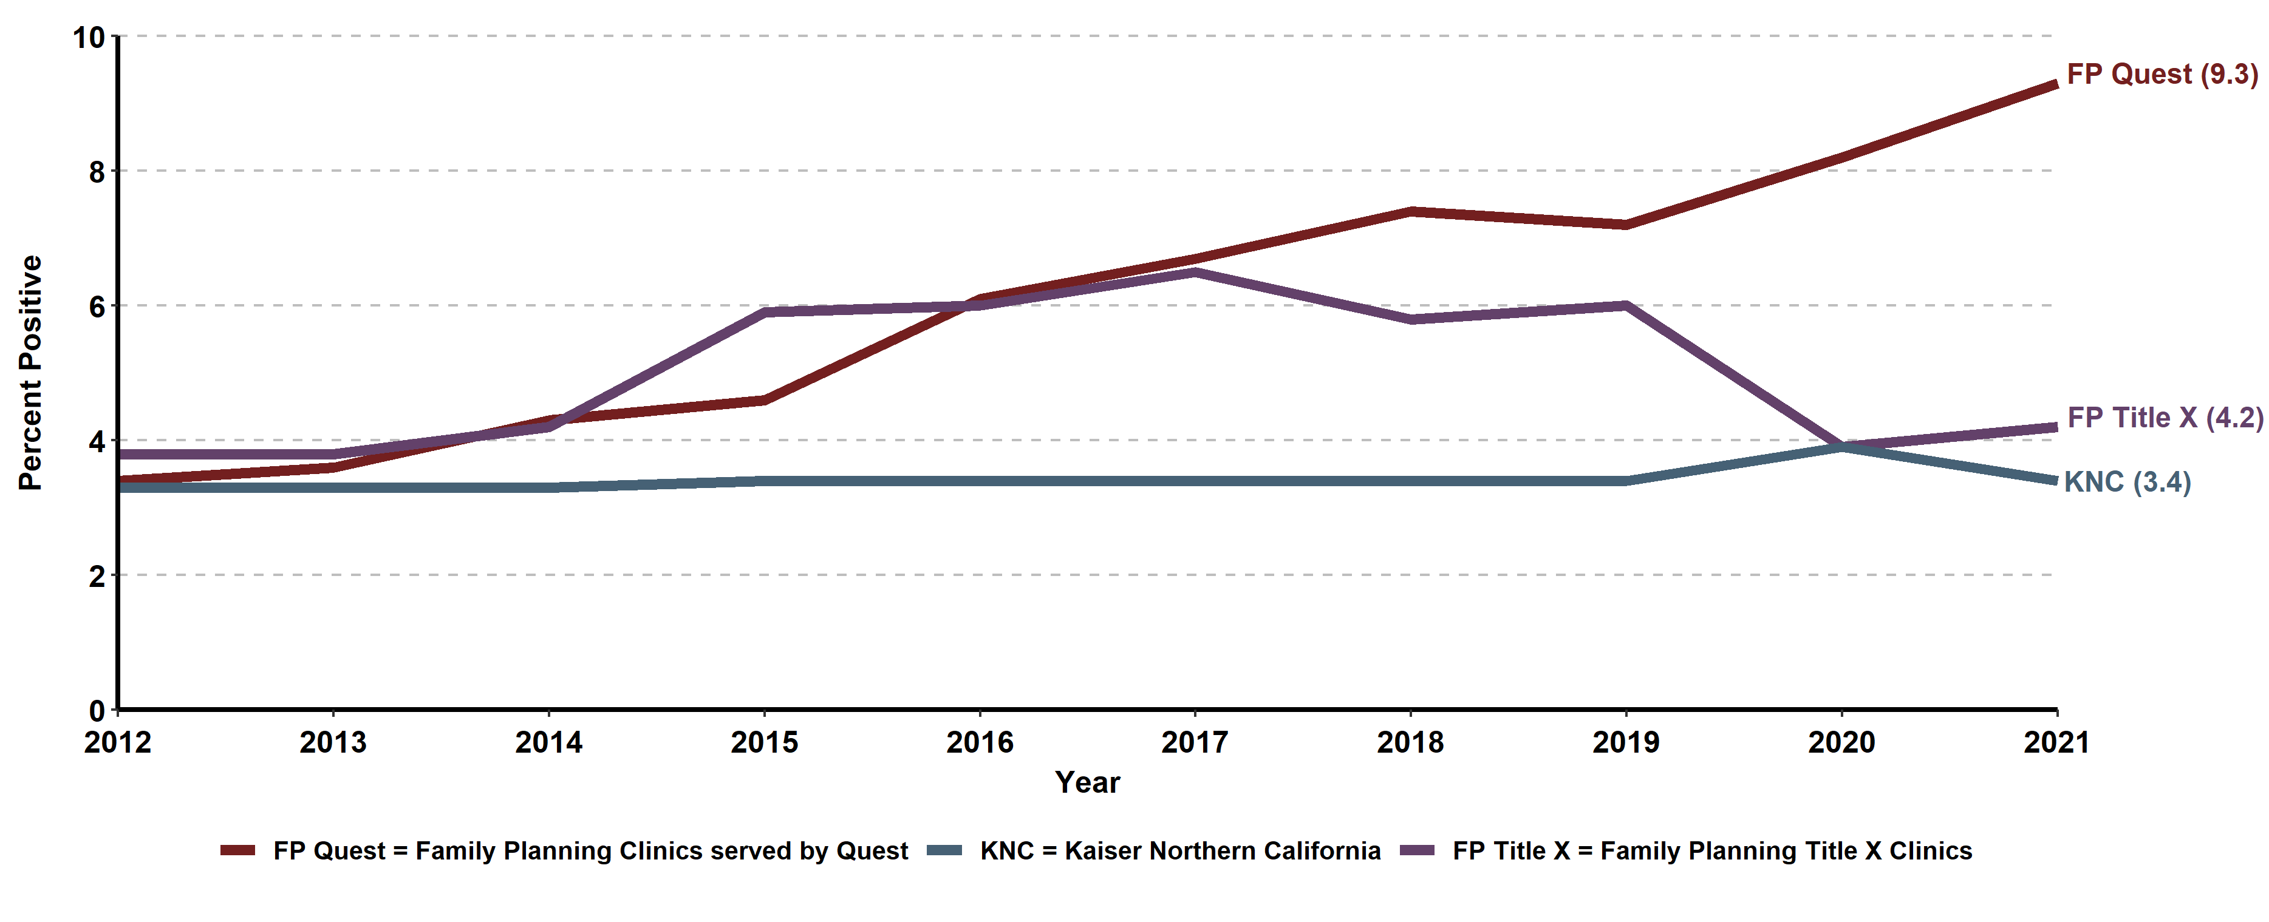
Chlamydia Prevalence Monitoring, Percent Positive for Females, by
Health Care Setting, California, 2012-2021
Sources: Kaiser Permanente Northern California, Essential Access Health, Quest Diagnostics

Slide 20
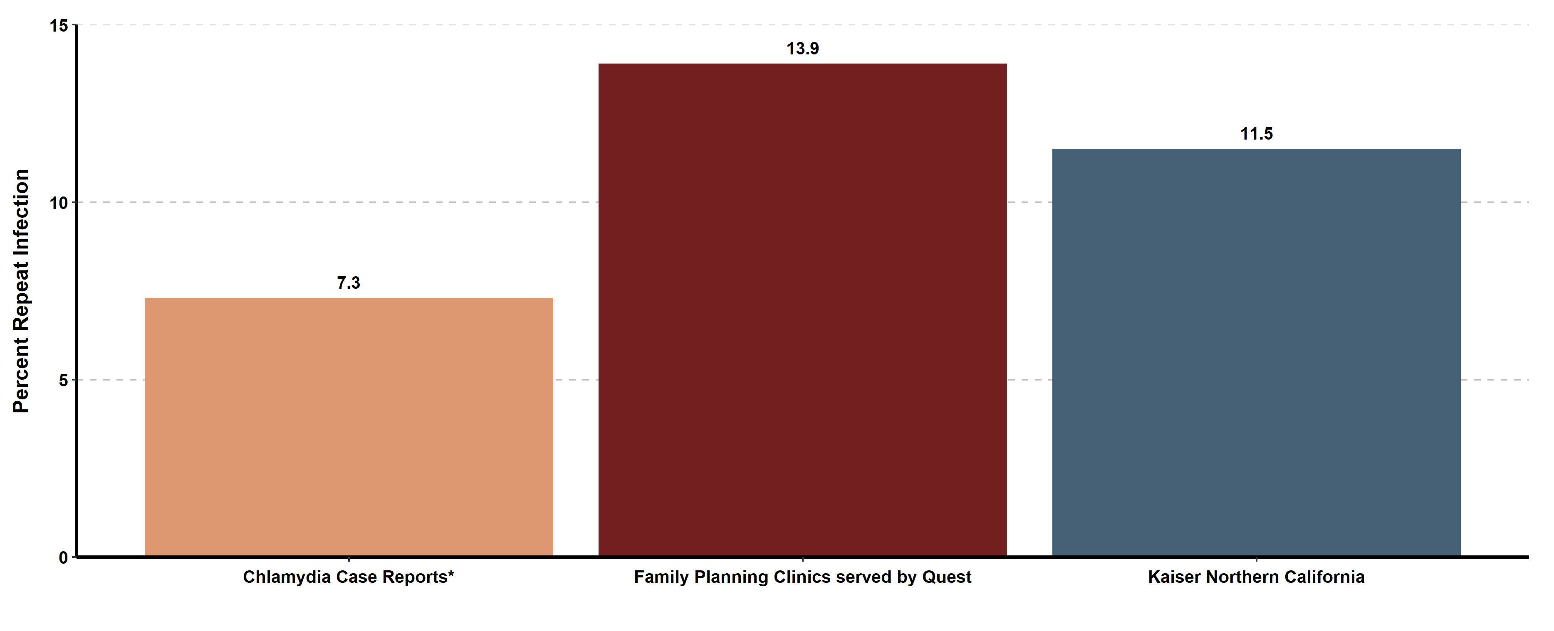
Chlamydia Repeat Infection among Females 1-6 Months after Infection, by Data Source, California, 2021
* Excludes Los Angeles and San Francisco local health jurisdictions

