Slide 1
SNF COVID-19 SURVEY DISTRICT OFFICE SUPPORT
May 2020

Slide 2
Provider Reporting Requirements
Each facility must report by 12:00pm Noon Each Day (including Saturday and Sunday).
Maintain data integrity by reporting accurate information in each daily report.
Work with the local Public Health Office, the Medical Health Operational Area Coordination (MHOAC), and the Regional Disaster Medical Health Specialists (RDMHS) to fulfill urgent resource needs.

Slide 3
Questions about Reporting?
If you have questions about the survey, or problems reporting –
Email our SNF Reporting Specialist at -
COVID-19SNFSURVEY@CDPH.CA.GOV
Contact your District Office (DO) SNF Reporting Single Point of Contact (SPOC)

Slide 4
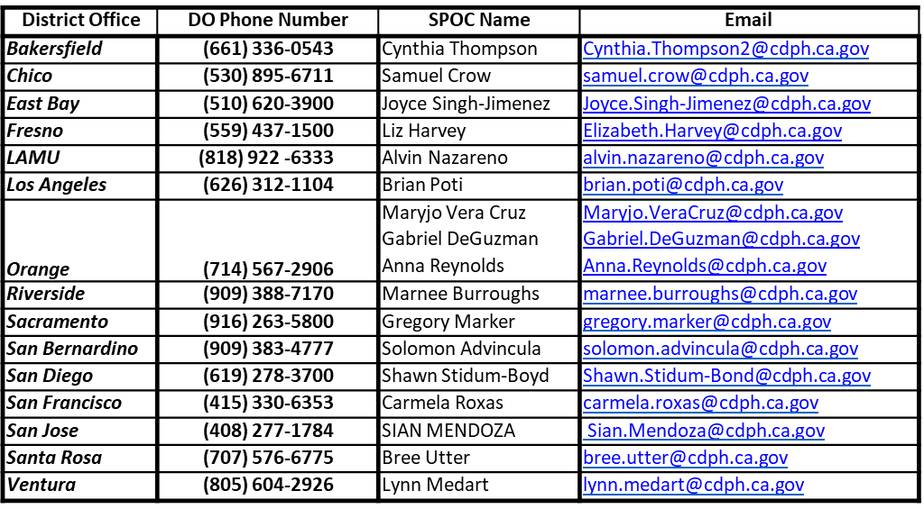
District Office (DO) Single Point of Contact (SPOC)

Slide 5
We Are Here to Help!!

